Slide 1
There is a pattern as a background in the production view, but the degraded stays.
As title is slim, all other letters will have to be slim to not rest protagonism.
The color of the navbar letters will change as the mouse move.
The selected page will be highlighted better in the production view.
Transparent navbar to see stars behind.
Welcome
I have created this portal with the objective of improving constantly as a person, and professional, by exposing to the world my achievements, projects and knowledge, I hope to find motivation to expand them.
If you pry a little by the page, maybe you can find some surprises.
Osmar Briones
If you click on any star, a message will be shown, color stars are rare but have longer messages.
Pssst, If you keep the mouse at the edges a little, you will discover something special.
Lines on the screen have a rainbow degraded that changes as mouse move.
I don’t have to much to put in the footbar so I put an easter egg to make it more interesting.
If you click on “Click here to see something nice”, the stars will acelerate and it will be more.

Slide 2

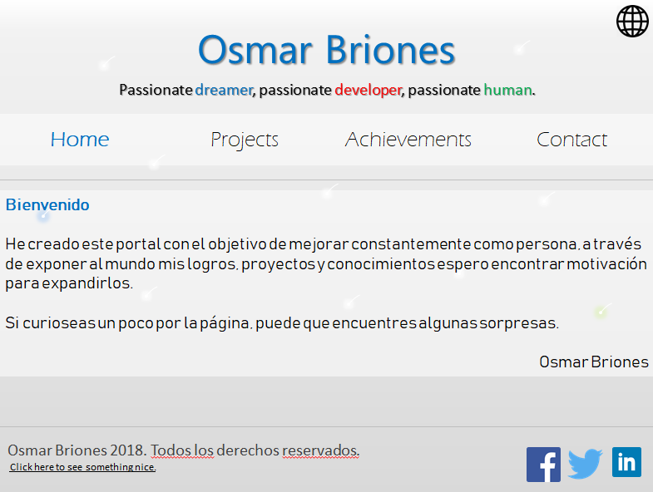
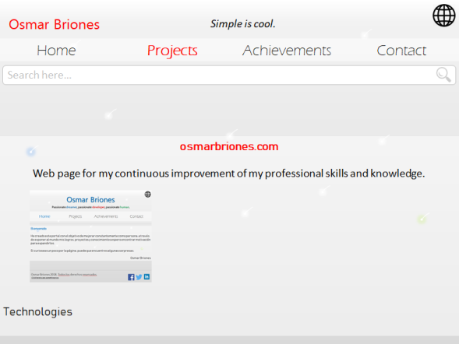




My name and other elements will have the color of the actual page, projects and achievements are red, contact is green, and home is blue.
Each page will be divided like this: Header
Tools (Like search bar)
Body
Footer
Header and tools are fixed.
Osmarbriones.com Web page for the continuous improvement of my professional skills and knowledge.
Search here…
Filters
When click on the arrows, people can see slides of relevant information of the project, such as the use of each technology.
Osmarbriones.com
Web page for the continuous improvement of my professional skills and knowledge.
The intention of this project is to have a common point for my continuous improvement as a person and as a professional.
All technologies used will be shown here, as a symbol to represent each one.

Slide 3
Sometimes the header in some pages will say “Simple is cool (and cheap)”.
Search here…
Filters
Countries of dreams
Go to the countries that I have dreamed of visiting all my life.
In progress
Italy
Norway
Spain
Japan
Denmark
Switzerland
Canada
Finland
Singapore

Slide 4
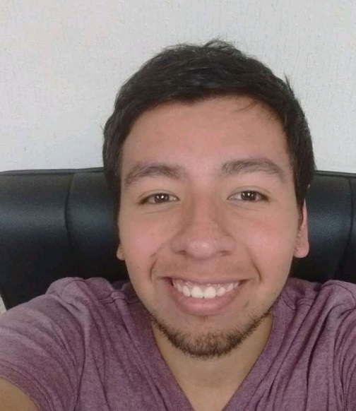
Osmar Alberto Saguilan Briones “Passionate dreamer, passionate developer, passionate human”. E-mail: osmarbriones@outlook.com Facebook: osmar.ab Twitter: @osmarbriones
I am a Mexican software developer that loves his career and dreams so high. I love altruism, development, videogames, writing, chess, soccer, computers and introspection. If you want to know more about my preparation, skills and experience, I suggest you to visit my linkedIn which is a platform more focused in that aspect, this page is for my personal and continuous improvement.

Slide 5

ce_Message
Title Content…
Author
ce_Project_short
Title Description
Logo
Technologies

Slide 6
ce_Project_full
Title Description
Logo
Creation Process
Technologies

Slide 7
Filters

