Slide 1
There is a pattern as a background in the production view, but the degraded stays.
As title is slim, all other letters will have to be slim to not rest protagonism.
The color of the navbar letters will change as the mouse move.
The selected page will be highlighted better in the production view.
Transparent navbar to see stars behind.
Bienvenido He creado este portal con el objetivo de mejorar constantemente como persona, a través de exponer al mundo mis logros, proyectos y conocimientos espero encontrar motivación para expandirlos.
Si curioseas un poco por la página, puede que encuentres algunas sorpresas.
Osmar Briones
If you click on any star, a message will be shown, color stars are rare but have longer messages.
Pssst, If you keep the mouse at the edges a little, you will discover something special.
Lines on the screen have a rainbow degraded that changes as mouse move.
I don’t have to much to put in the footbar so I put an easter egg to make it more interesting.

Slide 2

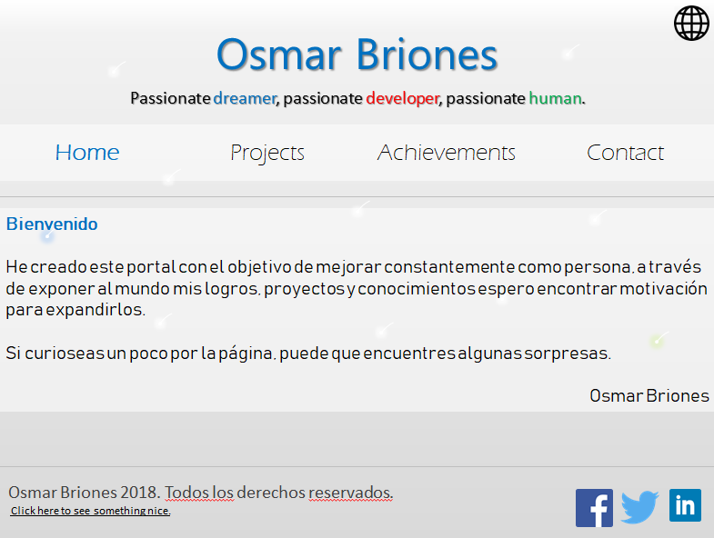
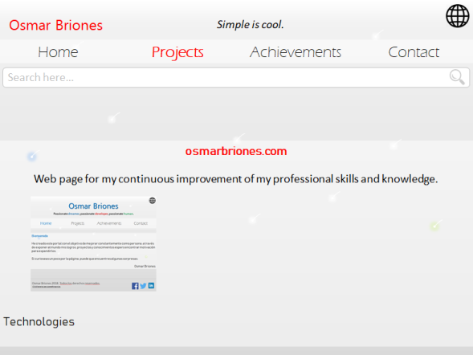




My name will have the color of the actual page, projects and achievements are red, contact is green, and home is blue.
Osmarbriones.com Web page for the continuous improvement of my professional skills and knowledge.
Search here…
When click on the arrows, people can see slides of relevant information of the project, such as the use of each technology.
Osmarbriones.com
Web page for the continuous improvement of my professional skills and knowledge.
The intention of this project is to have a common point for my continuous improvement as a person and as a professional.

Slide 3

ce_Message
Title Content…
Author
ce_Project_short
Title Description
Logo
Technologies

Slide 4
ce_Project_full
Title Description
Logo
Creation Process
Technologies

