Slide 1


Introduction to Unit Testing
Unit testing is a crucial practice in software development that involves testing individual units or components of an application to ensure they function as expected. This presentation will provide a comprehensive overview of unit testing using JUnit in the Eclipse IDE.
By Osama Malik | Liaquat Ali Khan

Slide 2

Importance of Unit Testing
1
Early Bug Detection
2
Code Refactoring
Unit tests help catch bugs early in the development process, making them much easier and cheaper to fix.
Unit tests provide a safety net when refactoring code, ensuring that changes don't break existing functionality.
3
Improved Reliability
Comprehensive unit tests lead to more reliable software, reducing the likelihood of unexpected issues in production.

Slide 3

Setting up JUnit in Eclipse
1
Step 1
Install the JUnit plugin in Eclipse by going to Help > Install New Software.
2
Step 2
Create a new JUnit test case by right-clicking on your project and selecting New > JUnit Test Case.
3
Step 3
Configure the test case settings, such as the class to be tested and the test method names.

Slide 4
Writing Basic Test Cases
Naming Conventions
Arrange-Act-Assert
Isolation
Use descriptive names for your test methods that clearly indicate what they are testing.
Structure your test cases using the Arrange-Act-Assert pattern: set up the initial conditions, perform the action, and verify the expected outcome.
Ensure that each test case is independent and doesn't rely on the state of other tests or the application.

Slide 5

Organizing Test Cases into Test Suites
Grouping Tests
Group related test cases into test suites to improve organization and make it easier to run specific sets of tests.
Execution Order
Specify the order in which test cases should be executed within a suite, if necessary.
1
2
3
Suite Annotations
Use JUnit's @Suite and @RunWith annotations to define and run test suites in Eclipse.

Slide 6
Assertions and Expectations in JUnit
Assert Methods
Hamcrest Matchers
Use JUnit's assert methods, such as assertEquals(), assertTrue(), and assertNull(), to verify the expected behavior of your code.
Leverage Hamcrest matchers, like hasItem() and hasSize(), to create more expressive and readable assertions.
Exception Handling
Timeouts
Verify that your code throws the expected exceptions using JUnit's @Test(expected=...) annotation.
Set timeouts on tests to ensure they don't run indefinitely, which can help catch performance issues.

Slide 7
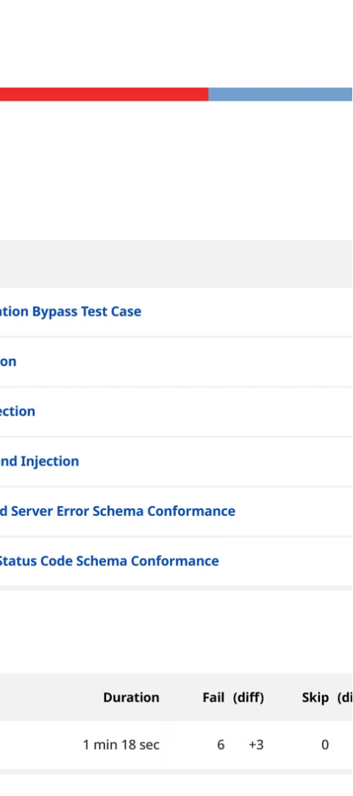



Running and Interpreting Test Results
Run Tests
Execute your test cases in Eclipse using the JUnit test runner.
View Results
Inspect the test results and identify any failures or errors.
Analyze Failures
Investigate the cause of failed tests and fix any underlying issues in your code.

Slide 8




Best Practices for Effective Unit Testing
Write Tests First
Automate Test Execution
Achieve High Coverage
Maintain Test Suite
Follow a Test-Driven Development (TDD) approach by writing tests before implementing the actual code.
Integrate unit tests into your CI/CD pipeline to ensure continuous testing and early defect detection.
Strive for comprehensive test coverage to catch as many potential issues as possible.
Regularly review and update your test suite to reflect changes in the codebase.

