Slide 1

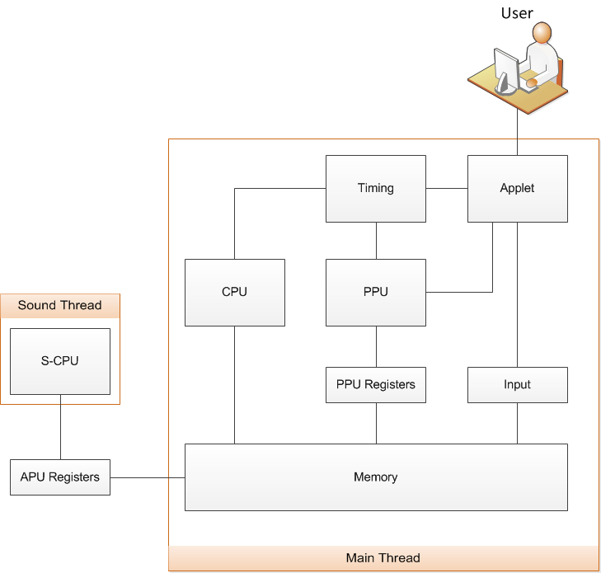
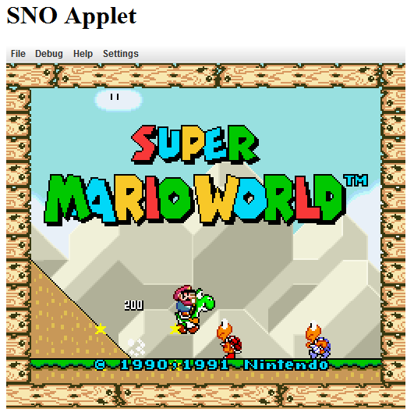
What is SNO?
SNO is a Super Nintendo Emulator that can be embedded into a web page. SNO allows website creators to embed a virtual Super Nintendo that lets users play Super Nintendo games right on their website!
Requirements
Embeddable Java applet
Executes SNES code in Java environment
Emulates Super Nintendo functions
  Process Main CPU and Audio CPU code simultaneously
  Render graphics to applet
  Controller input via keyboard
Loads snapshot of game state – drop the player into any point in the game!
Load game and snapshot from server
Testing
Unit testing using JUnit
  Unit tests for all 255 CPU instructions
  Memory write / read tests
  Graphics tests
Comparison with output of other SNES emulators
Acceptance testing to ensure games are playable
Challenges
Process hardware code using software
  Code is downloaded and executed live in software
Read over 1100 pages of documentation about SNES
Performance
  4 Tiled backgrounds of up to 64x64 tiles per background
  Up to 128 sprites on-screen at once
  Blend colors using color math & masking
Accurately reproduce precise timing
System Diagram
Screenshot
Team
Keith Johnson
Michael Kelly
Eric Wells
Sponsor: Dr. William Allen
Future Improvements
Improved compatibility
Audio output
Scripting integration via Javascript
Watch / fork on Github:
https://github.com/Osmose/sno

