Slide 1
Apartment Management System (AMS)
MEMBERS:
MARTINEZ, VALERIE
BENGAN, RHEA
SOLILAP, OSMHAR LENOUX
DELLOMES, MARVI DIANE
DEFANTE, THERENCE HILCEE

Slide 2
Project Overview

Slide 3
Statement of the Problem
Current methods of managing rental properties often lead to inefficient communication and misunderstandings between tenants and landlords. Our project aims to develop a Apartment Management System (AMS) to streamline these interactions and transactions, enhancing the overall rental experience.

Slide 4
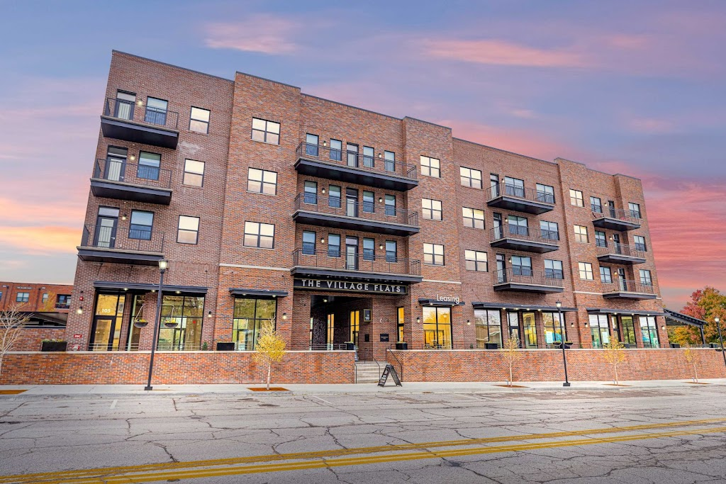
Project Objectives
Our proposed project title is about Apartment Management System(AMS), a digital solution specifically designed to simplify interactions between tenants and especially the owners, thereby enhancing the overall apartment living and management experience.

Slide 5
General:
To design and implement a robust Apartment Management System(AMS) that simplifies and enhances the management of apartments.
Specific:
1. To create a user-friendly interface for tenants and especially owners.
2. To automate processes like rent payments and maintenance requests.
3. To facilitate communication between all parties involved.
4. To incorporate a personalized profiling system that tailors the user experience.

Slide 6
swot analysis

Slide 7
Strengths:
User-friendly and intuitive.
Automates rent payments and can check payment history.
Personalized user experience.
Built with robust Java and GUI.

Slide 8
Weaknesses:
Tenant dashboard needs improvement.
Can’t provide receipts.
Opportunities:
Rising demand for digital solutions.
Potential to add more features.

Slide 9
Threats:
Market competition
Fast-paced tech changes.

Slide 10
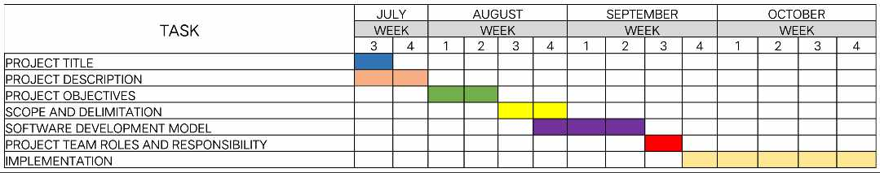
Gantt chart

Slide 11
High fidelity (figma)
https://l.facebook.com/l.php?u=https%3A%2F%2Fwww.figma.com%2Ffile%2FSCpJ0YNsONH9JRnYTaRDb0%2FUntitled%3Ftype%3Ddesign%26node-id%3D0%253A1%26mode%3Ddesign%26t%3DQiPM08hugsVXWDGo-1%26fbclid%3DIwAR3lMLSb1vvVERRuD-M6gH7lCVOHvM-HCXAnHB5xMgLSxEILfugq18dGqUw&h=AT3IGLePRqkWsIIFN5JHGwMmFQqXP80FCQdBfV5cecpVxJg9yDFqScV7oni8KES_920PCUwJPC9jYrYxlqkfc1xuHtKsQF07MRbsyH8GD7JbzJAPdoIS2YPZMYCmuXYuP-gcrrramwStQT5FOMX1wg

