Slide 1
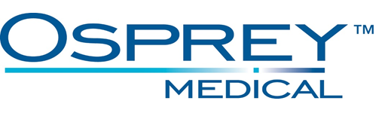
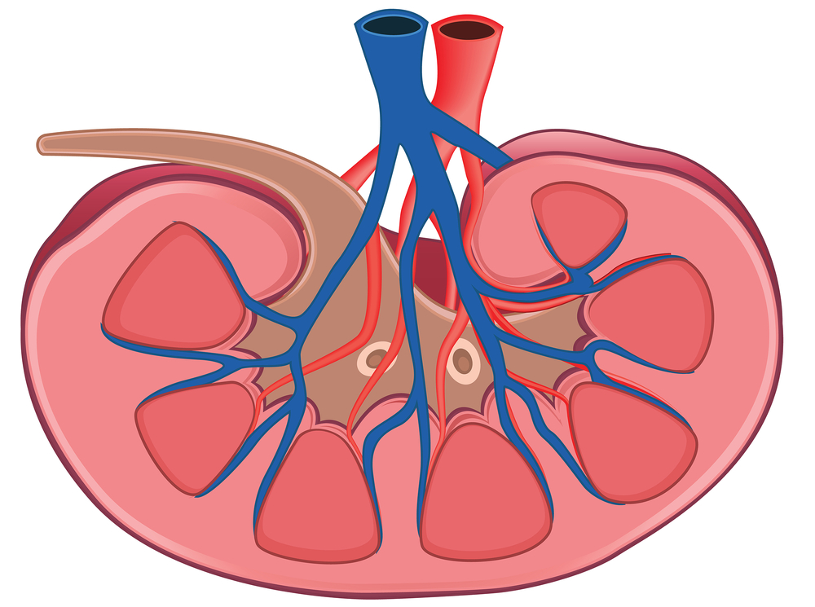
DyeVert Summary
DyeVert Summary
All cases (N=NUMBER_CASES)
PERCENT_SAVED avg
Less
Contrast
VOLUME_SAVED mL less total
Volume to Patient compared to Threshold (entered), 2/3 Threshold and 1/3 Threshold
Indications, contraindications, warnings, and instructions for use can be found in the product labeling supplied with each device. Risks may include air emboli and infection.
CAUTION: Federal (USA) law restricts these (referenced above) devices to sale by or on the order of a physician
This report is provided based solely on the information provided by the hospital/physician. Please refer to attached table. Osprey Medical intends for this report to be informational in nature only; and is not intended to diagnose, treat or direct patient care.
This product, and its use, may be protected by US Patents and pending applications. DyeVert is a trademark of Osprey Medical, Inc. © Osprey Medical, Inc. 2019 All Rights Reserved. PR0224 Rev B

