Slide 1
What is AWS Lambda? AWS Lambda is a compute service that lets you run code without provisioning or managing servers. Lambda runs your code only when needed and scales automatically, from a few requests per day to thousands per second. You pay only for the compute time that you consume—there is no charge when your code is not running. Developer Guide: https://docs.aws.amazon.com/lambda/latest/dg/welcome.html

Slide 2
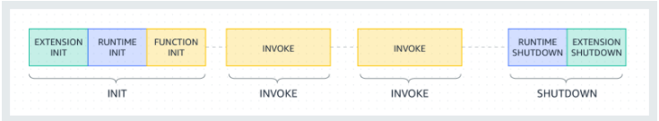
Lambda execution environment lifecycle: Init: In this phase, Lambda creates or unfreezes an execution environment with the configured resources. Invoke: In this phase, Lambda invokes the function handler. Shutdown: This phase is triggered if the Lambda function does not receive any invocations for a period of time. Extensions provide a method for monitoring, security, and other tools to integrate with the Lambda execution environment. Lambda supports multiple languages through the use of runtimes. Developer Guide: https://docs.aws.amazon.com/lambda/latest/dg/runtimes-context.html

Slide 3
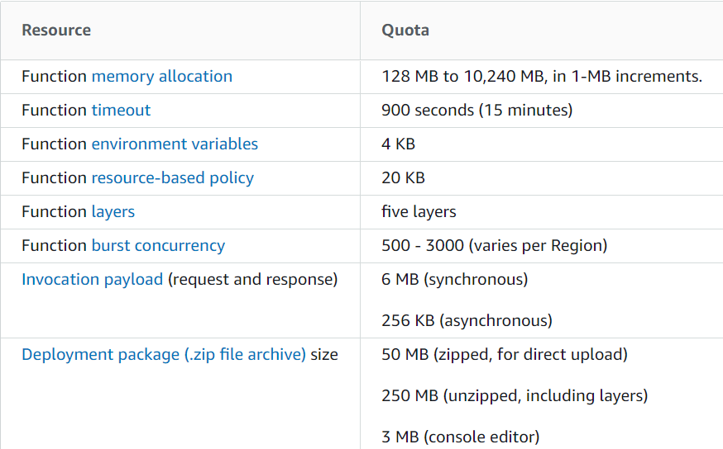
Lambda quotas Developer Guide: https://docs.aws.amazon.com/lambda/latest/dg/gettingstarted-limits.html, https://aws.amazon.com/ru/lambda/pricing/

Slide 4
Primitive ECHO Lambda. public Map<Object, Object> handleRequest(Object input) { System.out.println("System.getenv - " + System.getenv()); System.out.println("input - " + input.toString()); Map<Object, Object> output = Map.of( "isBase64Encoded", "false", "statusCode", "200", "headers", Map.of("Content-Type", "*/*"), "body", "{\"greeting\":\"Hello World\"," + " \"input\": \"" + input.toString() + "\"," + " \"env\": \"" + System.getenv().toString() + "\"" + "}" ); System.out.println("output - " + output); return output; }

Slide 5
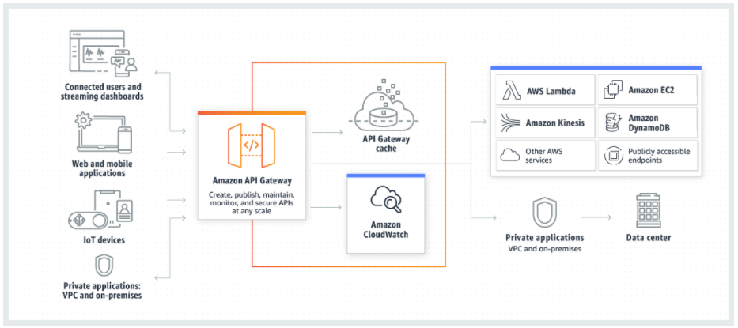
What is Amazon API Gateway? Amazon API Gateway is an AWS service for creating, publishing, maintaining, monitoring, and securing REST, HTTP, and WebSocket APIs at any scale. API developers can create APIs that access AWS or other web services, as well as data stored in the AWS Cloud. Pricing - https://aws.amazon.com/ru/api-gateway/pricing/

Slide 6
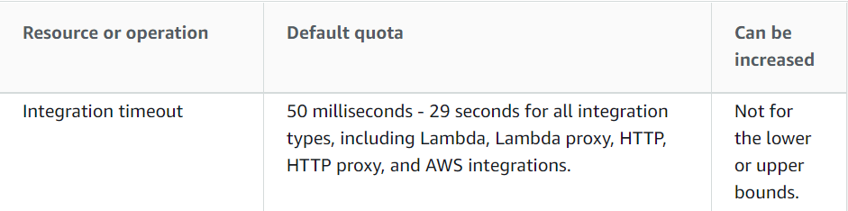
API Gateway REST API with Lambda integration 1. REST API with Lambda proxy integration (https://docs.aws.amazon.com/apigateway/latest/developerguide/api-gateway-create-api-as-simple-proxy-for-lambda.html) 2. REST API with Lambda non-proxy integration (https://docs.aws.amazon.com/apigateway/latest/developerguide/getting-started-lambda-non-proxy-integration.html) 3. Asynchronous invocation of the backend Lambda function (https://docs.aws.amazon.com/apigateway/latest/developerguide/set-up-lambda-integration-async.html) API Gateway quotas (https://docs.aws.amazon.com/apigateway/latest/developerguide/limits.html)

