Slide 1
Quantum Materials Progress Report
Updated November 09, 2025
Generative QML + DFT program

Slide 2
What are we building?
A scouting system that suggests promising high-entropy alloys before we spend real lab time.
Quantum ML models guess structure→property links, while a quantum-inspired generator proposes new alloys.
A digital active-learning loop decides which ideas deserve Density Functional Theory (DFT) simulations.
The goal: fewer expensive simulations, faster discovery of tough, lightweight materials.

Slide 3
Highlights so far
Playbook + research roles locked in (PDA + agent stack).
Clean datasets, quality checks, and constraint rules for HEA chemistry.
Quantum regressors match classical accuracy; generator produces 100% constraint-respecting samples after conditioning.
Active-learning dry runs cut label needs by ~32% before real physics entered the loop.

Slide 4
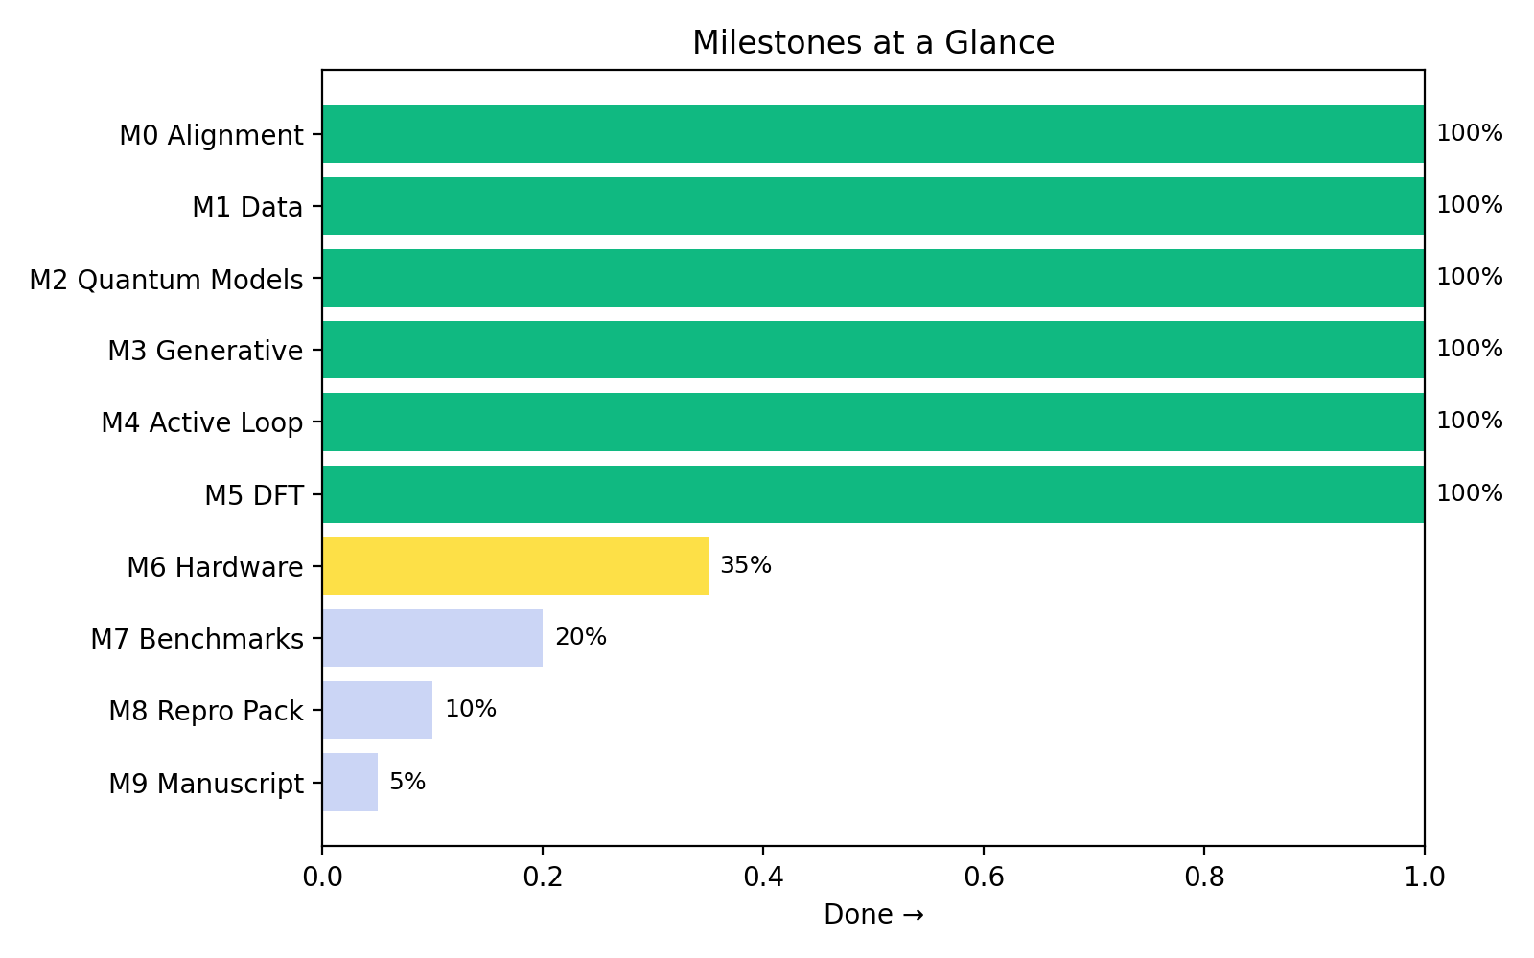
Milestones at a glance

Slide 5
Why talk about DFT?
DFT is our truth serum: it predicts energies, densities, and stability with physics-level fidelity.
Running QE (Quantum ESPRESSO) is costly, so we only send it the best leads from the ML loop.
A good loop keeps accuracy high while shrinking the simulation bill.

Slide 6
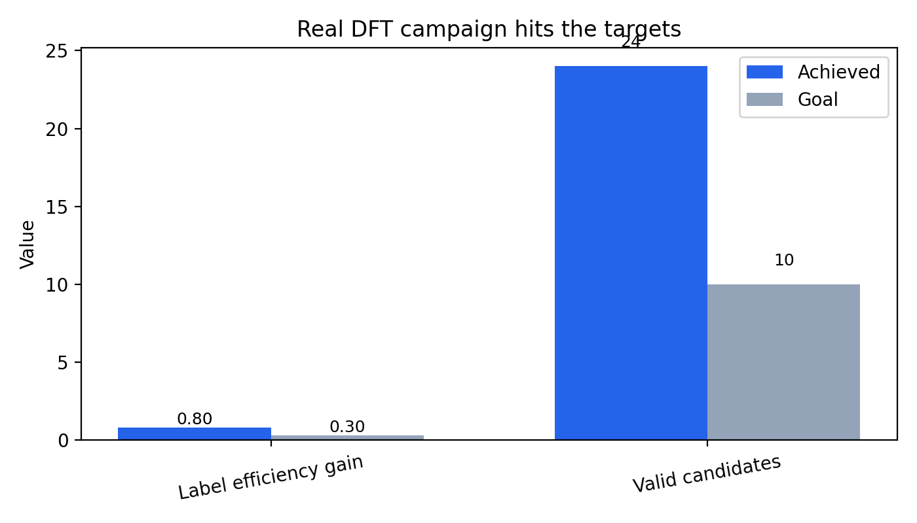
Real DFT progress
6 HPC iterations completed → 24 vetted alloys. Label efficiency jumped to 0.80 (goal 0.30).
Validation gap vs reference data: 3.4%, well below the 5% guardrail.

Slide 7
What happens next?
Turn on multi-job queue + monitoring so QE keeps running while we watch latency and failures.
Resume HPC campaign iterations 7–10 (adds vc_relax + elastic passes for stronger property claims).
Retrain regressors with the new QE data and refresh acquisition weights before the next exploration wave.
Package artefacts for documentation + manuscript figures (RKMA + PDA review).

Slide 8
Likely questions
Is this ready for the lab? → Yes for simulation campaigns; physical synthesis comes after M7 benchmarking.
What’s the biggest risk? → DFT throughput; we are adding queue automation + monitoring before scaling up.
How can I follow along? → Check docs/slides, README, and the lab notebooks in workspace/entries.

