Slide 1
Testing Market Efficiency of BTC using ML
Leipzig, 04.12.2025
Notes:
Good Morning, Today we are going to present our topic:

Slide 2
Agenda
Background + EMH
Sentiment analysis
Categorizing users
Prediction plans
Notes:
Can be changed

Slide 3
Background
Efficient Market Hypothesis: Essentially, Asset prices reflect all known information about the asset. Therefore, you cannot beat the market.
Bitcoin: not just a cryptocurrency but also as an asset/speculative commodity
It will be weak form efficient if the ML model cannot use past information to predict future returns.
Test if publicly available information and the reaction to that information affects the price and if the Model can predict future returns based on that information.
Notes:
Without going into too much detail, EMH is a theory that states that the price of an asset reflects all known information about that asset. Therefore, you cannot beat the market.
We will test it on Bitcoin, which due to its volatile nature has become a speculative commodity
We will test the efficiency by training a model using just the past movements of the price to predict and we will also try to prediction based on the public reaction to bitcoin online

Slide 4
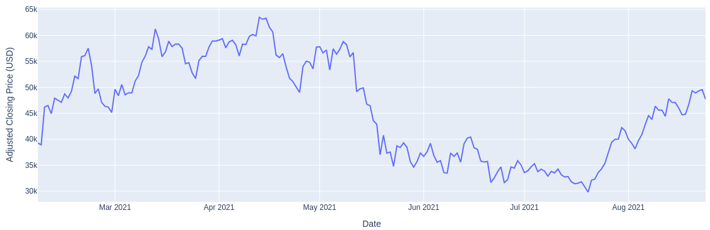
Data Set
Bitcoin Twitter Data
  Bitcoin related tweets
  From 05.02.2021 to 21.08.2021
  1 million Tweets
  200k Users
Bitcoin Historical Data
  1-min interval Bitcoin-Price
Notes:
In order to do that we Analyse more than 1 million bitcoin tweets by .ca 200k users from Feb 2021 to August 2021
And we will

Slide 5
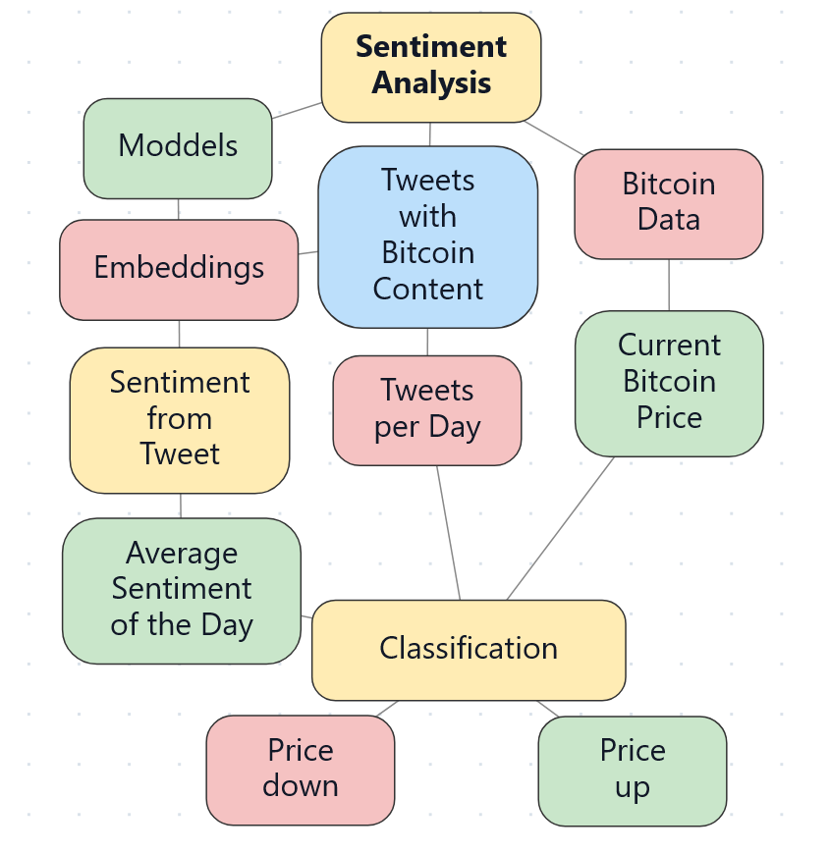
Sentiment analysis plan
Details:
Models
  Finbert (old) (free)
  Gpt 4o
  ModernBert-embed-large
  Multilingual E5 Mistral
  Fin-E5
Different Strategies with
  Price Plan
  Sentiment Clustering

Slide 6
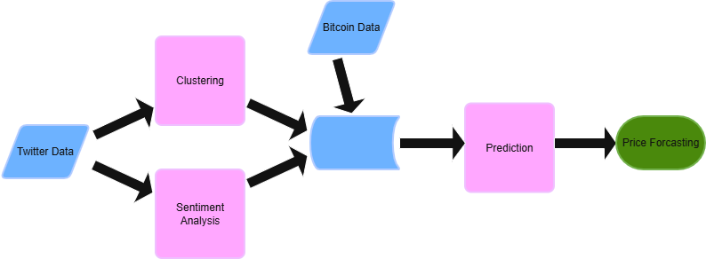
Categorizing users
Cluster Twitter-users by Bitcoin interest (traders, news, bots, etc.)
Find groups whose sentiment correlates with Bitcoin prices
Weight sentiments in the prediction based on cluster affiliation
Clustering based on posts and profile descriptions
Labeling by ChatGPT

Slide 7
Prediction Plans and Testing BTC Market Efficiency
Primary Goal:
Evaluate whether Machine Learning (ML) models can predict future BTC returns, potentially contradicting the Efficient Market Hypothesis (EMH).
1. Weak Form Test
Input Data: Historical BTC prices only (Past Information)
Testing Logic:
If ML cannot predict future returns using past prices → Market is Weak Form Efficient

Slide 8
2. Tools and Evaluation (ML Models & Metrics)
ML Models: LSTM, XGBoost, Random Forest, GRU, etc.
Success Metrics:
  Directional Prediction Accuracy
  RMSE / MSE
  Trading Strategy Profitability Simulation

Slide 9
Thanks a lot for your attention
RJDO

