Slide 1
Testing Market Efficiency of BTC using ML
Leipzig, 04.12.2025

Slide 2
Agenda
Background + EMH (Rohit)
Sentiment analysis (Daniel? Or Rohit)
Categorizing users (Johannes)
Prediction plans (Ostap)
Notes:
Can be changed

Slide 3
Efficient Market Hypothesis
Essentially, Markets or asset prices incorporate all available information.
In an efficient market: prices adjust quickly and accurately to new information. So, new information is reflected in the price.
Therefore, you cannot beat the market.
Notes:
EMH: Is a theory that says Markets efficiently incorporate all (public) information. prices of any good or asset adjust quickly and accurately to new information. so new information is reflected in the price. Therefore, you cannot beat the market.

Slide 4
Forms of Efficient Market
Weak Form
Semi Strong
Strong
Price of the stock reflects all information about its historical prices. Ergo, understanding the past value of the stock does not tell you what the price will be in the future. (Technical Analysis)
All publicly available information is reflected in the stock price. (Fundamental Analysis)
Share prices fully and fairly reflect not only all publicly available information and all past information, but also all private information (insider information) as well.
Notes:
Weak: Investors use technical analysis
Semi Strong: If you knew everything about a stock you should not be able to profit off that. Fundamental analysis. Profit through Insider Trading.
Strong: Even insider info will be reflected in the stock price, so everything is priced fairly

Slide 5
Background
Bitcoin: not just a cryptocurrency but also as an asset/speculative commodity
It will be weak form efficient if the ML model cannot use past information to predict future returns.
Test if publicly available information and the reaction to that information affects the price and if the Model can predict future returns based on that information.

Slide 6
Data Set
Bitcoin Sentiment Analysis | Twitter Data
  Bitcoin related tweets
  From 5.2.2021 21.8.2021
  1 Mio. Tweets
  200k Users
Bitcoin Historical Data
  1-min interval Bitcoin-Price

Slide 7
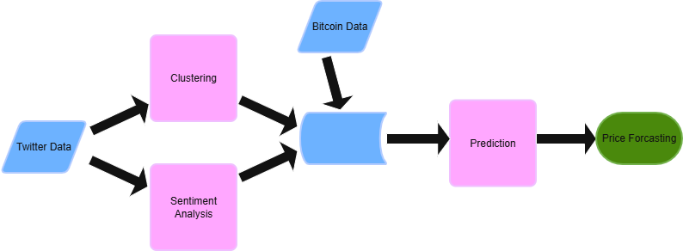
Categorizing users
Cluster Twitter-users by Bitcoin interest (traders, news, bots, etc.)
Find groups whose sentiment correlates with Bitcoin prices
Weight sentiments in the prediction based on cluster affiliation
Clustering based on posts and profile descriptions
Labeling by ChatGPT

Slide 8
Thanks a lot for your attention
RJDO

