Slide 1

Testing Market Efficiency of BTC using ML
Leipzig, 04.12.2025
Notes:
Good Morning, Today we are going to present our topic:

Slide 2
Agenda
Background + EMH
Sentiment analysis
Categorizing users
Prediction plans
Notes:
Can be changed

Slide 3
Background
Efficient Market Hypothesis: Essentially, Asset prices reflect all known information about the asset. Therefore, you cannot beat the market.
Bitcoin: not just a cryptocurrency but also as an asset/speculative commodity
It will be weak form efficient if the ML model cannot use past information to predict future returns.
Test if publicly available information and the reaction to that information affects the price and if the Model can predict future returns based on that information.
Notes:
Without going into too much detail, EMH is a theory that states that the price of an asset reflects all known information about that asset. Therefore, you cannot beat the market.
We will test it on Bitcoin, which due to its volatile nature has become a speculative commodity
We will test the efficiency by training a model using just the past movements of the price to predict and we will also try to prediction based on the public reaction to bitcoin online

Slide 4
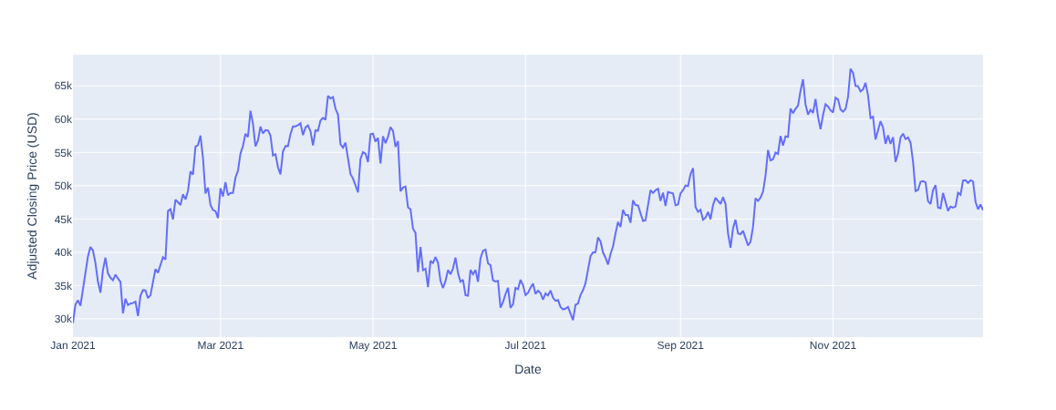
Data Set
Bitcoin Twitter Data
  Bitcoin related tweets
  Complete 2021
  15,6 million Tweets
  Over 2 million Users
  No Metainformation
  Users, No Labels
Bitcoin Historical Data
  1-min interval Bitcoin-Price
  Open, close, high, low, volume (We used close)
Bitcoin Chart 2021
Notes:
In order to do that we Analyse more than 1 million bitcoin tweets by .ca 200k users from Feb 2021 to August 2021
And we will the BTC data in the same time period. As you can see it does a nice rollercoaster movement.
Daniel will share further details about the analysis

Slide 5
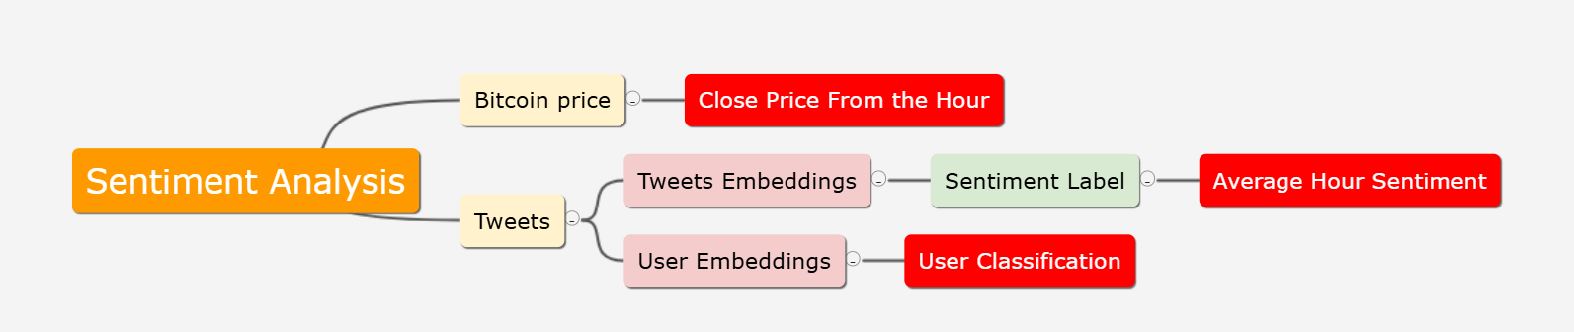
Sentiment analysis pipeline

Slide 6
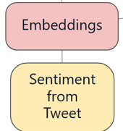
The label pipeline
Embeddings:
  Roberta
Labeling
  Since the Data is not Labeled
  Pre Trained Model for Twitter
  roberta-base-sentiment-latest
  Labels: { negativ, positive, neutral}

Slide 7
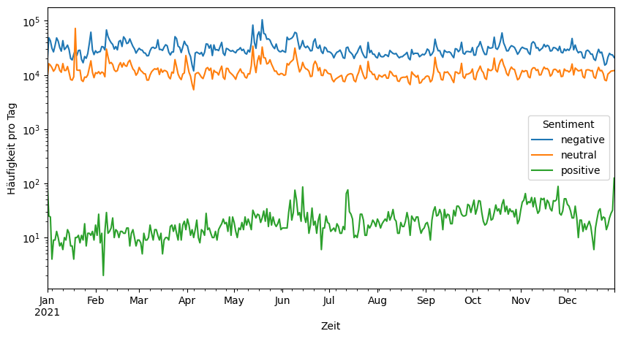
Timeline of embeddings labels

Slide 8
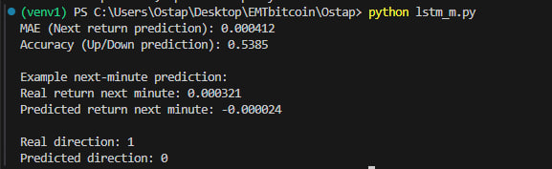
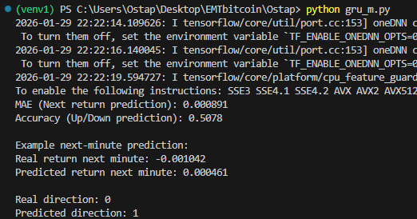
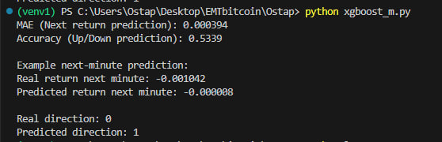
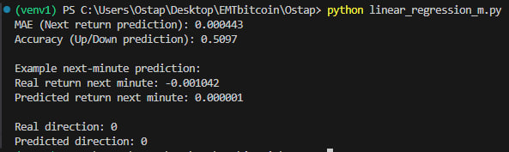
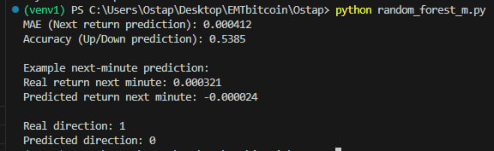
Prediction Results

Slide 9
Model Performance Metrics. EVALUATION OF ML MODELS
Model | MAE (Next Return) | Directional Accuracy
LSTM | 0.000412 | 53.85%
Random Forest | 0.000412 | 53.85%
XGBoost | 0.000394 | 53.39%
Linear Regression | 0.000443 | 50.97%
GRU | 0.000891 | 50.78%
Key Insight: * Non-linear models (LSTM, RF, XGBoost) outperformed Linear Regression (50.97%).
Results indicate a persistent, though narrow, predictive signal in historical BTC data.

Slide 10
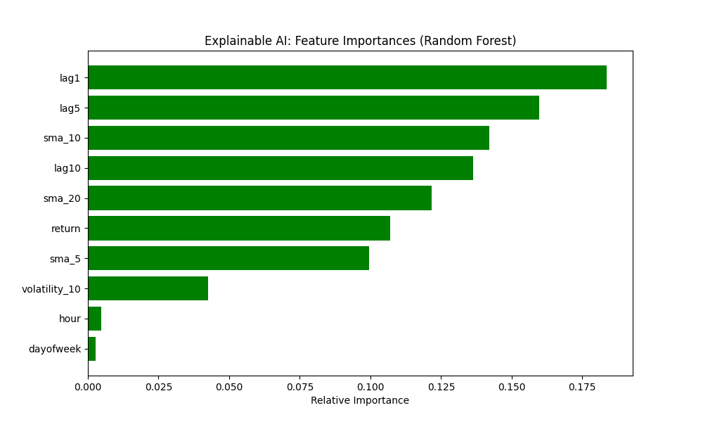

Slide 11
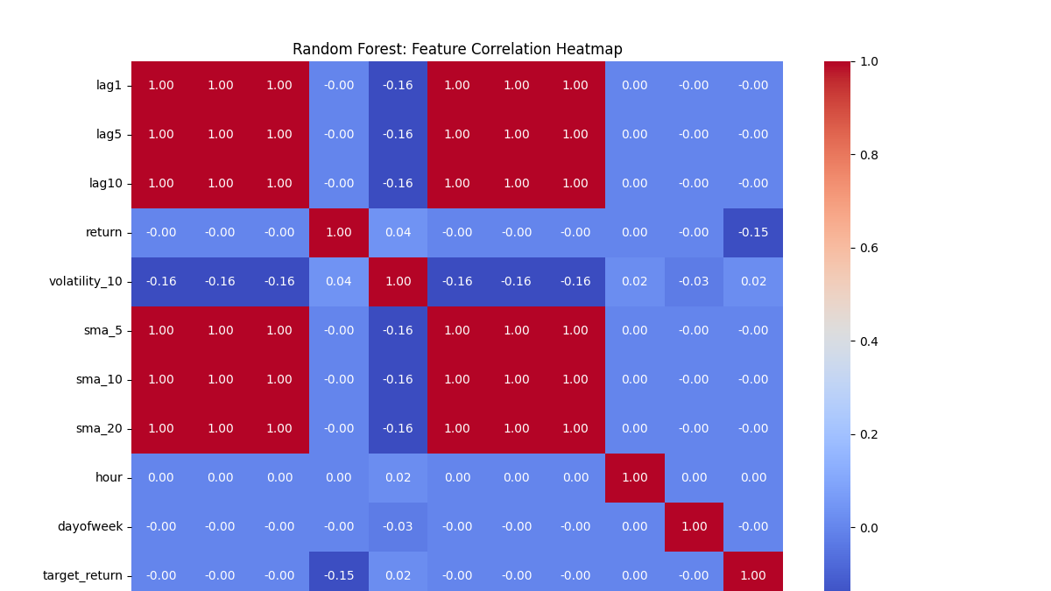

Slide 12
IMPLICATIONS FOR BTC MARKET EFFICIENCY
EMH Verdict:
Reject Weak-Form Efficiency: Models successfully used past prices to predict future direction with >53% accuracy.
Historical information is not fully reflected in current prices, contradicting the strict EMH.
Practical Outlook:
The ~3.8% edge over random guessing suggests the BTC market is "Incomplete" or "Semi-Weak" in its efficiency.
Profitability in real-world trading would still depend on transaction costs and execution speed.

Slide 13
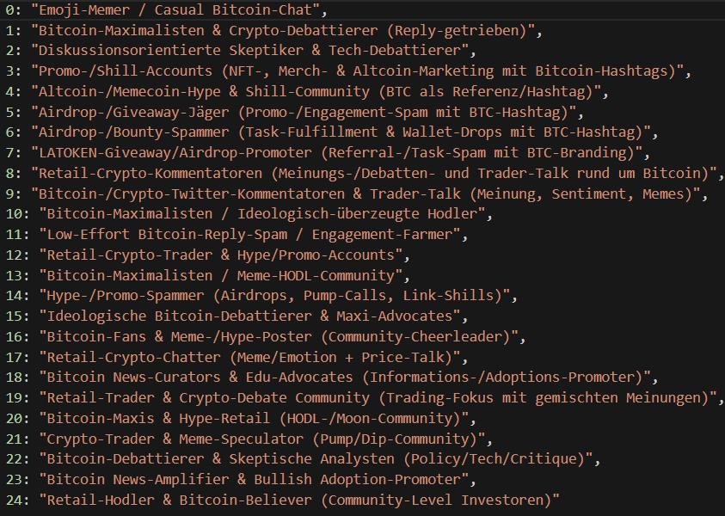
User-Interest Cluster
Tweet Embeddings:
  Twitter4SSE
User-Lvl embedding by Averaging
Tried different PCA, K-Means
Selected:
  PCA 20-dims
  K= 25
Labeled with ChatGPT5.2

Slide 14
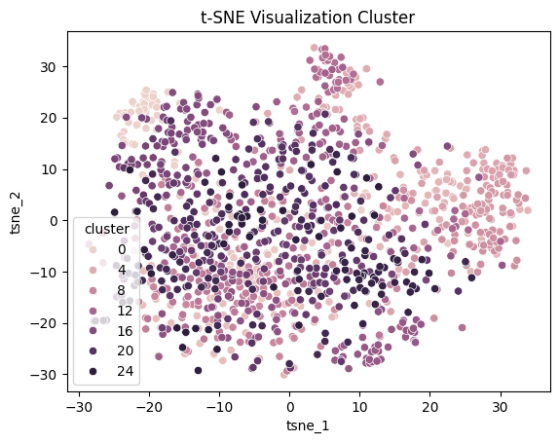
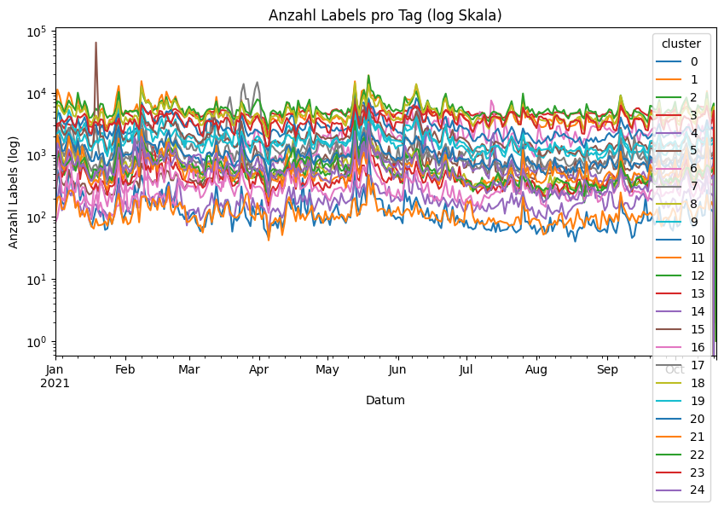
User-Interest Cluster Evaluation
Clusters:
  little temporal correlation
  noisy
Many Clusters with Similar Description
  Reduced to 8 Meta-Clusters
    Cluster Description

Slide 15
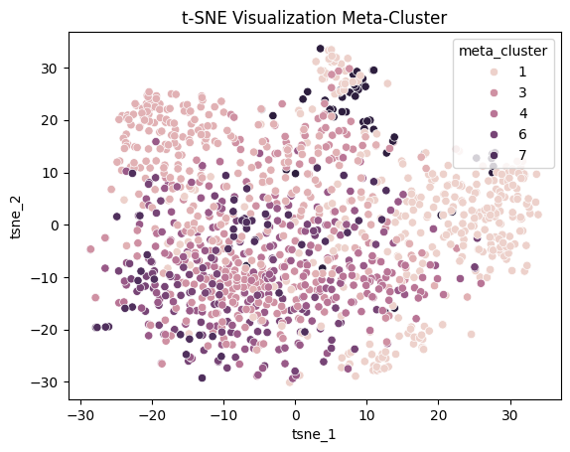
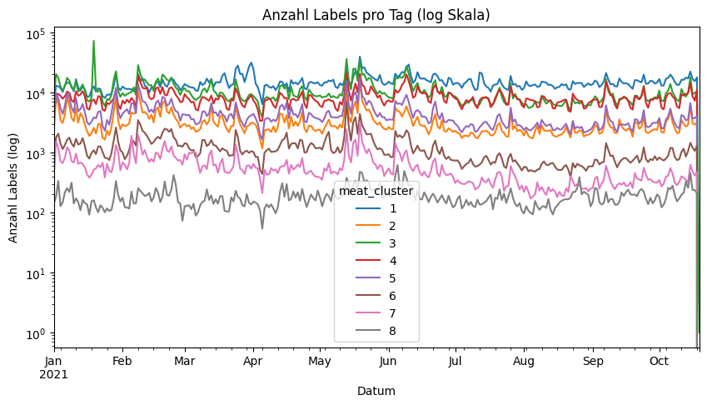
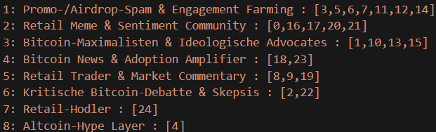
User-Interest Cluster Evaluation
Clusters:
  Less noisy
  little temporal dependence

Slide 16
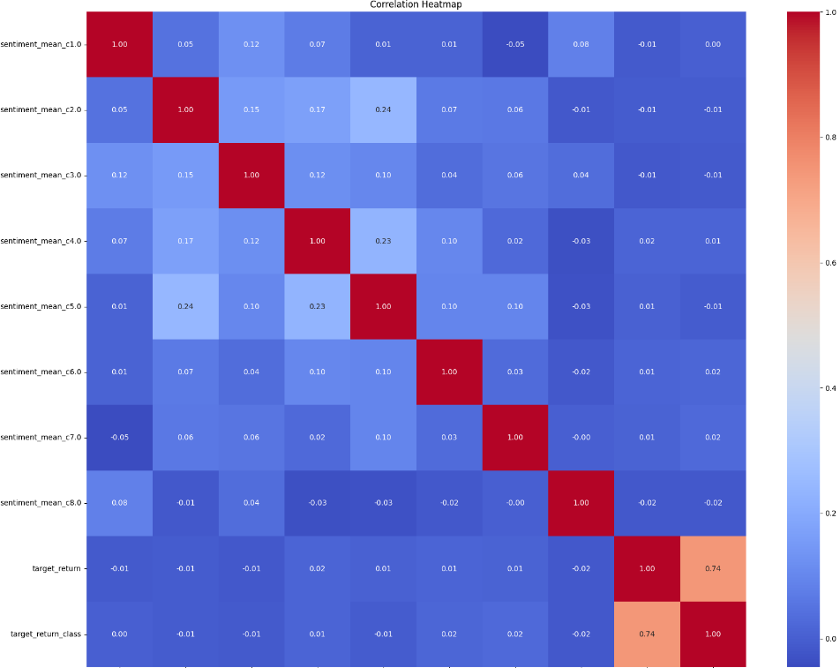
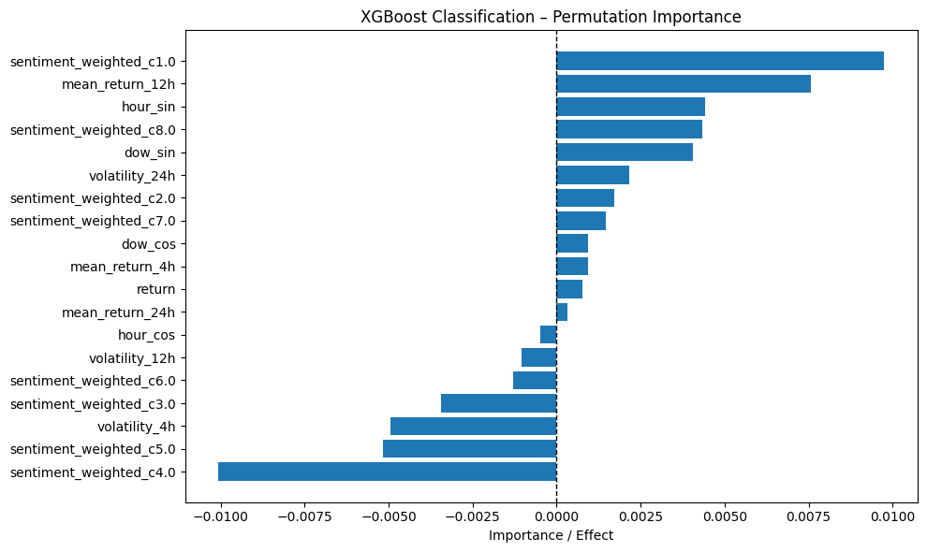
User-Clustering Effect on Price Prediction
uncorrelated with return
little corr between clusters
Model performance:
  Little influence

Slide 17
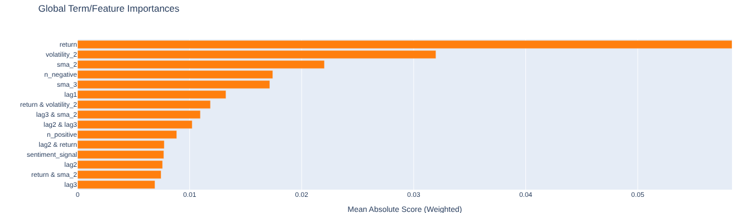
Further Changes
Using a different model
twitter-roberta-base-sentiment-latest
  Since the Data is not Labeled
  Pre Trained Model for Twitter
  twitter-roberta-base-sentiment-latest
  Labels: { negativ, positive, neutral}

Slide 18
Thanks a lot for your attention

