Slide 1
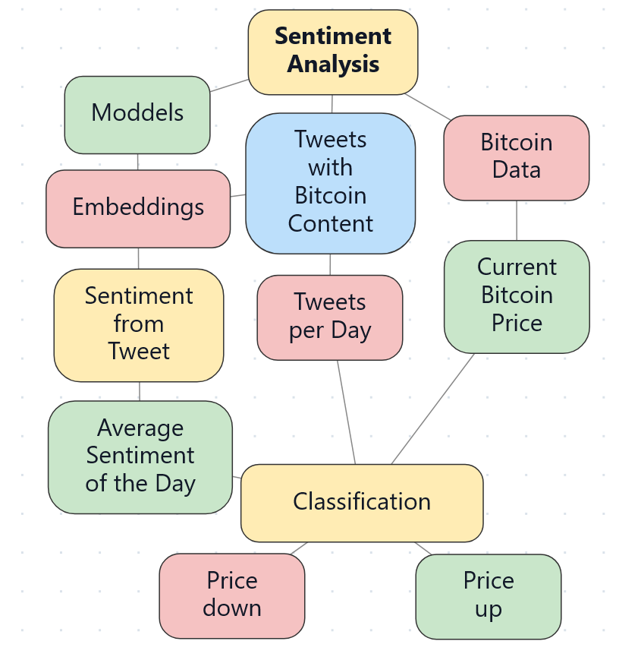
Sentiment analysis plan
Details:
Models
  Finbert (old) (free)
  Gpt 4o
  ModernBert-embed-large
  Multilingual E5 Mistral
  Fin-E5
Different Strategies with
  Price Plan
  Sentiment Clustering

