Slide 1
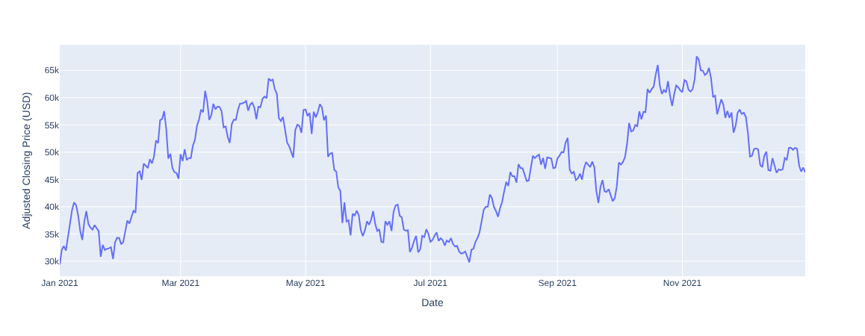
Data Set
Bitcoin Twitter Data
  Bitcoin related tweets
  Complete 2021
  15,6 million Tweets
  Over 2 million Users
  No Metainformation
  Users, No Labels
Bitcoin Historical Data
  1-min interval Bitcoin-Price
  Open, close, high, low, volume (We used close)
Bitcoin Chart 2021
Notes:
In order to do that we Analyse more than 1 million bitcoin tweets by .ca 200k users from Feb 2021 to August 2021
And we will the BTC data in the same time period. As you can see it does a nice rollercoaster movement.
Daniel will share further details about the analysis

Slide 2
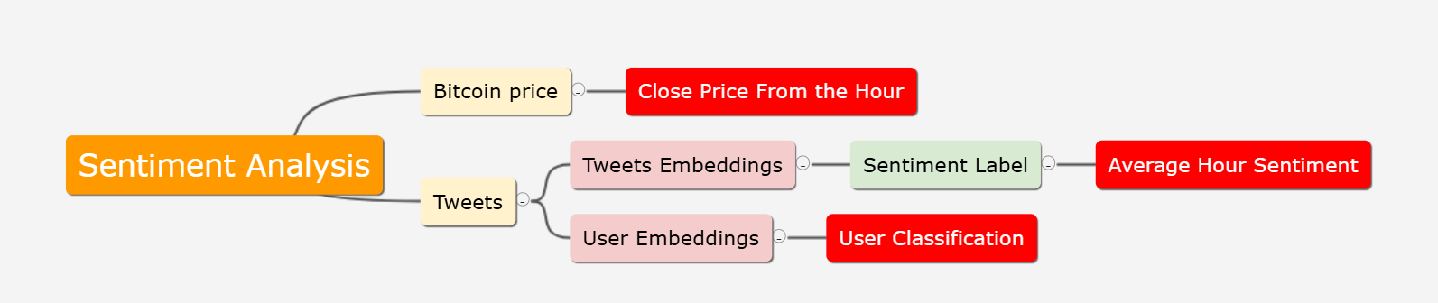
Sentiment analysis pipeline

Slide 3
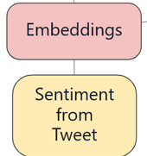
The label pipeline
Embeddings:
  Roberta
Labeling
  Since the Data is not Labeled
  Pre Trained Model for Twitter
  twitter-roberta-base-sentiment-latest
  Labels: { negativ, positive, neutral}

Slide 4
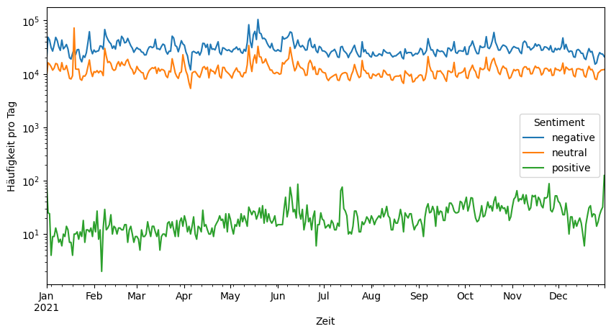
Timeline of embeddings labels

Slide 5
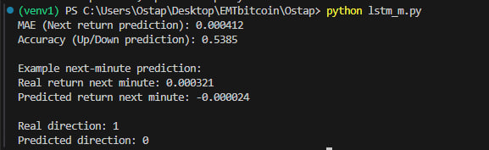
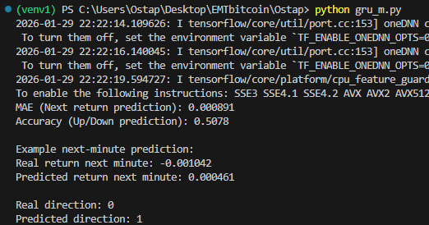
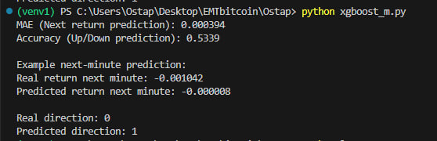
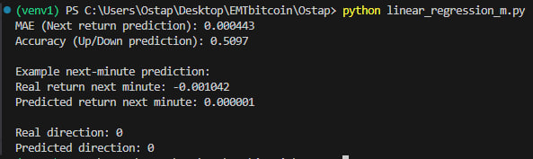
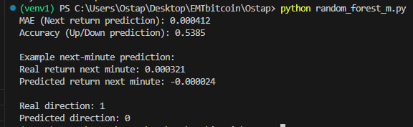
Prediction Results

Slide 6
Model Performance Metrics. EVALUATION OF ML MODELS
Model | MAE (Next Return) | Directional Accuracy
LSTM | 0.000412 | 53.85%
Random Forest | 0.000412 | 53.85%
XGBoost | 0.000394 | 53.39%
Linear Regression | 0.000443 | 50.97%
GRU | 0.000891 | 50.78%
Key Insight: * Non-linear models (LSTM, RF, XGBoost) outperformed Linear Regression (50.97%).
Results indicate a persistent, though narrow, predictive signal in historical BTC data.

Slide 7
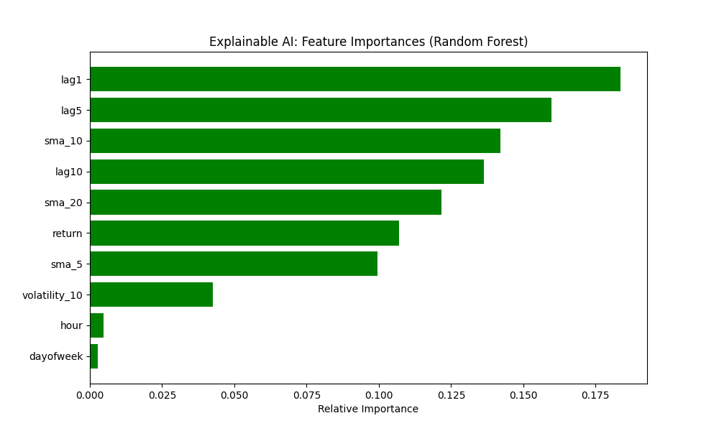

Slide 8
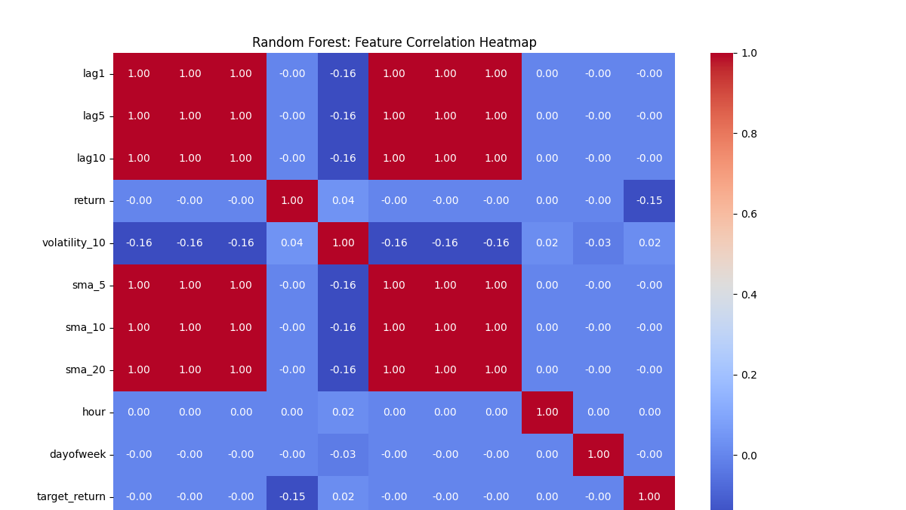

Slide 9
IMPLICATIONS FOR BTC MARKET EFFICIENCY
EMH Verdict:
Reject Weak-Form Efficiency: Models successfully used past prices to predict future direction with >53% accuracy.
Historical information is not fully reflected in current prices, contradicting the strict EMH.
Practical Outlook:
The ~3.8% edge over random guessing suggests the BTC market is "Incomplete" or "Semi-Weak" in its efficiency.
Profitability in real-world trading would still depend on transaction costs and execution speed.

Slide 10
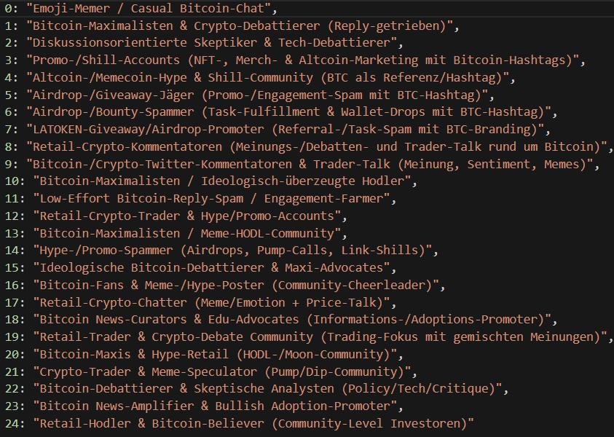
User-Interest Cluster
Tweet Embeddings:
  Twitter4SSE
User-Lvl embedding by Averaging
Tried different PCA, K-Means
Selected:
  PCA 20-dims
  K= 25
Labeled with ChatGPT5.2

Slide 11
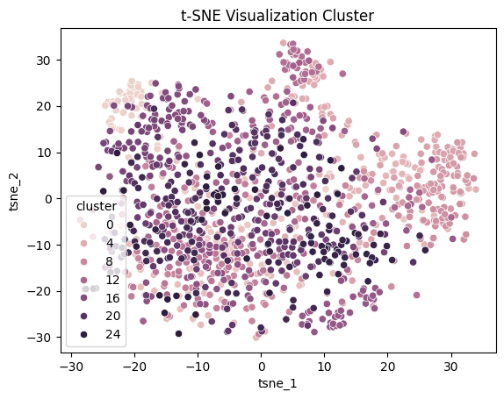
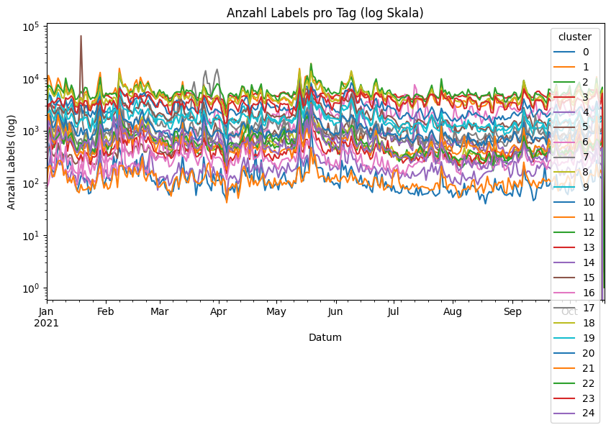
User-Interest Cluster Evaluation
Clusters:
  little temporal correlation
  noisy
Many Clusters with Similar Description
  Reduced to 8 Meta-Clusters
    Cluster Description

Slide 12
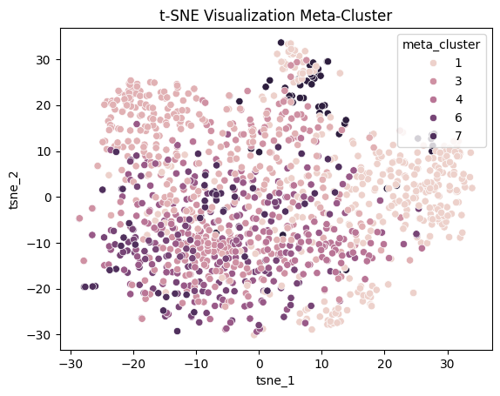
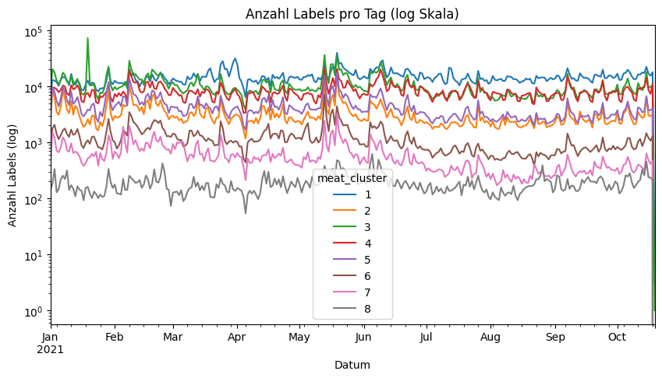
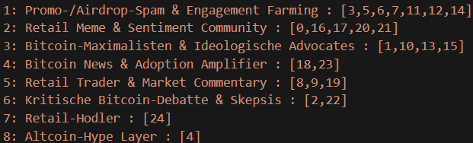
User-Interest Cluster Evaluation
Clusters:
  Less noisy
  little temporal dependence

Slide 13
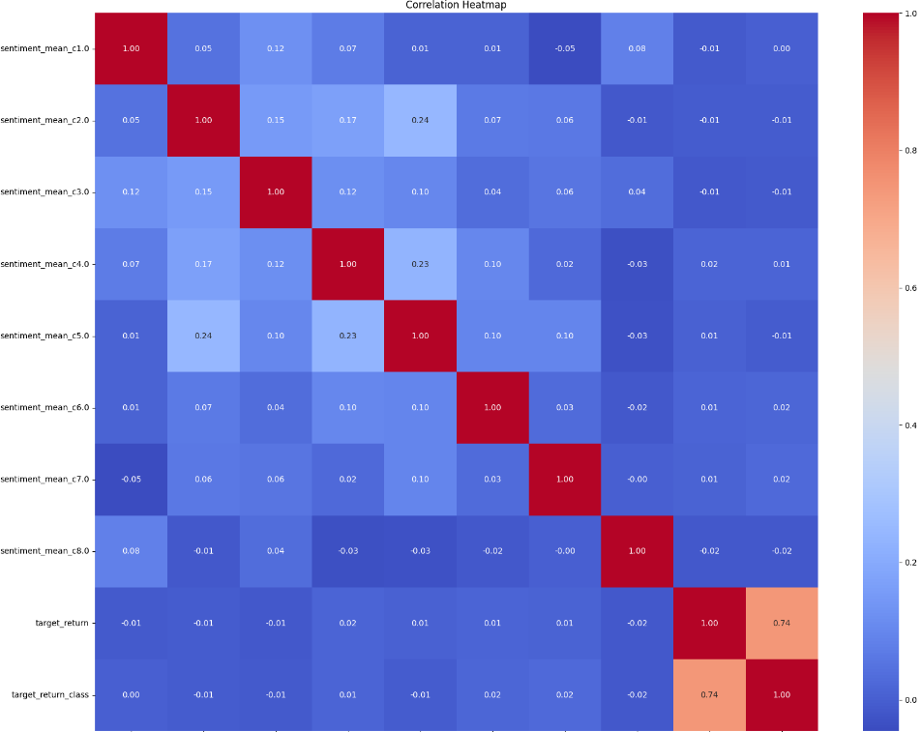
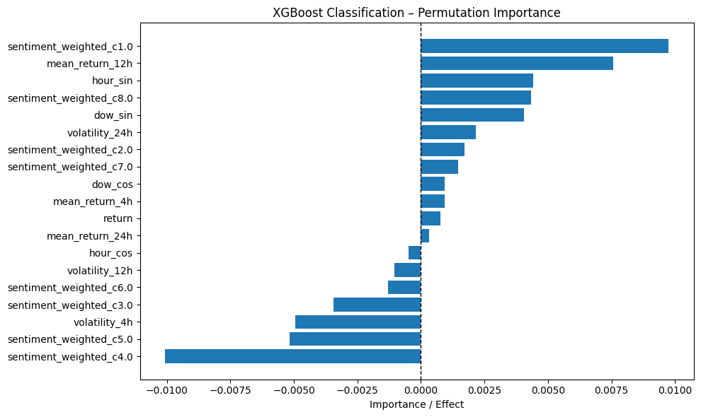
User-Clustering Effect on Price Prediction
uncorrelated with return
little corr between clusters
Model performance:
  Little influence

