Slide 1


Money Manager: Intuitive Financial Management for Everyone
The purpose of this application is to create an intuitive and useful budget and financial management tool that would facilitate the efficient management of the user's expenses and income. The main goal is to enable users to effectively control their finances, save money, invest and achieve their financial goals.

Slide 2





Problem solving
Simplifying budgeting
Monitoring of expenses
and income
Saving time
The app will allow users to create budgets, allocate money to different categories, and set financial goals.
The application will simplify the process of keeping records of finances, effectively using automation and calculations.
Users will be able to study their financial activity over the past month in detail to better understand where their money goes and where their income comes from.
Visualisation of finances
Motivation to save and invest
The application will provide users with convenient charts and graphs to visually display their financial status.
The application will create the conditions for effective financial management, encouraging users to use their money efficiently and achieve their financial goals.

Slide 3

Basic requirements for the application
1
Intuitive and user-friendly interface
4
Goal setting and notification function
2
Security and confidentiality
5
Warnings about overspending
3
Data visualization

Slide 4
Types of users
1
User
1. Ability to enter data on income and expenses
2. Ability to view the history of transactions
3. Ability to view graphs and charts to better understand the financial situation
4. Ability to set financial goals 5) Ability to create different budgets
5. Ability to edit your own profile and basically personal information
2
Administrator
1. + The same features as a regular user
2. Ability to manage user accounts (creating a blocking of deletion)
3. Ability to contact ordinary users

Slide 5

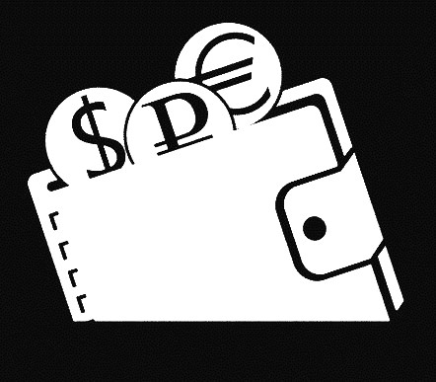
Similar apps
Moneygraph+
Money Wallet

Slide 6
Moneygraph+
Advantages
Disadvantages
Ability to manage multiple accounts
Confusing interface
Reports and analytics
Not perfect graphics
Regular backups
Prerequisites for making a deposit

Slide 7
Money Wallet
Advantages
Disadvantages
The ability to synchronize data between multiple devices.
Some interface issues that may not be entirely user-friendly.
Support for different types of accounts and currencies.
The software is paid.
The trial version has limitations on the number of accounts, groups, scheduled transactions and budgets.
Problems with app stability, especially after updates.

