Slide 1
Group 7
Made by Adrian, Daniel and Tobias

Slide 2
Problem introducion 0.5-1min
Theme: Flight price aggregator
Unified interface
Frontend and backend
Notes:
For this project, we were assigned the theme of building a Flight Price Aggregator, under the brand name Flight Finder. The primary objective was to develop a functional and user-friendly platform that enables users to efficiently compare flight prices from multiple providers.
The core problem we addressed is the fragmented nature of online flight booking. Today, users often rely on several different platforms—such as Skyscanner, Expedia, and Google Flights—to compare prices, schedules, and features. This process is inefficient and can lead to inconsistent or unclear pricing data.
Our platform aims to solve this by aggregating flight data from various sources and presenting it in a unified, structured, and accessible interface. The goal was not to process bookings directly, but to serve as a neutral intermediary that streamlines the discovery and comparison of flights.
From a technical perspective, this problem provided the opportunity to integrate a complete front-end and back-end solution, implementing key requirements such as user authentication, role-based access, responsive design, RESTful APIs, and dynamic data loading.
This project represents a practical application of the skills and methodologies taught throughout the semester, including agile development, version control, and clean code practices—while focusing on both usability and functionality.

Slide 3
Work methodology 0.5-1min
Agile development
2 week sprints
Physical meeting
Roles
1 Repository
Notes:
To manage our project efficiently, we followed an agile development process using parallel sprints—one for the frontend and one for the backend. Each sprint lasted about two week and followed a clear structure: sprint planning, execution, and retrospective.
In every sprint, roles were assigned—like Sprint Master and Stenographer—to ensure smooth coordination and documentation. Tasks were broken down into user stories with story points, and assigned individually.
We used version control with Git, and worked in 1 repository for the frontend and backend. Each team member was responsible for pushing updates regularly, allowing continuous integration and progress tracking.
Our sprint meetings was physical and we held verbal retrospectives where we wrote down individually what could be improved.
Throughout the sprints, we held regular stand-ups and adjusted our backlog as needed. For example, in Sprint 9, although we planned more than we could complete, we ended up achieving more functionality than in previous sprints—showing an increase in team velocity.
We documented our progress in detailed sprint reports and used retrospectives to reflect on performance and improve collaboration.

Slide 4
Architecture 0.5-1min

Slide 5
Design decisions and agreements 0.5-1min

Slide 6
Design guideline 1min
Professional theme
Shades of blue
WCAG 2.0,Uutilsynset and Yale
Notes:
For our design, we followed a serious and professional theme to build user trust—crucial when dealing with flight bookings and large payments. Our color scheme centered around shades of blue to evoke calmness and reliability, with a strong contrast using an orange call-to-action color.
We built our design guideline using principles from WCAG 2.0, UUtilsynet, and Yale’s usability checklist. Most of the defined design elements—like the color palette, layout hierarchy, responsive breakpoints, and semantic HTML—have been consistently followed in the final implementation.
We used clear typography, accessible contrast ratios, and responsive layouts for desktop, tablet, and mobile. Accessibility features like keyboard navigation, semantic tags, and alt text were also implemented across the site.

Slide 7
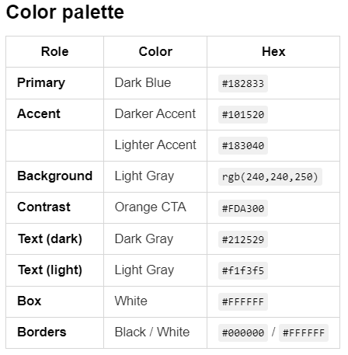
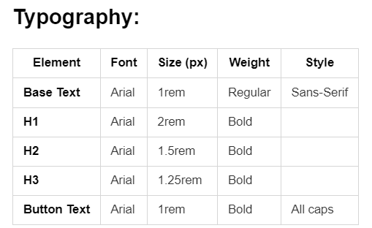

Slide 8
IDATA-2301

Slide 9
Wireframes 0.5-1min

Slide 10
Demo of the functionality 3-6min

Slide 11
Responsiveness 0.5min

Slide 12
Accessibility and usability 0.5-1min

Slide 13
Extras 0.5-1min

Slide 14
Reflection 1min

Slide 15
IDATA-2306

Slide 16
Database schema 1min

Slide 17
API endpoint documentation 0.5-1min

Slide 18
User roles 0.5min

Slide 19
Demo of the functionality 3-6min

Slide 20
Tests 1-3min

Slide 21
Extras 0.5-1min

Slide 22
Reflection 0.5min

