Slide 1
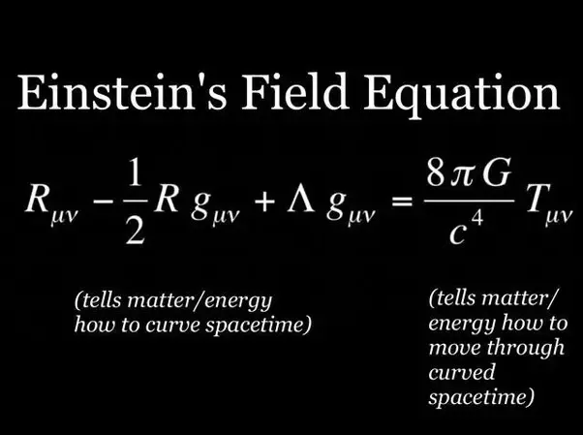

Slide 2
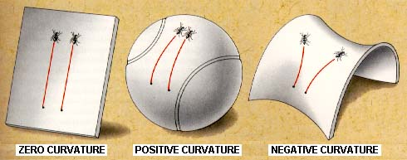
Spacetime Curvature

Slide 3
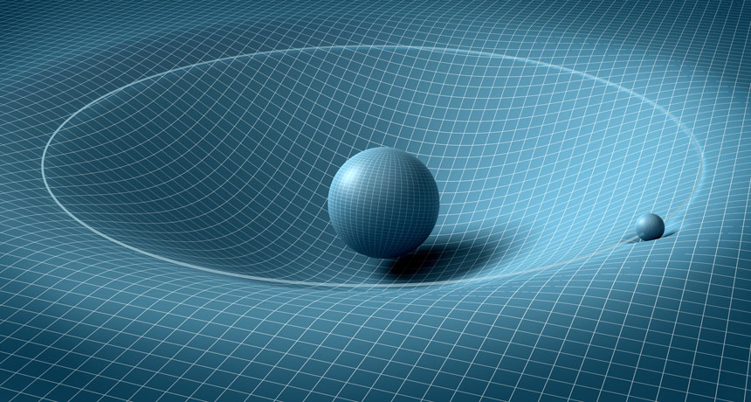

Slide 4
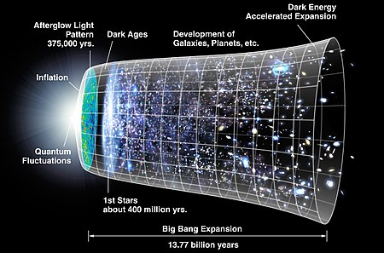

Slide 5
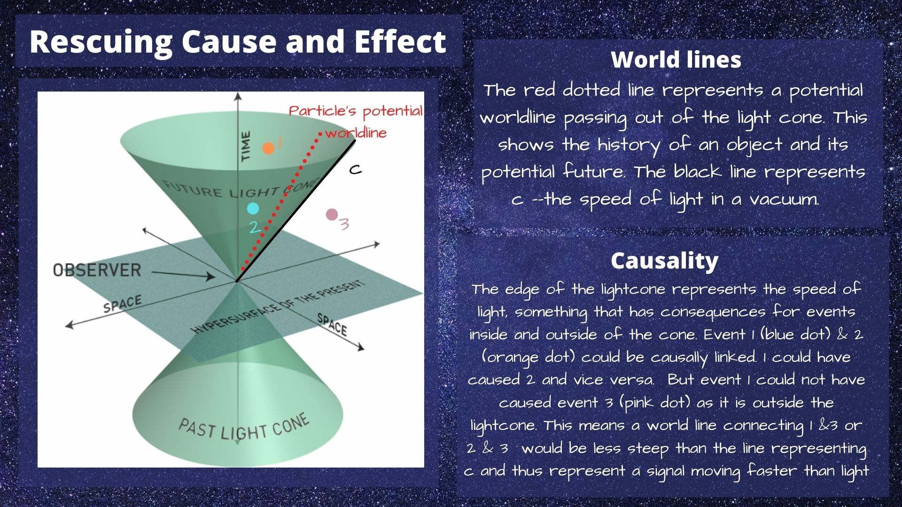

Slide 6
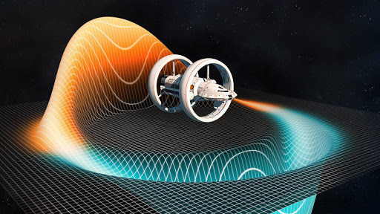
Warp Drive Bubble

Slide 7
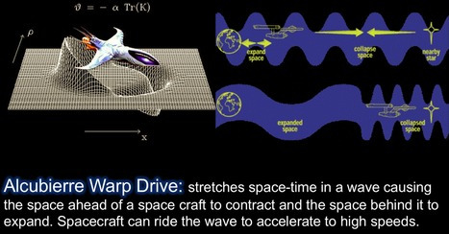
Alcubierre Warp Drive

Slide 8




Alcubierre Warp Drive Metric
α is the lapse function that gives the interval of proper time between nearby hypersurfaces.
$β^{i}$ is the shift vector that relates the spatial coordinate systems on different hypersurfaces.
The $γ_{ij}{dx}^{i}{dx}^{j}$ is just the Euclidean Metric defined on each hypersurface.

Slide 9
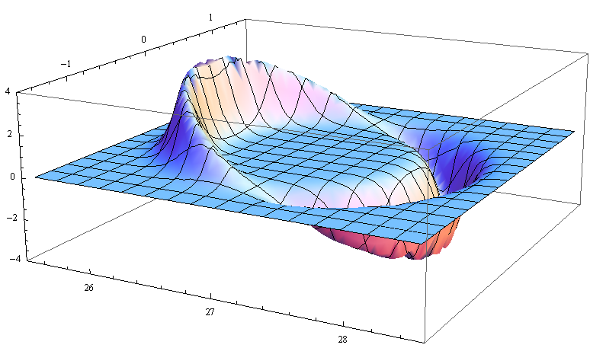
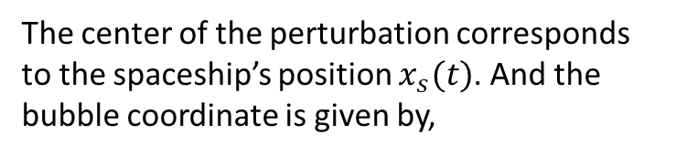
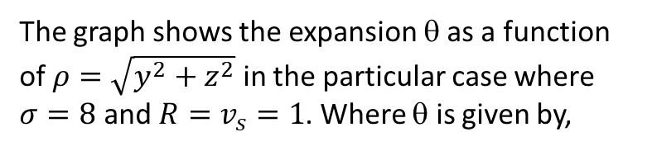
Warp Bubble Shape and Expansion
The graph shows the expansion θ as a function of $ρ=\sqrt{y^{2}+z^{2}}$ in the particular case where $σ=8$ and ${R=v}_{s}=1$. Where θ is given by,
The center of the perturbation corresponds to the spaceship’s position $x_{s}(t)$. And the bubble coordinate is given by,
The expansion θ of the volume elements associated with the Eulerian observers is given in terms of the extrinsic curvature tensor
where

Slide 10
Dust content solutions for the Alcubierre warp drive spacetime https://arxiv.org/abs/2008.06560
The Alcubierre metric is a spacetime geometry where a massive particle inside a spacetime distortion, called warp bubble, is able to travel at velocities arbitrarily higher than the velocity of light, a feature known as the warp drive. This is a consequence of general relativity, which allows global superluminal velocities but restricts local speeds to subluminal ones as required by special relativity. In this work we solved the Einstein equations for the Alcubierre warp drive spacetime geometry considering the dust matter distribution as source, since the Alcubierre metric was not originally advanced as a solution of the Einstein equations, but as a spacetime geometry proposed without a source gravity field. We found out that all Einstein equations solutions of this geometry containing pressureless dust lead to vacuum solutions. We also concluded that these solutions connect the Alcubierre metric to the Burgers equation, which describes shock waves moving through an inviscid fluid. Our results also indicated that these shock waves behave as plane waves.

Slide 11
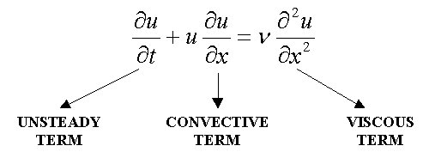
Burgers Equation
(Shock Waves)
Burgers Equation Solution Simulation

Slide 12
Fluid dynamics in the warp drive spacetime geometry
https://arxiv.org/abs/2101.11467
The Alcubierre warp drive metric is a spacetime geometry featuring a spacetime distortion, called warp bubble, where a massive particle inside it acquires global superluminal velocities, or warp speeds. This work presents solutions of the Einstein equations for the Alcubierre metric having fluid matter as gravity source. The energy-momentum tensor considered two fluid contents, the perfect fluid and the parametrized perfect fluid (PPF), a tentative more flexible model whose aim is to explore the possibilities of warp drive solutions with positive matter density content. Santos-Pereira et al. (2020; arXiv:2008.06560) have already showed that the Alcubierre metric having dust as source connects this geometry to the Burgers equation, which describes shock waves moving through an inviscid fluid, but led the solutions back to vacuum. The same happened for two out of four solutions subcases for the perfect fluid. Other solutions for the perfect fluid indicate the possibility of warp drive with positive matter density, but at the cost of a complex solution for the warp drive regulating function. Regarding the PPF, solutions were also obtained indicating that warp speeds could be created with positive matter density. Weak, dominant, strong and null energy conditions were calculated for all studied subcases, being satisfied for the perfect fluid and creating constraints in the PPF quantities such that positive matter density is also possible for creating a warp bubble. Summing up all results,energy-momentum tensors describing more complex forms of matter, or field, distributions generate solutions for the Einstein equations with the warp drive metric where negative matter density might not be a strict precondition for attaining warp speeds.

Slide 13
Charged dust solutions for the warp drive spacetime
https://arxiv.org/abs/2102.05119
The Alcubierre warp drive metric is a spacetime construction where a massive particle located inside a spacetime distortion, called warp bubble, travels at velocities arbitrarily higher than the velocity of light. This theoretically constructed spacetime geometry is a consequence of general relativity where global superluminal velocities, also known as warp speeds, are possible, whereas local speeds are limited to subluminal ones as required by special relativity. In this work we analyze the solutions of the Einstein equations having charged dust energy-momentum tensor as source for warp velocities. The Einstein equations with the cosmological constant are written and all solutions having energy-momentum tensor components for electromagnetic fields generated by charged dust are presented, as well as the respective energy conditions. The results show an interplay between the energy conditions and the electromagnetic field such that in some cases the former can be satisfied by both positive and negative matter density. In other cases the dominant and null energy conditions are violated. A result connecting the electric energy density with the cosmological constant is also presented, as well as the effects of the electromagnetic field on the bubble dynamics.

