Slide 1
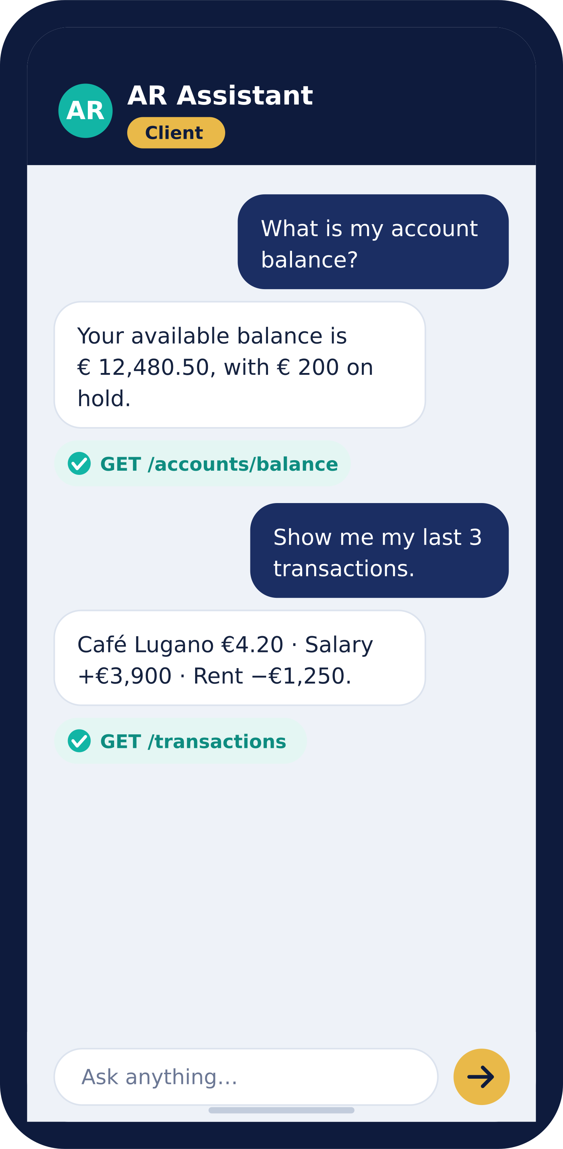



ARWEB · AI BANKING ASSISTANT
AR Conversational
Your bank’s knowledge — one conversation away.
The AI assistant your staff and clients simply talk to. Ask a question in plain language; get a clear, trustworthy answer drawn from your bank’s own systems.
Available 24/7
English & Italian
Private & secure

Slide 2




THE PROMISE
Banking answers shouldn’t need a banking degree.
Your clients and your front office both want the same thing — a straight answer, fast. AR Conversational understands the question, finds it in your real banking systems, and replies in clear words. No menus, no jargon, no waiting on hold.
24/7
2
14
25
Always on, never tired
Languages out of the box
Expert assistants
Banking domains covered

Slide 3
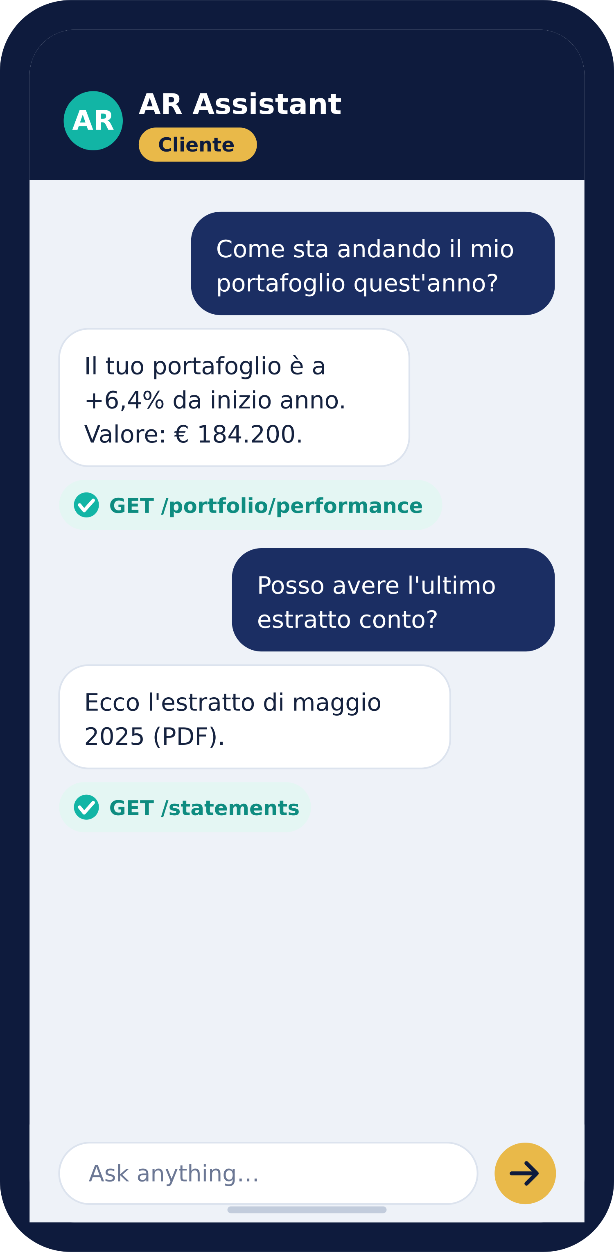



SEE IT IN ACTION
For your clients
Plain English or Italian — no training needed.
1. Ask
“What is my balance?” — typed the way they’d say it.
2. Answer
A clear reply in seconds, in everyday language.
3. Proof
Every answer shows the source it came from.

Slide 4
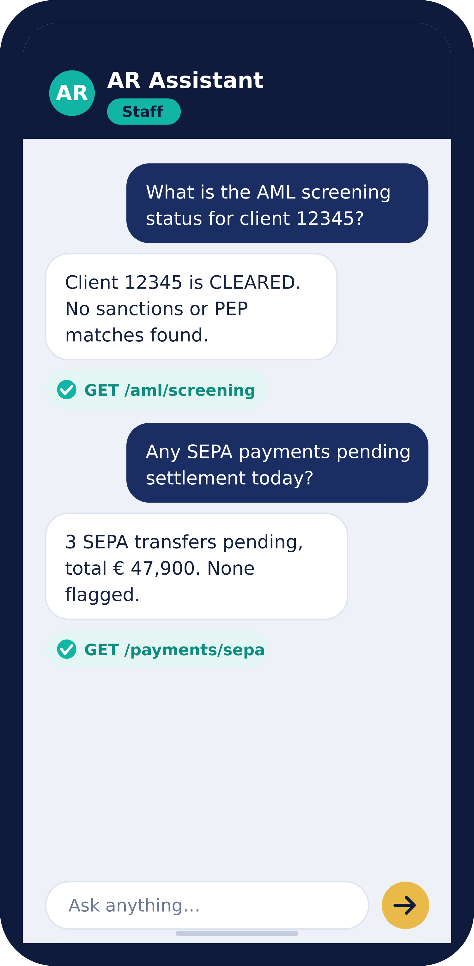

SEE IT IN ACTION
…and for your front office
Relationship managers, cash desks and compliance teams get instant, evidence-backed answers — without digging through five systems.
What’s the AML screening status for client 12345?
Which SEPA payments are pending settlement today?
Show the portfolio allocation for account CH93-0076.
Any suspicious activity flagged in the last 30 days?

Slide 5

HOW IT WORKS
Three simple steps
1
2
3
→
→
Ask
Answer
See the proof
Type or speak a question in plain language — English or Italian.
AR finds the answer in your bank’s real systems and replies clearly.
Every reply shows exactly which source it came from.

Slide 6




ONE ASSISTANT, TWO EXPERIENCES
Built for staff and clients alike
Employee Mode
Client Mode
For your internal teams
For retail & private customers
9 specialist assistants
5 specialist assistants
Relationship & portfolio managers
Cash, payments & treasury desks
Compliance, risk & back office
Full operational + regulatory reach
Balances, transactions & statements
Portfolio value & performance
Loans, cards & repayments
Simplified, client-safe language

Slide 7











MEET THE TEAM
Fourteen specialists, one chat box
AR routes every question to the right expert automatically — you just ask.
FOR STAFF — 9 ASSISTANTS
Relationship Manager
Portfolio Advisor
Cash & Payments
Securities Trading
Credit & Lending
Compliance & Risk
Back Office Ops
Reporting & COO
Audit & UAT
FOR CLIENTS — 5 ASSISTANTS
Wealth Assistant
Cash Assistant
Trading Assistant
Credit Assistant
Messages & Docs

Slide 8



WHY BANKS TRUST IT
Answers you can stand behind.
It never makes things up
It always cites its source
AR can only answer from endpoints that exist in your catalog — invented answers are impossible by design.
Every reply names the exact system it drew from, so staff and auditors can verify in one glance.
Bank-grade security
Stays on your turf
All credentials encrypted with AES-256. Sensitive values are masked in logs, reports and responses.
Run fully on-premise with a local AI — nothing about your customers ever leaves your network.

Slide 9
READY WHEN YOU ARE
Turn your API catalog into a 24/7 banking expert.
Plug AR Conversational into the systems you already have, and give every client and colleague a knowledgeable banker to talk to — instantly, in their language, around the clock.
Book a live demo
ARWeb · AR Conversational

