Slide 1
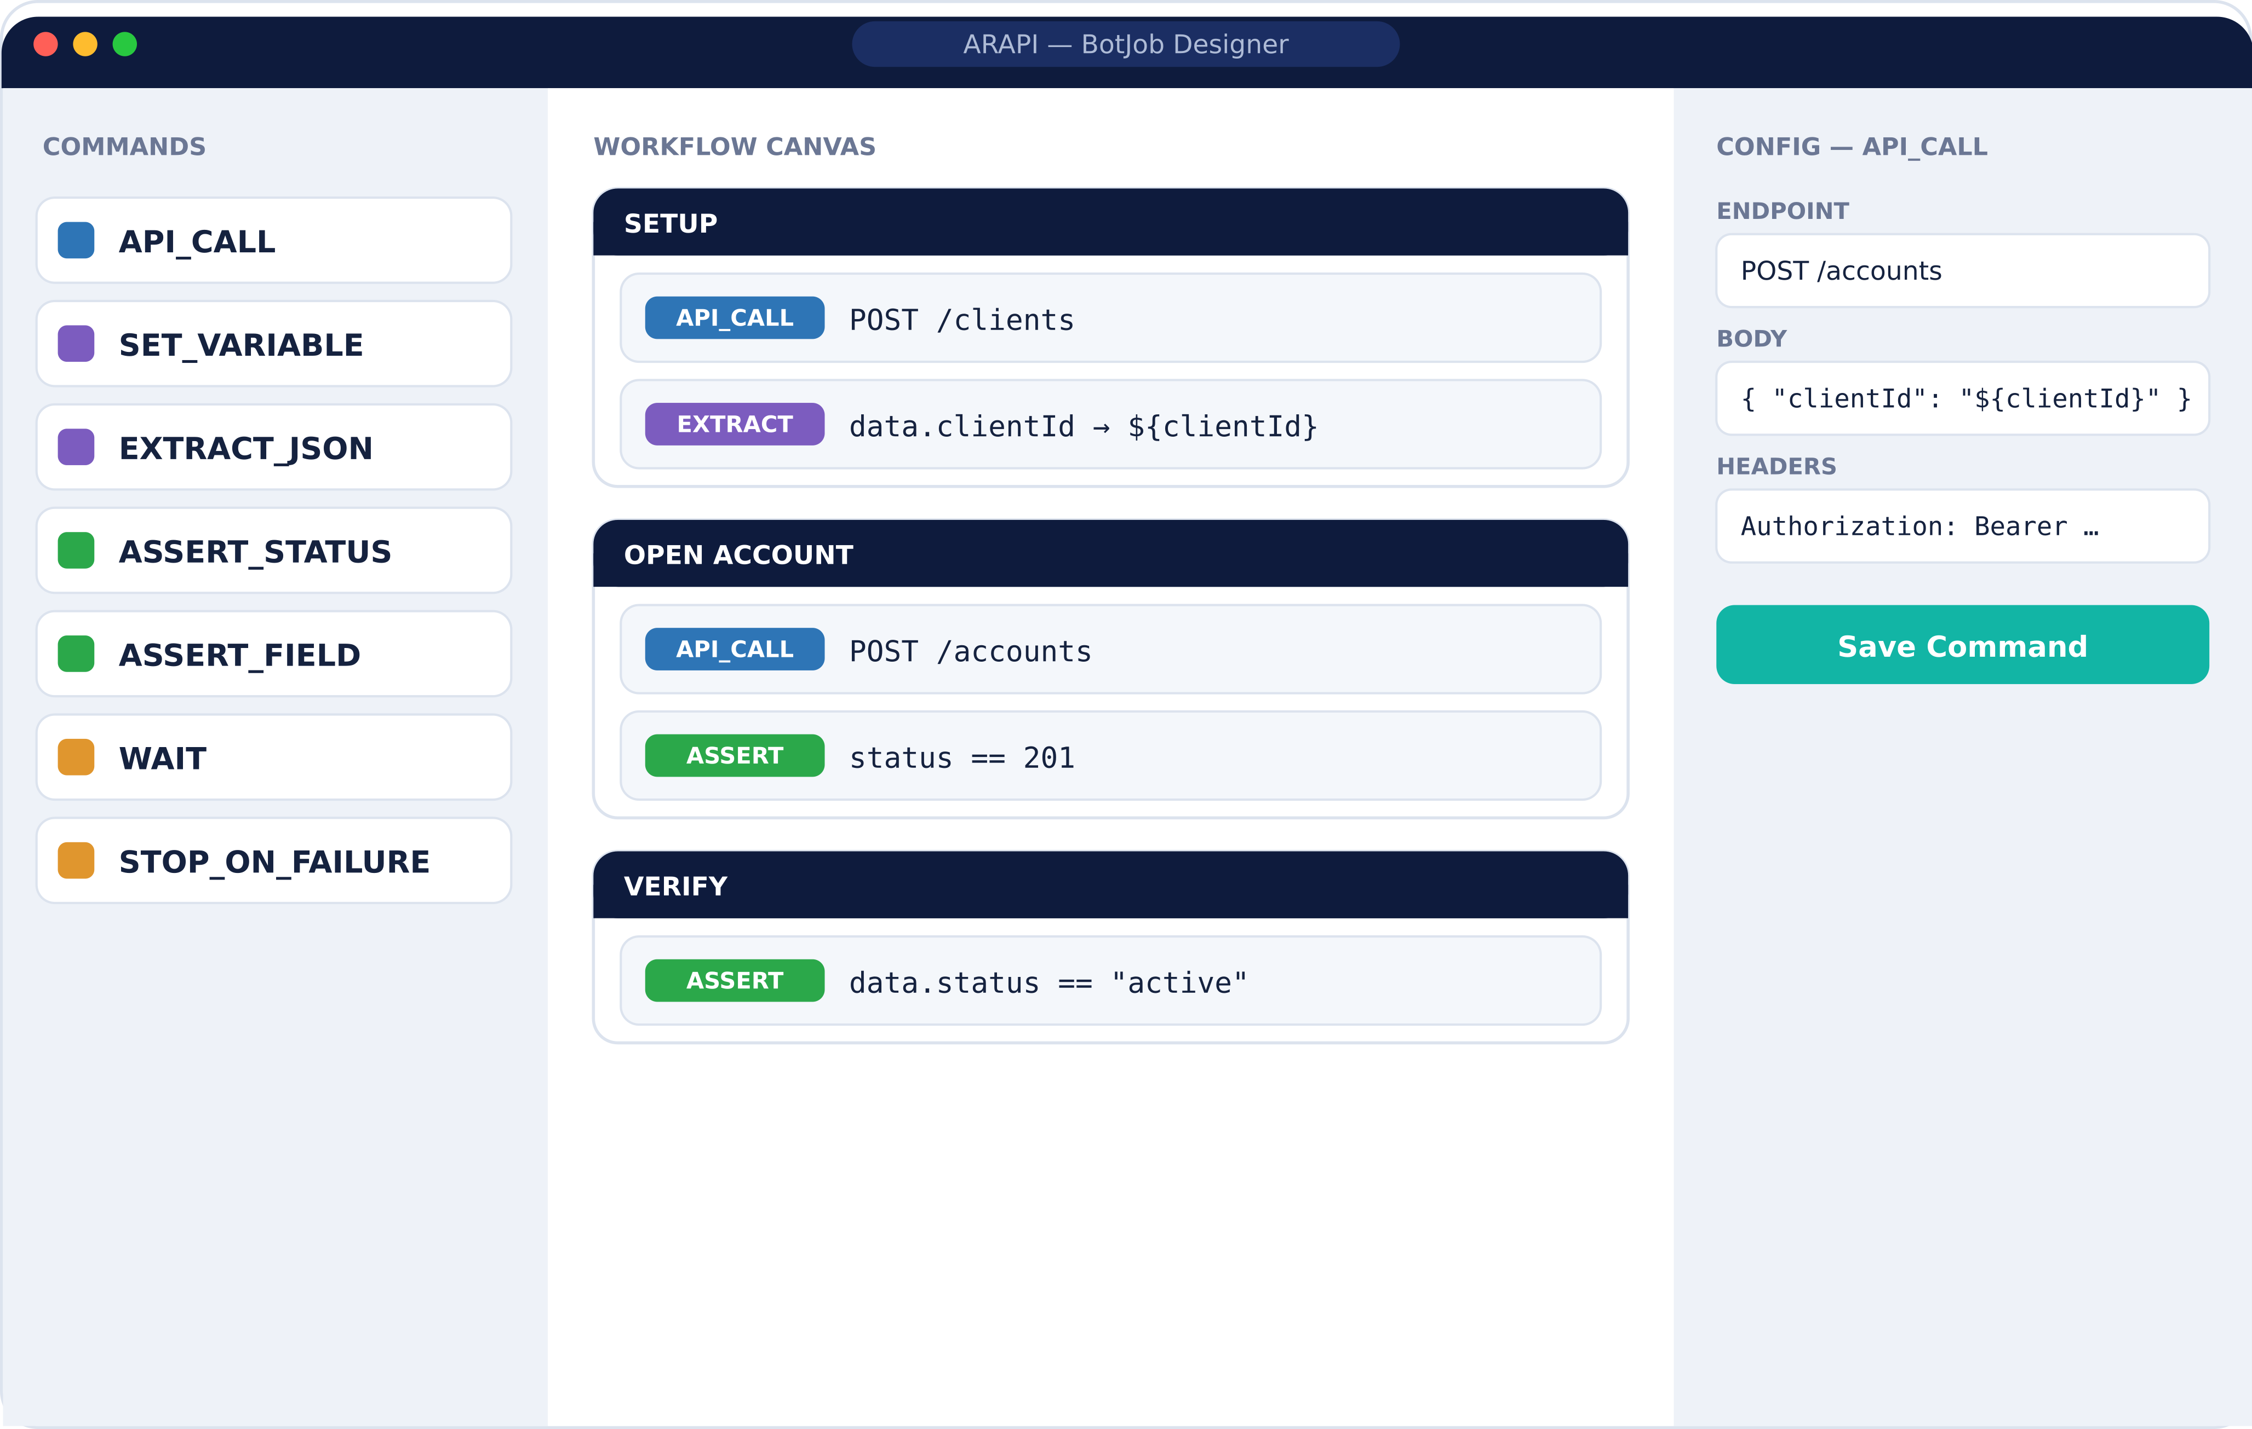



ARWEB · API TEST AUTOMATION
ARAPI
Test your banking APIs without writing a line of code.
Import your OpenAPI specs, build test workflows by drag-and-drop, and run them against a safe mock or your real environments — with results your whole team can read.
100% no-code
Built for banking
AI test builder

Slide 2




THE PROMISE
API testing shouldn’t need a team of engineers.
QA teams in banking spend weeks scripting tests by hand. ARAPI turns your API specs into a living catalog, lets anyone assemble test workflows visually, and runs them safely — so you catch problems before your customers do.
0
25
8
7
Lines of code to write
Banking domains mapped
Drag-and-drop commands
AI providers supported

Slide 3



SEE IT IN ACTION
Build a test by dragging blocks
No scripts. No framework setup.
1. Import
Drop in your OpenAPI or Swagger files — whole folders welcome.
2. Design
Drag commands onto the canvas to shape the flow.
3. Run
Execute against the mock, staging or production.

Slide 4
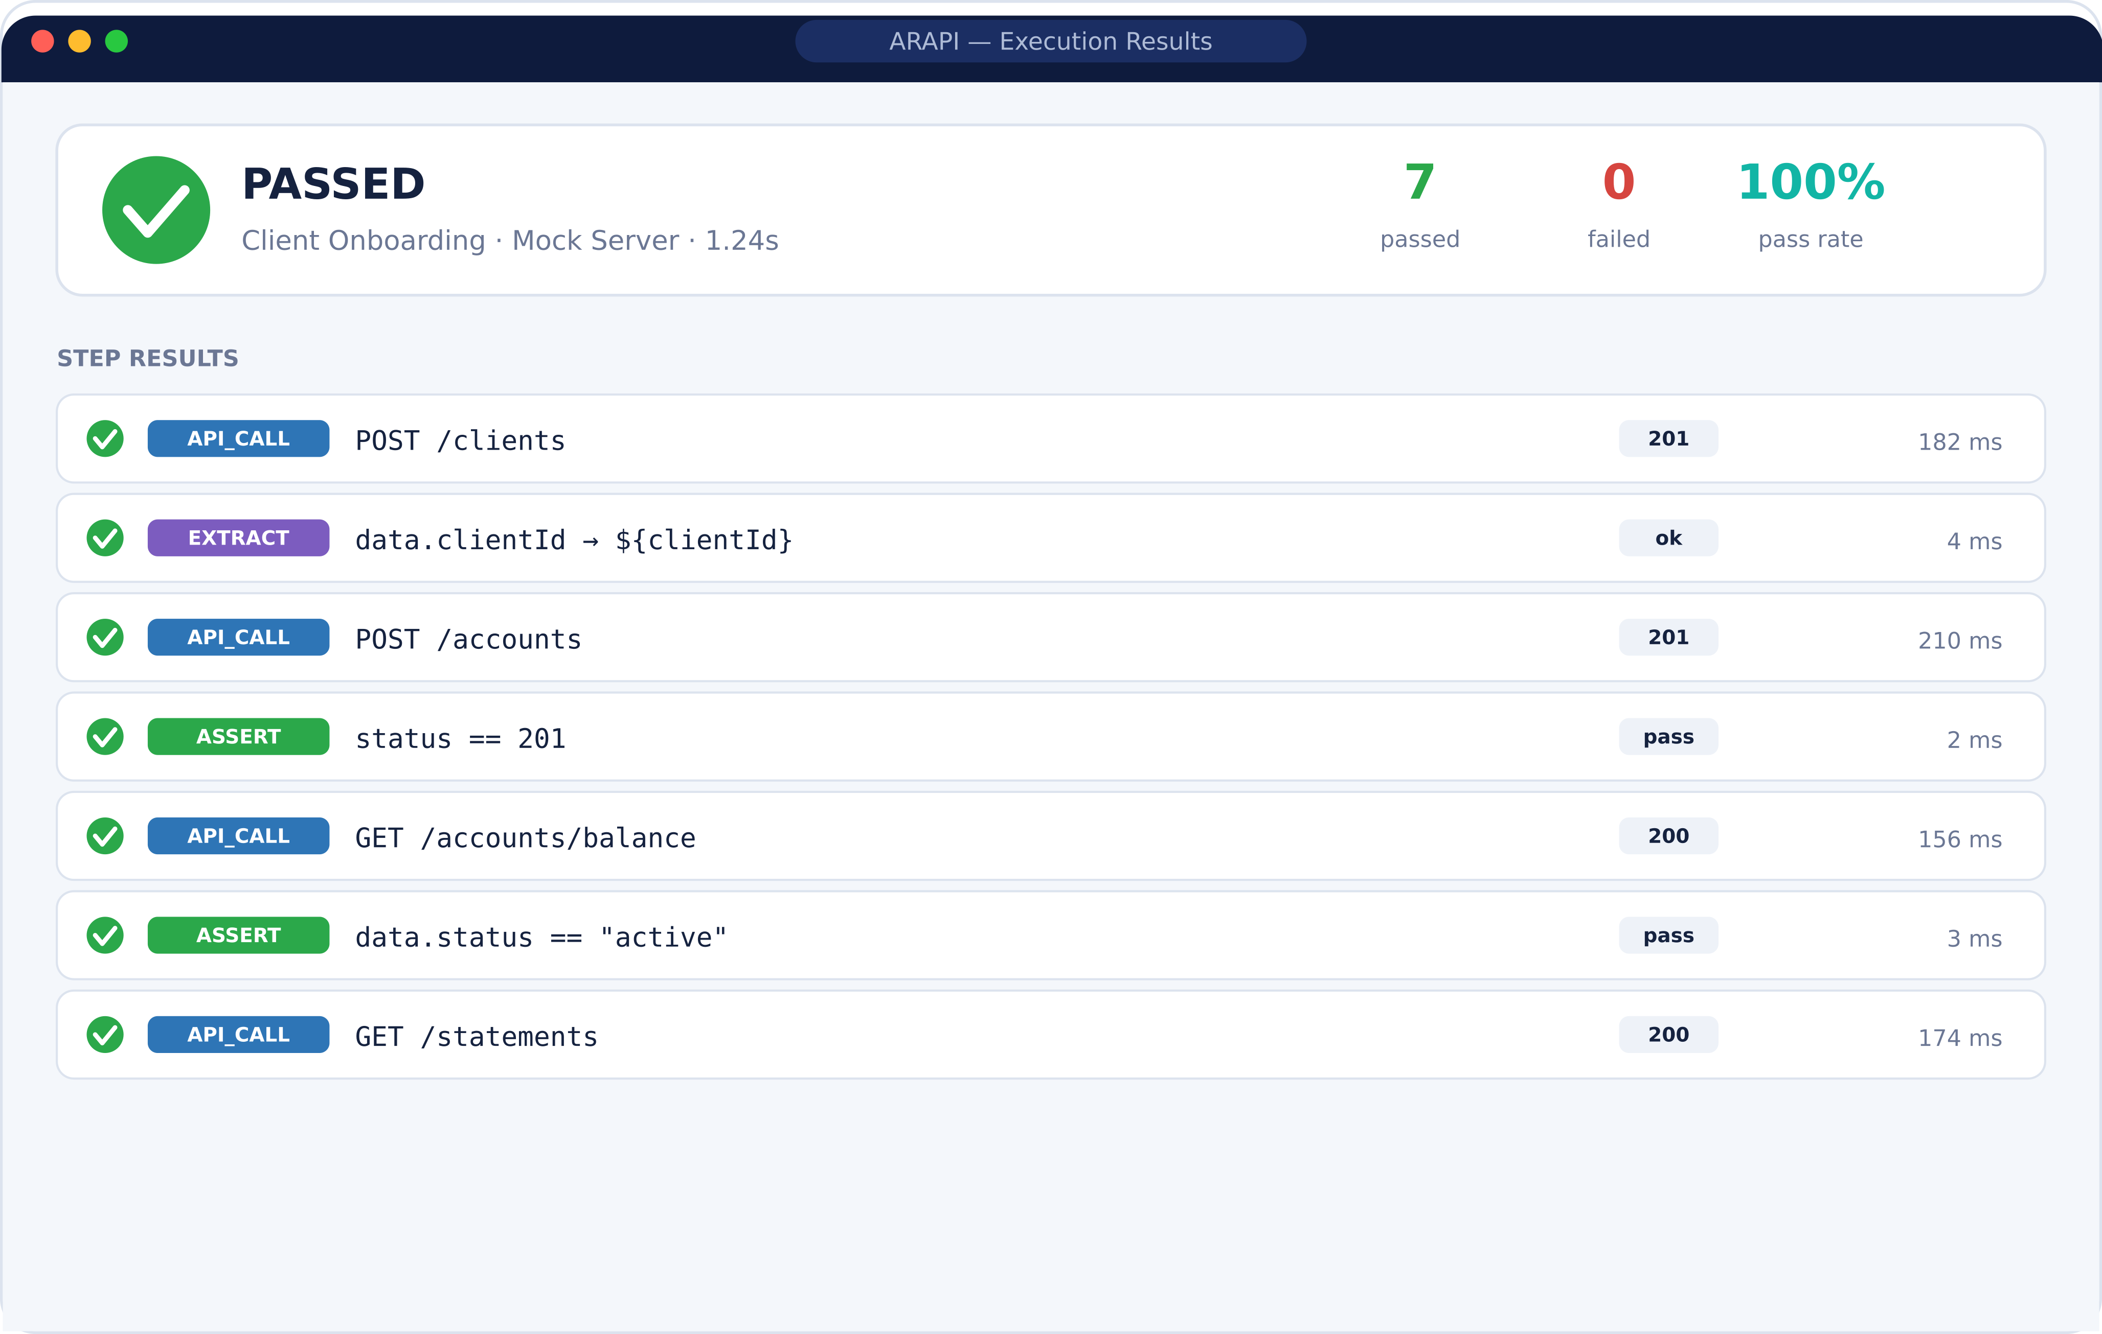



SEE IT IN ACTION
Results everyone can read
Step-by-step pass / fail
Every request, assertion and timing, laid out clearly.
HTML & CSV reports
Share a polished report or pipe data into Excel and BI.
Full run history
Every execution stored, filterable by workflow.

Slide 5





HOW IT WORKS
From API spec to confident release
1
2
3
4
5
6
›
›
›
›
›
Import
Catalog
Design
Execute
Analyze
AI Builder
specs & folders
25 domains
visual builder
mock or live
reports & history
chat to test
Each stage flows into the next — and the AI Builder can do all of it from a single chat.

Slide 6
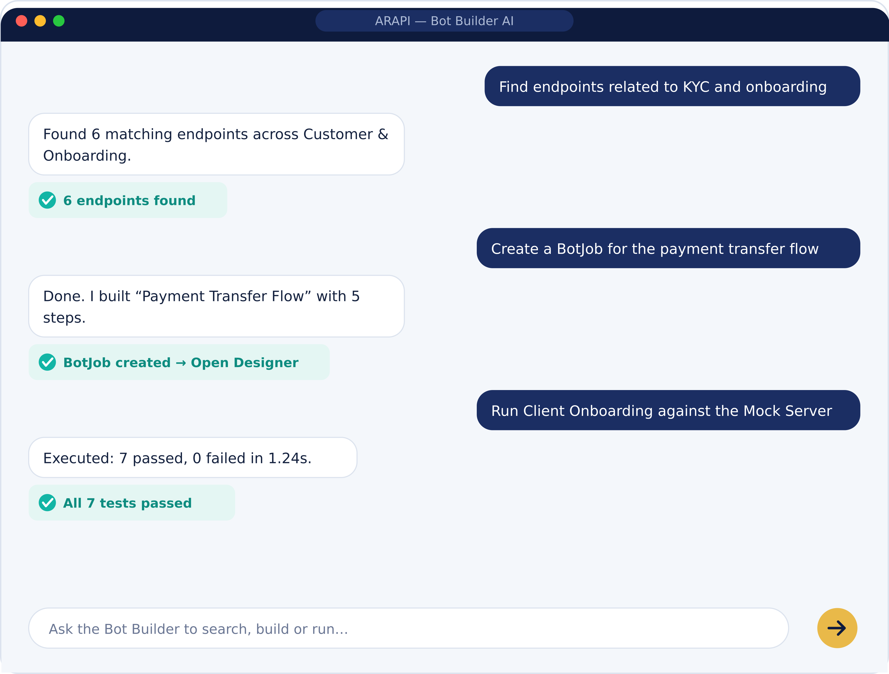



YOUR AI TEST ASSISTANT
Just ask the Bot Builder
It doesn’t just chat — it takes action.
Search your catalog
“Find endpoints related to KYC and onboarding.”
Create BotJobs
“Build a test for the payment transfer flow.”
Run tests
“Run Client Onboarding against the Mock Server.”

Slide 7






THE BUILDING BLOCKS
Eight commands cover any test
Mix and match these to model any banking workflow — no programming required.
API Call
Set Variable
Extract
Assert Status
Send a request to any endpoint
Stage or compute a value
Pull a value from a response
Check the HTTP status code
Assert Field
Assert Exists
Wait
Stop on Failure
Check a value in the response
Confirm a field is present
Pause for async operations
Halt if a critical step fails

Slide 8



WHY BANKS TRUST IT
Safe to run, anywhere.
Test without touching production
No phantom endpoints
A built-in Mock Server replays your catalog — zero risk to real banking systems.
Every test is validated against your live catalog before it runs. ARAPI can’t invent APIs.
Encrypted by default
Runs on your terms
API keys secured with AES-256. Secrets are masked in logs, reports and responses.
Isolated, locally-bound services behind your proxy. On-prem AI keeps data in your network.

Slide 9
READY WHEN YOU ARE
Ship banking APIs with confidence.
Point ARAPI at the specs you already have and start testing in minutes — no code, no risk to production, and an AI assistant ready to do the heavy lifting.
Book a live demo
ARWeb · ARAPI

