Slide 1
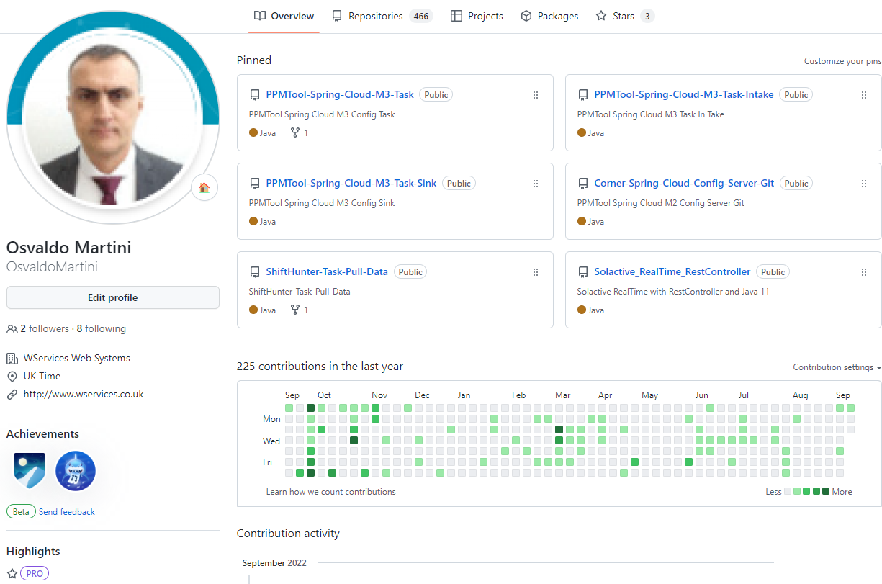

Slide 2
LCO Probe
Probes the LANSA LCO listener to establish if the listener is active or not

Slide 3
LCO Probe & Lansa Connect
LCO Probe
It is a Java6/JSP application for monitoring Active Servers.
It runs another application on a secure internet layer, which returns the status of Servers.
Lansa Connect
It is an application that performs secure access and checks the status of servers

Slide 4
Main Task
Migrate Java6 to Java8
Covert from Java JSP Web Pages to Java 8 Spring Boot
Update Log4J1.xx to Latest Logs
Create pipeline CI/CD

Slide 5
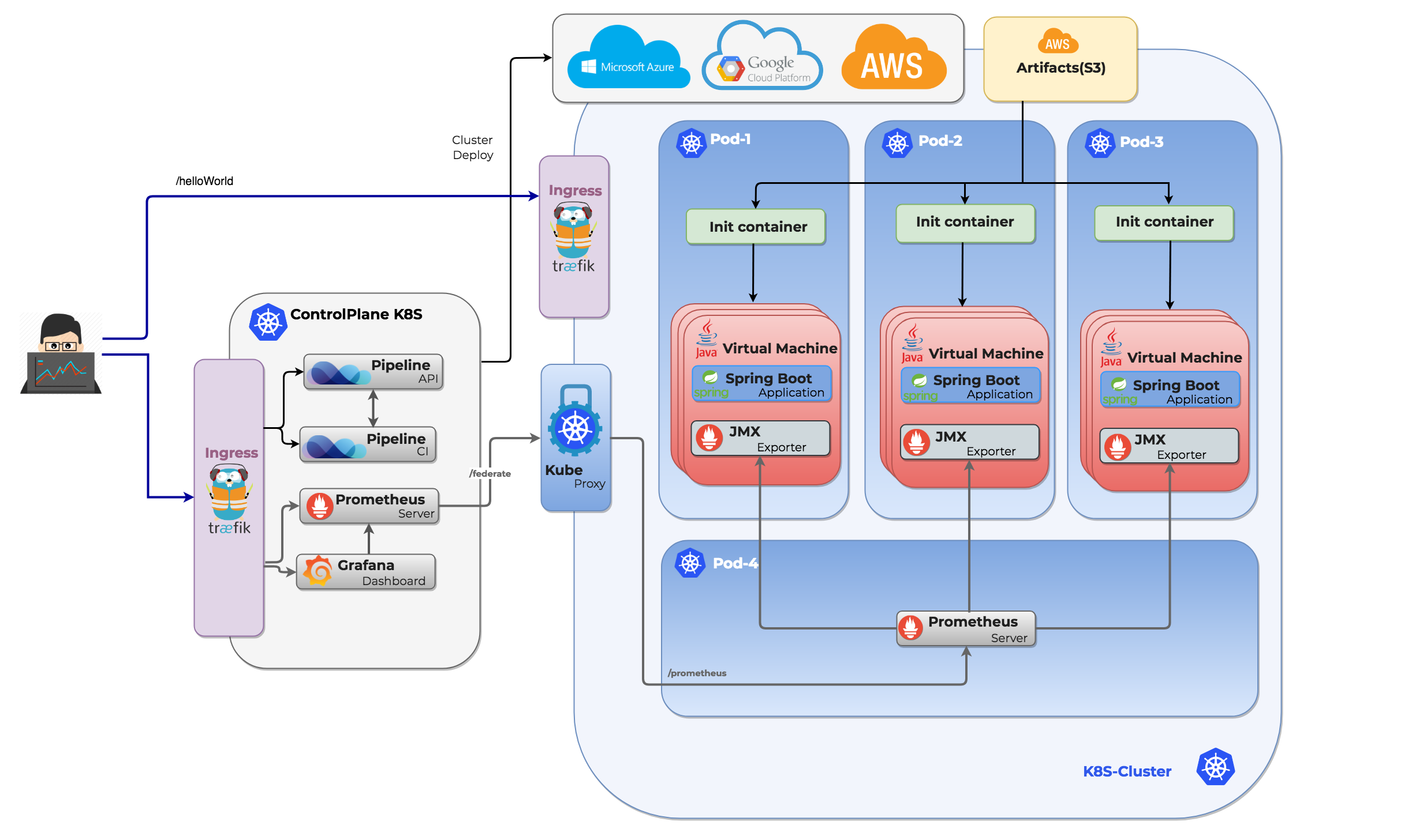
Make it possible to include

Slide 6
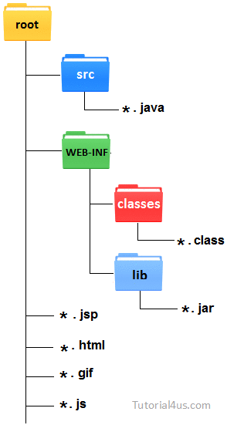
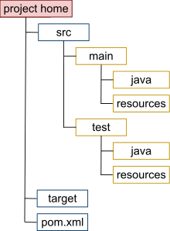
Java Structures
Java JSP Pages
Java Maven Project

Slide 7
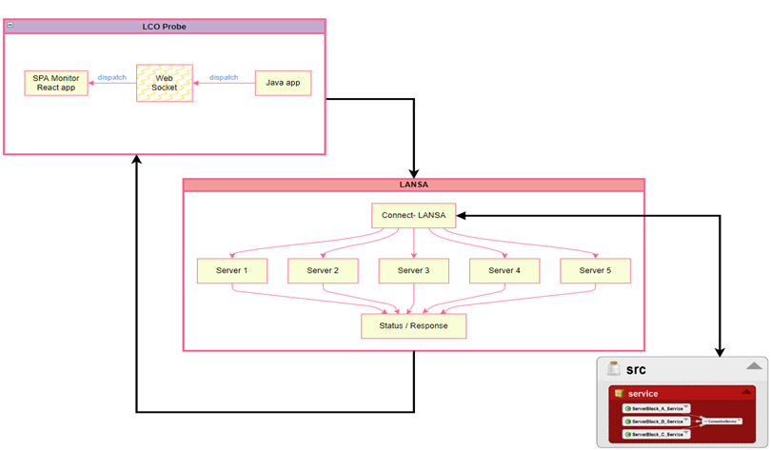
LCO Probe vs Lansa Connect

Slide 8
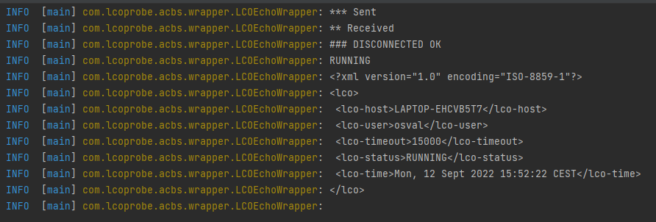
LCO response Format
LCO Probe first design, was for responding just once per call.
As its original version, the first server (configuration), returns the XML below
The current version was designed to support multiple servers monitoring
<?xml version="1.0" encoding="ISO-8859-1"?>
<lco>
<lco-host>LAPTOP-EHCVB5T7</lco-host>
<lco-user>osval</lco-user>
<lco-timeout>15000</lco-timeout>
<lco-status>RUNNING</lco-status>
<lco-time>Mon, 12 Sept 2022 15:52:22 CEST</lco-time>
</lco>

Slide 9
Servers Status Expected
INVALID CREDENTIALS
RUNNING
STOPPED
FAILED
NOT IMPLEMENTED
TIME OUT

Slide 10
LCO Probe scenarios
Single Page App Monitoring
One Time Call
Specific Profile

Slide 11
Lansa Connect executions
Lansa Connect
java –jar target/lanca-connect-check.jar
Profiles | Expected
default/Block_A | ### CONNECTED OK
Block_B | ### CONNECTED OK
Block_C | ### DISCONNECTED

Slide 12
LCO Probe executions
LCO Probe
java –jar target/LCOProbe-RealTime.jar
Features | Parameters | Expected | SPA Monitoring
SPA Monitoring | None | RUNNING | http://localhost:12000
One Time Call | <host> <user> <password> <timeout> | RUNNING | None
Specific Profile | <host> <user> <password> <timeout> <profile> | FAILED | http://localhost:12000

Slide 13
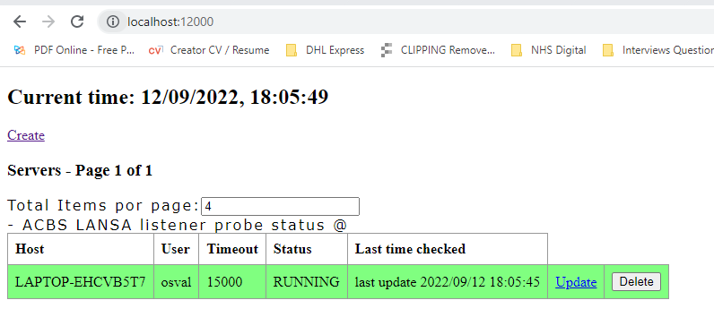
LCO Probe monitoring page
Single Page App Monitoring
Params: None
http://localhost:12000/

Slide 14
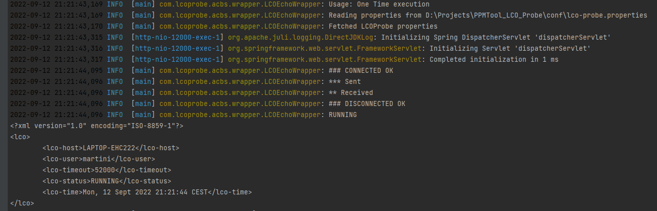
LCO Probe monitoring page
One Time Call
Params: <host> <user> <password> <timeout>

Slide 15
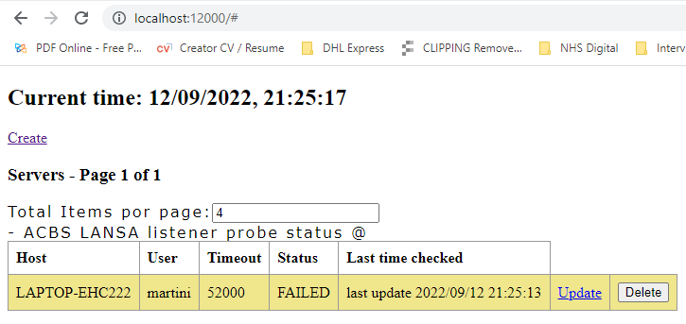
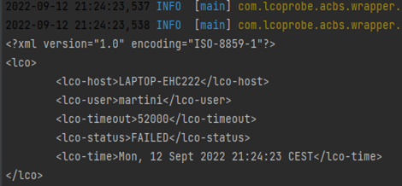
LCO Probe monitoring page
Specific Profile
Params: <host> <user> <password> <timeout> <profile>
http://localhost:12000/

Slide 16
LCO Probe features
Java 11
Spring Frameworks
WebSocket with Spring
Spring-data-Rest
Spring-data-Jpa
Thymeleaf
Hibernate
Packaging process with maven-assembly-plugin
SQL Server / H2
Embed React app
Javadoc at folder: “/Docs/Javadoc”
Logs at folder: “/Logs”
Environment Path: ("LANSA\\CONNECT") is required

Slide 17
Lansa Connect features
Java 11
Spring Boot
Packaging process with maven-assembly-plugin
Javadoc at folder: “/Docs/Javadoc”
Logs at folder: “/Logs”

Slide 18
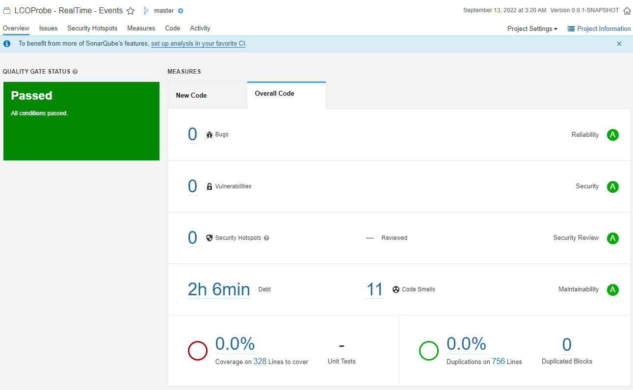
SonarQube – LCO Probe

Slide 19
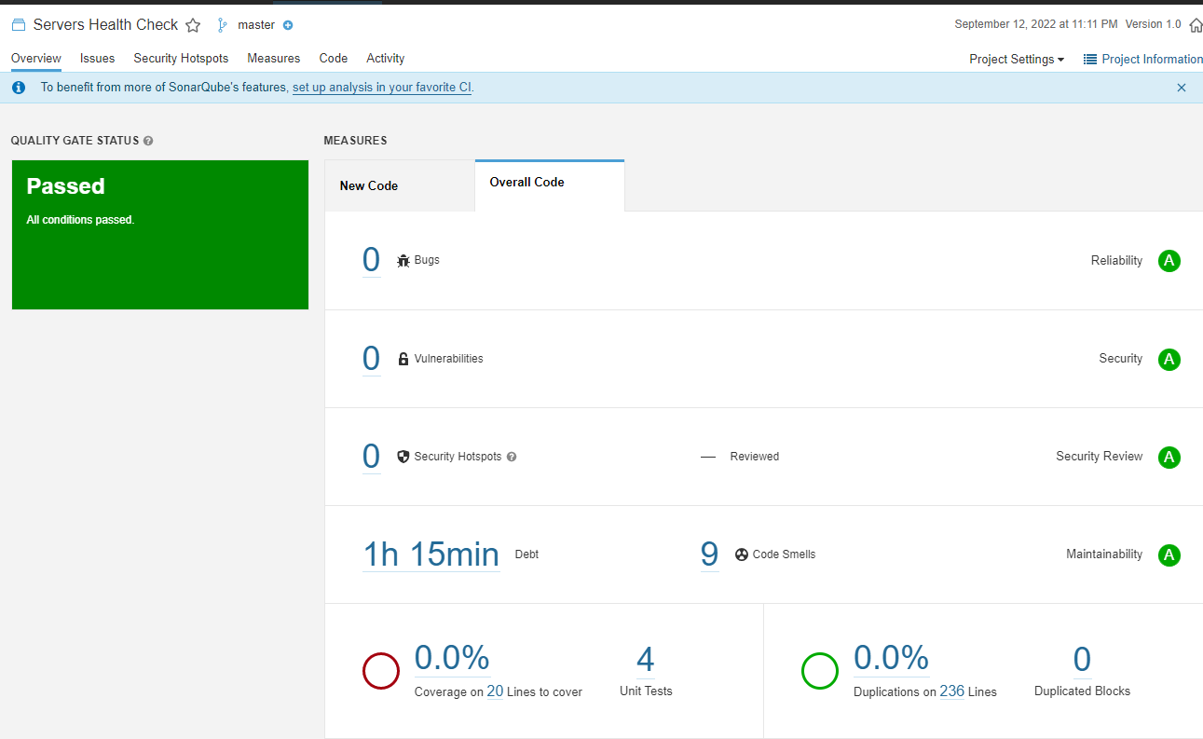
SonarQube – Lansa Connect

