Slide 1
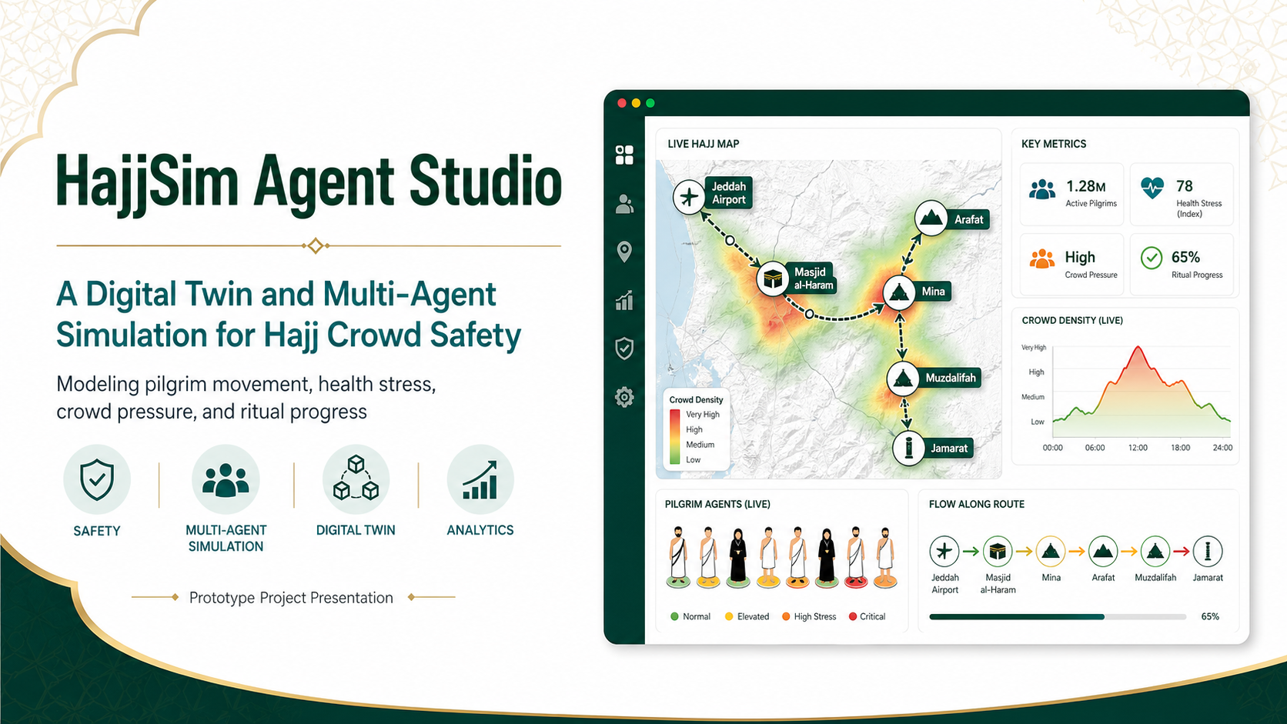
Prepared by: Osama Abutaha - Ahmad Babood
Notes:
Today, I will present HajjSim Agent Studio.,It is a prototype digital twin for Hajj crowd safety.,The system models pilgrim movement, health stress, crowd pressure, and ritual progress.,The goal is to help planners understand risk before it becomes a real problem.

Slide 2
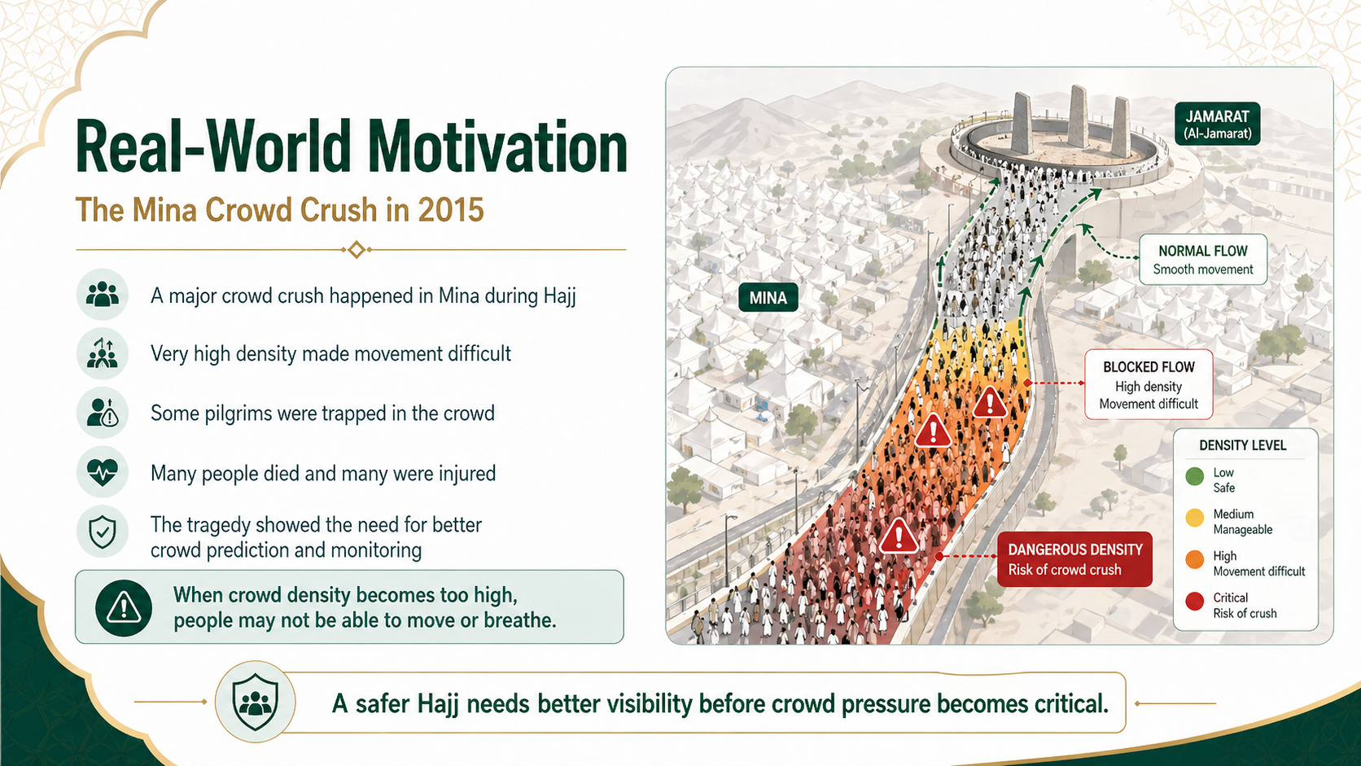
Notes:
A major example is the Mina crowd crush in 2015.,The crowd became extremely dense and movement became very difficult.,Some pilgrims were trapped, and many people died or were injured.,This tragedy shows why crowd prediction, monitoring, and simulation are important.

Slide 3
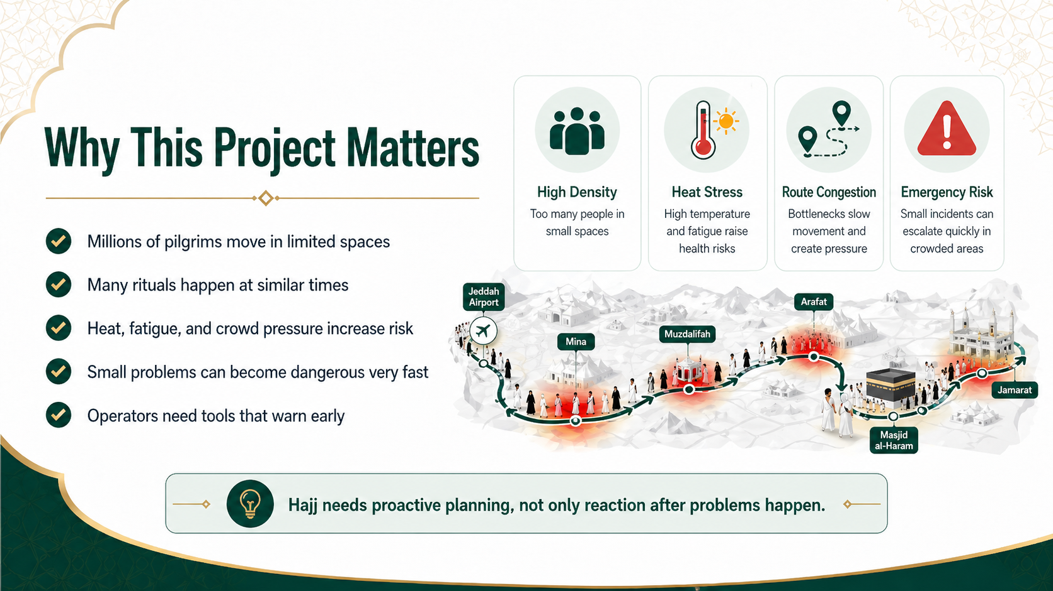
Notes:
This project matters because Hajj is one of the largest crowd events in the world.,Millions of pilgrims move through limited spaces and many rituals happen at similar times.,Heat, fatigue, route congestion, and high density can increase risk.,HajjSim helps operators see early warning signs instead of reacting too late.

Slide 4
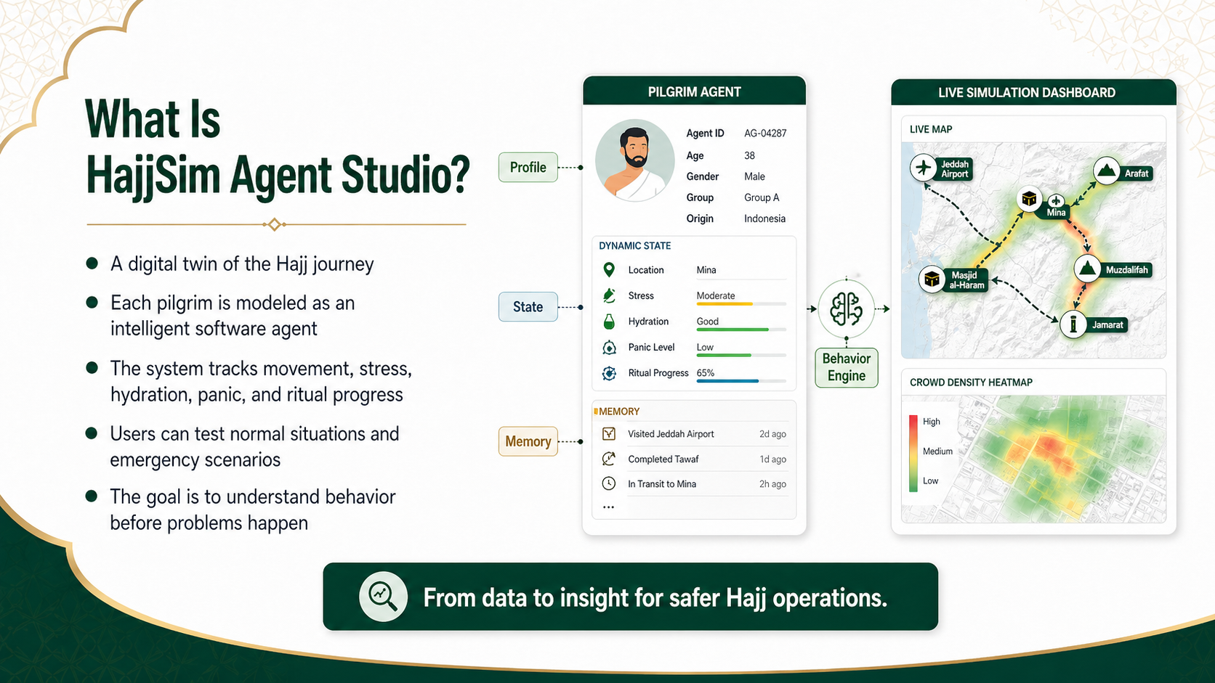
Notes:
HajjSim creates a digital version of the Hajj journey.,Each pilgrim is represented as a software agent.,The agent has a profile, a live state, and memory.,This allows the system to track stress, hydration, panic, location, and ritual progress.

Slide 5
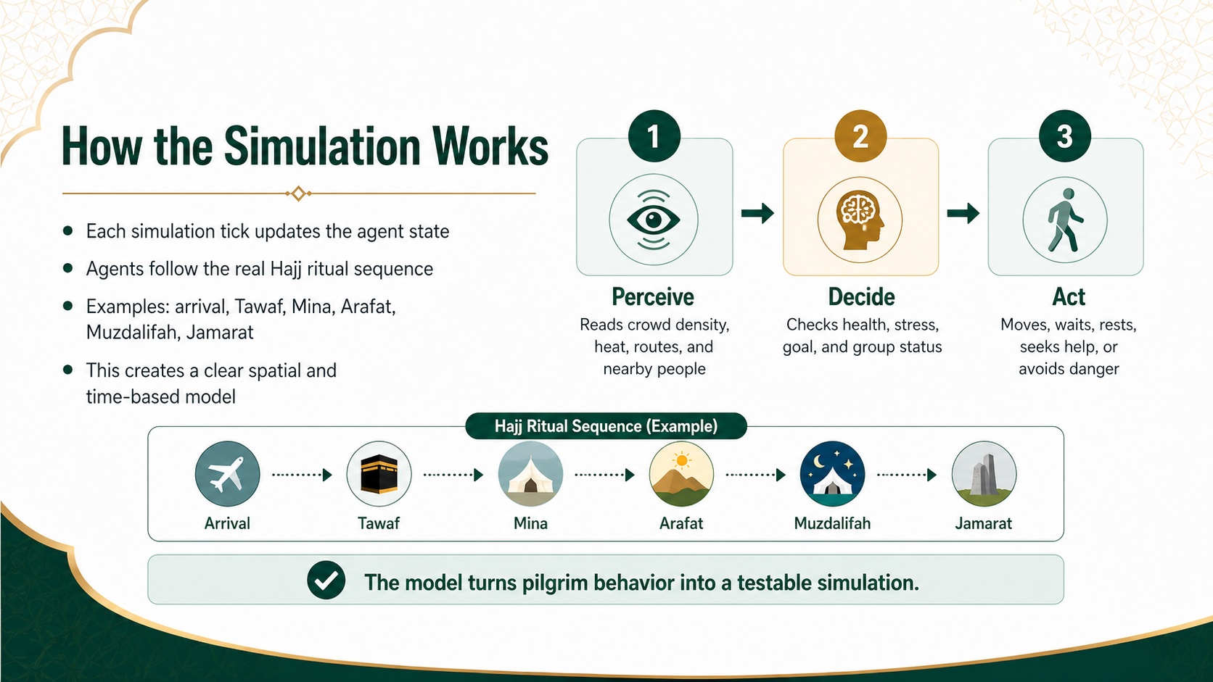
Notes:
The simulation uses a simple loop called Perceive, Decide, and Act.,First, the agent reads the environment, including density, heat, routes, and nearby people.,Second, it checks its health, stress, goal, and group status.,Third, it acts by moving, waiting, resting, asking for help, or avoiding danger.

Slide 6
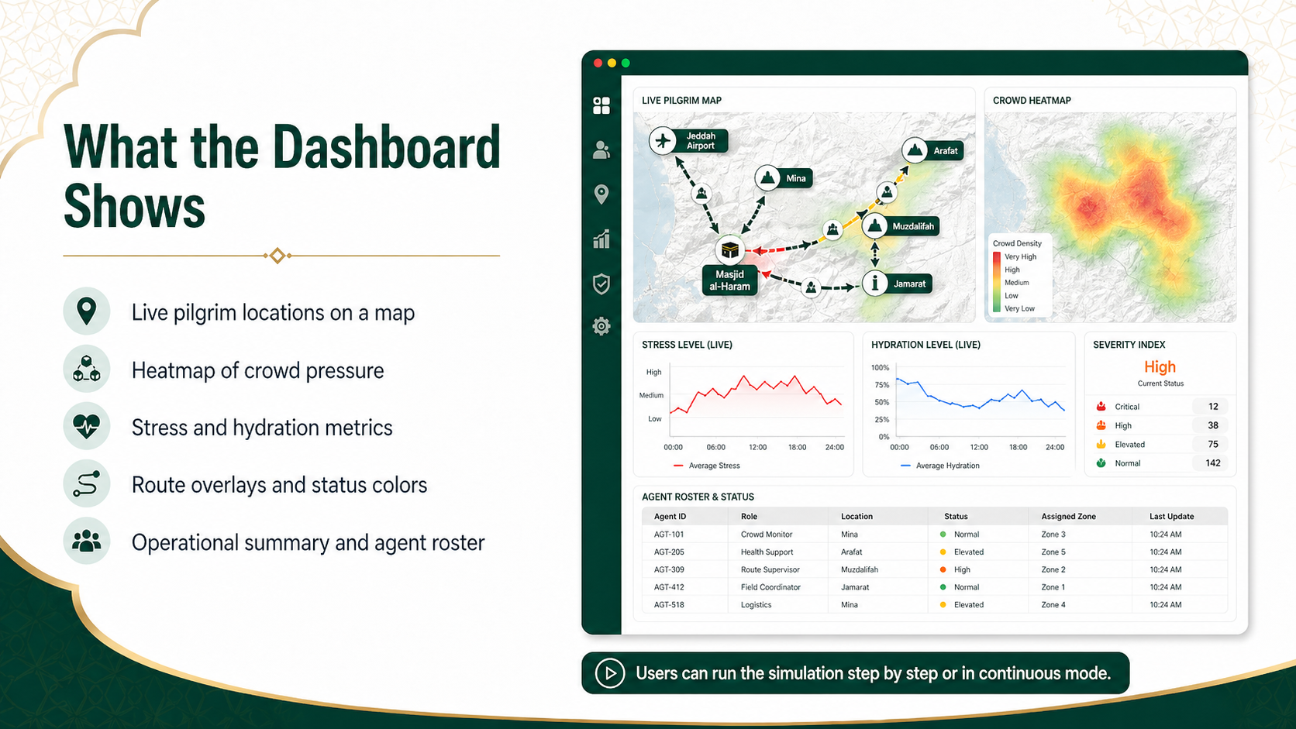
Notes:
The dashboard shows the live simulation in a clear way.,Users can see pilgrim locations, heatmaps, route overlays, stress, hydration, and severity level.,The dashboard also shows an agent roster so users can search and monitor each group or agent.,The simulation can run step by step or continuously.

Slide 7

Notes:
HajjSim can help operations teams in several ways.,It can detect bottlenecks before routes become unsafe.,It can identify vulnerable pilgrims with high stress or health risk.,It can also test emergency plans safely before using them in the real world.

Slide 8
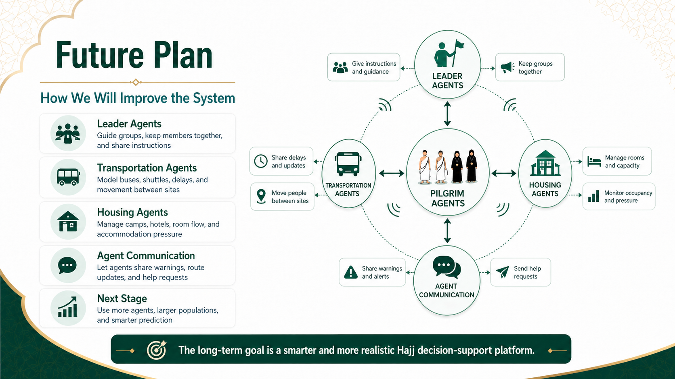
Notes:
The future plan is to make the model more realistic.,Leader agents will guide groups and keep members together.,Transportation agents will model buses, shuttles, delays, and movement between sites.,Housing agents will model camps, hotels, rooms, and accommodation pressure.,All agent types will communicate by sharing warnings, route updates, and help requests.

Slide 9
References
1. Reuters. Death toll in Saudi haj disaster at least 2,070, Reuters tally. 29 Oct 2015.
2. Associated Press. AP count: Over 2,400 killed in Saudi hajj stampede, crush. 9 Dec 2015.
3. Salamati P, et al. Hajj Stampede in Mina, 2015: Need for Intervention. 2016.
4. Alaska YA, et al. The impact of crowd control measures on the occurrence of stampedes. 2017.
5. Project source: HajjSim Agent Studio prototype description provided by the project team.
These references support the historical motivation slide. The project description and technical content come from the provided HajjSim brief.
HajjSim Agent Studio
Prototype Project Presentation
Notes:
These are the sources used for the 2015 Mina incident and crowd-safety motivation.,The rest of the presentation is based on the HajjSim Agent Studio project description.

