Slide 1
Designing for Humans
@AnandChowdhary

Slide 2
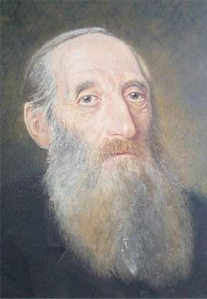

Oswald the Octopus
Public Figure
Oswald Berkhan
Identified Dyslexia

Slide 3

Winner, Code4Impact Challenge
AngelHack Delhi 2016

Slide 4
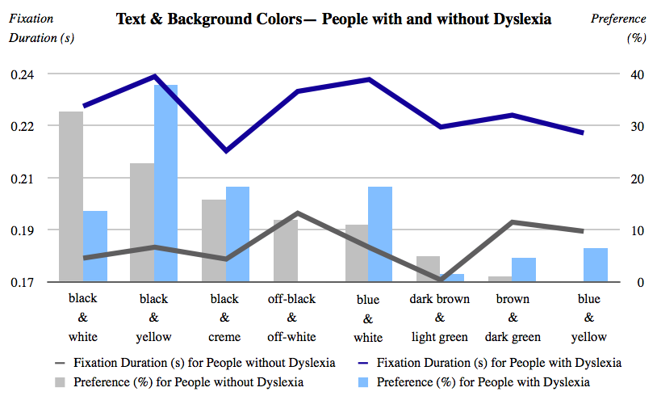
Optimal Colors to Improve Readability for People with Dyslexia by Luz Rello, & Ricardo Baeza-Yates, Pompeu Fabra University
https://www.w3.org/WAI/RD/2012/text-customization/r11

Slide 5
Volunteer

Slide 6
A good world is a world without Oswald.

Slide 7
15% people have a disability of some kind, and 10M people are diagnosed with dyslexia each year in India.
Design for Humans.

Slide 8
getoswald.xyz

