Slide 1
Default Prediction
AI-Powered Loan Application Processor
60 / 20 / 20 Train – Validation – Test Pipeline
Oscar Wang | University of Waterloo | MDS-AI

Slide 2
Pipeline Overview
generate_data.py
eda_feature_
engineering.py
training_split.py
evaluation_split.py
fairness_split.py
→
→
→
→
2,000 synthetic
applications
15 features
6 engineered
60/20/20 split
4 models compared
Honest test
metrics + plots
Employment
bias analysis
Key decisions: Exclude 164 ongoing (no label) | Fill missing docs as signal, not noise | Threshold chosen on validation only
Notes:
2000 synthetic data
each applicant having income, loan amount, employment status and a few more variables which contributes to final outcome

Slide 3
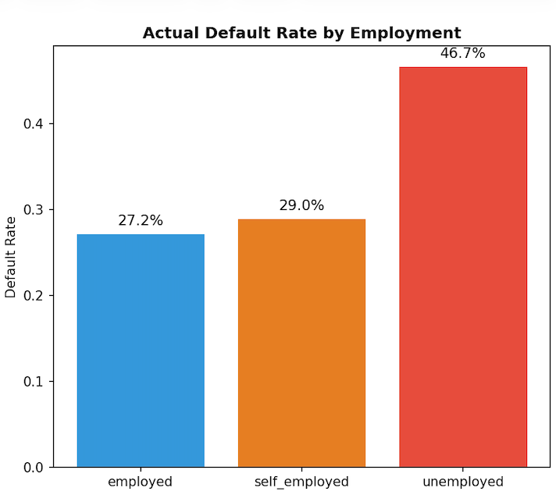
Exploratory Data Analysis
Notes:
this chart shows that employed and self employed applicants have very similiar default rate, unemployed people are having a much higher default rate aroung 47%
making employment status very vital to examine for, we will mention it again in fairness review

Slide 4
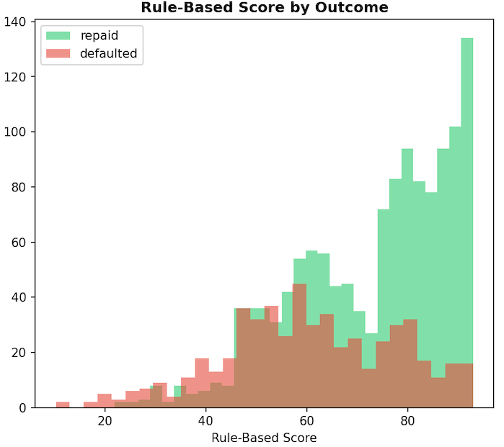
Exploratory Data Analysis
Notes:
This histogram shows that repaid applicants tend to have higher rule-based scores than defaulters, but there is substantial overlap between the two groups. So the rule system captures some risk signal, but it does not cleanly separate good and bad borrowers.

Slide 5
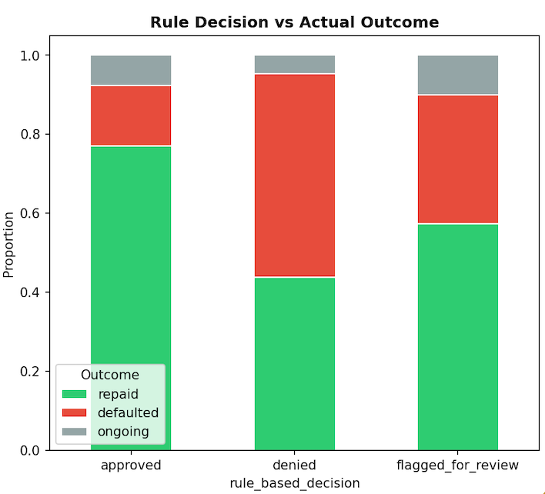
Exploratory Data Analysis
Notes:
This chart compares the rule-based decisions with actual outcomes. Approved applicants are mostly repaid, which suggests the rule system is somewhat sensible, but the denied and flagged groups still contain many mixed outcomes. That means the rule system is not fully efficient and may be missing opportunities to separate true risk more accurately.

Slide 6
Data Findings
14%
Missing documentation
Not random — people who skip docs default at 49% vs 26%.
4%
Income misrepresentation
Documented income < 50% of stated. Default rate jumps to 44%.
27% vs 29%
Employed vs Self-employed
Nearly identical default rates, but rule system treats them very differently.
47%
Unemployed default rate
Genuinely higher risk — differential treatment is defensible here.
Notes:
Nulls (283 rows with missing
documented_monthly _income): Treated the missingness as a signal,
Instead of imputing the mean or median, I created has _documentation - a binary feature that's 1 if docs exist, 0 if NaN.
This turned out to be the single most important predictor: people who skip docs default at 49% vs 26%.
Used class_weight= 'balanced' in logistic regression, which upweights the minority class (defaults) by roughly 2.3x during training. Without this, the model would learn to just predict "repaid" for everyone and get 70% accuracy while catching zero defaults.
Ongoing applications (164 rows): Dropped them. They have no outcome label - we can't train on data where we don't know the answer.

Slide 7
Feature Engineering — 15 Features
Income Verification
Affordability
Account Health
Other
has_documentation, income_ratio,
suspected_misrepresentation
income_covers_loan_3x,
stated_monthly_income, loan_amount
withdrawal_to_deposit_ratio,
low_balance, bank_has_overdrafts
employment_encoded,
bank_ending_balance, deposits, etc.
Key principle: encode domain knowledge as features. The model learns optimal weights instead of hand-tuned rules.
Notes:
this is the features i added during processing, mostly used to reflect their ratio relationship such as withdrawal to deposit ratio, and some encoding like employment encoded, emplyment as 1 , unemployment as 0, along with original inportant featres kept

Slide 8
Model Selection — Train-CV Results
Model | AUC-ROC | F1 | Notes
Logistic Regression | 0.71 | 0.52 | Best AUC, most interpretable
Random Forest | 0.67 | 0.41 | Overfits on small data
Gradient Boosting | 0.67 | 0.39 | Same issue, high variance
Neural Network | 0.61 | 0.21 | Unstable, too many params
Why LR wins: The data generation function is a weighted sum through a sigmoid — that IS logistic regression. With only 1,101 training rows and 15 features, simpler models generalize better.
Threshold selected on validation set: 0.42
Notes:
compared to random forest, gradient boost, and a simple neural network,
Logistic regression is the best algorithm here for a few reasons.
First, the dataset is fairly small after the split— only about 1,100 training cases with 15 engineered features-so a simpler model is less likely to overfit than trees or a neural network.
Second, many of the features are already high-level risk indicators like affordability,
which is exactly the kind of pattern logistic regression handles well.
third in data generation function, the default prob used to decide whehter some one will default is a weighted sum through a sigmoid, which is logistic regression formula.
We split the resolved loan data into 60% training, 20% validation, and 20% test, used the training set for model selection, the validation set for threshold tuning, and the held-out test set for honest final evaluation.

Slide 9
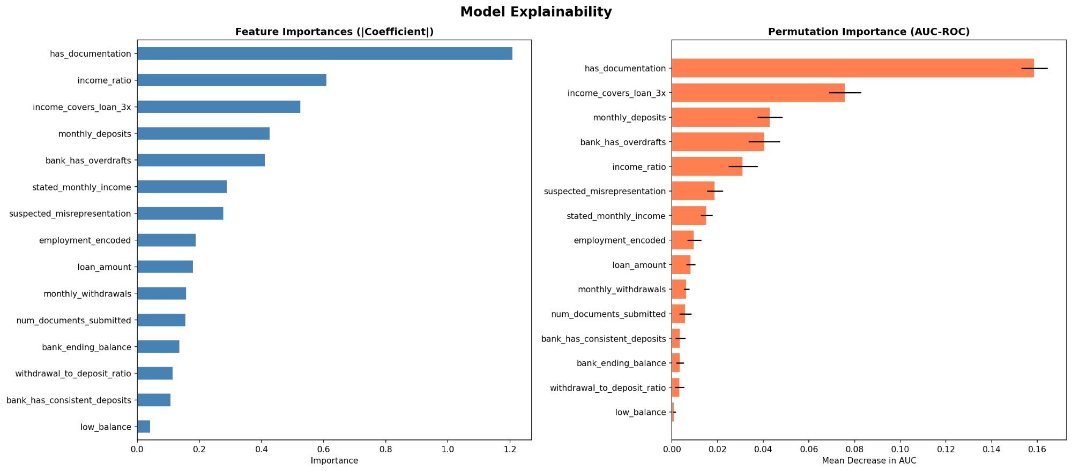
Model Explainability
Notes:
The most important feature was clearly has_documentation. After that, the strongest signals were affordability-related features like income_ratio
So overall, the model relied most on whether income could be verified, whether the loan looked affordable relative to income, and whether the applicant's bank activity looked financially stable.

Slide 10
Test Set Results — The Honest Numbers
 | ML Model | Rule (strict) | Rule (conservative)
Defaults caught | 96/109 (88%) | 36/109 (33%) | 85/109 (78%)
Good wrongly denied | 135/259 (52%) | 22/259 (8.5%) | 123/259 (47.5%)
Precision | 42% | 62% | 41%
F1 (default) | 0.56 | 0.43 | 0.54
AUC-ROC | 0.728 | 0.722 | —
The ML model catches 2.7x more defaults than the strict rule. The tradeoff: higher false positive rate. The threshold can be adjusted based on business cost of default vs lost customer.
Notes:
Compared with the strict rule baseline, the ML model catches far more defaults: 96 of 109 (88%) versus 36 of 109 (33%), so it greatly reduces false negatives. The tradeoff is that it also wrongly denies many more good applicants: 135 of 259 (52%) versus 22 of 259 (8.5%), which means a much higher false positive rate. Overall, the ML model has the best F1 for default (0.56) and slightly better AUC-ROC (0.728), so it ranks risk better and gives a stronger balance of detection performance. If deployed as-is, it would stop more bad loans but also reject many more good customers, so the threshold should be adjusted based on business tolerance for default losses versus lost applicants.

Slide 11
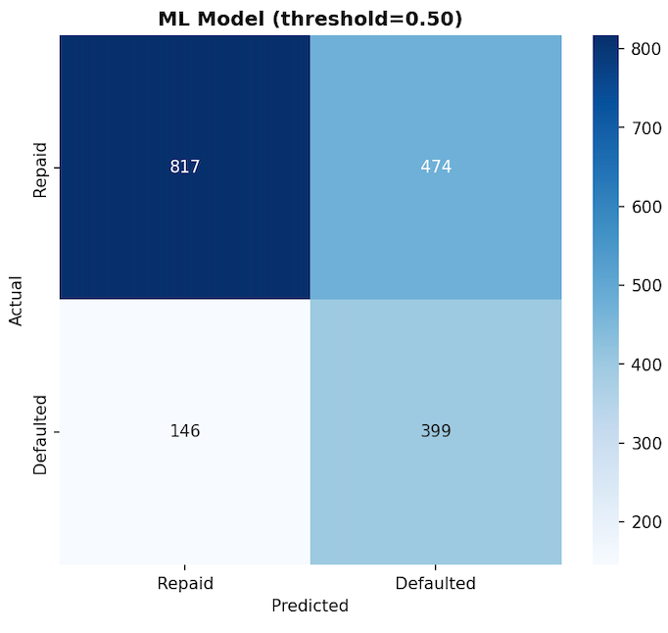
Held-Out Test Evaluation
Notes:
The confusion matrices show that the ML model catches many more real defaulters than the strict rule-based system, but it also wrongly flags many more good applicants.
This makes the tradeoff very concrete: stronger risk detection versus higher false positives.
if the lender cares most about avoiding defaults, the ML model is attractive; if the lender cares more about not rejecting good customers, the current strict rule is safer

Slide 12
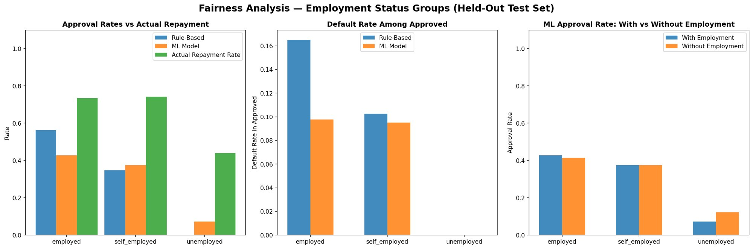
Fairness Analysis — Held-Out Test
Key finding: Removing employment_status costs only 0.007 AUC on test but reduces the employed-vs-self-employed approval gap. Recommendation: drop the feature.
Notes:
This compares approval rates with actual repayment by employment group. The key point is that employed and self-employed applicants have fairly similar repayment behavior, but both the rule-based system and the ML model still approve them at somewhat different rates,
The ML model approves a riskier pool than the rule-based system for employed and self-employed groups, which fits the earlier result that the model catches more defaults overall by being more aggressive.
This compares the ML model with and without the employment feature. The approval rates barely change for employed and self-employed applicants, and unemployed approvals rise only slightly, which suggests we can remove the explicit employment feature with very little effect on model behavior while making the system cleaner and fairer

Slide 13
What Would Go Wrong Tomorrow?
Data Drift
A recession shifts default rates. Model probabilities and threshold become miscalibrated.
Selection Bias
We only observe outcomes under the old rule system. High-risk approvals are underrepresented.
Regulatory Risk
Rule system is transparent. ML needs an interpretability layer for audits.
Threshold Sensitivity
Small score shifts cause large swings in approval rates. Needs weekly monitoring.
Recommendation: Deploy as a decision-support layer alongside the rule system. Flag disagreements for human review.

Slide 14
Summary
Logistic Regression wins — matches the data generation process, generalizes best on 1,101 training rows.
Honest 60/20/20 evaluation: catches 88% of defaults on held-out test (vs 33% for rule system).
Threshold is a business decision, not a technical one — slides between 52% and 8% FPR.
Fairness: removing employment feature costs ~0 AUC but reduces unjustified approval gaps.
Production: deploy alongside rules, not as a replacement. Monitor weekly.

