Slide 1


Marathwada Mitra mandal’s
COLLEGE OF ENGINEERING
Karvenagar, Pune
An Autonomous Institute
Presentation
On
PROJECT TOPIC
Financial Management Tool: Develop a web-based tool for personal finance management, integrating budgeting, expense tracking, and financial goal setting with a clear and intuitive interface.

Slide 2
Team
Sr.No
PRN No
Name
1
B24IT1054
Gaurav Jadhav
2
B24IT1130
Shreyash Mandlapure
3
B24IT1049
Tanushree Patil
4
B24IT1058
Sanika Pujari

Slide 3
Project Introduction
Finlytic is a mobile application designed to simplify personal finance management. Addressing the challenges of budgeting, expense tracking, and goal setting, Finlytic provides users with an intuitive platform to manage their finances effectively. Our design process, driven by UX research and user analysis, focuses on creating a user-friendly experience with clear navigation and data visualization to empower users in achieving their financial goals.

Slide 4

Project Objectives
Track Income and Expenses
Set and Monitor Goals
Users track savings goals and analyze spending habits.
Accurately monitor all transactions in real time.
User Accessibility
Simple interface for all financial literacy levels.

Slide 5
Key Features of Finlytic
User Authentication
Data Visualization
Secure login, signup, and password reset features.
Charts and graphs deliver clear financial insights.
Transaction Recording
Category Management
Easy data entry for incomes and expenses.
Organize transactions for better analysis.
Savings Goals
Support & Profile
Set and monitor personal financial targets effectively.
User-friendly profile settings and help resources.

Slide 6
Requirements: Functional & Non-Functional
Functional Requirements
Non-Functional Requirements
User authentication and password reset
Data encryption and security
Transaction recording capabilities
Intuitive, accessible navigation
Visualization with charts and graphs
Fast loading and responsiveness
Savings goal tracking
Reliable and accurate data handling
Category and profile management
Scalable for growing user base

Slide 7
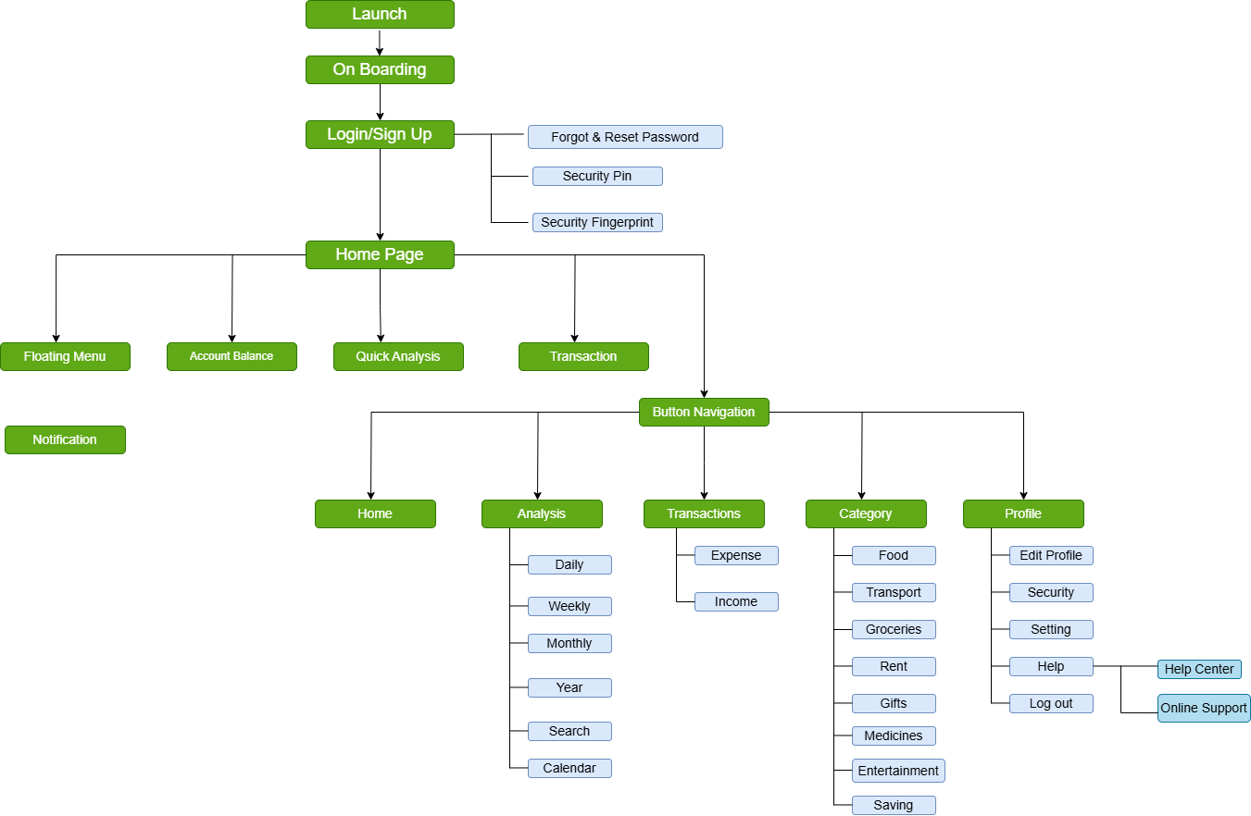
Task Flows

Slide 8
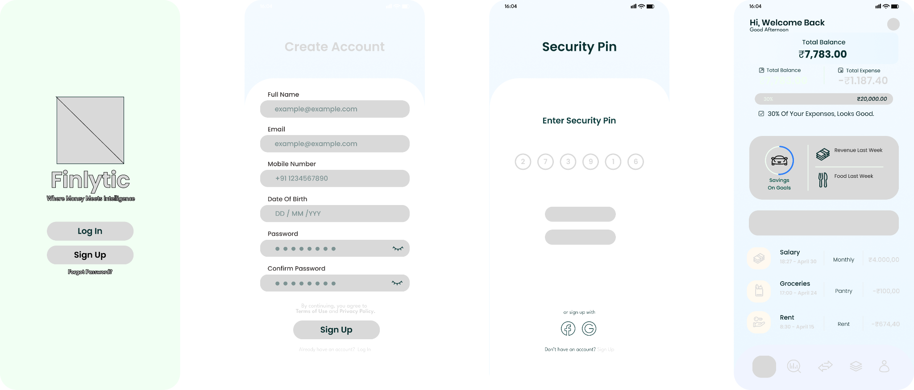
Low-Fidelity Wireframes

Slide 9
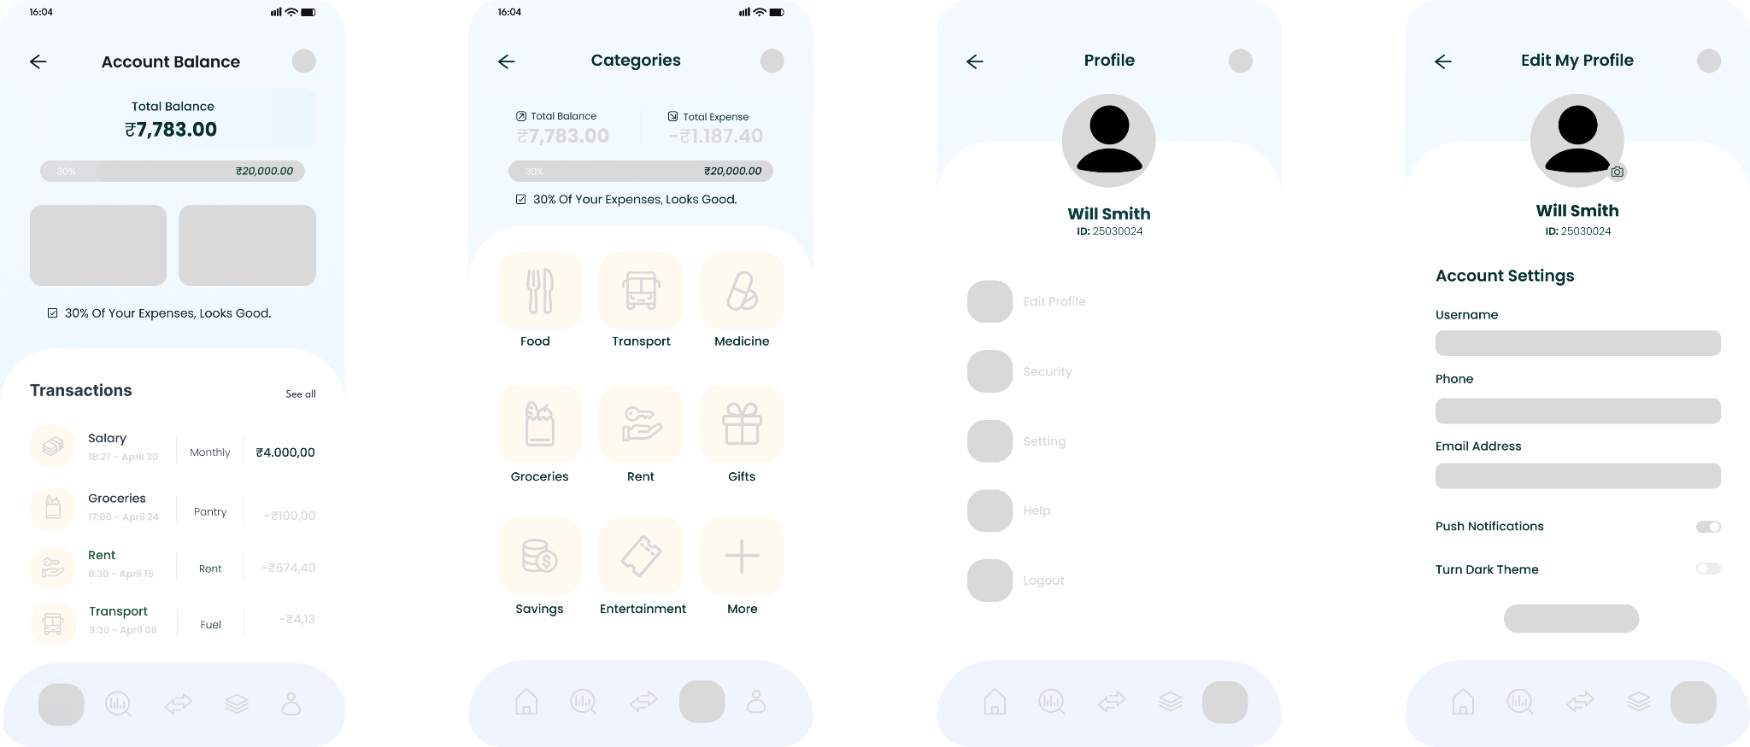
Low-Fidelity Wireframes

Slide 10
Links
Low Fidelity
High Fidelity
Video
Github

