Slide 1
Typing Tutor
Project Presentation
Gaurav Jadhav

Slide 2
Objective
- Help users improve typing speed and accuracy
- Provide a fun and interactive typing experience

Slide 3
Features & Functionality
- Typing Test Mode
- Practice Mode
- Real-time Speed and Accuracy Display

Slide 4
Technology Stack
- HTML, CSS, JavaScript
- Google Fonts, FontAwesome
- LocalStorage (for theme persistence)

Slide 5
Challenges & Solutions
- Challenge: Accuracy calculation issues
- Solution: Adjusted event listeners to improve real-time calculation

Slide 6
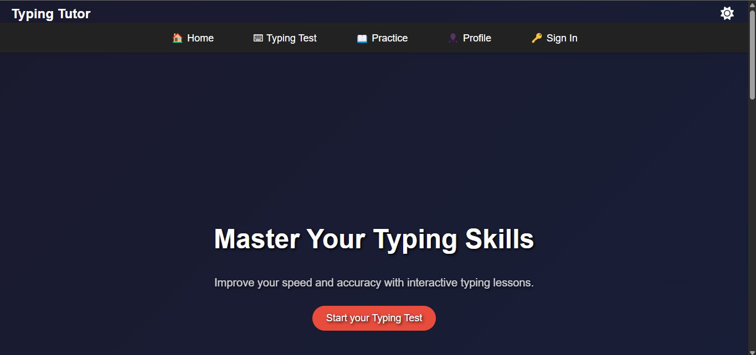
Demo/Results

Slide 7
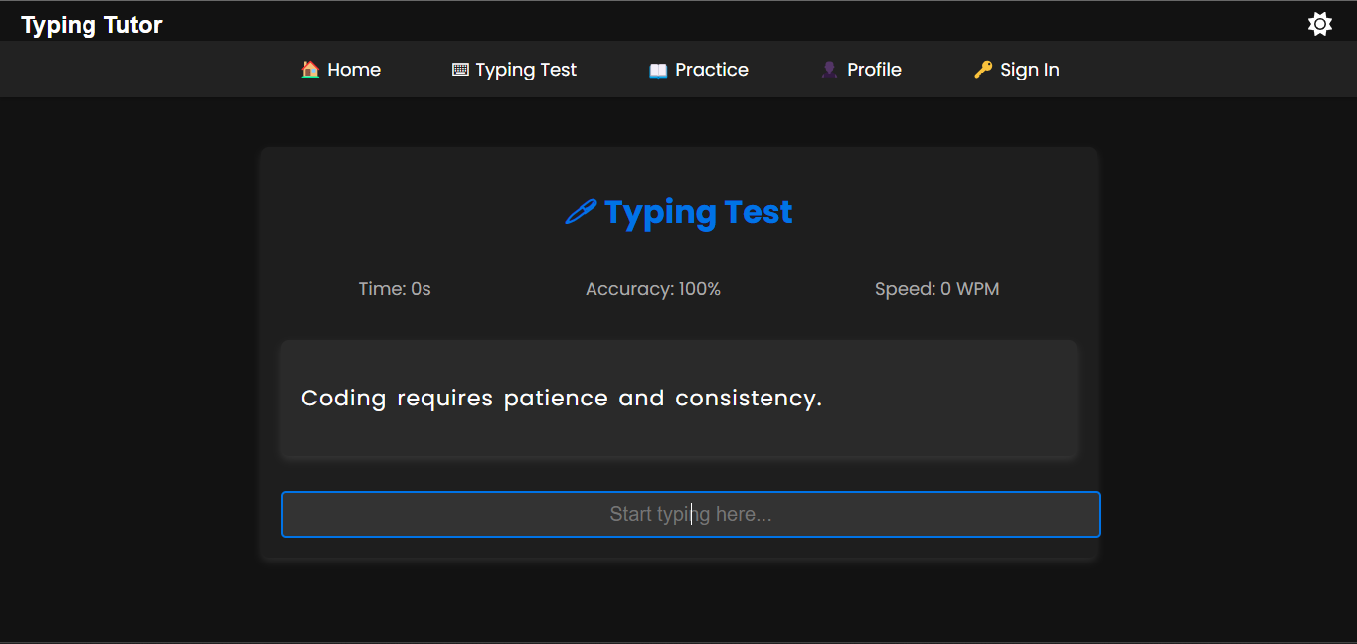
Demo/Results

Slide 8
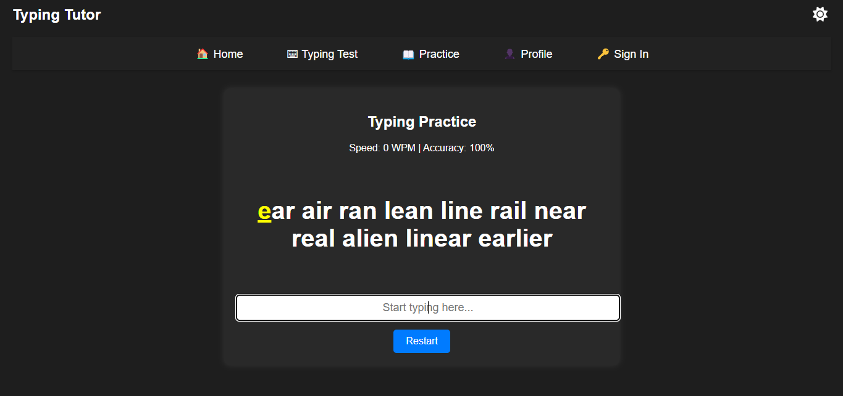
Demo/Results

Slide 9
Conclusion & Future Scope
- Learned: Improved coding and debugging skills
- Future Scope: Add different difficulty levels, more themes and add multiplayer mode.

