Slide 1
SEMANTIC ARENA / LIVE PILOT
Vector search,
head to head.
11,648
indexed chunks
4
latency queries
Apache Solr × Meilisearch
qwen3-embedding:8b • 4,096-dimensional vectors
5 × 3
trials × repeats
A controlled vector-search latency comparison
27 OCT 2026
PILOT RESULT — NOT A UNIVERSAL RANKING

Slide 2
A fair comparison starts with shared inputs
Vector retrieval only — indexing, embedding, fusion, and answer generation are not in query latency.
01
02
03
04
Same corpus
Same vectors
Same query
Measured output
11,648 chunks from zbdoc.
One shared qwen3-embedding:8b query vector per question.
Top-10 vector-only retrieval; no lexical search or RRF.
Four fixed queries; latency measured without making quality claims.
Alternating engine order • 1 warm-up/query • 5 trials • 3 measured repeats/query/trial
SEMANTIC ARENA / VECTOR SEARCH PILOT / 27 OCT 2026
02

Slide 3
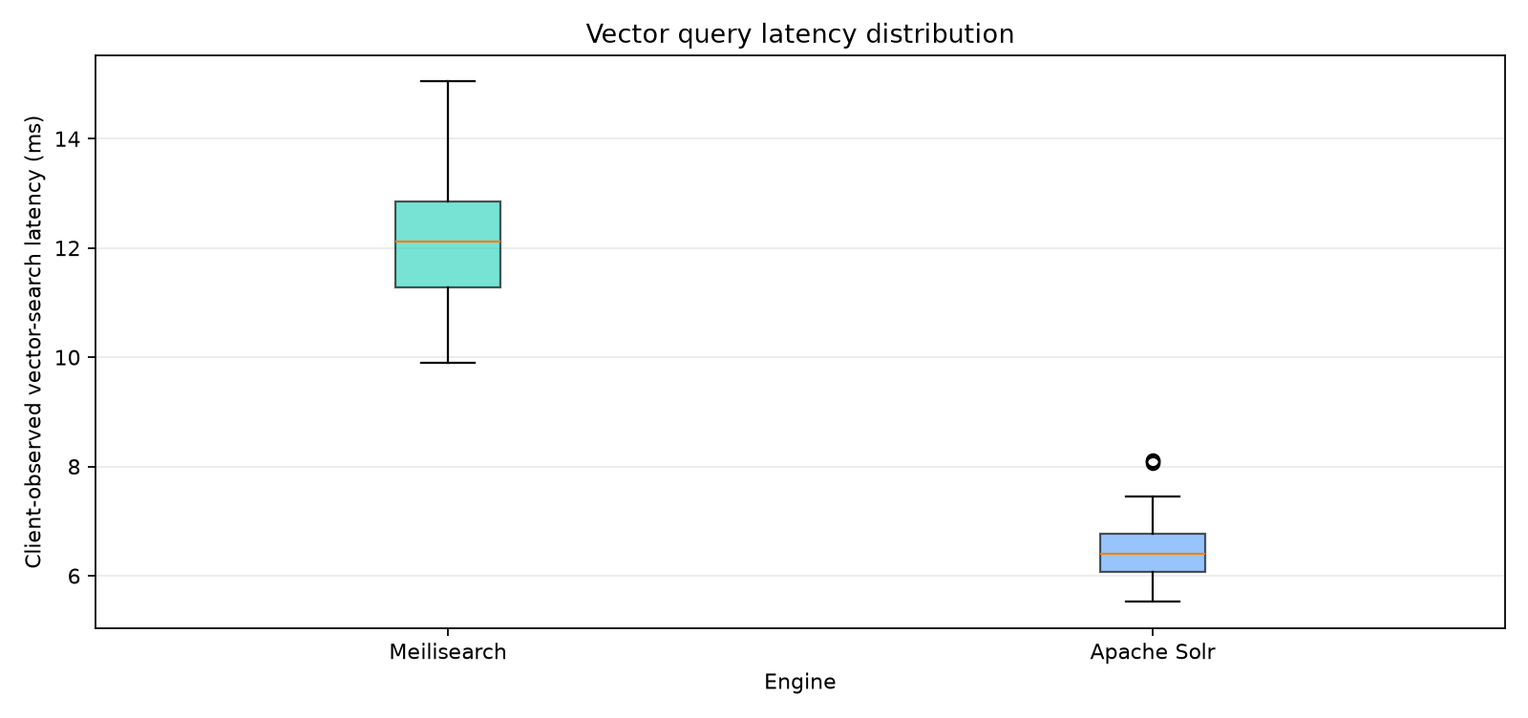
On this pilot, Apache Solr had lower mean latency
Client-observed latency across successful vector-search requests; lower is faster.
Meilisearch
60 measured requests
Apache Solr
60 measured requests
12.09
6.47
ms mean
ms mean
p50 12.08 ms p95 14.05 ms
p50 6.36 ms p95 7.45 ms
1.9×
Apache Solr lower mean latency
Measured in this setup only.
SEMANTIC ARENA / VECTOR SEARCH PILOT / 27 OCT 2026
03

Slide 4
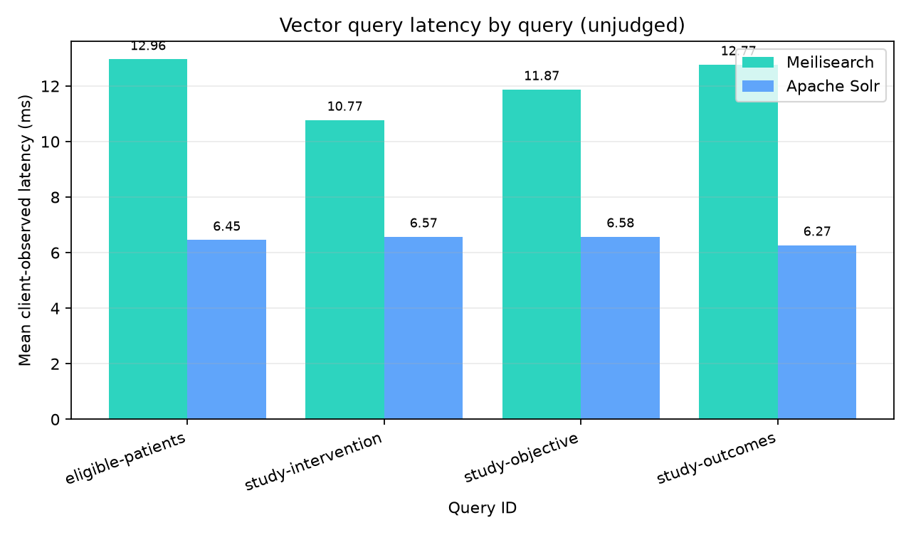
Latency by query — retrieval quality not scored
No reviewed relevance judgments were supplied; these charts make no recall or ranking claims.
4
fixed test queries
No qrels supplied
Latency is reported; Recall, MRR and nDCG are intentionally omitted.
Query phrases cover study objectives, patient groups, interventions and outcomes.
SEMANTIC ARENA / VECTOR SEARCH PILOT / 27 OCT 2026
04

Slide 5
What this result does — and does not — say
A presentation-ready smoke test is not a production-scale engine benchmark.
What we measured
What we did not measure
Vector query latency
Client-observed, sequential calls on one local host.
Top-1 relevance
Latency only; no relevance judgments were supplied.
Controlled inputs
Same Ollama model, dimensions, and query vectors.
Scale
11,648 indexed chunks and 4 queries.
Concurrency
No load test, query throughput, or saturation point.
Server resources
No CPU, RAM, disk, or server-only timing.
Treat latency as a local pilot result—not a universal winner.
SEMANTIC ARENA / VECTOR SEARCH PILOT / 27 OCT 2026
05

Slide 6
Next: turn the pilot into a decision-grade comparison
Keep the same controls; increase query coverage, corpus scale, and workload realism.
01
Grow the qrels
02
Test realistic scale
Build 100–300 representative queries; have a reviewer judge relevant chunks.
Use the target corpus size and identical chunk/vector inputs.
03
Add concurrency
04
Report trade-offs
Measure p50/p95/p99, throughput, errors, and resource use at target load.
Compare quality and latency together; repeat on the intended hardware.
Reproducible run: 5 trials × 3 repeats • query embeddings shared • engine order alternated
SEMANTIC ARENA / VECTOR SEARCH PILOT / 27 OCT 2026
06

