Slide 1
History of AI in Video Games

Slide 2
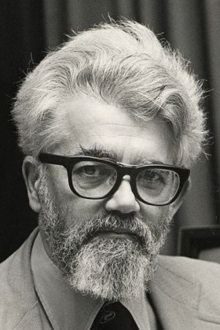
So What is Artificial Intelligence?
The Term Artificial Intelligence was Coined by John McCarthy in 1956
As a Noun:
The Intelligence of Machine
As a Field:
The Science of Engineering and Making Intelligent Agents
This Photo by Unknown Author is licensed under CC BY-SA-NC

Slide 3
Overview
How does AI apply to games
Trends Through the History of Video Games
Highlight certain AI Techniques and trends
Go through pitfalls of AI development in Game Industry

Slide 4
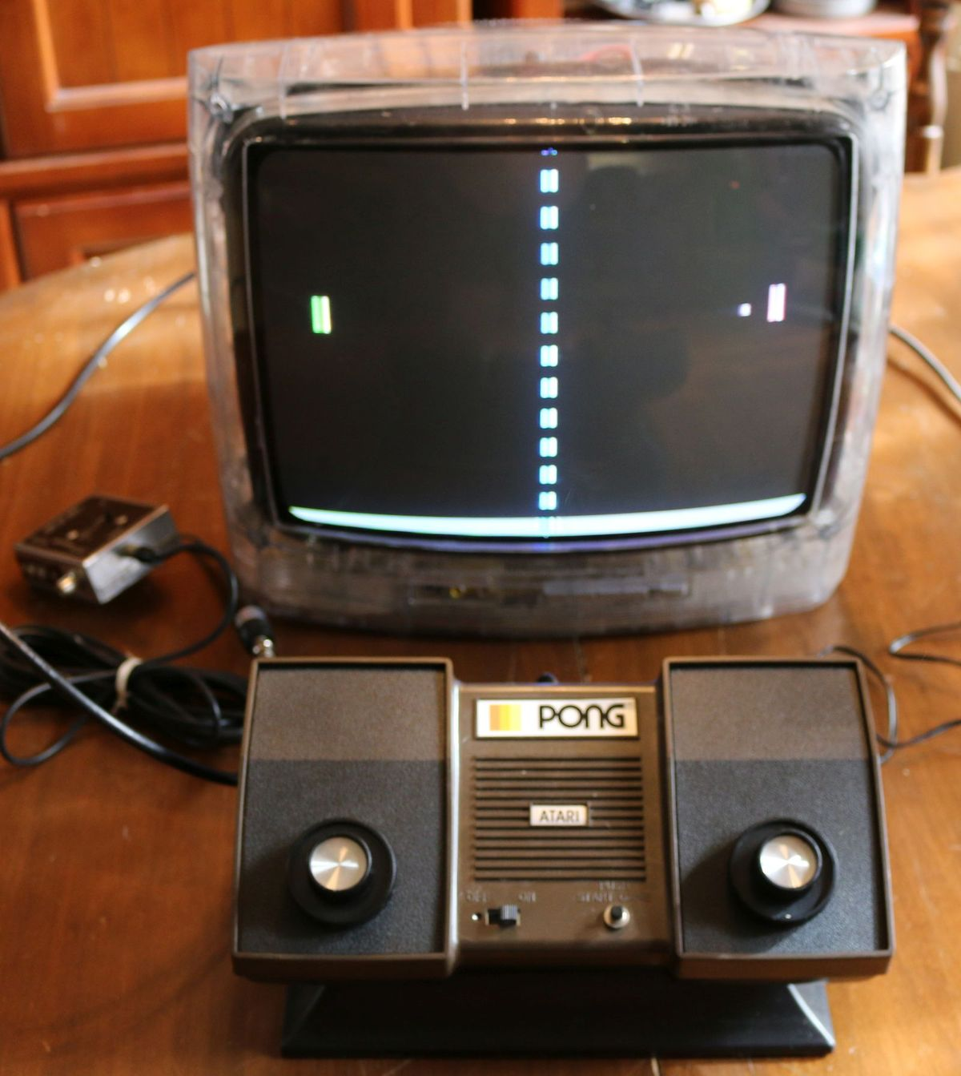
Pong
The First Commercial Video Games
Manufactured by Atari
Released in 1972
Designed for 1 or 2 players
This Photo by Unknown Author is licensed under CC BY-SA-NC

Slide 5
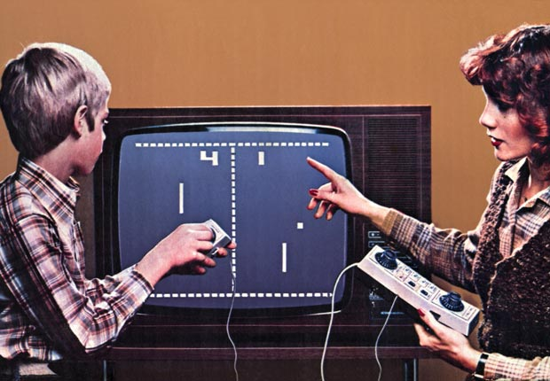
The AI of Pong
There is Logic How the Computer moves the paddle
The computer predicts where the ball will ends up based on the number of factors then move the paddle to predicted location
To simulated Human error the computer is designed to skip its adjustments every 8 frames
This Photo by Unknown Author is licensed under CC BY-SA-NC

Slide 6
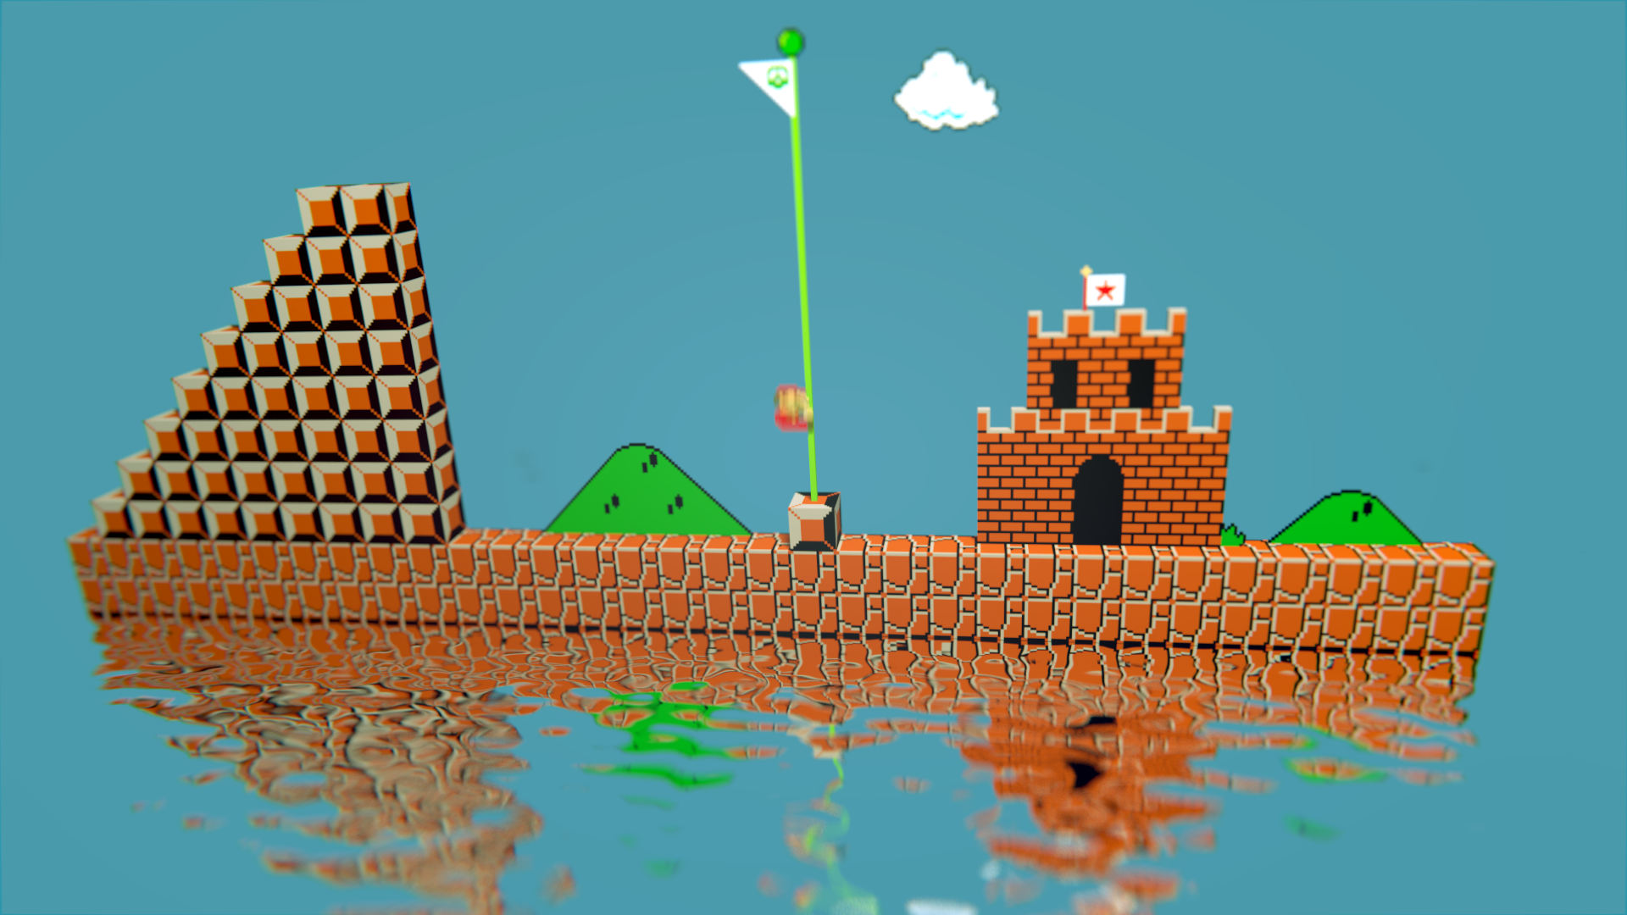
Super Mario Bros.
Developed by Nintendo
Released in 1985
Classic example of the Platformer
This Photo by Unknown Author is licensed under CC BY-NC-ND

Slide 7

Scripted Ai
Enemy units in the game are designed to follow a scripted pattern
Either move back and forth in given location or attack a player if nearby
Became a staple technique for AI design

Slide 8
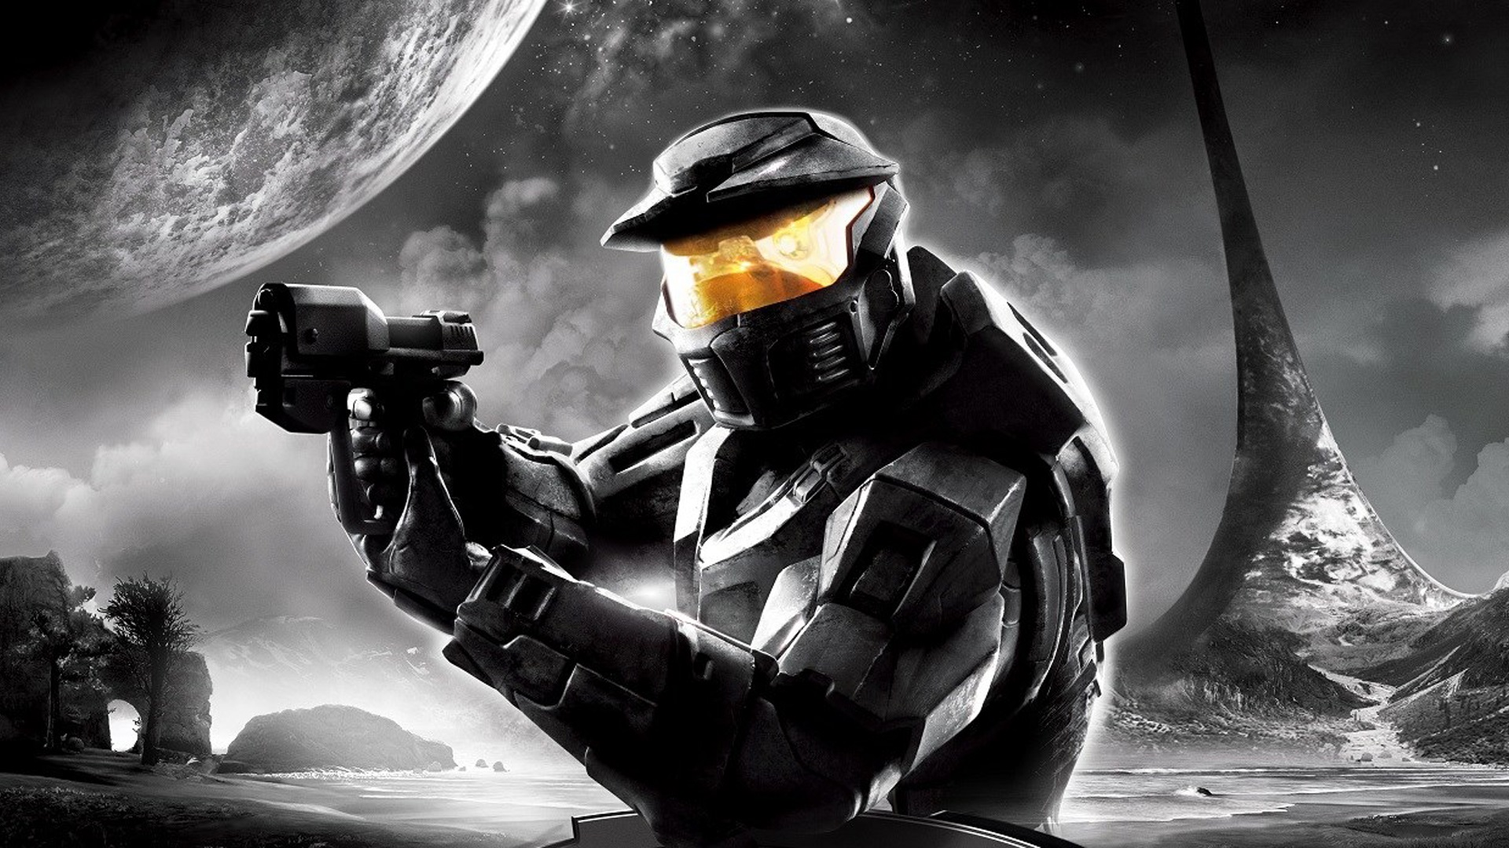
Halo: Combat Evolved
Developed by Bungi
Published by Microsoft
Release in 2001
FPS that garnered fame for competently bring genre to Consoles
This Photo by Unknown Author is licensed under CC BY

Slide 9
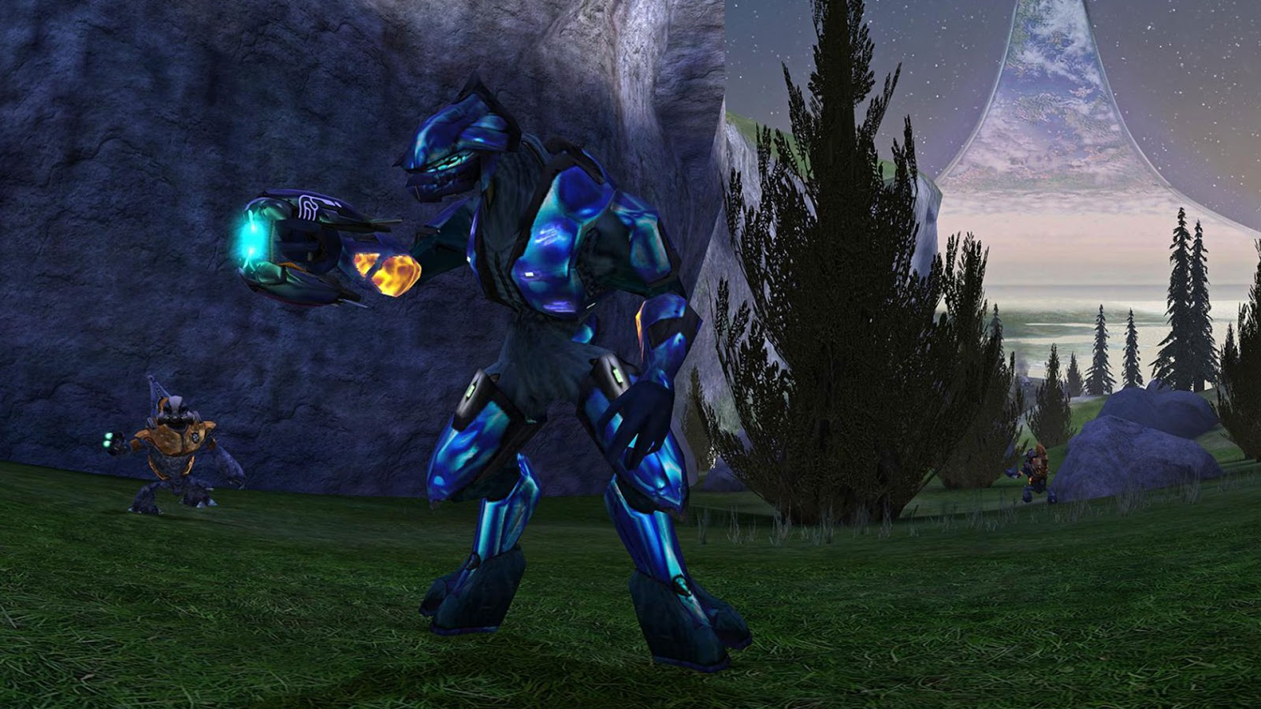
Dynamic Enemy AI
Enemies reacted in dynamic ways
Different enemies would react differently in different situations
Enemies would work together against the played (try surviving in legendary)
This Photo by Unknown Author is licensed under CC BY-SA

Slide 10

So How is this possible?

Slide 11
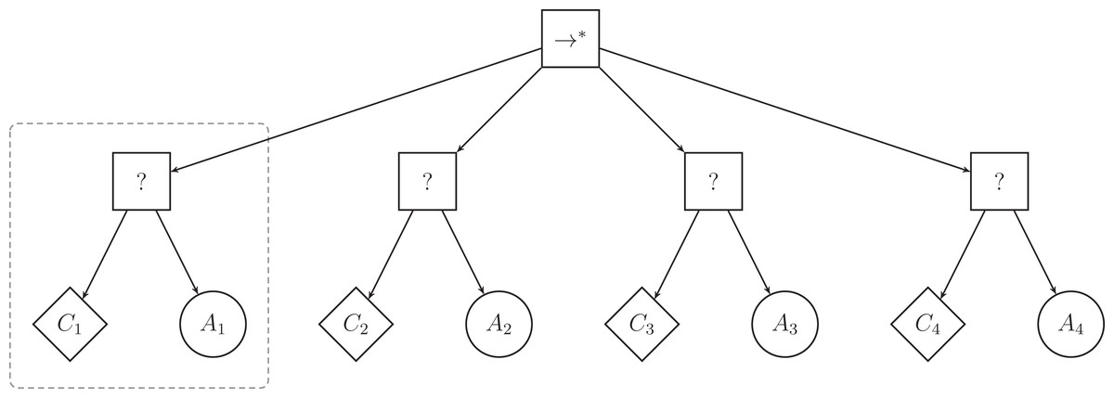
Behaviour Trees
This Photo by Unknown Author is licensed under CC BY
This Photo by Unknown Author is licensed under CC BY

Slide 12
Task
Condition
Action
Represent read only function
When AI unit observes some information about its environment
E.g Searching for enemies or nearby cover, determining orientation etc.
Represent actual performed functions
Generally represented in graphical representation
E.g Firing on an enemy, throwing a grenade, reloading etc.

Slide 13
Sequences and Selectors
Sequences
Selectors
Represent a group of task that must be carried out in order for the overall task to complete
Ultimately only carry out one task until it finds the correct task for the situation
Flow of execution

Slide 14
?
Go to College
Go Home
Walk
Train
Walk
Train
Station ka straing road
Depends on context
Station Right wala straing road
Wait 10 min
6.54 wali train
7.10 wali train
Station ka straing road
Station Right wala straing road

Slide 15
Bottom Line
Pros
Cons
Allows AI to act in dynamic ways depending on situation
Designer to group different action for different situation
Enemy differentiation
Time consuming to generate
Complex
Running through all the possible action can take a lot of time

Slide 16
Thank You

