Slide 1
SENTIMENT ANALYSIS OF E-COMMERCE AND SOCIAL MEDIA COMMENTS
Date:17/2/25

Slide 2
OBJECTIVES
E-commerce and social media generate vast customer feedback, but manual analysis is inefficient. Traditional sentiment analysis methods are complex and lack real-time insights. This research aims to develop an automated system that helps businesses track sentiment trends, improve customer engagement, and make data-driven decisions efficiently.
Develop an Automated Sentiment Analysis System – Build a tool to analyze customer feedback from e-commerce and social media.
Provide Real-Time Sentiment Insights – Enable real-time sentiment tracking and visualization.
Improve Business Decision-Making – Help businesses leverage sentiment data for strategic decisions.
Enhance User Accessibility – Design a user-friendly system for both technical and non-technical users.
Detect Emerging Consumer Trends – Identify sentiment patterns to predict market trends.

Slide 3
MODULES
1. Data Collection and Preprocessing
Gather reviews and comments from e-commerce platforms and social media.
Clean, tokenize, and normalize text for analysis.
2. Sentiment Classification
Use machine learning or deep learning models (e.g., SVM, LSTM) to categorize sentiments as positive, negative, or neutral.
3. Feature Extraction
Apply NLP techniques like TF-IDF, word embeddings, or BERT to extract meaningful insights from text data.

Slide 4
MODULES
4. Visualization and Reporting
Generate dashboards with sentiment trends, word clouds, and statistical analysis for better decision-making.
5. Performance Evaluation and Optimization
Assess model accuracy using precision, recall, and F1-score.
Fine-tune models to improve sentiment prediction

Slide 5
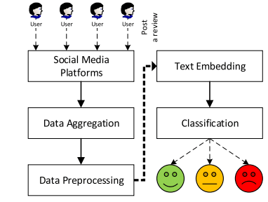
ARCHITECTURE DIAGRAM

Slide 6
PRPOSED METHODOLOGY
1. Sentiment Classification - Utilize VADER or TextBlob for fundamental sentiment classification and apply spaCy or Transformers for enhanced deep learning-based sentiment detection.
2. Data Processing & Storage - Process textual data using Python (Pandas, NumPy) and store structured information in SQLite or PostgreSQL for efficient retrieval and management.
3. Machine Learning Implementation - Integrate scikit-learn models for basic sentiment classification, allowing optional implementation of advanced machine learning models.

Slide 7
4. Dashboard Development & Visualization - Leverage Dash or Streamlit to design an interactive dashboard while using Plotly or Matplotlib for comprehensive sentiment visualizations.
5. Backend Development & API Integration - Deploy Flask or FastAPI for seamless backend operations, enabling real-time sentiment analysis and user interactions.
6. Deployment & Hosting - Implement containerization with Docker and host the application using cloud services like HTML and Git for scalable deployment.

Slide 8
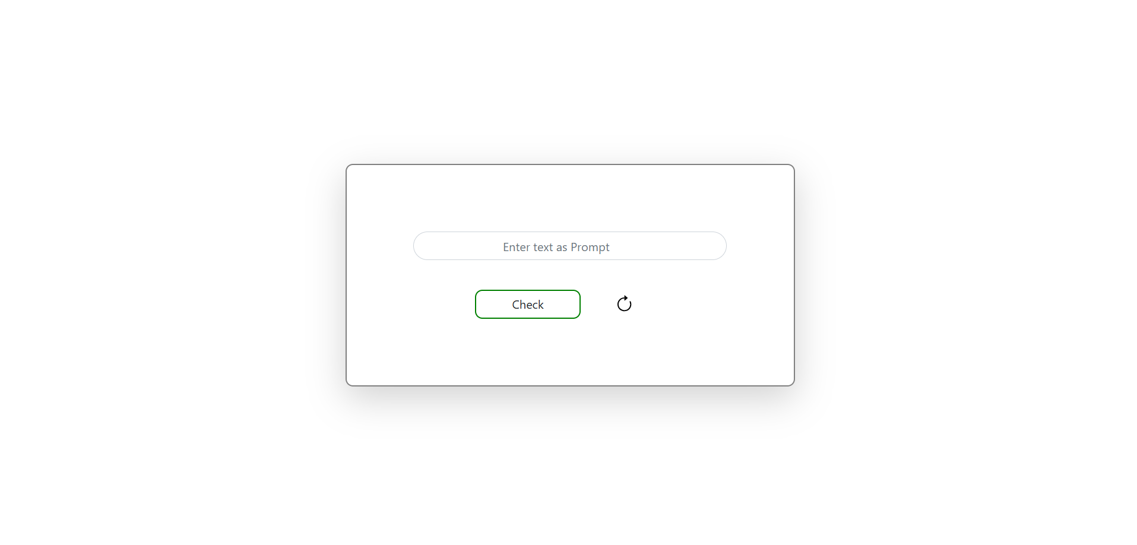
EXPECTED OUTPUT

Slide 9
