Slide 1
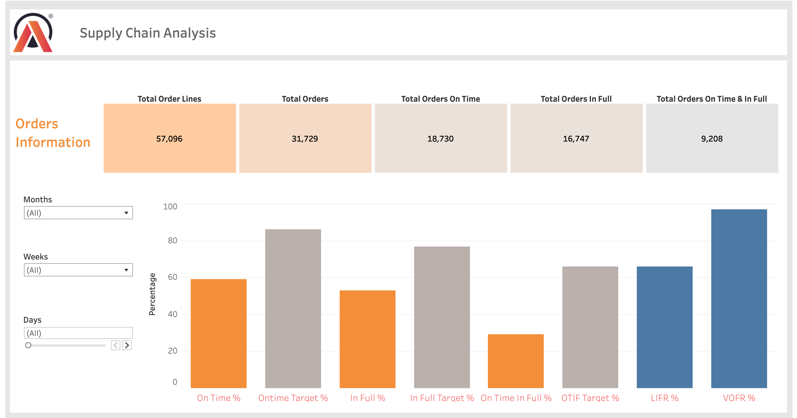
Insights
&
Key Findings
1
Even though LIFR% is low (~65%), VOFR remains high (~97%). Thus, even though only 65% of order lines were fully shipped, around 97% of the total qty of items ordered were shipped.
2
On average OT%, IF%, and OTIF% are much lower than their targets.

Slide 2
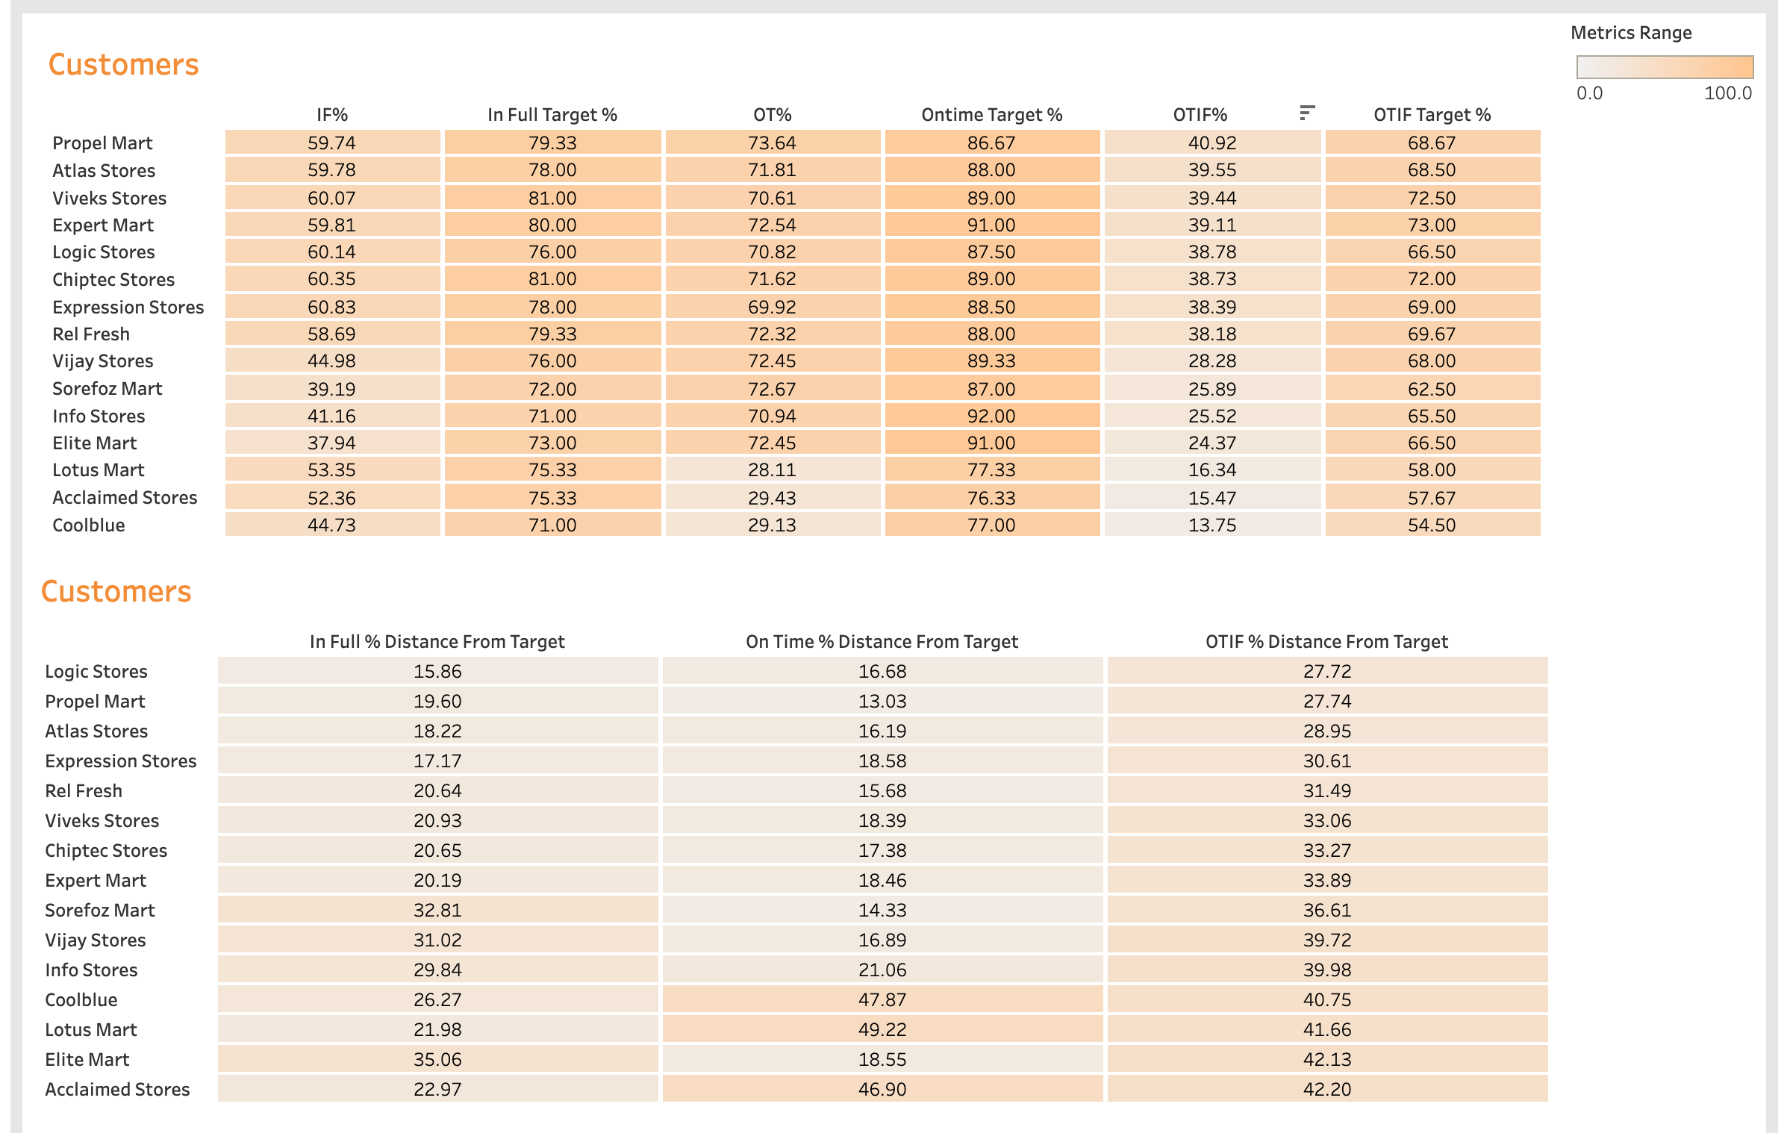
Insights
&
Key Findings
Coolblue, Acclaimed Stores, and Lotus Mart have the worst OTIF%. Additionally, they have an OT% less than 30%, thus, more than 60% of their orders come late!
1
Logic Stores and Propel Mart have the closest OTIF% with respect to their target. Meanwhile, Acclaimed Stores has the furthest OTIF% with respect to their target.
2

Slide 3
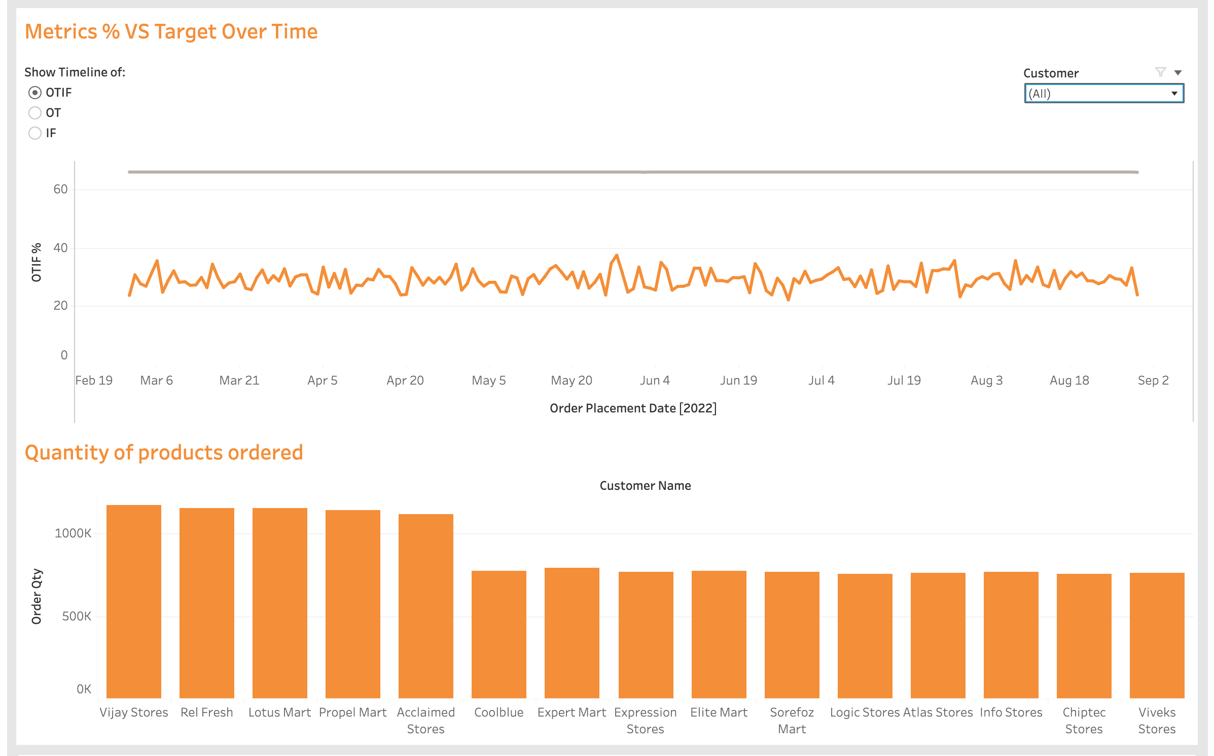
Insights
&
Key Findings
The average OTIF% never reached the average OTIF% target on any day.
1
2
Vijay Stores, Rel Fresh, Lotus Market, Propel Mart, Acclaimed Stores, and Coolblue seem to be the key customers.

Slide 4
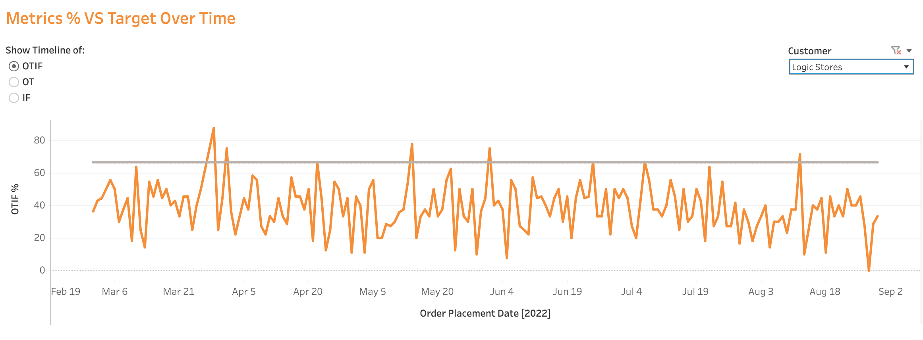
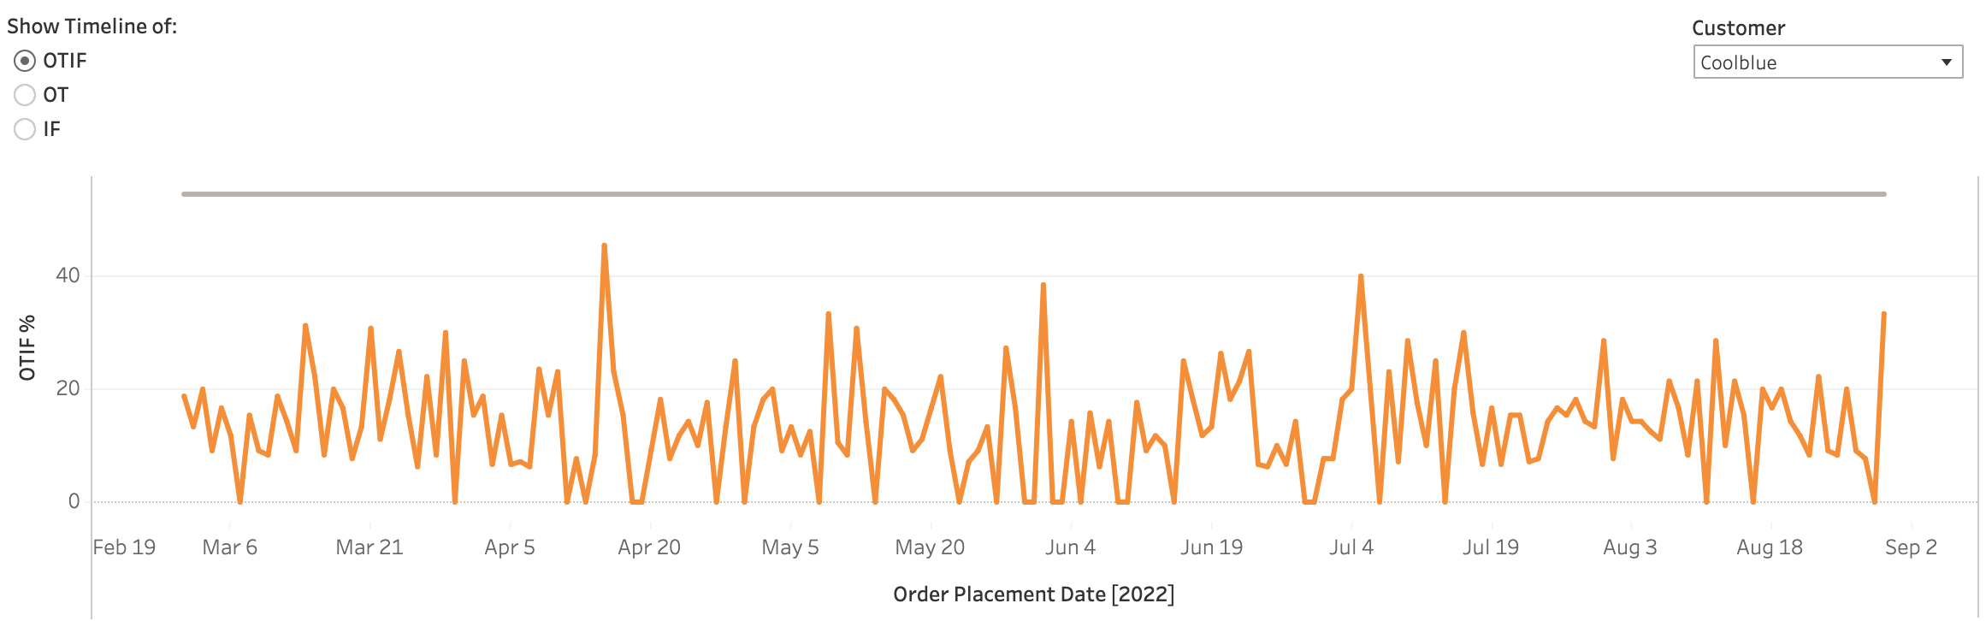
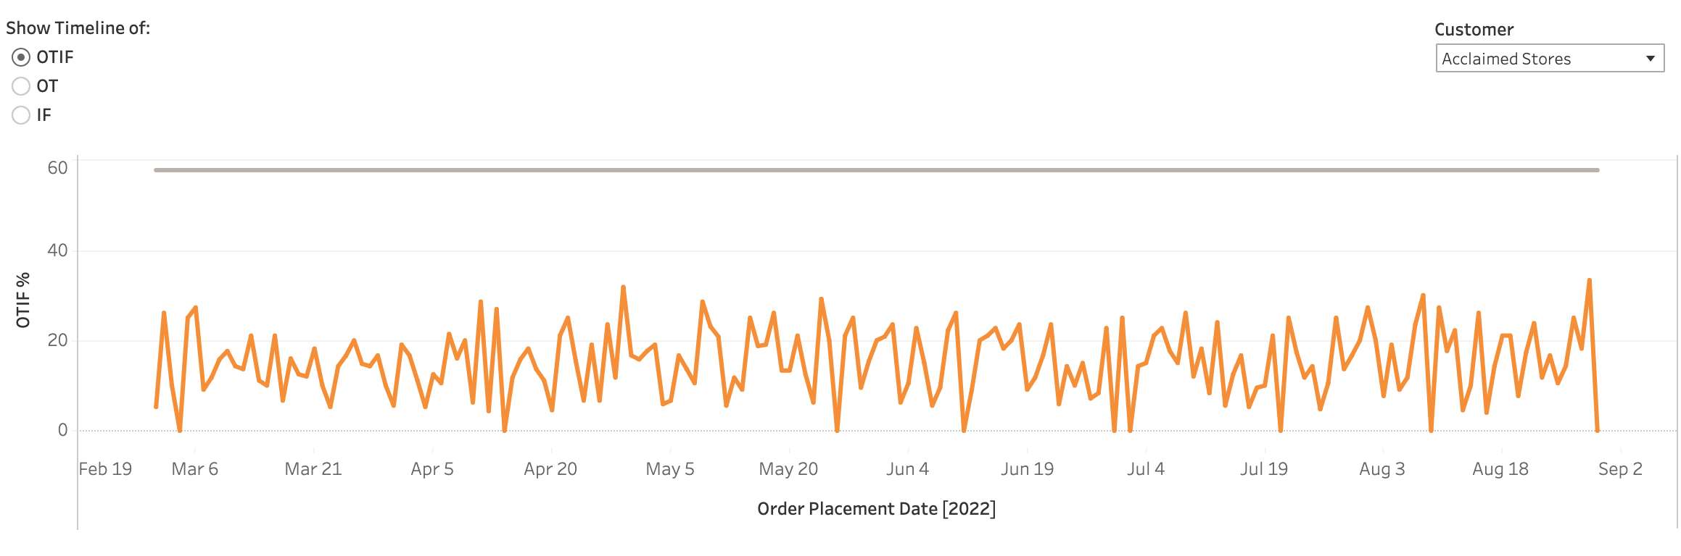
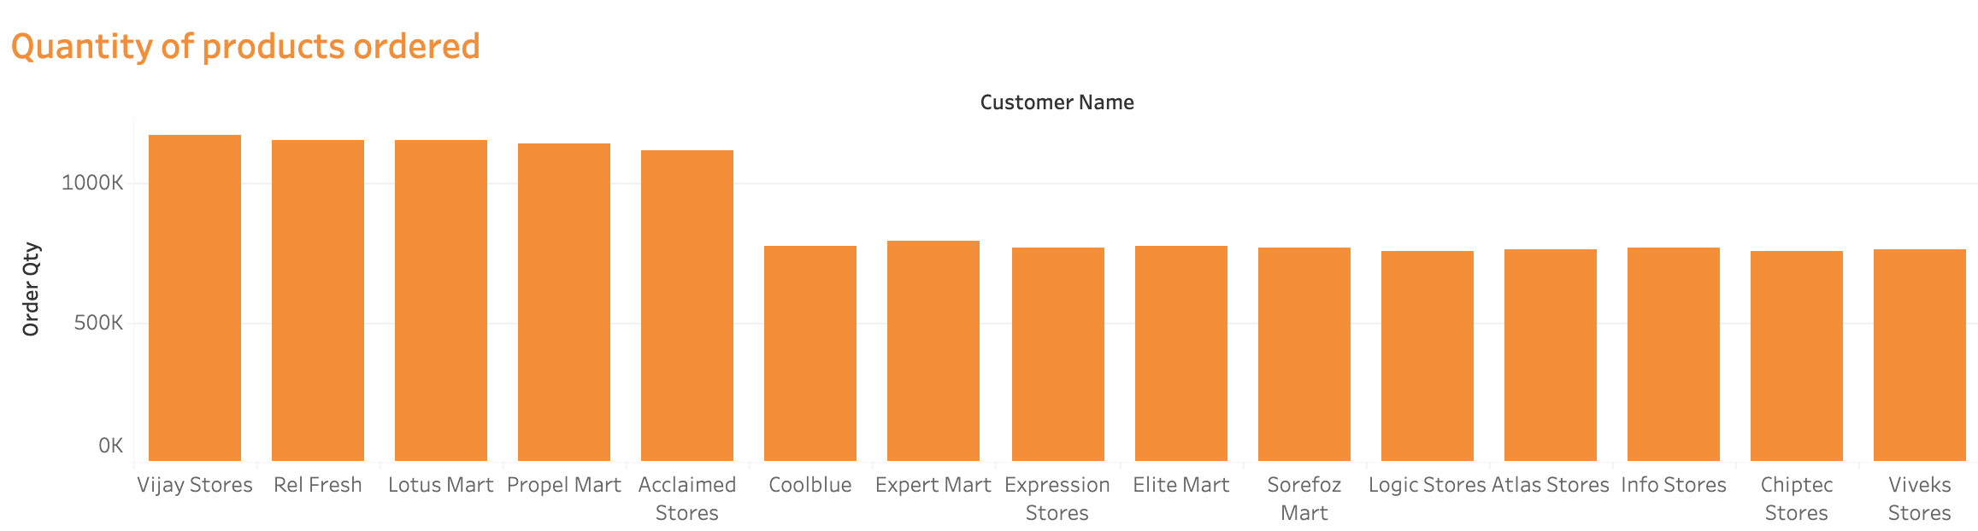
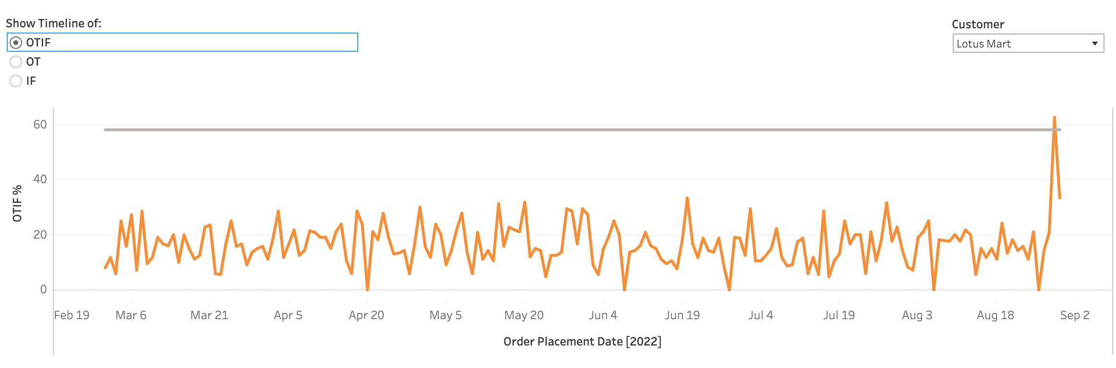
Insights
&
Key Findings
1
Coolblue, Acclaimed Stores, and Lotus Mart have the worst OTIF%. Additionally, they have an OT% less than 30%, thus, more than 60% of their orders come late!
Unlike Logic Stores, Coolblue, Acclaimed Stores, and Lotus Mart have not passed their Target OTIF% a single time.
Note: Lotus Mart did at the very end
2
Summary: it is very likely that Acclaimed Stores, Lotus Mart, and Coolblue are the key customers that wouldn’t renew the contract.

Slide 5
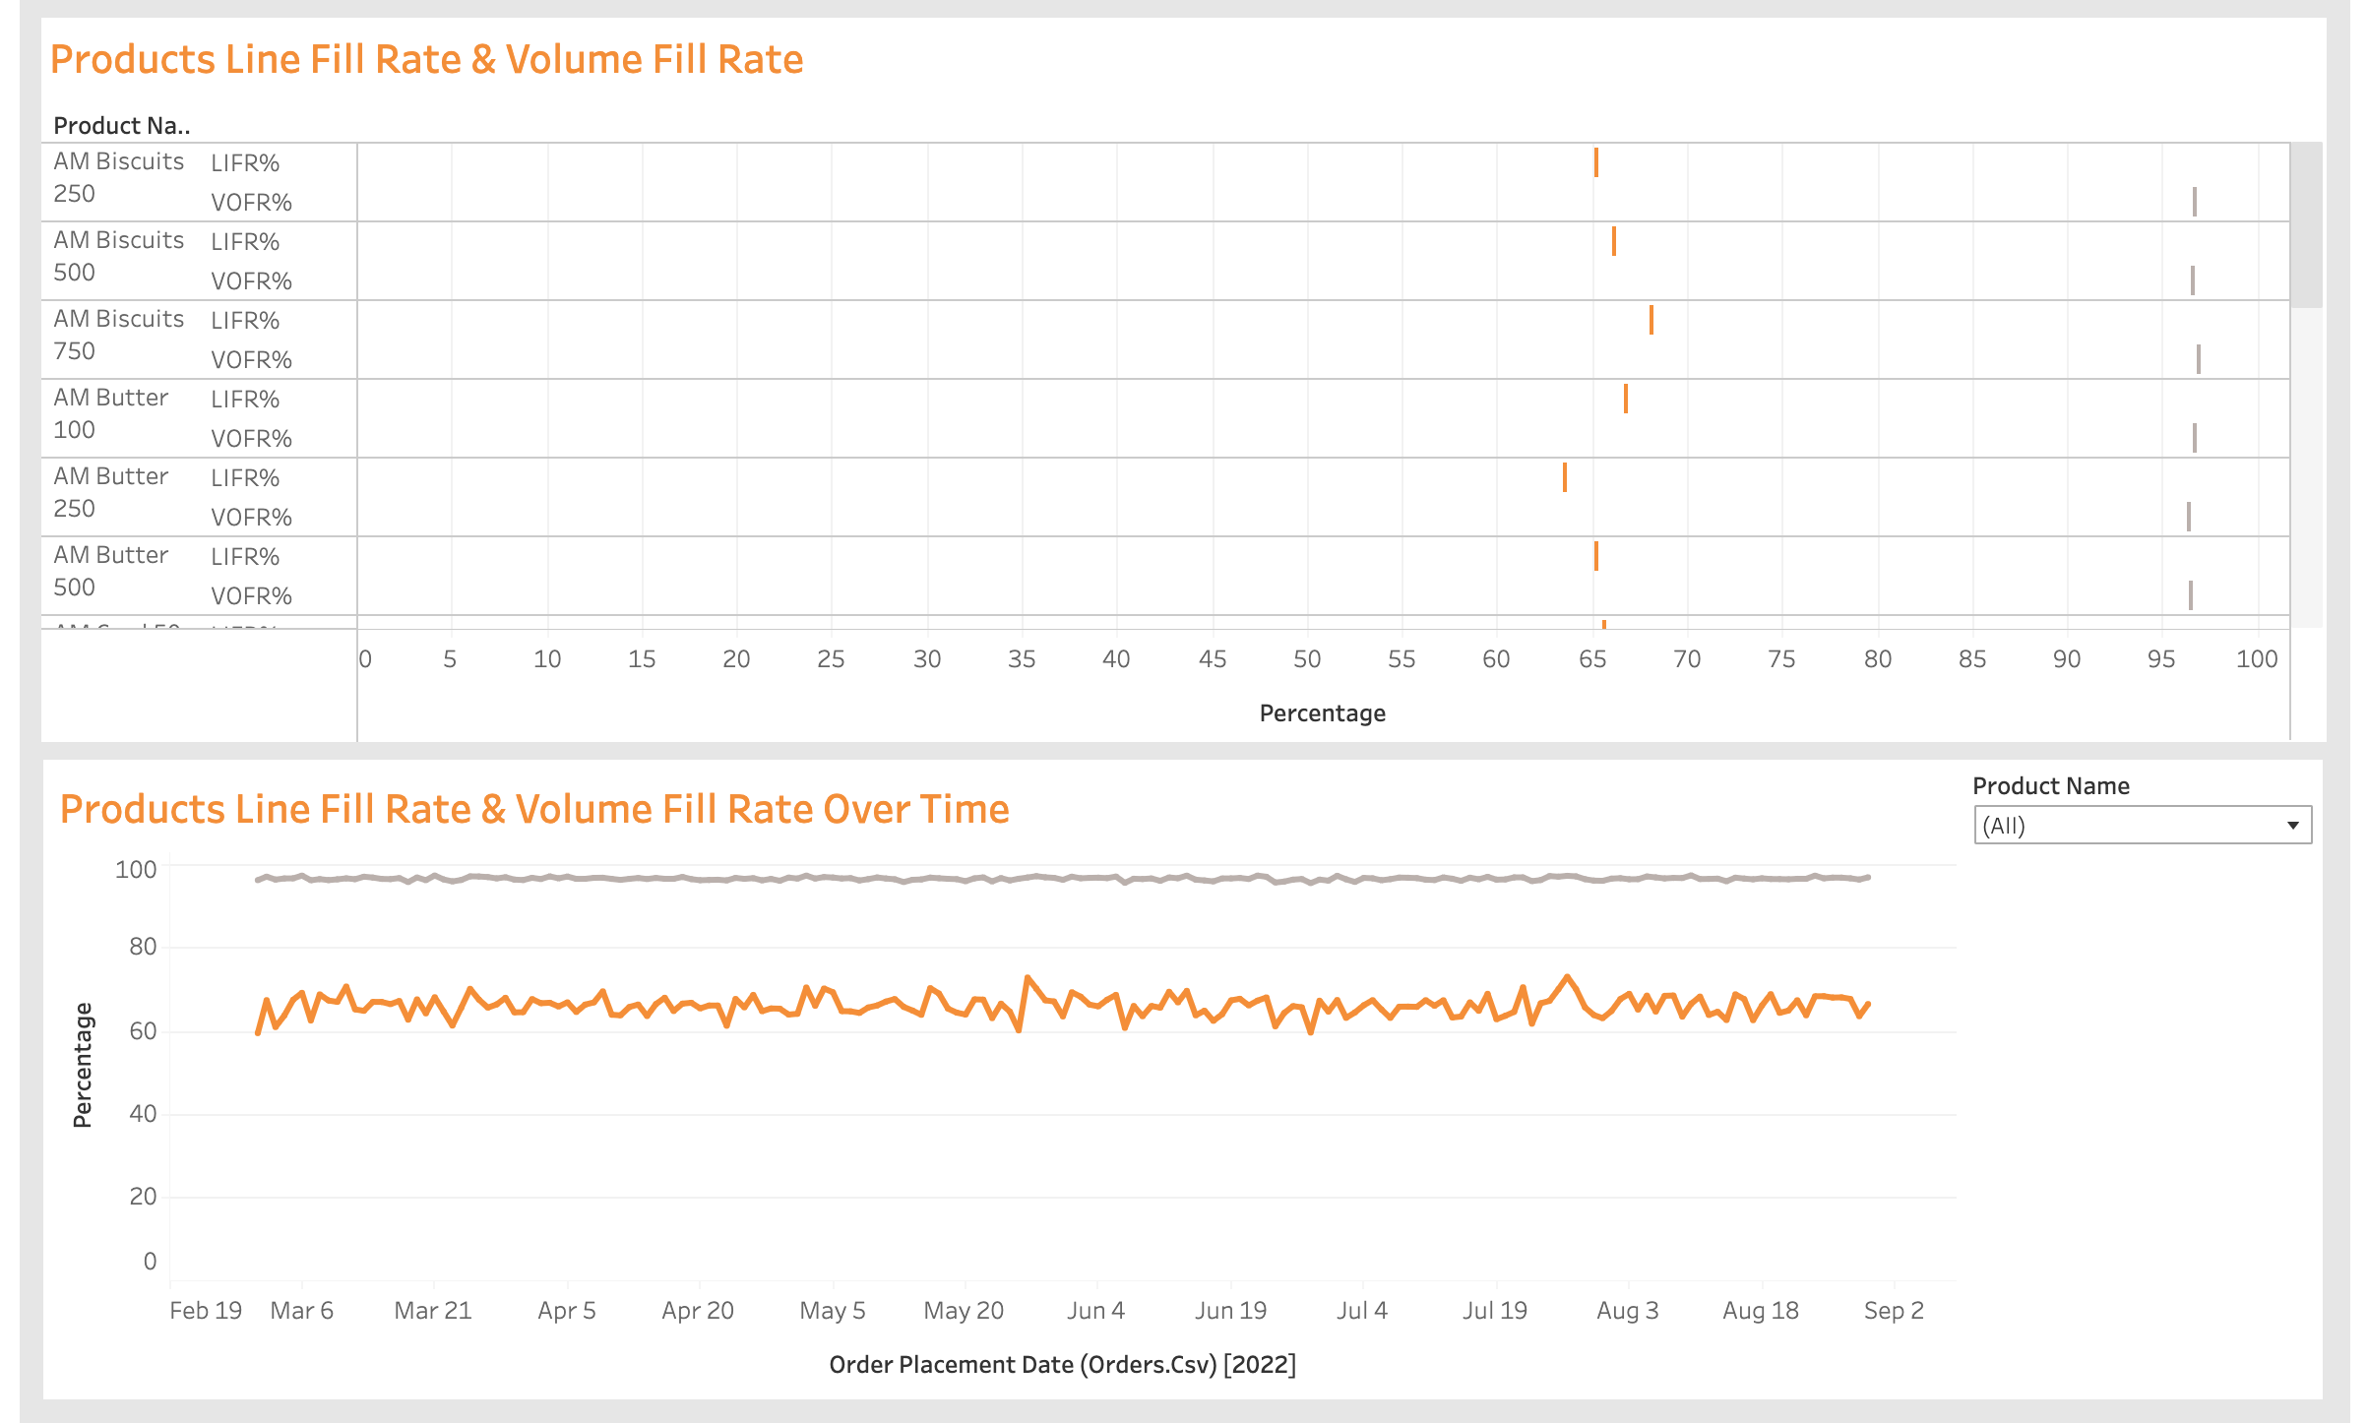
Insights
&
Key Findings
1
Even though LIFR% averaged around ~65%, VOFR remained high on average (~97%). Thus,
Informing us that many of these products ordered may not have been delivered in full, but on average were only missing a few products.

