Slide 1
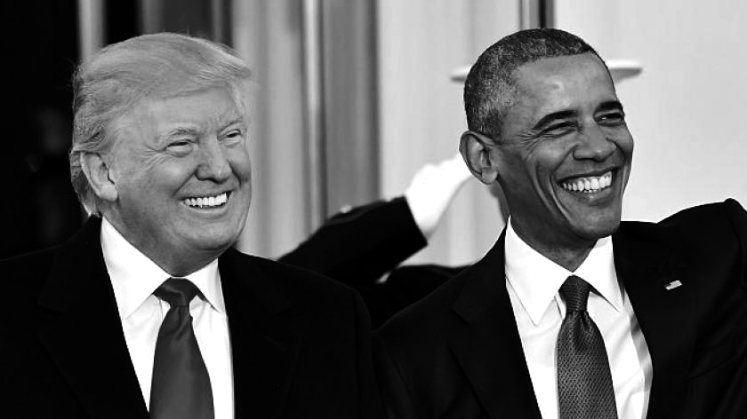
Comparative Analysis of the Speeches of Barack Obama and Donald Trump Using NLP
Otari Tchigladze -
University of Trento

Slide 2
RESEARCH QUESTIONS
What are the similarities and differences between the rhetorics of the two speakers?
What makes them so persuasive?
What are their main literary styles?

Slide 3
METHODS
Text Normalization:
Convert text to lowercase
Remove punctuation and numbers
Remove common stop words

Slide 4
METHODS
Further Processing Using SpaCy:
Split text into chunks of 100
POS-tagging
Named Entity Recognition

Slide 5
METHODS
Catchphrase detection using NLTK
Identifying top 10 adjectives
Topic Modelling:
LDA for identifying prevalent topics (Parameters: topics=10, random state=42)

Slide 6
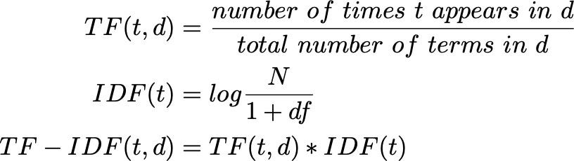
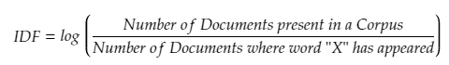

METHODS
TF-IDF
Importance of words
Highlight key terms
Calculate the frequency of each term in a document
Inverse frequency of the term across all documents
Inverse frequency of the term across all documents

Slide 7
METHODS
Semantic Similarity
paraphrase-MiniLM-L6-v2 from Sentence Transformers
Generate sentence embeddings for each speech
Cosine similarity scores between embeddings
pytorch_cos_sim to calculate similarity scores

Slide 8
METHODS
Emotion Analysis
NRCLex built-in lexicon
Map NRCLex emotions to personalized categories
Anger
Happiness
Sadness
Fear
Disgust
Gratitude
Pain
Hopefulness
Emotion frequencies sum = 100% for comaparability

Slide 9
RESULTS

Slide 10
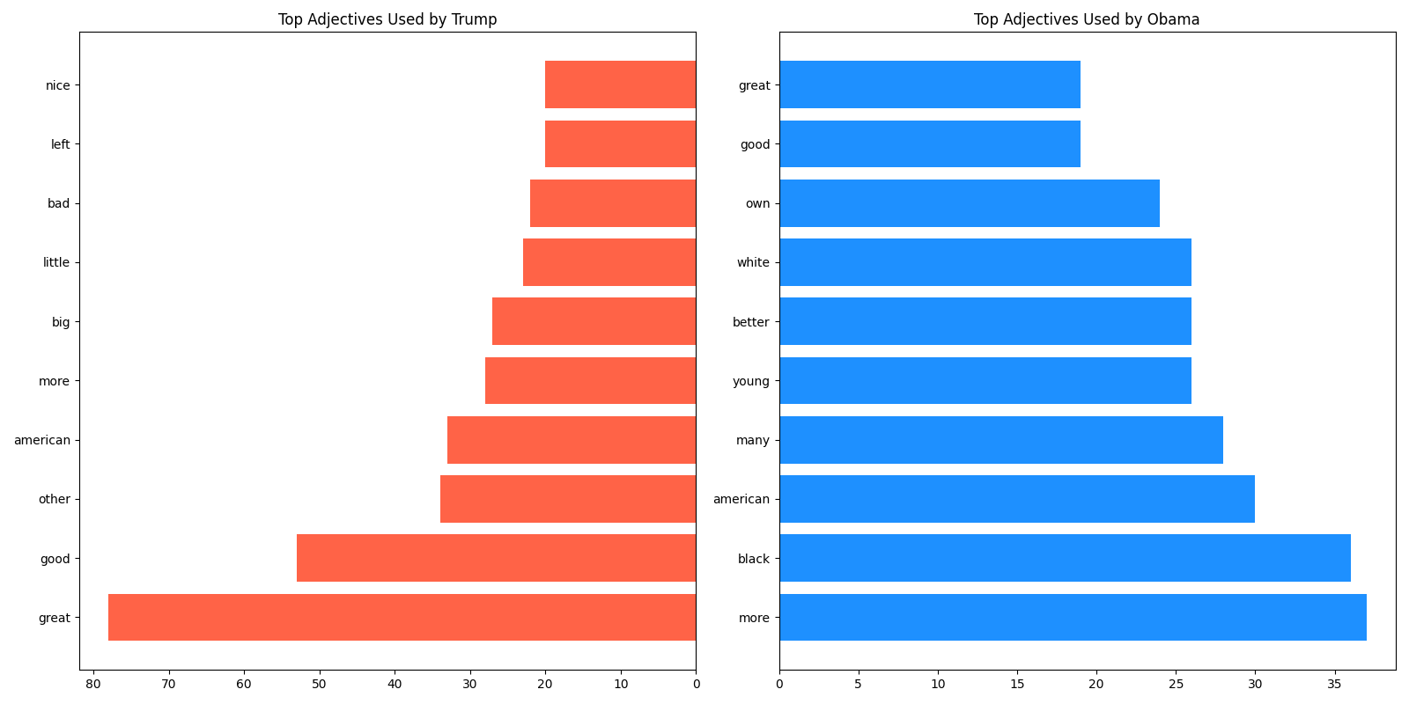
RESULTS
Obama leans towards more inclusive adjectives
Trump leans towards arguably more boastful language

Slide 11
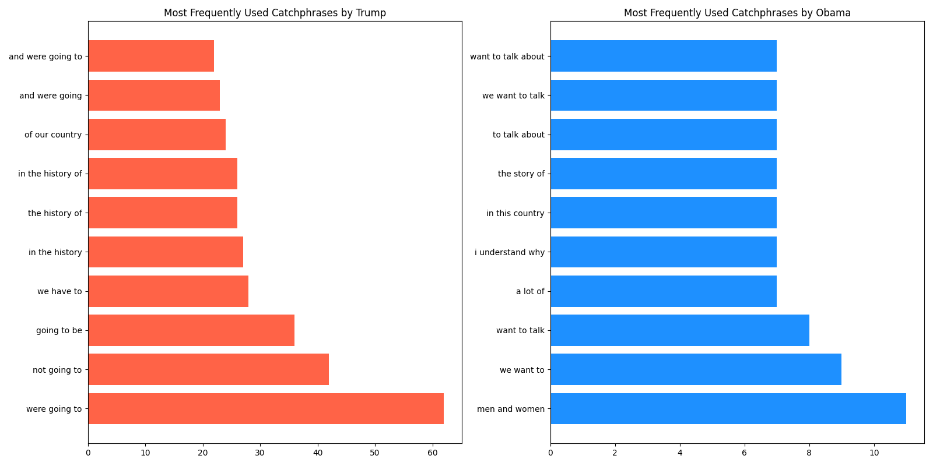
RESULTS
Obama = Inclusive and receptive
Trump = Matter of fact attitude

Slide 12
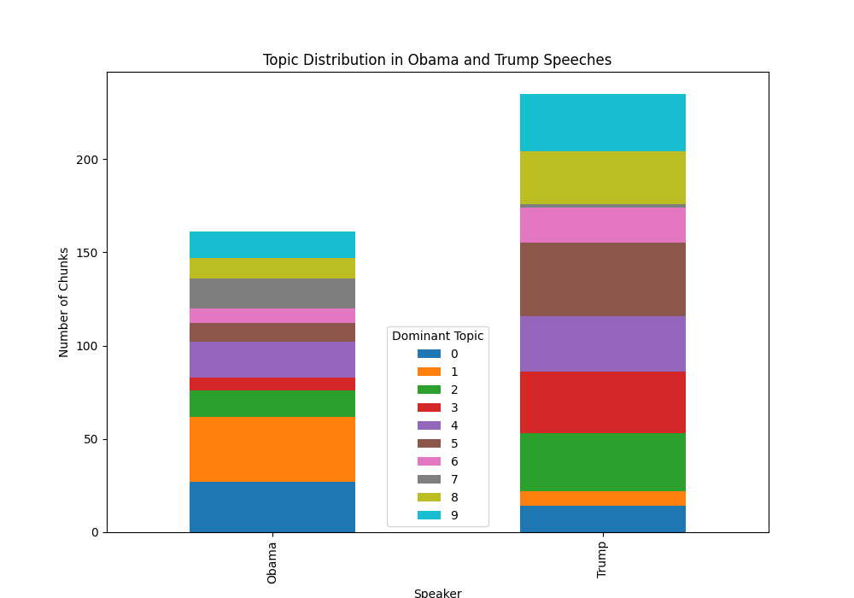
RESULTS

Slide 13
RESULTS

Slide 14
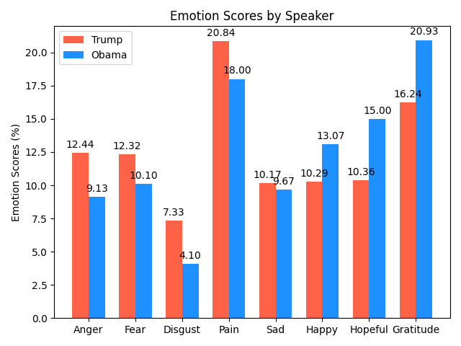
RESULTS
Obama high in positive emotions
Trump high in each negative emotions score

Slide 15
STRENGTHS
Comprehensive Analysis:
Multiple NLP tools:
Sentiment
POS-tagging
NER
Topic modelling
Advanced tools:
paraphrase-MiniLM-L6-v2 for similarity calculation
Clear Visualization
Side by side graphs for comparison

Slide 16
WEAKNESSES
Limited Dataset
Lexicon Based Sentiment Analysis
Topic Modelling Limitations:
Setting the parameters right
More Sophisticated tools:
BERT
XLNet

Slide 17
THANK YOU

