Slide 1
Embedded Systems

Slide 2
The Future
Embedded System
  Future of 21st Century
Success in computing platforms
  Cellular phones
  PDAs
  iPOD
  iPhone
  iPAD
  Gizmos to displacement of PC and laptops
  Shaping up landscape of mobile app and mobile web
Enabling Technologies
  Network
  Computing Platform
Evolution of both hardware and software layers

Slide 3
History of Embedded Systems
1970
  Computers for commercial and admin apps
  Microprocessor – miniaturization – Moore’s Law
1980
  Computer networks – bridge IT + Telecommunication
  Mouse, Windows and GUI
1990
  Internet and WWW – access to digital technologies
2000
  Second revolution for embedded systems
Economic Challenges
  Increase fuel economy and reduce emissions in automobile by adjusting motor state
  Airbags and assisted braking systems – improve comfort and security of passengers
  Improve security, performance, attractiveness and market share

Slide 4
Introduction to Embedded System
System
  Way of working, organizing, performing one or many tasks as per rules or plan
  Arrangement – units assemble and work together as per program or plan
Examples of system
  Time display system – watch
  Automatic cloth washing system – washing m/c
Embedded Systems are
  Omnipresent (homes, office, shopping malls, hospitals, cars, aircraft…)
  Computing Device – does a specific focused job

Slide 5
What is Embedded System?
Embedded System
  any device that includes a computer but is not itself a general purpose computer
  h/w and s/w - part of some larger systems and expected to function without human intervention
  respond, monitor, control external environment using sensors and actuators
embedding a computer - but not for general purpose
Applied Computer System
Includes analog interface to the external world

Slide 6
Embedded System - Definitions
An embedded system is an application that contains at least one programmable computer (typically in the form of a microcontroller, a microprocessor or digital signal processor chip)
  is used by individuals who are, in the main, unaware that the system is computer-based
        From Embedded C Programming perspective by Michael.J.Pont
“An embedded system is a system that has software embedded into computer-hardware, which makes a system dedicated for an application (s) or specific part of an application or product or part of a larger system.”
  s/w usually embeds into a ROM or flash
  Independent system or part of a large system
        by Raj Kamal

Slide 7
Embedded System - Definitions
“An embedded system is one that has a dedicated purpose software embedded in a computer hardware.”
        By Raj Kamal
Any device that includes programmable computer but not self intend to be a general purpose computer
        Wayne Wolf
Electronic system contains microcontroller or microprocessor but not general purpose computers
    computer is hidden or embedded in the system
        Todd D. Morton
Combination of Software and Hardware in which the software controls the entire hardware for a dedicated application
        Raj Kamal
A general-purpose definition of embedded systems is that they are devices used to control, monitor or assist the operation of equipment, machinery or plant. “Embedded” reflects the fact that they are an integral part of the system. In many cases, their “embeddedness” may be such that their presence is far from obvious to the casual observer.
  >> Institute of Electrical Engineers (IEE)

Slide 8
Embedded System Vs Desktop System
Desktop / Laptop
  General purpose computer
  Used for playing games, word processing, accounting, SDT etc.,
Embedded System
  Single Purpose and
  fixed embedded software for specific job
Typical Examples
  A/C, VCD/DVD Player, Printer, Fax m/c, Mobile phone etc
  Customized embedded hw + fixed embedded sw (firmware) + specific processor
    to meet the specific requirement

Slide 9
Examples
  PDA
  Digital camera
  Cell phone
Simple Control: front panel of microwave owen – less functionality
Camera - Canon EOS has 3 microprocessors - 32b RISC CPU runs auto focus
Analog TV - tuning and channel selection - less functionality
Digital TV
  decompression, descrambling etc., more functionality
  complex signaling functions

Slide 10
Examples
Automobile ES
  high end automobile may have 100 microprocessors
    4b up checks tension of the seat belt
    uc run dashboard devices - display services
    16/32b up controls engine - most complex function
Example Automobile system
ABS (Anti-Lock Braking System)
  4 sensors senses the speed of wheels
  4 brakes controlled by hydraulic pump
  Embedded ABS
  receives inputs from sensors
  actuates hydraulic pump
Similar control system implemented through microcontroller in AU

Slide 11
Characteristics of Embedded System
sophisticated functionality - differ by appliances
RT operation (not always necessary)
low manufacturing cost
application dependent processor and not GPP
Restricted memory
low power
  critical in battery operated devices
  excessive power consumption increases system cost even in wall powered devices

Slide 12
Characteristics of Embedded System
Manufacturing cost
  Non-Recurring Engineering cost (NRE) – cost for design and development
  cost of production and marketing each unit
production cost should be taken care when targeting mass market
  Ex: AU Versus low cost cell phone
Technology choice depends on no of units plan to produce

Slide 13
Characteristics of Embedded System
RT operation
  finish operations by deadlines
HRTS - missing deadline is catastrophic
  automated missile launch system
SRTS - missing deadline degrades performance
  playing video - missed decoded frame
many systems are multi rate - inputs from external world comes at different rates

Slide 14
Characteristics of Embedded System
Application dependent requirements
  Fault Tolerance and Reliability
    continue operation despite hw or sw faults
    Ex: aircraft and medical monitoring sys
  Safe
    avoid physical or economic damage to person or property

Slide 15
Characteristics of Embedded System
More Features – Dedicated Systems
  Pre-defined functionalities – h/s accordingly designed
  Programmability rarely used during life time of system
    not programmed on regular basis
    OTP and execute infinitely
    do specific task
    RT, fault-tolerant and safe

Slide 16
Characteristics of Embedded System
Single Functional - cannot be programmed to do different things
  pagers and mobile phones
Limited Resources - fixed RAM, ROM
  No secondary storage CD-ROM, FDD
Work against deadlines - Real Time systems
    Missing deadline cause catastrophe
Power constrained - Battery powered products
Highly reliable - No 3 finger salute – cannot afford to reset
Extreme environment conditions - Temperature and humidity
Cost sensitive to CE - Millions of units sold
Diversified processors and OS unlike desktop (intel + MS - Wintel)
  complex to chose right platform

Slide 17
Constraints in Embedded Systems
Tightly constrained than traditional software systems
Cost
  Cannot have high end or fast processor
  Cannot have more memory – processor footprint should be less
Size
  Processor footprint should be less
    Ex: gun stabilization control for Arjuna Tank in Defence
    Cooling requirements + Processor should take less space
Performance
  Ex: Digital camera snaps, Mobile phone address book contact list etc.,
Power
  Battery power products – Mobile phones
  Optimized power saving algorithms and operating modes – reduce power dissipation
  SW Program size + # of instructions – affect processor’s energy consumption
Available System Memory and Processor Speed
Limited power dissipation when running system continuously
Reactive and Real Time – Adaptive cruise control and radar missile detection systems

Slide 18
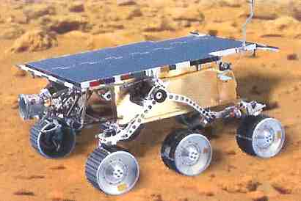
More Examples
NASA Mars Rover uses an Intel 80C85 8-bit microprocessor

Slide 19
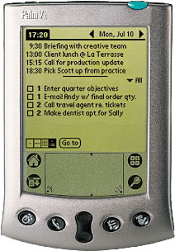
More Examples
Palm Vx Handheld uses Motorolla Dragonball EZ 32-b microprocessor

Slide 20

More Examples
Philips sonicare plus toothbrush – Zilog Z8 8b microprocessor

Slide 21
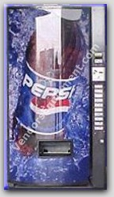
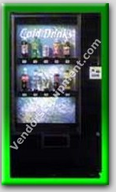
More Examples
Vendo V-MAX 720 vending machine uses the Motorola M68HC11 8b microprocessor
  electronic and mechanical parts should go in hand
  delivering a good wrt cash - transformed - web enabled cashless delivery
    stock monitored remotely
    transactions through credit or smart card
    security monitor from remote

Slide 22
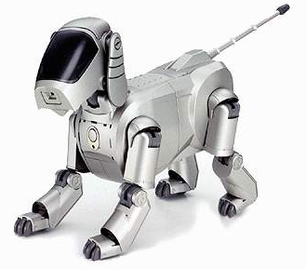
More Examples
Sony’s Aibo Robotic Dog uses ERS-110 an MIPS 64b RISC processor
  coordinate the motions
  needs to do sensing
  control the manipulators
  need to communicate
    Ex: football competition b/w robo

Slide 23
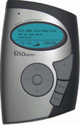
More Examples
Rio MP3 Player uses 32b RISC processor
  compressed form of audio is mp3
  sophisticated up to be used for audio processing

Slide 24
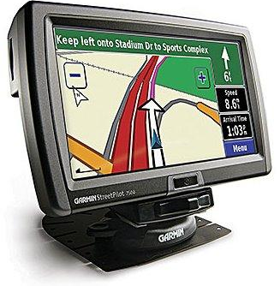
More Examples
Garmin Streetpiolot GPS receiver uses a 16b processor
  any transport system can get its global location
  automated navigation system make use GPS
  communication with satellite and output about vehicle position and map display

Slide 25
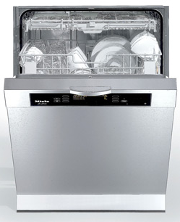
More Examples
Miele dishwashers uses 8b Motorola 68HC05 processors and can be reprogrammed with a laptop to adjust temperatures and cycle times

Slide 26
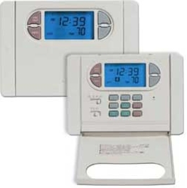
More Examples
Hunter 44550 programmable thermostat uses a 4b processor

Slide 27
Types of Embedded System
similar to general computing
  PDA, video games, STP box, ATM
    Since the functionalities is subset of PC functionalities
    i/0 based
    no sensing of ext environment and no control of actuators
    more like general purpose
    respond to users input
Control systems
  sensing and actuating - is a specific job
  feed back control of RT systems
    vehicle engines - fuel injection control
    flight control
    nuclear reactors

Slide 28
Types of Embedded System
signal processing
  core job is processing of signals
    radar
    sonar
    DVD players
communication and networking
  cellular phones,
  internet appliances
  web enabled vending m/c

Slide 29
Nature of System Functions
Functions expected from Embedded Systems – To do
  obey control laws - for sensing and actuation
  sequencing logic - task specific and not general
  signal processing - if there is external interface
    may not be a core activity
    but required to deal with sensing inputs
  app specific interfacing
    what kind of sensors and actuators interconnected
    h/s interfacing for i/o devices
  fault response
    what happens if fault occurs
    General philosophy is - graceful degradation
    Catastrophic failure should not happen
      Ex: battery low in mobile phone – message to user before shut down

Slide 30
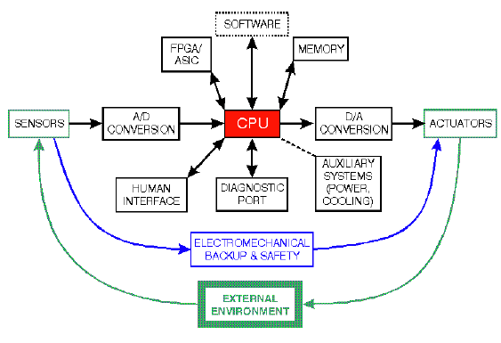
Embedded System Architecture
Memory - has the software to control the system
AD conversion blocks - interface to sensors
DA conversion blocks - interface to actuators
  integral and essential component of embedded control systems

Slide 31
Embedded System Architecture
FPGA / ASIC
  special hw interfaces with CPU
  CPU off shores special functionalities
human interface with CPU - LCD, LED
diagnostic tools
  trace failures
  system does self checks to check all paths on regular basis using diagnostic tools
    if not system may damage the users due to unexpected malfunctions
power cooling systems
  proper package of whole systems wrt external environment
  good well system can fail due to improper packaging
  Ex: moisture controlling
  mechanical aspects of design - too critical

Slide 32
Implementing Embedded System
HW
  PE - uc and up
  peripheral devices
    i/o
    interfacing sensors and actuators
    interfacing protocols
  Memory
  Bus
  HW aspects looks similar to general purpose systems
  But embedded systems differ by peripherals
    General purpose is about std i/o devices
    in ES - i/o devices varies a large
  diff kinds of sensors - so PE should be defined wrt i/o devices

Slide 33
Implementing Embedded System
cross assemblers and compilers
  host and target m/c
  Ex: compiler for PIC uc on simple PC
    compile c program for PIC uc (target board)
    not executed on PC in which it is compiled
  compilers for family of processors (variants)
    since similar architecture but differ by registers or features
emulators
  IS emulators
  emulates target processor on another m/c
simulation environment
  timing analysis of code on host m/c

Slide 34
Implementing Embedded System
PC - hw connector - target board
  monitor execution of code from PC
  debugging tools
System SW
  Cross compilers and assemblers
  emulators and simulators
  debugging tools
System SW aspects differ from that of general purpose system
Top of the system sw is specialized OS with RT features if required
App sw - flavors for different devices
  Ex: same os vxworks on laser printer and on other appliances
  app sw targeted for printing on top of OS
  app sw distinguish the functionality

Slide 35
History of HW Evolution
Based on faster clock and degree of integration
  GP up and uc
    get OTS products and develop system out of it
    Development cost (NRE) is reduced by using GP up and uc
  DSP
    signal processing is the basic task
    cost is more than GP
  AS processors (ASSP / ASIC)
    designing processor that exactly suit application need
    development cost is more
    application will be an additional cost
  SoC
    multi cores + Co-Processor + peripherals
    Ex: TI - RISC + TI DSP + entire communication integrated
    more sophisticated functionalities

Slide 36
History of Processor Architecture Evolution
Von-Neumann Architecture
  Primitive architecture
  Computer programs – small and simple but memory is costly
  Program and data stored in same memory
  Instruction and data access on same bus from memory
    Single bus b/w CPU and memory
    RAM and program memory share the same bus and same memory and so must have same bit width
    Each instruction fetched from memory, decoded and executed
    On decoding, any operands required fetched from same memory
  Bottleneck: getting instructions interfere with accessing RAM
    Provide address on bus to fetch instruction as well as data
    Use bus to r/w data onto memory
    No diff b/w data and instruction
    Distinct cycles for getting address and data
  Stored program computers
  Instructions / programs stored in ROM
    No changes at run time

Slide 37
History of Processor Architecture Evolution
Harvard Architecture
  Separate data paths (address and data buses) – access code (program) and data (data operands) - Separate program and data bus – buses can be of different widths
  Next instruction can be fetched while decoding and executing current instruction => Instruction pipelining is easy
  Ex: program memory <- 12/14/16b bus -> cpu <-8b bus-> data memory
    program memory different from data memory
    two distinct buses b/w CPU and memories
  Advantages
    fetch instruction from program memory - process data and store processed data into data memory
    fetch next instruction while storing the previous result due to separate memories and separate buses
    facilitates instruction pipelining
    fetch instruction and fetch/store data at the same time on different buses
  many uc built on harvard architecture

Slide 38
History of Processor Architecture Evolution
Harvard Architecture Derivatives
  Modified harvard or super harvard architectures
  Multiple data paths for data access
  More suited for data intensive applications : DSP – require multiple data operands for each instruction execution
  Fetch data operands in parallel using multiple data paths – significantly improves performance

Slide 39
History of Processor Architecture Evolution
CISC – Complex Instruction Set Computer – Intel 8086, Pentium
  Earlier application were in machine or assembly code – no HL / MLL
  Computer hw supported large instructions – simplify programming – easier and faster
  Instructions do complex operations
    Single instruction fetch multiple operands and execute multiple operations on the operands
  Advantages
    Made programming easier – less instructions to do given task
    Favored for low memory – memory cost is reduced since less instructions to store
      Dense instruction set to reduce memory requirements
  CISC – Basic philosophy
    Different instructions of different formats, lengths, addressing modes
    Require multiple clock cycles for execution
    More complex instructions be implemented as part of hw
    more elaborated accessing of data as part of instructions
    diff addressing modes of accessing data

Slide 40
History of Processor Architecture Evolution
RISC – Reduced Instruction Set Computer
  CISC complex instructions take many osc cycles to execute
  Pipelined processor overall speed depends on the slowest operation being performed
    Relatively complex instructions even slow down the execution of simpler instructions
    complex instructions were a major performance bottle-neck
Advent of compilers and HLL / MLL
  Compiler translates HLL code to low level assembly or machine code
  Compilers generally used a combination of simple instructions to achieve the complex operations
  breaking the complex operations in to a combination of simple operations was much efficient
    took less processor cycles to execute, than doing the same operations using a single complex CISC instruction
    most of the complex instructions were not being used by compiler generated programs

Slide 41
History of Processor Architecture Evolution
Most of the addressing modes (offered by CISC) were also not being used by compilers.
  This led to a shift in processor design philosophy
Processor designers started focusing on
  reducing the size and
  complexity of instruction sets
    since most complex instructions were not being used and
    making a small and simple instruction set - which could be used by compilers
Advantages
  simpler instructions could speed up the pipe-line and thus provide a performance improvement.
  simple instruction set implies less computer hardware and thus reduced cost.

Slide 42
History of Processor Architecture Evolution
RISC basic design goals
  Less # of instructions – instruction designed for simple operations executed in single cycle
  provide basic simple instructions, which could execute faster.
  Compilers could use these instructions to construct complex operations
  Each instruction is of fixed length
    facilitates instruction pipelining - reading of next instruction byte will not interfere current instruction being read
      Design fetch cycles to fetch words of fixed length corresponds to single instruction
  large # of general purpose register set
    contain data or address (symmetry) - used for address and data manipulation equally

Slide 43
History of Processor Architecture Evolution
Load / Store Architecture of RISC
  ALU operations always involve registers and not memory locations
    no memory access for data processing instructions
  load instructions to load data from memory to register
  store instructions to store processed data from register to memory
RISC Architecture => referred to as Load/Store Architecture
Implementing pipelining in CISC architecture is more complex than RISC arch
Interesting trend in this era (early eighties)
  sharp increase in the speed of processors (whereas the memory speeds still remained comparatively low)
    This meant that memory accesses were becoming a bottle-neck.
    This led to the design of processors with large number of internal registers
      used for temporary storage rather than depending on external and slower memory and cache memories.

Slide 44
History of Processor Architecture Evolution
DSP
  special purpose processors
  processing units and instruction set suit the Signal Processing Applications
  MAC (Multiply and Accumulate) and Shifter (Arithmetic and Logical shift) units are added to the DSP cores
    Signal Processing Algorithms heavily depend on such operations
  Other common features in DSP architectures
    Circular Buffers, Bit Reversal Addressing, Hardware Loops, and DAG (Digital Address Generators)
  Signal Processing Applications are data intensive
    the data I/O bandwidth of DSP processors is designed to be high
  lot of embedded systems run signal processing applications (cell phones, portable media players etc)

Slide 45
History of Processor Architecture Evolution
VLIW Architecture
  “Very Large Instruction Word” architecture consists of multiple ALUs in parallel
  designed to exploit the “Instruction Level Parallelism” in application.
  Programmers can break their code such that each ALU can be loaded in parallel.
    The operation to be done on each ALU (in a given cycle) forms the instruction word (for that cycle).
  It is completely up to the programmer to take care of partitioning of the application across different ALUs.
    Also, it is programmer’s burden (and compiler’s burden if the code is being written in high level language) to make sure that there is not interdependency between the instructions with are part of “instruction word”.
  The processor does not have any hardware to ascertain (and reschedule) the order of instructions (this is called static scheduling).

Slide 46
Characteristics of Embedded SW
logically and temporally correct programs
  cant do correct at wrong time
  correct operation has no meaning
deal with inherent physical concurrency
  GP m/c - multi users and processes running
  ES - physical world is concurrent - have to support concurrency
    Reactive Systems
has to be reliability and fault tolerance
has to be app specific and single purpose

Slide 47
Multitasking and Concurrency
deal with several i/o and multiple events occurring independently
Many of ES - expected to be multitasking
separating tasks simplifies programming complexity
  but requires s/w mechanism for multi-tasking - switching b/w different tasks
concurrency => appearance of simultaneous execution of many tasks

Slide 48
Challenges in ES Design
how much hw do we need?
  word size of CPU and size of memory
how do we meet our deadlines (deadlines for a RT system)
  faster hw or cleverer sw
  faster cpu means extra cost
  cleverer sw requires faster cpu
  so, design logic on FPGA or ASIC a dedicated function using low cost cpu and include it for compromising on cost
  dedicated logic on FPGA or ASIC to compromise of SW so as to meet deadline
how do we minimize power
  turn off unnecessary logic
  reduce memory accesses

Slide 49
ES Design – A Global Picture
multi objective
  dependability
    not fail
    should have fault tolerance or graceful degradation
  affordability
    depending on the market targeted
  safety
  security
    not cause bodily harms to users
  scalability
  timeliness
    operation in time

Slide 50
ES Design – A Global Picture
To meet above multi objectives of ES design we need multi-discipline
    electronic hw
    mechanical hw
    control algorithms
    sw
    humans
    society / institutions
      sociological acceptance of product - accept by society

Slide 51
ES Design – Life Cycle
ES Design Life cycle events
  LC => how do a ES gets developed
    Requirements
    Design
    Manufacturing
    Deployment
    Logistics of maintaining the system
    Retirement support

Slide 52
ES Design Goals
performance
  overall speed, deadlines
funtionality and user interface
mfg cost
power consumption
phy size etc.,
size and power also related to performance and should be taken care accordingly
  Ex: cannot design a digital camera of wt 10 kg

Slide 53
ES Design Goals
Functional and Non Functional Requirements part of ES design
Functional requirements
  o/p as a function of i/p - specification of ES as i/o
Non Functional requirements
  time to compute o/p
  size
  weight
  power consumption
  Reliability etc.,
functional and non functional requirements are critical for product acceptance

Slide 54
Design and Development Process of ES Life Cycle
  Requirements
  Specifications
  Architecture
  Components Design
  System Integration
  Testing is critical
    GP system - patch download for a bug
    ES system - use forever and no flexibility for patch update

Slide 55
ES Design Approach
TD or bottom up as like SDLC
TD
  start from most adt description work to most detailed
BU
  work from small components to big system
  re-use of parts already developed
real design uses both techniques
stepwise refinement (both h/s development go in hand)
  at each level of ADT analyze design to determine characteristics of current state of the design
  refine design to add detail
in ES: since special purpose h/w is designed if deadline not met with SW
  so hw and sw design should go in hand

Slide 56
Microcontroller
Device
Integrates # of components of microprocessor system on to a single microchip
Optimized to interact with ext world through on-board interfaces
  i.e. it is a little gadget that houses a microprocessor, ROM (Read Only Memory), RAM (Random Access Memory), I/O (Input Output functions), and various other specialized circuits all in one package.
Microprocessor
  Optimised to coordinate flow of information b/w separate memory and peripheral devices located outside itself
  System bus (AB / DB / CB) - up uses to select the peripheral for sx/rx data
Microcontroller
  Processor and peripherals on single silicon
  Self-contained device – rarely bus structures extend outside package

Slide 57
Microprocessor Vs Microcontroller
Microprocessor
Collection of on/off SWI on Silicon for computations
CPU is stand-alone, RAM, ROM, I/O, timer are separate
designer can decide on the amount of ROM, RAM and I/O ports.
Expandable
Expensive
High Speed (1000 MIPS)
General purpose and Versatile
Large Architecture (32b, 64b)
Lots of IO and Peripherals externally connected
Microcontroller
Small and self-suffice SoC to control devices
CPU, RAM, ROM, I/O and timer are all on a single chip
fix amount of on-chip ROM, RAM, I/O ports
Not Expandable – no external bus interface
for applications in which cost, power and space are critical
Low speed, on the order of 10 KHz – 20 MHz
single-purpose
Small usually an 8b
Limited IO, enough for intended app

Slide 58
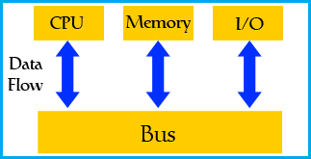
Microcontroller – Fundamental Components
Microcontroller incorporates onto the same microchip the following:
  The CPU core
  Memory (both ROM and RAM)
  Some parallel digital I/O
Microcontrollers will also combine other devices such as:
  A Timer module to allow the microcontroller to perform tasks for certain time periods.
  A serial I/O port to allow data to flow between the microcontroller and other devices such as a PC or another microcontroller.
  An ADC to allow the microcontroller to accept analogue input data for processing.

Slide 59
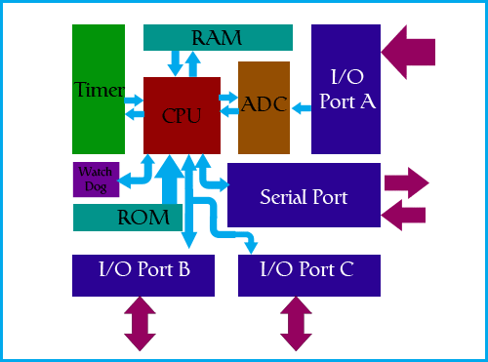
Basic Microcontroller Architecture
Memory Unit
  Store data and program
  Addressing and memory locations
  Control line to r/w
CPU
  ALU + CU + Shifter + Memory L/S opns
  Processor Registers
  Connection b/w memory and CPU
Bus
  Wires in power of 2 – address, control and data bus
  address bus – wires = amount of memory
  data – word length – connect all blocks inside microcontroller
MU + CPU + BUS – self contained unit + no external interface

Slide 60
Basic Microcontroller Architecture
External I/O Interface
  Block with several memory locations
  One end to DB and other end to output lines on uc – pins on IC
Input-output unit
  Ports are memory locations
  Types of ports : input, output or bidirectional ports.
  Working with Port
    Select the port
    Configure for i/o and r/w data
  Ports simply acts like memory locations

Slide 61
Basic Microcontroller Architecture
Serial Communication
  Parallel data transfer lines affects economy
  3 line with protocol preferred
  Ex: Serial Protocol – Non Return to Zero
  Full Duplex communication
  Data transferred serially (bit by bit)
  Rx => Data read from received port location and stored in memory
  Sx => data from memory via bus to sending port location and to rx unit as per protocol
Timer Unit
  Info about time duration, protocol in serial communication
  free-run counter which is in fact a register whose numeric value increments by one in even intervals – elapsed time calculation b/w time intervals

Slide 62
Basic Microcontroller Architecture
Watchdog Timer
  flawless functioning of the microcontroller during its run-time
  What if uc stops working or works incorrectly due to interference?
  PC => reset but ES => no reset button since no human intervention
  Watchdog Block - in fact another free-run counter
    SW program needs to write a zero in every time it executes correctly.
    If SW "stuck", zero will not be written in
    counter alone will reset the microcontroller upon achieving its maximum value.
      This will result in executing the program again, and correctly this time around.
    an important element of every program to be reliable without man's supervision

Slide 63
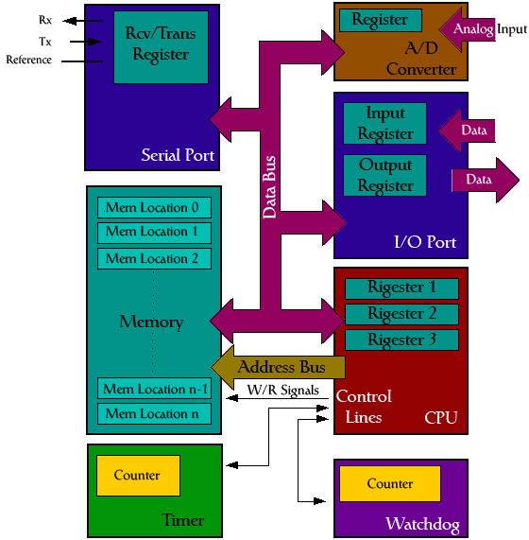
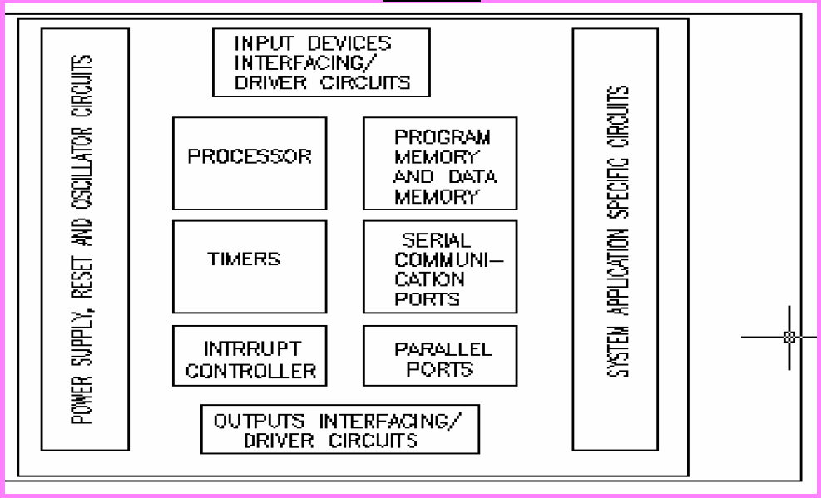
Basic Microcontroller Architecture
Analog to Digital Converter (ADC)
  Peripheral signals (voltage) differ from uc signals (binary)
  ADC block for conversion
Assembling all the blocks into an electronic component where uc will access the inner blocks through the outside pins

Slide 64
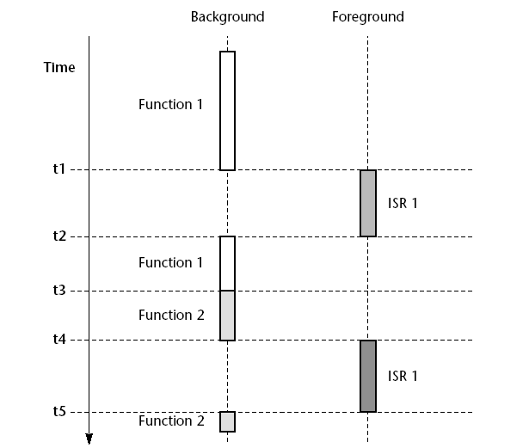
Interrupt
Major diff b/w DTP SW and embedded sw is ‘interrupt’
Low level perspective
  hw mechanism for notification to CPU about event occurrence
    Internal events: overflow of timer
    External events: arrival of char through serial interface
High level perspective
  Mechanism for creating
  multitasking applications
  Apparently performing
  >1 task at a time using a single up
Interrupt handling in embedded
system

Slide 65
Why 8051?
Price less than $1.00 (US)
    1 MIPS performance
    256 bytes of on-chip RAM
Profile - price, performance, available memory match needs
8051 architecture - by Intel
  Philips, Infineon, Atmel and Dallas
  Instruction Set / Code compatible
  60% microcontroller market - 50% of the 8-bit microcontroller market
  Used in automotive systems to children’s toys
low cost, huge range, easy availability and widespread use of the 8051 family makes it
    an excellent platform for developing embedded systems:
    ideal platform for learning about embedded systems.

Slide 66
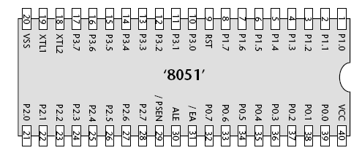
Intel MCS-51 family
Standard 40-Pin DIP pacakage
Excellent device for building embedded systems
Minimum # of external components to operate

Slide 67
Choosing a Microcontroller
Meeting computing needs of task at hand efficiently and effectively
Speed – highest speed supported
Packaging – for space, assembling and prototyping of end product
Power consumption – crucial for battery powered products
Amount of RAM and ROM on-chip, # of Timers and IO Pins
How easy to upgrade to high performance or low power consumption versions
Cost per unit
Availability of SDT (Compilers, assemblers, debuggers) and expertise
Wide availability and reliable sources (Source of Suppliers beside Originator)
  Intel, Atmel, Philips / Signetics, Infineon, Dallas Semi / Maxim

Slide 68
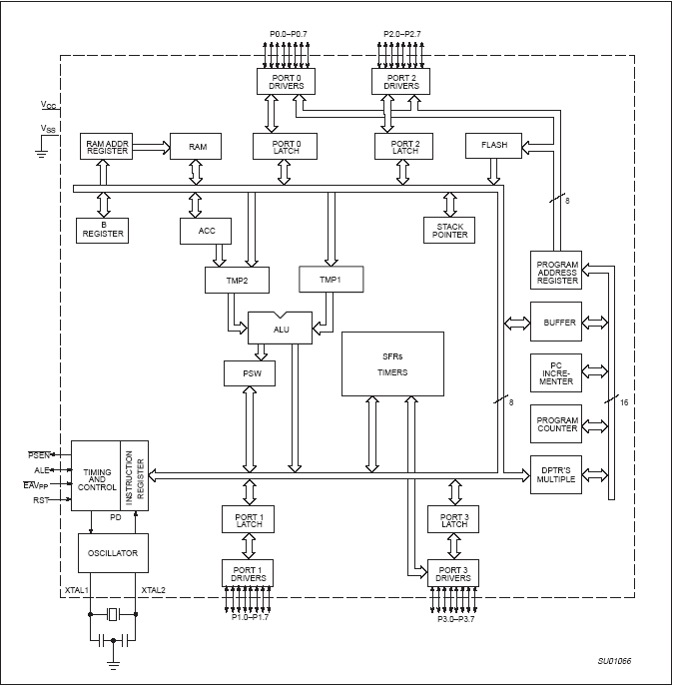
8051 – Block Diagram
4K bytes On-Chip ROM + 128 bytes RAM + 2 Timers
32 I/O Pins – 4 Ports each 8b wide
1 Serial Port + 6 Interrupt Sources
MCS-51 Family: 8052, 8031
  8052 – 256 bytes RAM + Timer (Timer2) + 8 interrupt sources
  8031 – ROM-less 8051

Slide 69
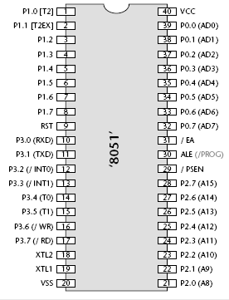
Pin Description
1-8 – Port 1 – bi-directional – individual control of pins as i/o
9 – Reset Pin
  Logic 0 – normal run mode of chip
  Logic 1 - >= 2 machine cycles – reset chip
10-17 – port 3 – bi-directional input port
  Dual role of individual pins
  P3.0 – RXD – receive serial data
  P3.1 – TXD – transmit serial data
  P3.2 and P3.3 – process external interrupts
  P3.4 and P3.5 – Alternative functions of T0 and T1
  P3.6 and P3.7 – r/w signals for external memory
18-19 – external crystal, ceramic resonator or oscillator module for clock source to the chip
20 – Ground Vss
21-28 – Port 2 – bi-directional input port
  Dual role - MSB address byte of 16b address to external memory
29 – PSEN – control access to external code memory
30 – ALE –
    When working with external memory
    Disabled to reduce EMI generated by the product
    Also used as PROG – program pulse input during flash programming
31 – EA
  Connected to Vcc to execute code from internal memory (on chip flash)
  Connected to ground to execute code from external memory
32-39 – Port 0 – bi-directional input port
  Does not have internal pull-up resistors
  Dual role – gives LSB address byte of 16 address to external memory
40 – Vcc – 5V pin

Slide 70
Memory Issues relating to 8051
Types of memory
  Computer tapes –access time varies for r/w wrt location on tape
  RAM – volatile r/w memories
    Same time for accessing any random memory element
  ROM – random access but non volatile
DRAM
  r/w memory
  Capacitor along with active elements to store data
  Circuit to refresh capacitor frequently for retention
  Volatile
SRAM
  r/w memory
  Use FF (active elements) to store information
  No refreshing
  Circuit is Costly than DRAM of same size
  Access time is 1/3 rd of DRAM

Slide 71
Memory Issues relating to 8051
Mask ROM
  RO from s/w developer perspective
  Manufacture able to write at the time of chip creation according to mask given by company
  Factory programmed ROM
  Not cheap and not an option of low volume
  Mistakes are expensive
  Providing code for first mask is like character building process
  Slower access times than DRAM
  8051 members with on chip, mask programmed ROM are available
PROM
  WORM (write once read only memory) or OTP
  PROM programmer – blow tiny fuses in the memory device
  Fuses blown cannot be repaired but devices are cheap
  Modern 8051 variants include OTP ROM

Slide 72
Memory Issues relating to 8051
UV EPROM
  Programmed electrically
  Has quartz window to erase memory by exposing the device to UV light
  Erasure takes several minutes
  Quartz window covered with UV opaque label after erasure
  Can withstand 1000’s of program / erase cycles
  Useful for prototyping but expensive to use in production
  More Flexible than PROM and rather primitive compared to EEPROM
  8051 members with on board UVEPROM are available
EEPROM and Flash ROM
  More user friendly form of ROM
  Can be both Programmed and erased electrically
  EEPROM erasure is byte-by-byte basis – used to store password or persistent user data
  FLASH ROM requires block sized erase operation before programming
    Size of block in order of several KB
    Used for storage of program code
  Many 8051 members have onboard EEPROM and Flash both

Slide 73
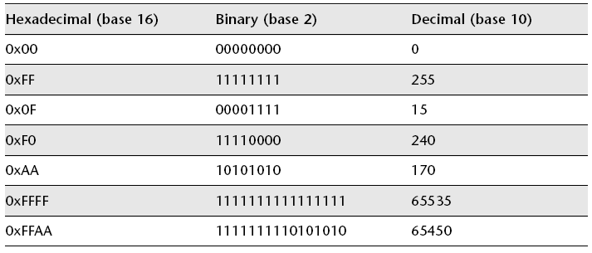
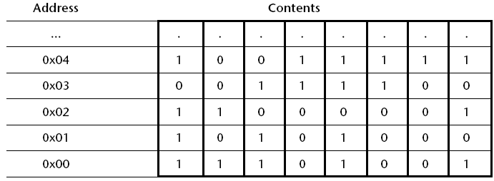
Memory Organization and hex
All data items in memory => binary codes in bits form
Memory locations with address => simplify storage and retrieval of data items
Byte oriented memory => each memory location has a byte with unique address
Memory addresses in hex notation
Hex – base-16 number system – compact way of representing large binary numbers
Table shows list of # with hex, ordinary and binary representations

Slide 74
8051 Memory Architecture
8051 – 128 Bytes of RAM (00H- 7FH)
RAM memory space allocation
  32 bytes (00H – 1FH) – register banks and stack
  16 bytes (20H – 2FH) – bit addressable r/w memory
  80 bytes (30H – 7FH) – Scratch pad
    Data and parameters of 8051 programs
Data Memory
  Store data variables and stack while program runs
  implemented using some form of RAM
  byte-oriented memory organization
  within the DATA area is a 16-byte BDATA area which can also be accessed using bit addresses
    used to store bit-sized variables
    has machine instructions which allow bit variables to be manipulated very efficiently
    instructions can be easily utilized from C
7FH
Scratch pad RAM
30H
2FH
Bit-Addressable RAM
20H
1FH
Register Bank 3
18H
17H
Register Bank 2
10H
0FH
(Stack) Register Bank 1
08H
07H
00H
Register Bank 0

Slide 75
8051 - CODE Memory
8051 – 4K bytes of on-chip ROM
Store program code – usually in some form of ROM
May contain read-only variables (‘constants’)
  such as filter co-efficients or data for speech playback
DTP PC Context
  Program copied from Disk to RAM
  Executed from RAM
Embedded System Context
  code is ‘executed in place’, from ROM
Consequence of the ‘execute in place’
  most applications, may require up to 10 kbytes of CODE memory, will rarely need much DATA memory
  Many 8051 - > 20 bytes On-Chip ROM + not >= 256 bytes of RAM
    appropriate mix for most general applications

Slide 76
Timers
Atleast 2 Timers – T0 and T1 (8052 – additional Timer T2)
16b Timers – hold (0 -65535) values
Incremented periodically: 8051 - every 12 osc cycles
8051 OSC – 12MHz => 1 million increments per second
Used to
  measure intervals of time
    For example, we can measure the duration of a function by comparing the duration at begin and end
  generate precise hardware delays
  generate ‘time out’ facilities - a key requirement in systems with real-time constraints
  generate regular ‘ticks’, and drive an operating system

Slide 77
Interrupts
Fundamental difference b/w DTP SW and Embedded SW
low-level perspective
  hardware mechanism to notify a processor that an ‘event’ occurs
  Internal events (overflow of timers) or
  External events (arrival of char through serial interface)
high-level perspective
  mechanism for creating multitasking applications
    App performing more than one task at a time using a single processor

Slide 78
8051 Interrupt Sources
8051/8052 – support 7 interrupt sources
  two or three timer/counter interrupts (related to Timer 0, Timer 1 and – in the 8052 – Timer 2)
  Two UART-related interrupts
    share the same interrupt vector - viewed as a single interrupt source
  Two external interrupts
  In addition, there is one further interrupt source over which the programmer has minimal control
    The ‘power-on reset’ (POR) interrupt

Slide 79
Serial Interface
8051 - serial port compatible with RS-232 communication protocol
  transfer data b/w 8051 and desktop PC/notebook PC or similar
  Serial interface is common in embedded processors and widely used
The serial port may be used to
  debug embedded applications, using a desktop PC
  load code into flash memory for ‘in circuit programming’ (ISP)
    when code must be updated ‘in situ’ (for example, when the product is already installed in a vehicle, or on a production line)
  transfer data from embedded data acquisition systems to a PC, or to other embedded processors

Slide 80
Timers and Counters
crucial component of most embedded systems.
  In some cases, a timer measures elapsed time (counting processor clock ticks)
  In others, we want to count or time external events.
The names counter and timer can be used interchangeably when talking about the hardware.
The difference in terminology has more to do with how the hardware is used in a given application.
  Both differs largely by their use and not in logic

Slide 81
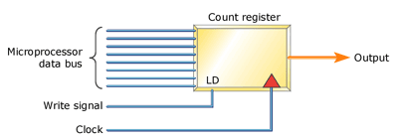
A Simple Timer / Counter
simple timer similar to those often included on-chip within a microcontroller
  build something similar from a couple of 74HC161 counters or a programmable logic device.
The timer shown consists of a loadable 8-bit count register, an input clock signal, and an output signal
Software loads the count register with an
initial value between 0x00 and 0xFF.
Each subsequent transition of the input
clock signal increments that value.
When the 8-bit count overflows, the output signal is asserted.
The output signal may thereby trigger an interrupt at the processor or set a bit that the processor can read
To restart the timer, software reloads the count register with the same or a different initial value.
If a counter is an up counter, it counts up from the initial value toward 0xFF.
A down counter counts down, toward 0x00.
Start counter usually by setting a bit in a control register
real counter would generally also provide a way for the processor to read the current value of the count register at any time, over the data bus

Slide 82
Semi-Automatic Timers
A timer with automatic reload capability
  will have a latch register to hold the count written by the processor
Initial value as starting point
When the processor writes to the latch, the count register is written as well
When the timer later overflows,
  it first generates an output signal
  then, it automatically reloads the contents of the latch into the count register
Since the latch still holds the value written by the processor, the counter will begin counting again from the same initial value
Such a timer will produce a regular output with the same accuracy as the input clock.
This output could be used to generate
  a periodic interrupt like a real-time operating system (RTOS) timer tick,
  provide a baud rate clock to a UART, or
  drive any device that requires a regular pulse.

Slide 83
Semi-Automatic Timers
Initial value as end point
timers uses the value written by the processor as the endpoint rather than the initial count
  In this case, the processor writes into a terminal count register that is constantly compared with the value in the count register
The count register is always reset to zero and counts up
When it equals the value in the terminal count register, the output signal is asserted
Then the count register is reset to zero and the process repeats
The terminal count remains the same
Initial Value or Terminal Value
The overall effect is the same as an overflow counter.
A periodic signal of a pre-determined length will then be produced.

Slide 84
Software Configuration for Timer modes
If a timer supports automatic reloading, it will often make this a software-selectable feature
To distinguish between a count that will not repeat automatically and one that will, the hardware is said to be in one of two modes:
  one-shot or periodic
The mode is generally controlled by a field in the timer's control register

Slide 85
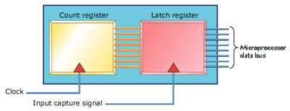
Input Capture Timer
has a latch connected to the timer's count register
timer is run at a constant clock rate (usually a derivative of the processor clock )
  so count registers is constantly incrementing (or decrementing, for a down counter)
On an external signal
  latches the value of the free-running timer into the processor-visible register and
  generates an output signal (typically an interrupt)

Slide 86
Input Capture Timer
Use for:
  to measure the time between the leading edge of two pulses.
    By reading the value in the latch and comparing it with a previous reading, the software can determine how many clock cycles elapsed.
In some cases, the timer's count register might be automatically reset just after its value is latched
  If so, the software can directly interpret the value it reads as the number of clock ticks elapsed
input capture pin can usually be programmed to capture on either the rising or falling edge of the input signal.

Slide 87
Bus Based Computer Systems
Created using up, IO devices and memory components
Up is vital components of embedded computing system
  Cannot do job without IO devices and memories
How interconnect up and devices using cpu bus
Similarities in bus b/w platforms required for different applications – general useful principles from basic concepts of bus
To Know
  Cpu bus – back bone of hw system
  Memory – important component of embedded platforms – types of memory devices
  Varieties of IO devices types
  Basic techniques for interfacing memories and IO devices to the cpu bus
  Structure of complete platform
  Development and debugging
  System level performance analysis for bus based systems
  Alarm clock design example

Slide 88
The CPU Bus
Computer system
  encompasses much more than CPU
  also includes memory and IO devices
Bus – mechanism by which cpu communicates with memory and IO devices
Bus
  collection of wires + also defines protocol by which cpu, memory and devices communicate
  Major role of bus – to provide interface to the memory and IO devices
  Characteristics of memory and IO device components is important

Slide 89
Memory issues in Embedded Systems
Modern microprocessors do more than just read and write a monolithic memory.
Architectural features improve both the speed and capacity of memory systems.
  Microprocessor clock rates are increasing at a faster rate than memory speeds
    memories are falling further and further behind microprocessors every day.
  computer architects resort to caches to increase the average performance of the memory system.
  Although memory capacity is increasing steadily, program sizes are increasing as well, and designers may not be willing to pay for all the memory demanded by an application

Slide 90
Memory – Bus – Design Factors
Functional aspects of memory
Bus + Protocol
Memory + Controller
Factors for designing memory subsystem
  Speed
  Capacity or Size (not physical size)
  Cost

Slide 91
Memory Classification
Based on holding data
Hold data irrespective of power => Volatile and Non-Volatile
  Volatile => memory contents erased when the power goes off
  Non – Volatile => memory holds contents (data) even if power is not there
  Ex: Magnetic Tape
    does not require power all the time to store the data
    contents available even if power is off
    volatile still can be used as back up
Functional perspective of Memory SS
ROM and RAM - RO and R/W
    RO
      CPU place the address and it can only send read control signal
      content of the address location is passed on data bus
    R/W
      random access
      any location in memory can be accessed at the same rate
        same rate => time to place address and get the data is going to be same for all the locations in memory, so it can be randomly accessed
  counter part of random access is serial access => block by block or byte by byte
  so in serial access time taken to access is < n+1th block

Slide 92
Memory Classification
Semiconductor based Memories
  Ex: all RAM / ROM subsystems comes under this classification
  since they make use appropriate semiconductors for storage
Contrast to semiconductor memory is magnetic tape
  Magnetic Tapes are used solely for storage purpose
  Farther away from CPU compared to other memories
  closer to CPU is Memory and farther to CPU is Tape or any storage systems
Based on how exactly data stored
  Static RAM
    Principle: Current flow exists through some active element as long as power exists
    Fast but costly
  Dynamic RAM
    Passive element along with active element
    Memory controller to take care of memory retention in passive element
    Slow with higher capacity and less cost

Slide 93
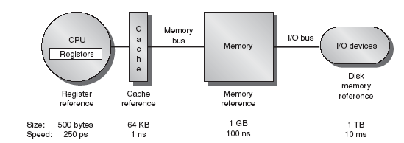
Memory Hierarchies
Memory Hierarchy basically comes from
  Speed mismatch b/w CPU and Memory System
  Principle of Locality and focus on
  Increasing the processor utilization
Speed - Size or Capacity - Cost are in linear relation
Fast, Medium and Slow Memories by dividing entire address space into sections
  Fast Memory – Cache – SRAM – easy and peak access – less size
  Medium Memory – Main Memory – RAM – DRAM – medium size
  Slow Memory – storage subsystems – Tapes or HDD – CPU may not directly access - larger size
    Ex: 1KB cache - 1GB RAM - 1TB HDD
Ensure that CPU always access only the faster memory in order to keep the processor utilization always up
  CPU essentially access the cache – so entire address space will not used by same kind of memory

Slide 94
Cache
SRAM – Closest – Fastest – Costlier - Less Size
  Ex: 1KB Cache
Caches are widely used to speed up memory system performance
Many microprocessor architectures include caches as part of their definition
cache speeds up average memory access time when properly used
increases the variability of memory access time
  accesses in the cache will be fast,
  while access to locations not cached will be slow
cache is a small, fast memory that holds copies of some of the contents of main memory
  Because the cache is fast, it provides higher-speed access for the CPU
  But since it is small, not all requests can be satisfied by the cache, forcing the system to wait for the slower main memory

Slide 95
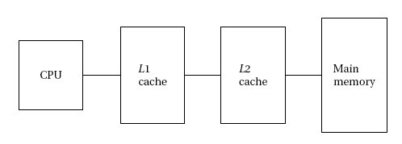

Multi Level Caches
Modern CPUs may use multiple levels of cache
A Two Level Cache System is shown
The first-level cache (commonly known as L1 cache) is closest to the CPU

