Slide 1

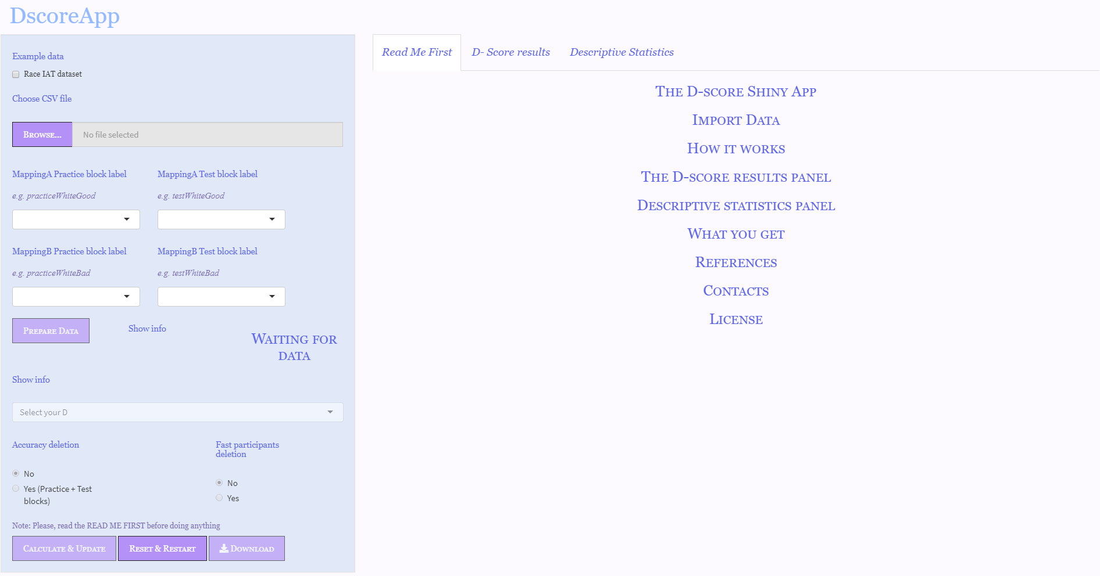

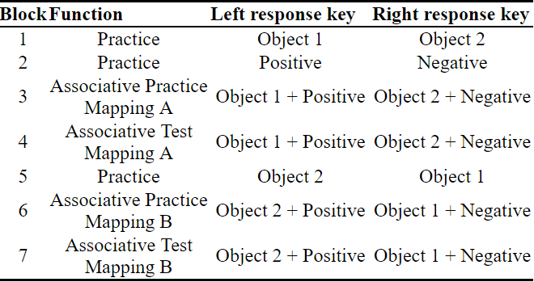
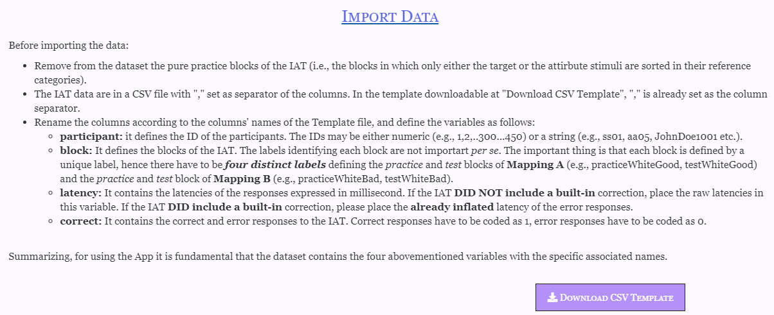
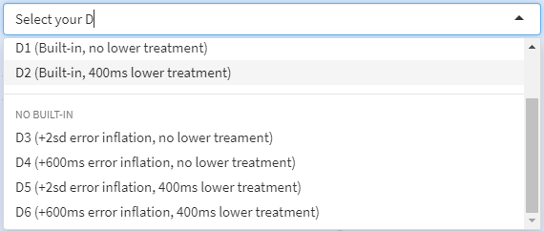
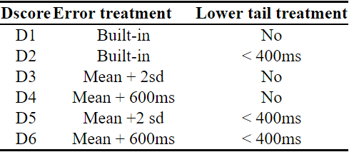




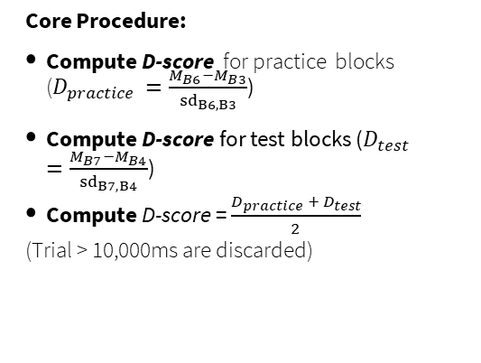
DscoreApp : : CHEAT SHEET Ottavia M. Epifania, Pasquale Anselmi, & Egidio Robusto, University of Padova
The Implicit Association Test
DscoreApp
Appereance & Input
The Implicit Association Test (Greenwald et al., 1998) is one of the most commonly used measures for the implicit assessment of attitudes and preferences. It is based on the speed and accuracy with which stimuli representing four different categories (two contrasting objects and positive and negative attributes) are sorted in their belonging category by means of two response keys.
Toy dataset
Import data (CSV)
IAT Structure
IAT Blocks labels
Warn when data are ready
Prepare data for computation
IAT D-score
Core Procedure:
Compute D-score for practice blocks ($D_{practice }=\frac{M_{B6}−M_{B3}}{{sd}_{B6, B3}}$)
Compute D-score for test blocks ($D_{test }=\frac{M_{B7}−M_{B4}}{{sd}_{B7, B4}}$)
Compute D-score = $\frac{D_{practice} + D_{test}}{2}$
(Trial > 10,000ms are discarded)
Render settings changes in the results
Restart app
Download Template
Download results
Algorithms:
works
with
Getting started – Prepare dataset
Getting started – Compute
and wait for
Prepare a CSV file with comma set a separator
Get rid of the pure practice blocks (B1, B2, & B5)
Name the columns as following:
participant: Participants’d IDs
block: IAT blocks labels (4 unique labels)
latency: Response times in milliseconds
correct: response accuracy (either 0 or 1)
Save the file & upload it with
Click on
Choose a D-score from the drop-down menu
Discard inaccurate partcipants (Accuracy deletion)?
Discard fast partcipants (Fast participants deletion)?
Click on
Click this button everytime you want to make a change effective!
Any bugs, problems, or just a question? Report them here: https://github.com/OttaviaE/DscoreApp/issues
marinaottavia.epifania@phd.unipd.it

Slide 2
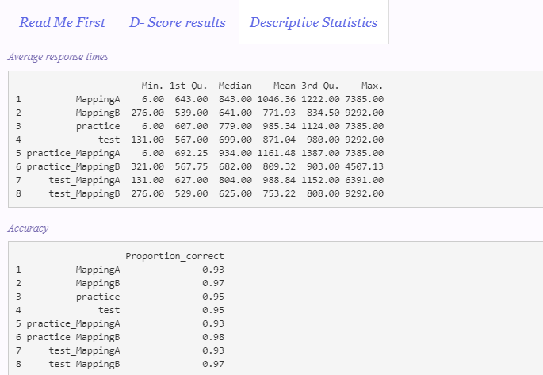
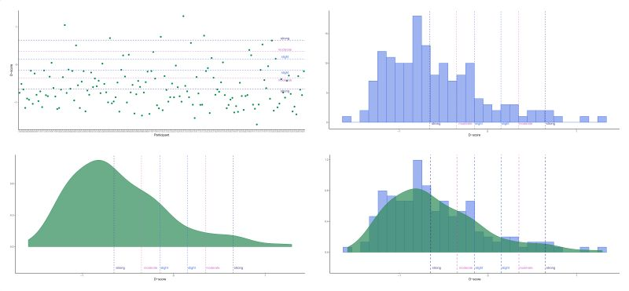
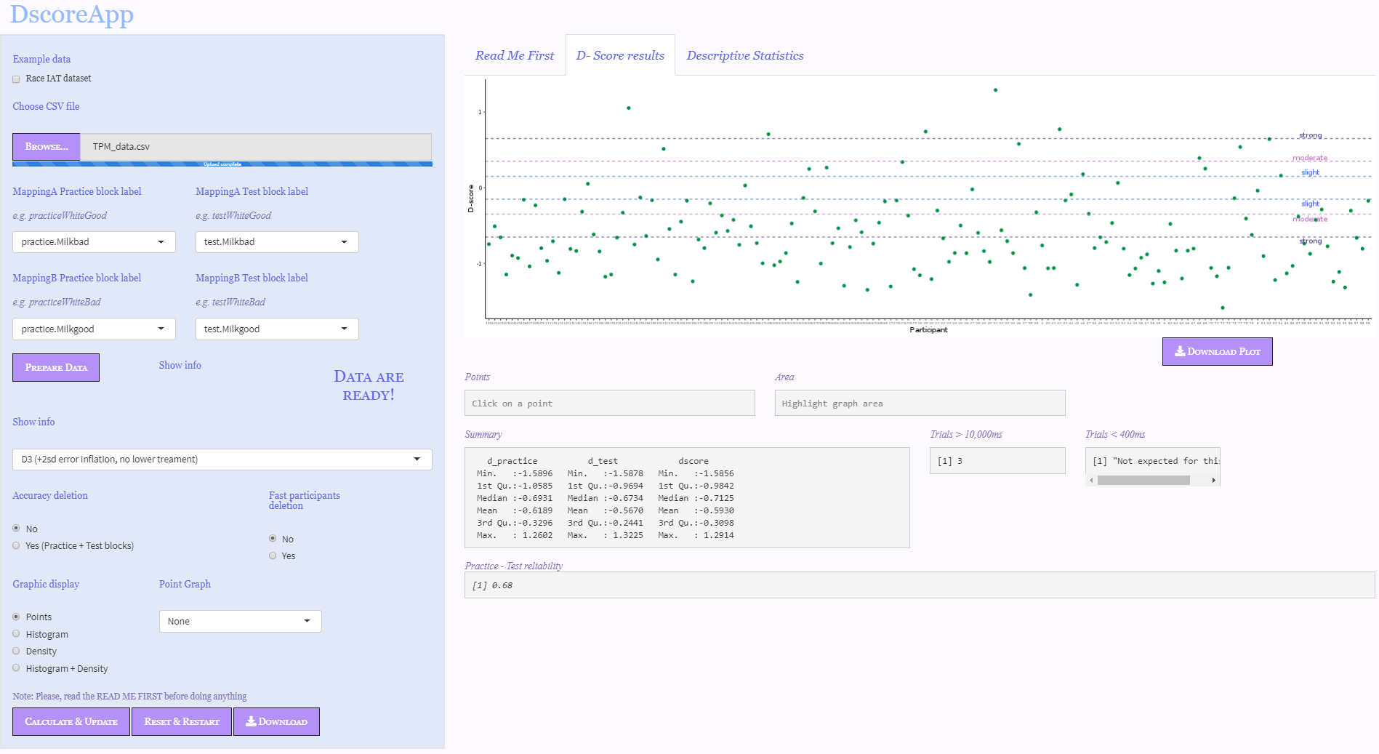


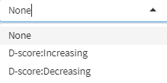
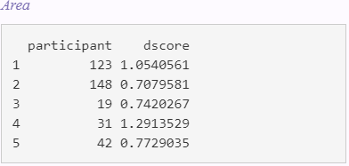
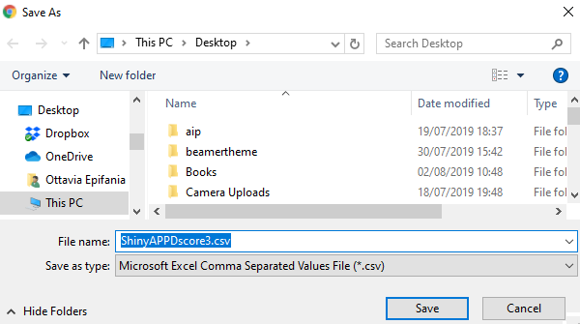
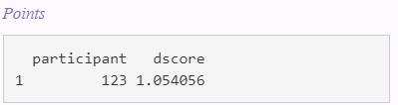


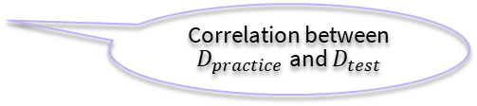
Graphs and Results
Available graphs
Results will appear in the
“D-score results” Panel. Once the first D-score is computed, the
button is
activated, and results can be downloaded in a CSV format. By clicking on the
section in the
panel, it is possible to obtain infos on the contents of the CSV file.
Dowloand Plot (PDF)
# of trials > 10,000ms
Choose graph type
# trials < 400ms (according to the algorithm)
Correlation between $D_{practice}$ and $D_{test}$
Highlight a graph area:
You’ll get the participants’ IDs and D-scores
Choose partcipants’
order of presentation
Select a point in the graph:
You’ll get the participant’s ID and D-score
http://fisppa.psy.unipd.it/DscoreApp/
https://github.com/OttaviaE/DscoreApp (Source Code)
Any bugs, problems, or just a question? Report them here: https://github.com/OttaviaE/DscoreApp/issues
marinaottavia.epifania@phd.unipd.it

