Slide 1
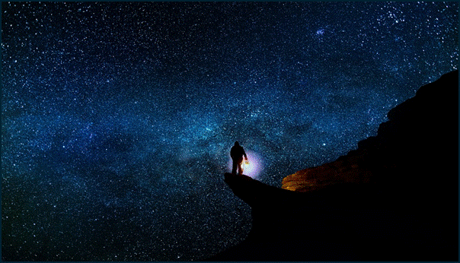

Hiking Backpack
You are going on a hiking trip with your daughter Juno. While planning the trip, she asks you to secure her favourite plushy in the “special backpack”. You oblige and secure the plushy with a series of locks.
The issue is, you have ADHD and know you won’t be able to remember all the combinations!
But you planned ahead and left yourself clues to help find the correct combinations.
Good luck!

Slide 2




Backpack flowchart (1/3)
1 - Start of Backpack
2 – Front Compartment
Includes (needed):
Includes (for later):
Includes (needed):
Includes (for later):
Water bottle + stickers
Welcome card with QR code
N/A
Note card (ADHD & Plushy)
Word search + sudoku page
Lego number (0 blue)
Lego hobbies pieces
Sticker with IV blue
Solution:
Stickers have hidden number in the animals. The order is the era of the animals depicted.
Solution:
Word search draws a 7 and a 3 (from the words in the note) and the highlighted box in the sudoku is a 4.
Code:
7 4 9
Unlocks:
Front Compartment
Code:
7 3 4
Unlocks:
Front pocket
3 – Front Pocket
4 – Large Compartment
Includes (needed):
Includes (for later):
Includes (needed):
Includes (for later):
Card from grandparents
News article about dog
Value of v (back of news clipping)
Periodic table
Note about stars and ISS
Calculator
Locked pouch + final bag
ISS instructions + Note
Lego cube
Lego jobs pieces
Solution:
On the dog’s collar, you can see the name of the dog: MOON.
Solution:
Solution is the sum of each number of the elements mentioned in the ISS note (KNoWN PHYSiCs).
Code:
M O O N
Unlocks:
Large Compartment
Code:
6 2 3
Unlocks:
Top Pocket

Slide 3

Backpack flowchart (2/3)
5 – Top Pocket
2 – Front Compartment
Includes (needed):
Includes (for later):
Includes (needed):
Includes (for later):
Lego pieces for satellite
Lego number (4 orange)
Lego pets' pieces
Note card (ADHD & Plushy)
Word search + sudoku page
Lego number (0 blue)
Lego hobbies pieces
Sticker with IV blue
Solution:
Stickers have hidden number in the animals. The order is the era of the animals depicted.
Solution:
Word search draws a 7 and a 3 (from the words in the note) and the highlighted box in the sudoku is a 4.
Code:
8 1 4
Unlocks:
Front Compartment
Code:
7 3 4
Unlocks:
Front pocket
3 – Front Pocket
4 – Large Compartment
Includes (needed):
Includes (for later):
Includes (needed):
Includes (for later):
Card from grandparents
News article about dog
Value of v (back of news clipping)
Periodic table
Note about stars and ISS
Calculator
Locked pouch + final bag
ISS instructions + Note
Lego cube
Lego jobs pieces
Solution:
On the dog’s collar, you can see the name of the dog: MOON.
Solution:
Solution is the sum of each number of the elements mentioned in the ISS note (KNoWN PHYSiCs).
Code:
M O O N
Unlocks:
Large Compartment
Code:
6 2 3
Unlocks:
Top Pocket

Slide 4






Backpack flowchart
Start Backpack
Needed:
Water bottle
Card + QR code
Additional:
None
Solution: 749
-> Opens medium pocket
Medium pocket
Needed: 734
Note card
Word search
Additional:
None
Opens front pocket
Front pocket
Needed: MOON
Grandparent card
News clipping
Additional:
None
Opens main pocket
Main pocket
Needed: 326
Periodic table
Notes stars/ISS
Additional:
Treasure pouch
Locked pouch
Instructions Lego
ISS equation
Calculator
Top pocket
Needed: 414
Lego satellite pieces
Additional:
None
Inside pocket
Needed: 102
Otter puzzle
Hockey cards
Additional:
None
Outside pocket
Needed: 518
Last Lego Puzzle
Previous puzzles
Additional:
None
Large pocket
Needed: DICK
Notepad with riddle
Additional:
None
Smaller pocket
Needed: 263
Map puzzle
Agenda
Additional:
None
Final Pouch
Needed: 4130
Map puzzle
Agenda
Additional:
None

Slide 5
Backpack flowchart
Start of the backpack:
Includes (mandatory): Water bottle
Needs from previous: N/A
Includes (later): card with QR code (in the side pocket)
Solution is 749 (numbers hidden on animals)
Opens the front compartment:
Includes (mandatory): ADHD note + Word Search + pen
Needs from previous: Lego Zero Blue
Includes (later): Number IV in blue for last clue + Hobbies pieces
Solution is 734 (numbers in word search + sudoku box)
Opens the front pocket:
Includes (mandatory): Includes a card from grandparents + a news clipping
Needs from previous: N/A
Includes (later): v value for ISS equation at the back
Solution is MOON (name on the collar)
Opens the main compartment:
Includes (mandatory): Periodic Table + Stars notes
Needs from previous: N/A
Includes (later): Lego instructions + ISS equation Notes + Calculator + Final Pouch + Locked Pouch + Lego Cube + Jobs Pieces
Solution is 326 (sum of elements on periodic table)
Opens top of the backpack:
Includes (mandatory): Lego pieces for satellite
Needs from previous: ISS Note + Calculator
Includes (later): Lego Four Orange + Pets pieces
Solution is 414 (equation + six)
Opens the inside backpack pocket:
Includes (mandatory): Otter puzzle + Hockey Cards
Needs from previous:
Includes (later): Square Lego Puzzle + Heads pieces
Solution is 102 (sum of all Canadian born hockey players cards)
Opens the front pouch pocket:
Includes (mandatory): Flat Lego puzzle
Needs from previous: 2 other Lego puzzles + Grandparents card
Includes (later): Hair Pieces
Solution is 518 (numbers on the Lego puzzles, order from the card)
Opens the pouch compartment:
Includes (mandatory): Notepad with clues + Names Pieces
Needs from previous: Lego pieces for characters
Includes (later): Lego One Brown
Solution is DICK (sum of elements on periodic table)

Slide 6
Backpack flowchart
Opens back pouch pocket:
Includes (mandatory): Map in pieces + Agenda
Needs from previous: Names of all characters
Includes (later):
Solution is 263 (2 from map, 6 3 from date)
Opens inside pouch pocket:
Includes (mandatory): Number 3 red in Lego
Needs from previous: Other Lego numbers + inscription on order
Includes (later): Solution is 4130 (Lego numbers + correct order)
Opens the final pouch:
Get the gift + congrats card

Slide 7
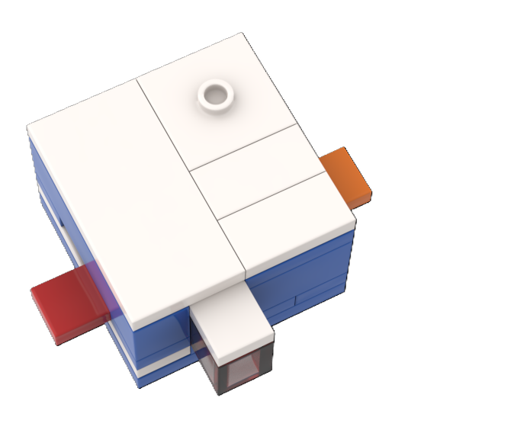
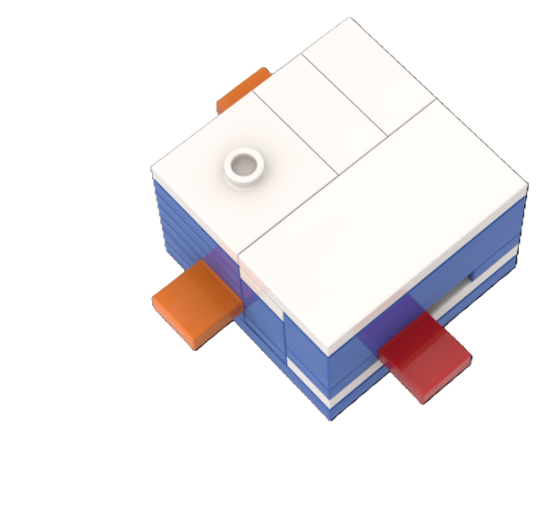
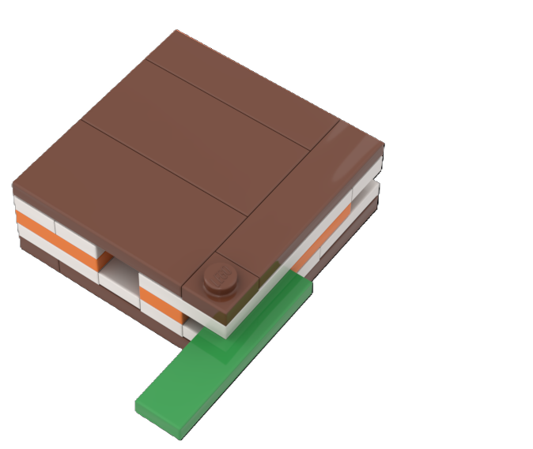
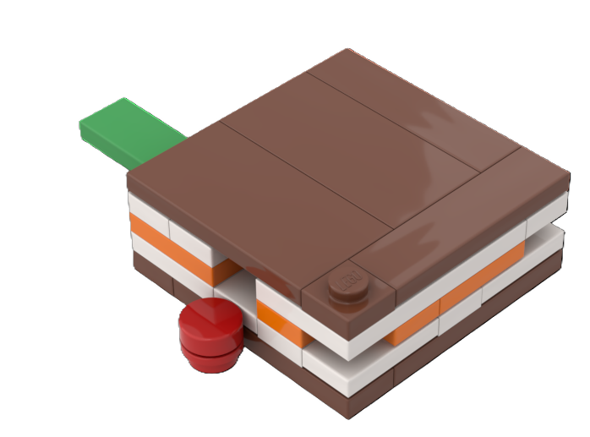
2
1
3
1
2
3

Slide 8




Icons for locks
II
IV
I
III
A
Lock 1 – Water Bottle
Code: 749
Lock 6 – Hockey Puzzle
Code: 102
Lock 2 – Word Search + Sudoku
Code: 734
Lock 7 – Lego Puzzles
Code: 518
Lock 3 – News Article
Code: MOON
Lock 8 – Einstein Riddle
Code: DICK
Lock 4 – Periodic Table
Code: 326
Lock 9 – Errands Map
Code: 263
Lock 5 – ISS equation
Code: 409
Lock 10 – Lego Numbers
Code: 4130
GM = 401,926.91 km³/s²
R_{e} = 6,371 km

Slide 9


Icon v2
1
2
3
4
5
A
B
C
D
6
7
8
9
10
1

Slide 10
Website Design
#1f3a2e
#d4a668
#f4ede0
#d4a668
#a8492b
#1a1814

Slide 11
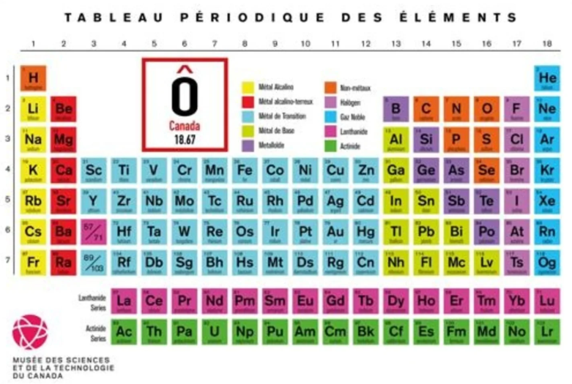

Slide 12
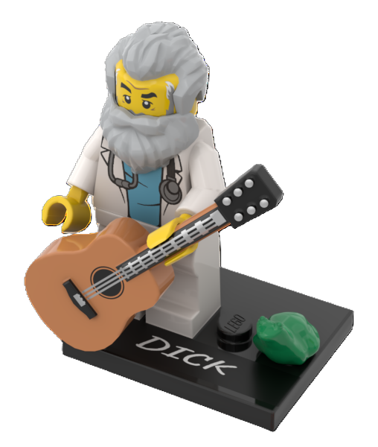
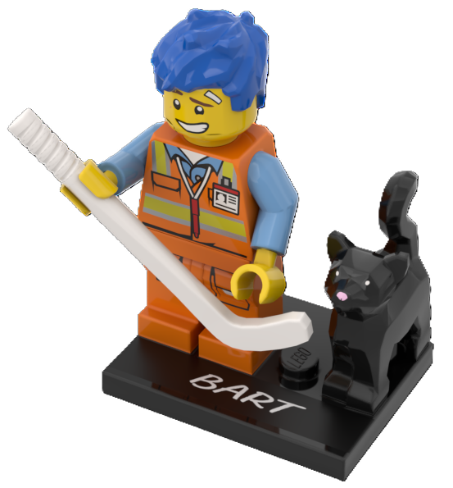
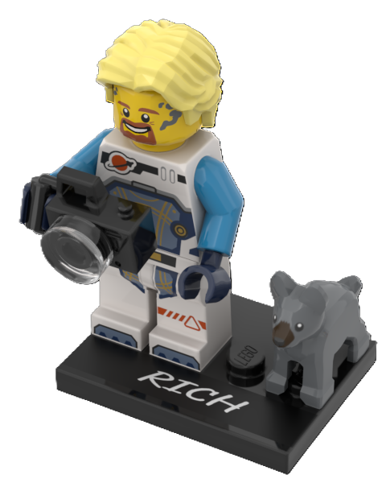
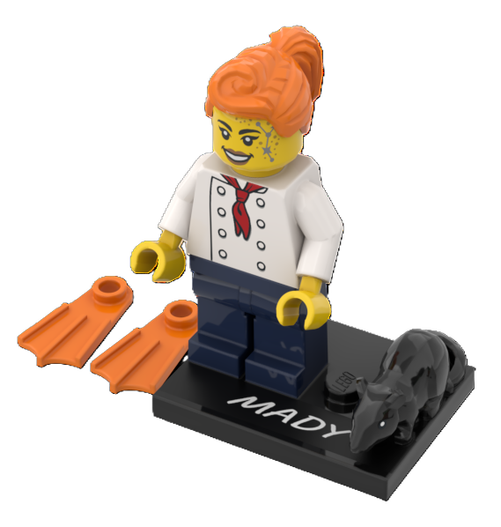
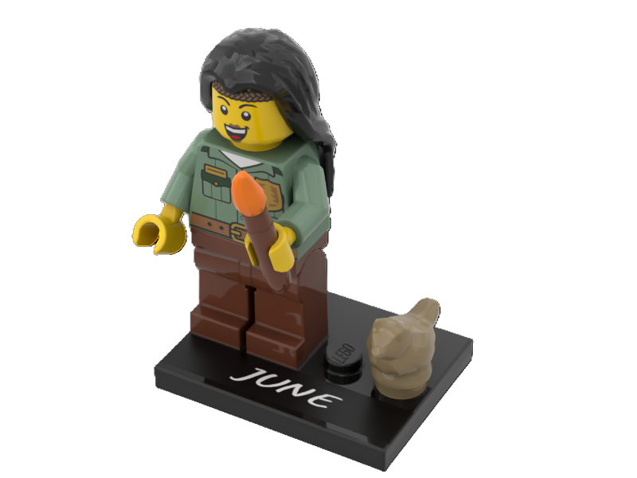

Slide 15














N

Slide 16
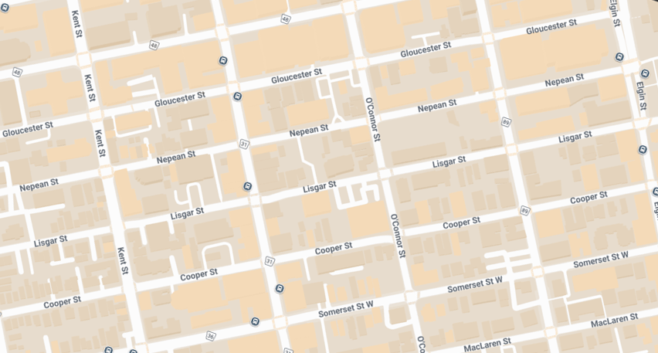

Rich’s house
June’s house
Dick’s house
Mady’s house
Bart’s house

Slide 17
Rich’s house
June’s house
Dick’s house
Mady’s house
Bart’s house

Slide 18
Rich’s house
June’s house
Dick’s house
Mady’s house
Bart’s house

Slide 19
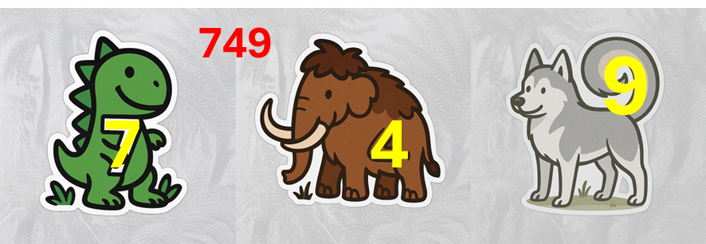



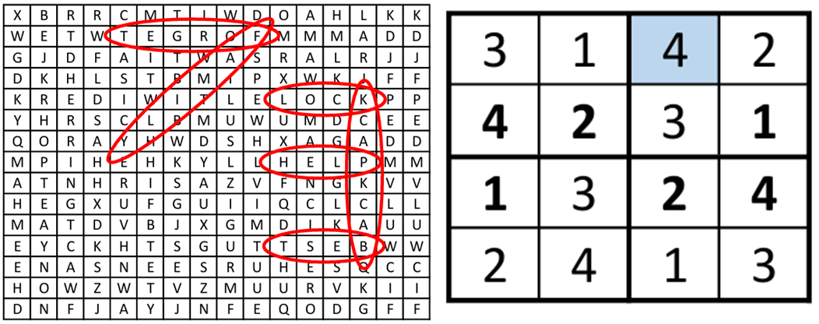
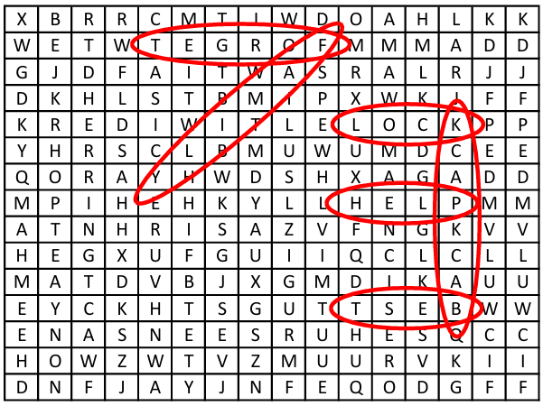
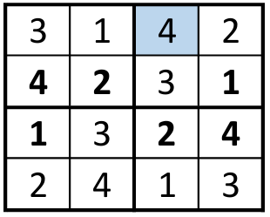
Solutions
749
9
7
4

Slide 20
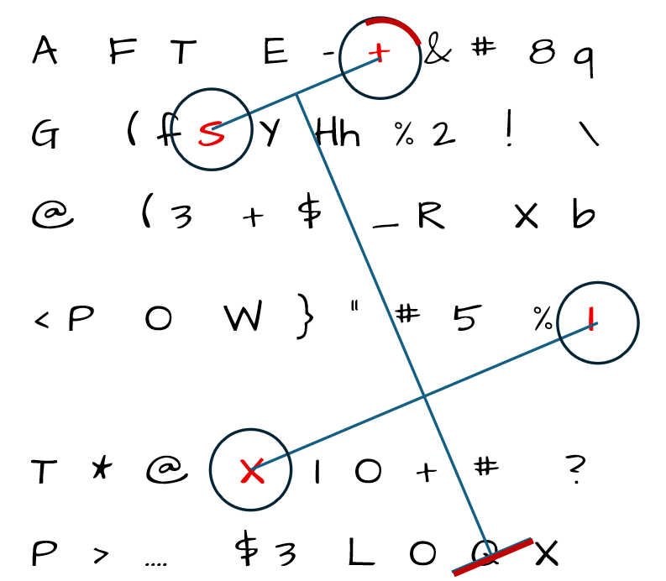


Solutions

Slide 21
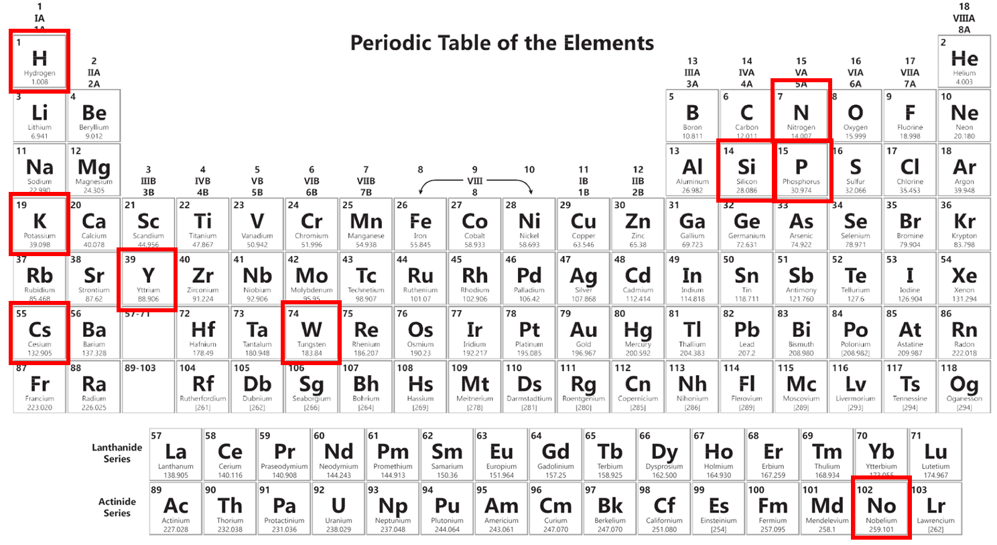
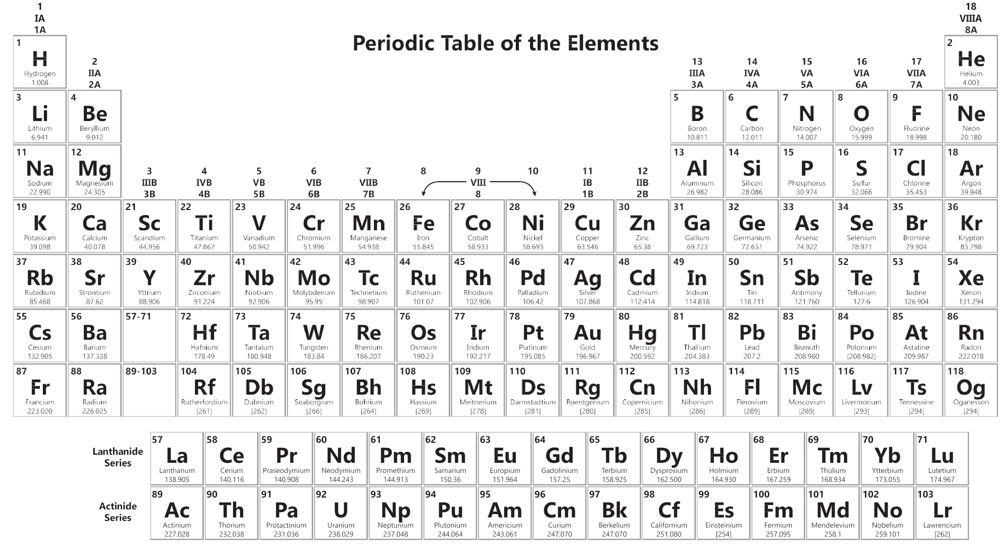
Solutions

Slide 22


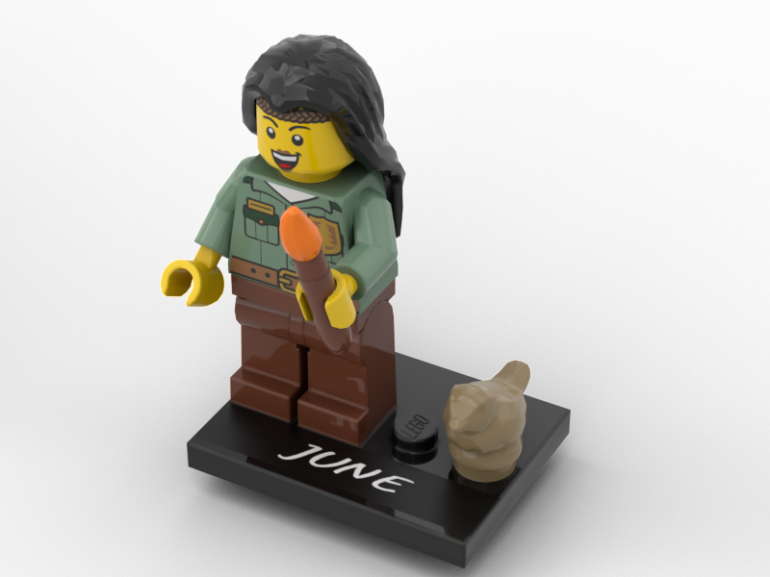

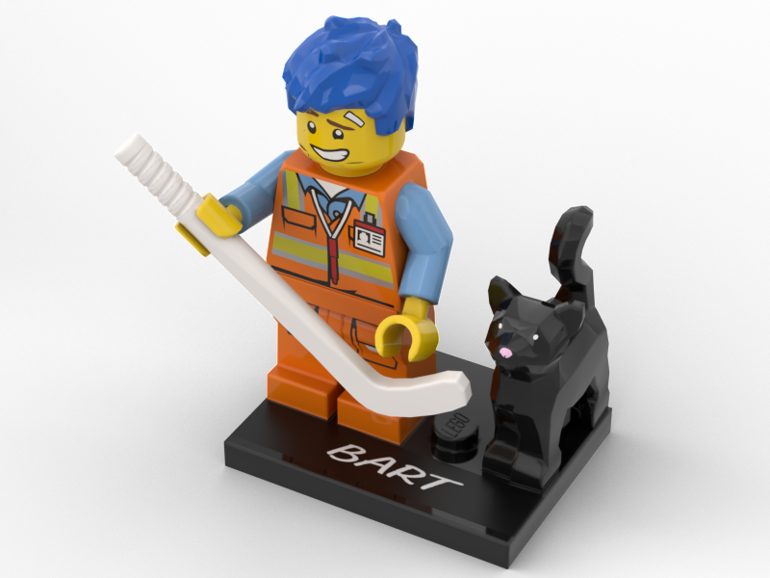
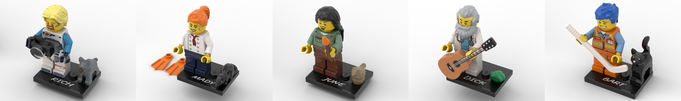
Solutions

Slide 23
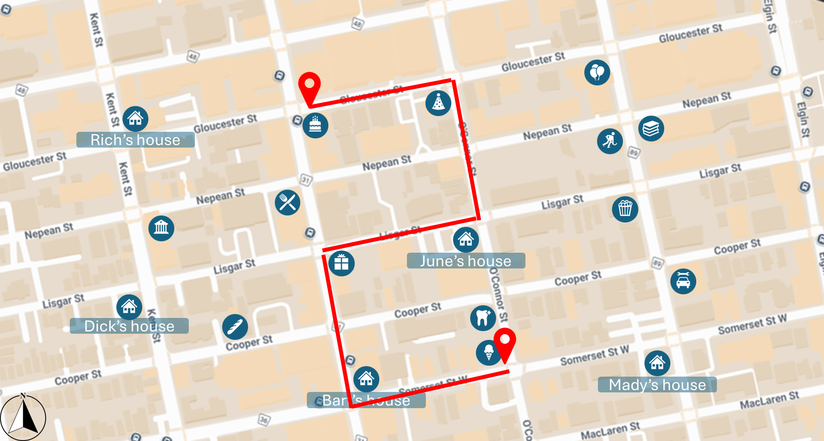
Rich’s house
June’s house
Dick’s house
Mady’s house
Bart’s house

