Slide 1
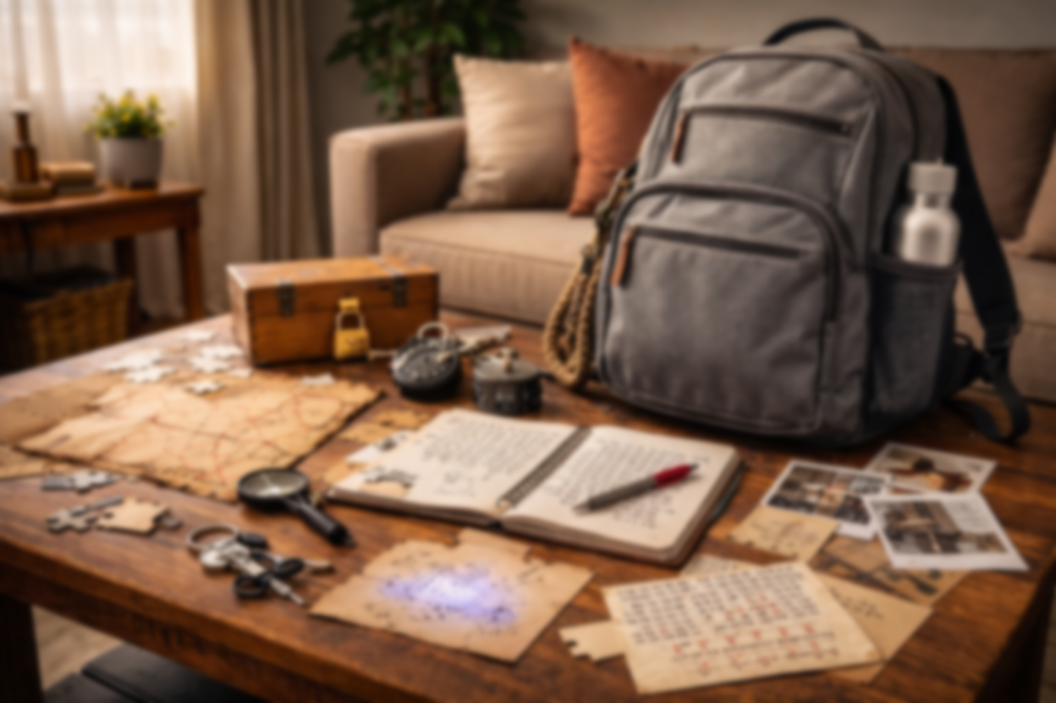
Escape Backpack
Information about the different Escape Backpack adventures and ideas for future Backpacks

Slide 2
story
You received a box from your great-aunt that has been traveling the world for the last decade. She has been researching your family history and your Nordic origins.
Final reveal is a plane ticket to join her in Norway for an archeological dig.

Slide 3
Design Ideas
Fonts to be used:
Norse

Slide 4
Puzzles Clues ideas
Use runes for a cypher
Use the norse chess game
Use norse mythology

Slide 5
Postcard design
Handwritten note
Stamp
Address
Fun fact

