Slide 1
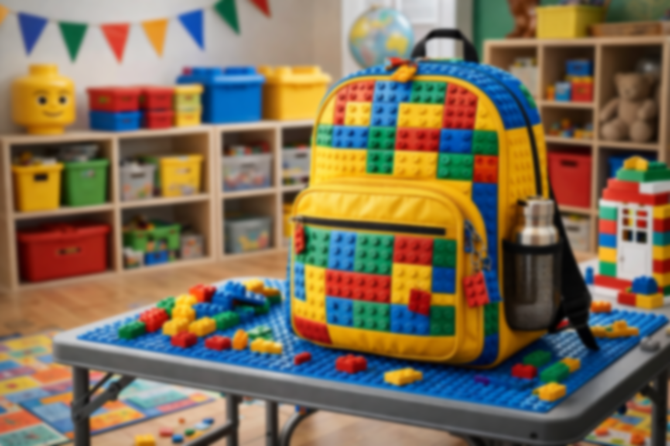
Lego Backpack
Information about the different Escape Backpack adventures and ideas for future Backpacks

Slide 2

Ideas
What would be the adventure:
Simple backpack for kids
Re-uses other backpack clues/puzzles but in a simpler version
Story could be trying to free a Lego minifigure from a locked box
Lego minifigure could be changed to be the kid’s interest (wizard, astronaut, doctor…) and for them to keep
Font ideas:
DynaPuff: https://fonts.google.com/specimen/DynaPuff
Chewy: https://fonts.google.com/specimen/Chewy

Slide 3

Physical Puzzle Ideas
Powders (baking soda, sugar, salt) to be mixed with vinegar. The one that reacts is the correct code.
Lego panels that when assembled correctly give you a number
Simple Einstein Riddle with 3 characters: Wizard, Astronaut, Princess
Could have different versions with different genders
Lego map with instructions to go from one place to the next. Reveals a number.
can be laminated and have a marker to help. Marker could be attached to vehicle to be more interactive
Lego contraption that has levers/wheels and will reveal the code with the correct sequence
Use elastic band to force position back
Lego build that contains a certain number of stud per colour (3 colours of the lock)

