Slide 1
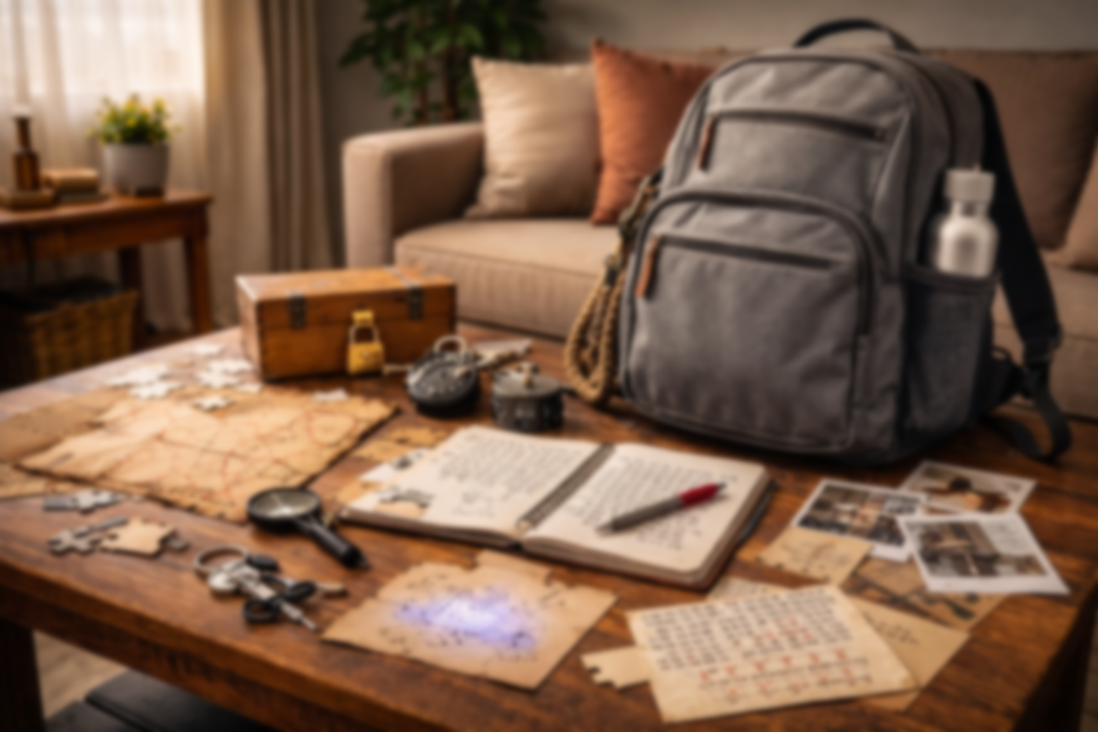
Escape Backpack
Information about the different Escape Backpack adventures and ideas for future Backpacks

Slide 2
Names ideas
Potential names for the whole thing:
Escape Backpacks
Good Lock
Good Lock Backpacks

Slide 3
How to share?
Potential ways to share the backpack adventures:
Retirement homes?
Libraries?
Schools?
Reddit post?
Work? (social committees)

Slide 4
Backpack Ideas
Fairy/Magic backpack
Viking backpack
Medieval backpack
Cold war/spy backpack

Slide 5
Physical Puzzle Ideas
3D printed canals with different slopes. Fill with the correct amount of liquid to reveal a number
Receptacles to fill with liquid that will change to orientation of the text placed behind

Slide 6
Electronic Puzzle Ideas (Ardiuno)
3D printed box with electronic part that needs the correct code to open the door
Item with places for pieces that need to be placed in the correct spot to reveal a code on a small display

Slide 7
Digital Puzzle Ideas
Map with coordinates

Slide 8
Font ideas
Cool Fonts that we can use:
Quantico: https://fonts.google.com/specimen/Quantico
Cinzel: https://fonts.google.com/specimen/Cinzel
IBM Plex Mono: https://fonts.google.com/specimen/IBM+Plex+Mono
Special Elite: https://fonts.google.com/specimen/Special+Elite
Macondo: https://fonts.google.com/specimen/Macondo
Pirata One: https://fonts.google.com/specimen/Pirata+One
Ceasar Dressing: https://fonts.google.com/specimen/Caesar+Dressing
Uncial Antiqua: https://fonts.google.com/specimen/Uncial+Antiqua
Orbitron: https://fonts.google.com/specimen/Orbitron
Architects Daughter: https://fonts.google.com/specimen/Architects+Daughter
Skranji: https://fonts.google.com/specimen/Skranji?preview.script=Latn

Slide 9
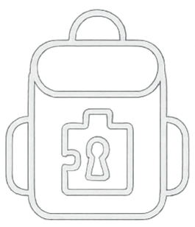


Design elements

Slide 10
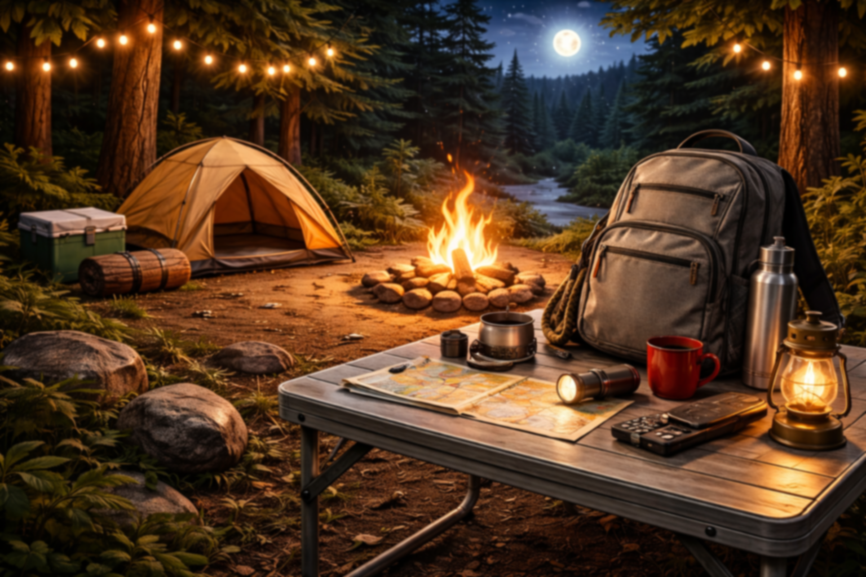
Hiking Backpack
You and your daughter are going on a hiking trip soon. She asked you to lock her favourite plushy in the “special backpack” so it would be safe for the trip. With your ADHD, you know you tend to forget things, so you left yourself clues to help you unlock the backpack and retrieve your daughter’s plushy.

Slide 11
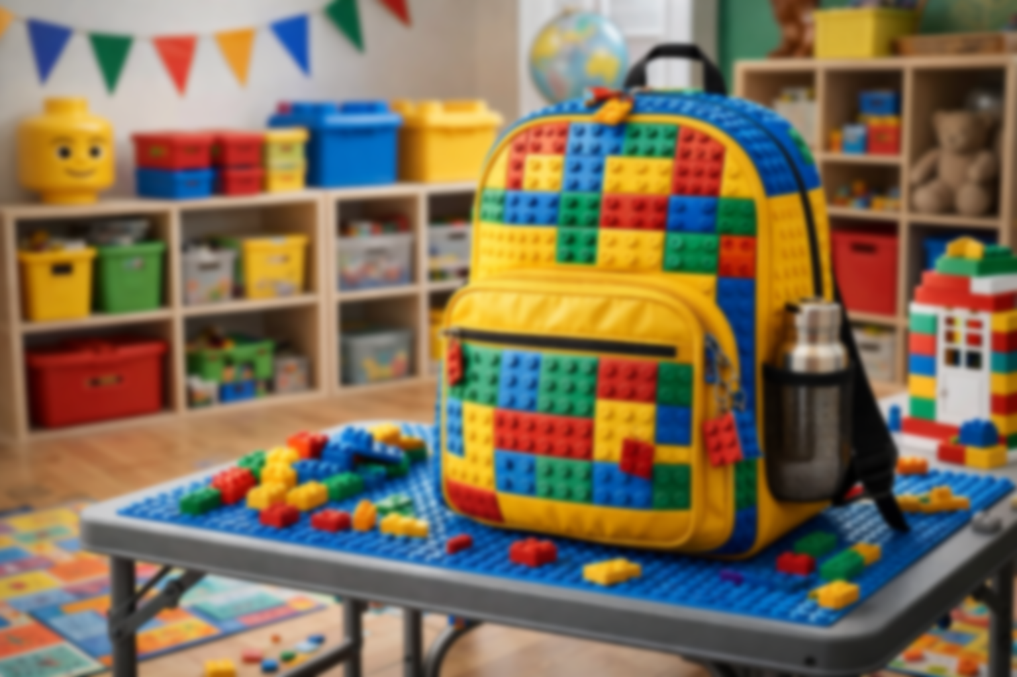
Lego Backpack
You and your daughter are going on a hiking trip soon. She asked you to lock her favourite plushy in the “special backpack” so it would be safe for the trip. With your ADHD, you know you tend to forget things, so you left yourself clues to help you unlock the backpack and retrieve your daughter’s plushy.

Slide 12
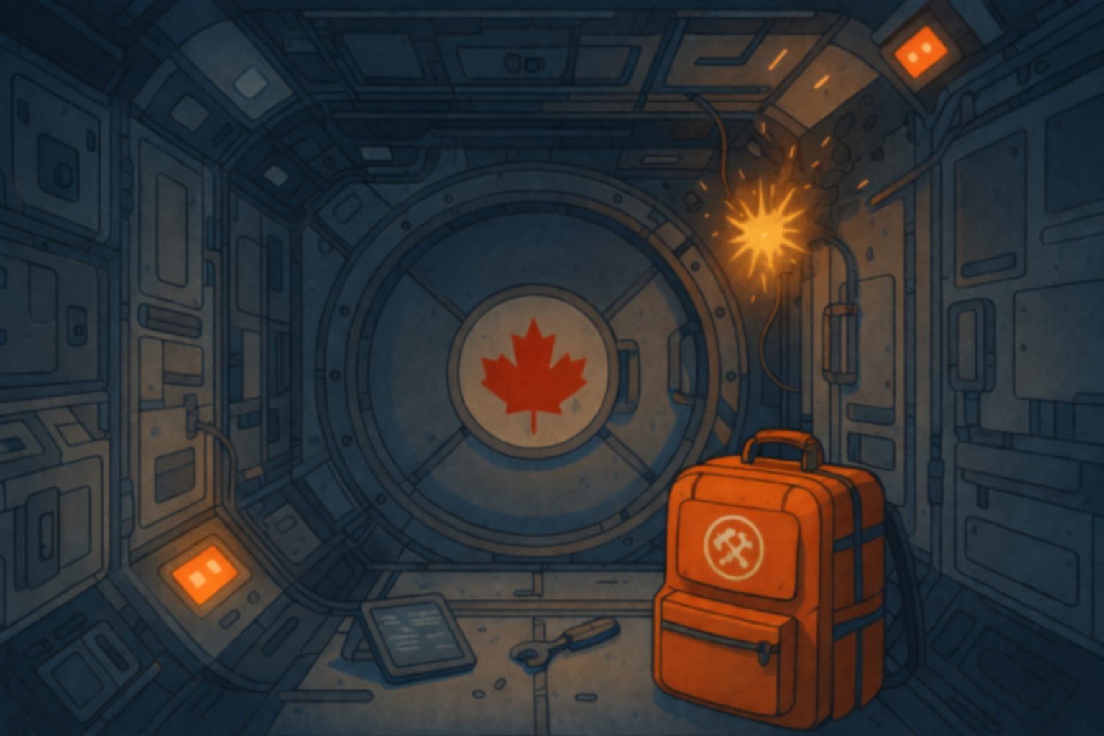
Space Station Aurora
A meteorite strike has crippled the space station you recently boarded with your crew. You are the only one that can save the crew and the newly-built space station.

