Slide 1
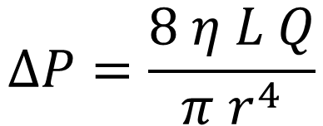
The physical limits of Straws
The physics behind the theoretical limits of straws based on length, diameter and type of fluid. And why the diameter has such a big impact.
Fluid - Viscosity
Air | Water | Milkshake | Honey
Tube Diameter
Slider
Tube Length
Slider
$$∆P=\frac{8 η L Q}{π r^{4}}$$

Slide 2
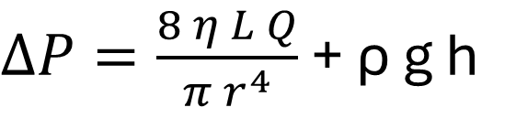
The physical limits of Straws
The physics behind the theoretical limits of straws based on length, diameter and type of fluid. And why the diameter has such a big impact.
Fluid - Viscosity
Air | Water | Milkshake | Honey
Tube Diameter
Slider
Tube Length
Slider
$∆P=\frac{8 η L Q}{π r^{4}}$ + ρ g h

