Slide 1
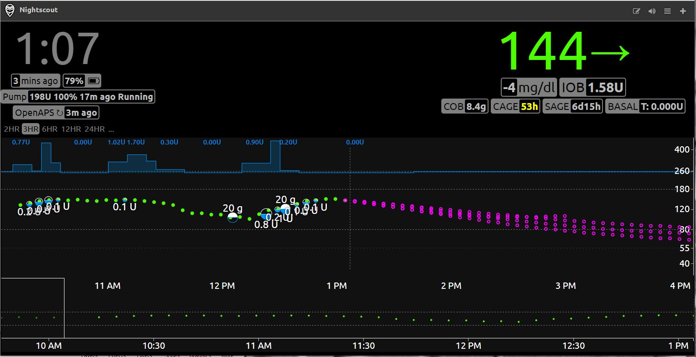
Section 1
Section 2
Section 3
Section 4
Section 5
Section 6

