Slide 1
Multivariate WEASEL (MWSL)
Patrick Schäfer, Humboldt-Universität zu Berlin, Knowledge Management in Bioinformatics
patrick.schaefer@hu-berlin.de
19.09.2016

Slide 2
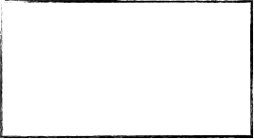
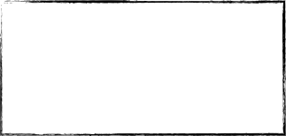
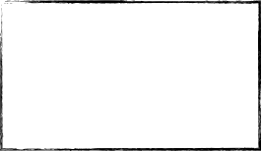
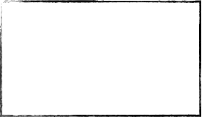




Word ExtrAction for time SEries cLassification (WEASEL)
It is a multivariate bag-of-patterns representation:
Extract subsequences of lengths: 8 to 51.
Fourier transform subsequences and discretize to words (6 values, low-pass filter).
Add sensor-id (1 to 24) to each word.
Add unigrams & bigrams to identify co-occurring words.
Chi-Squared-test to filter unimportant words.
A Logistic Regression Classifier is trained to identify important words.
Time Series
(real values)
Discrete Values (SFA)
BAG-OF-PATTERNs
Logistic Regression
Fourier Transform
DisCretizE
(1,2)-grams
CHI²
Test
Input
Build Feature Vector
Feature Matching

Slide 3
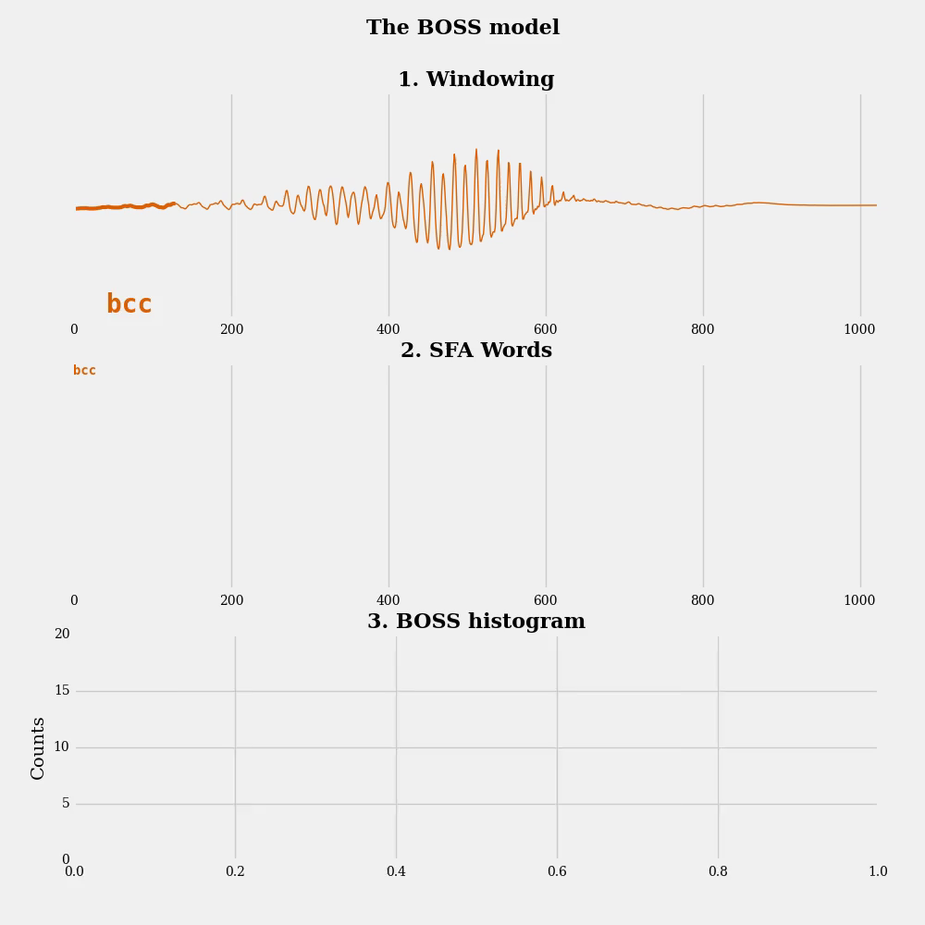
The bag-of-patterns representation extracts subsequences from a time series for a subsequence length.
It then transforms each time series to a word.
And builds a histogram of word counts.
Make it multivariate by adding sensor-id to each word.

Slide 4



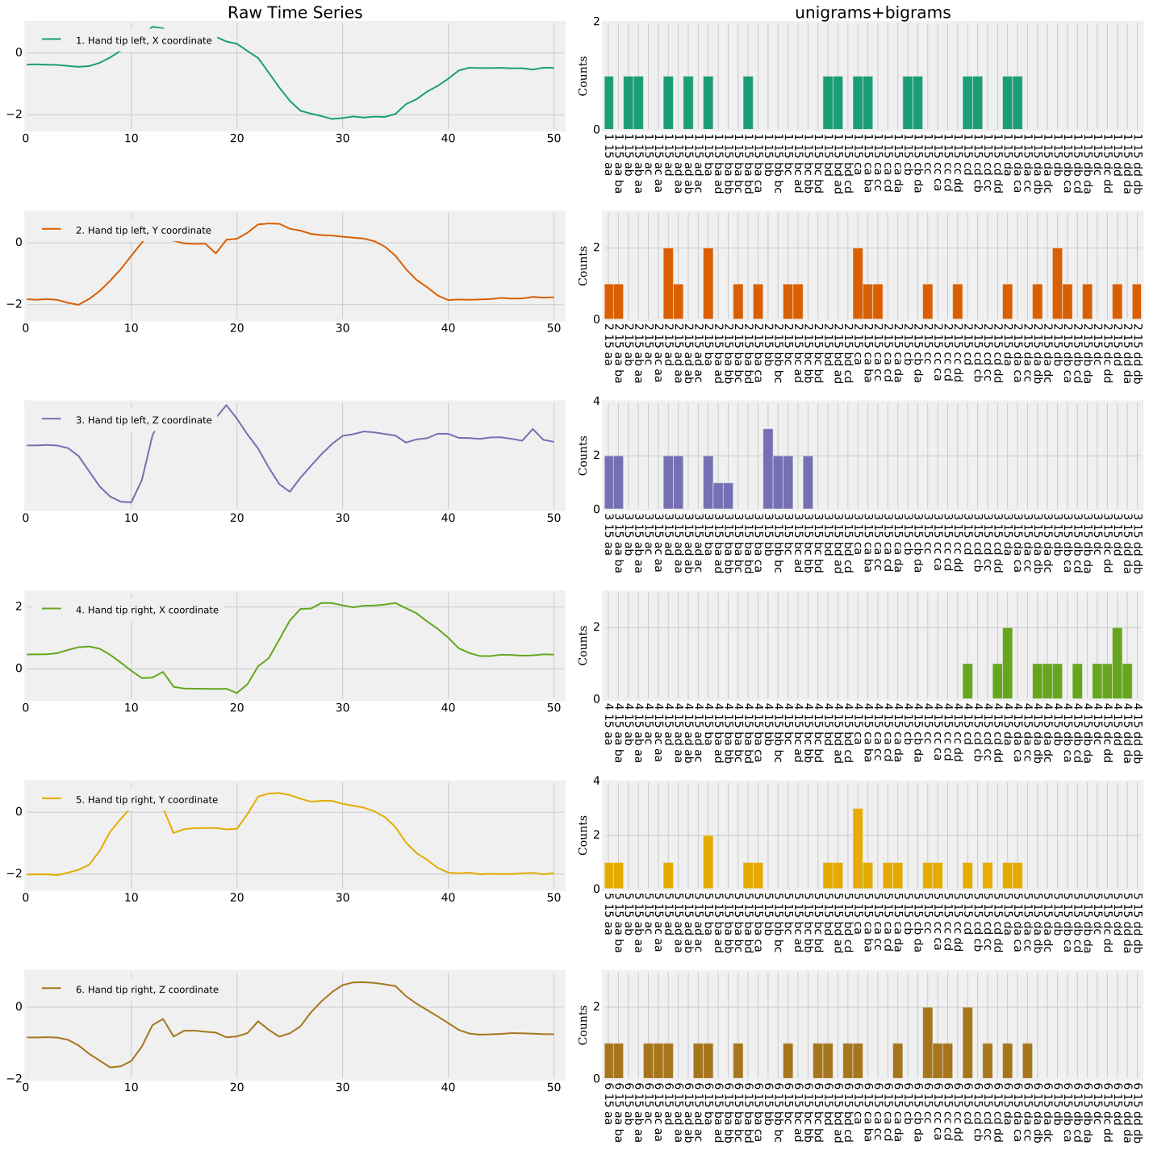
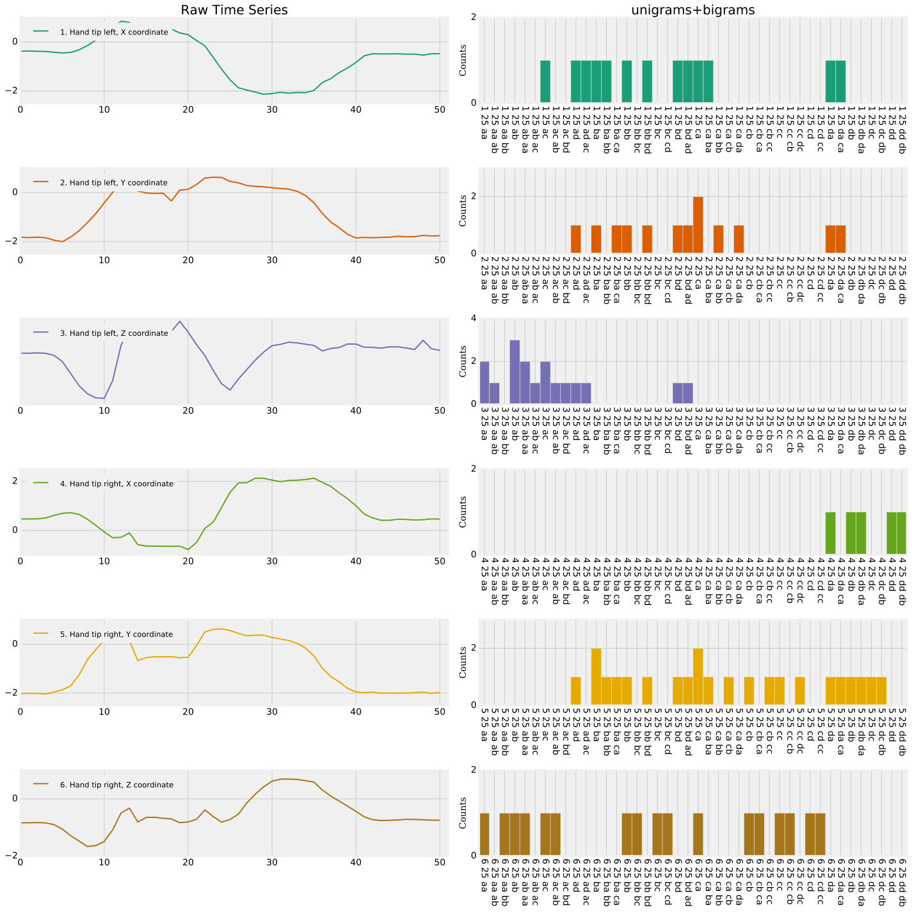
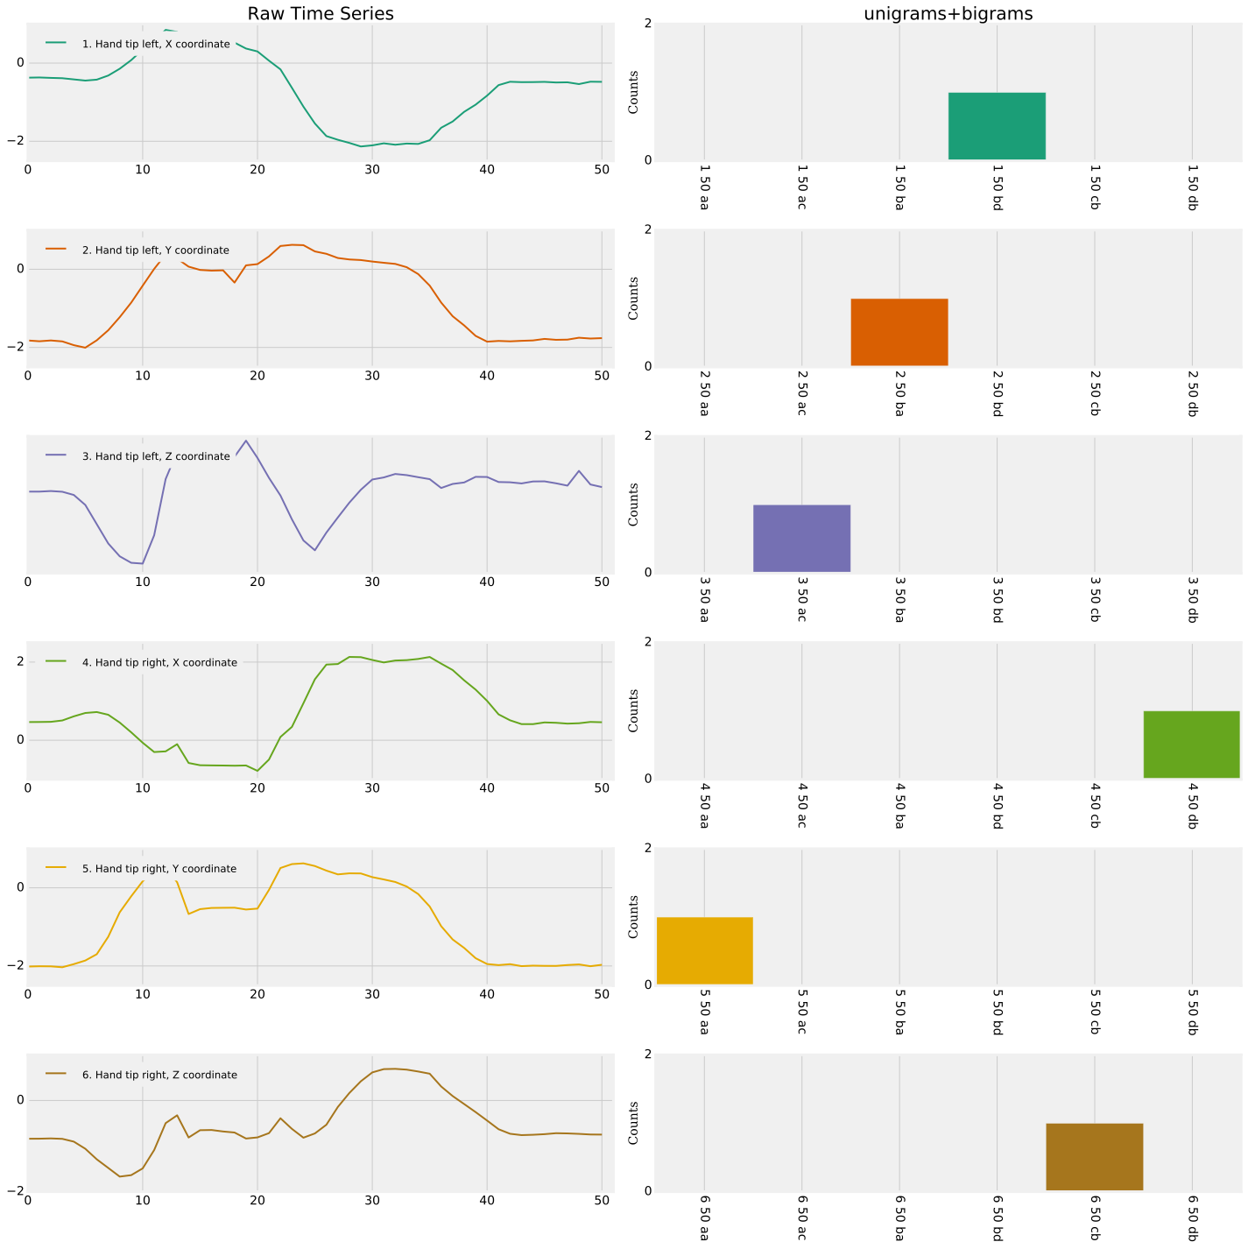




raw sensor data
subsequence length 15
subsequence length 25
subsequence length 50
…
For WEASEL a word contains:
sensor-id
+ window length
+ word (unigram or bigram)

Slide 5
Huge feature space!
The Chi-Squared-test removes those words that have equal frequency across all gestures.
The logistic regression classifier assigns high weights to important words, i.e., sensor ids, subsequence lengths and co-occurring words that are important to identify each gesture.

Slide 7
Thank you!

