Slide 1

Proof of Funds
Bitcoin Risk Quantification for KYT / AML Compliance
Group 3 · Crypto Asset Analytics
Ottitsch Franz Stefan Jakob (12024717) · Arora Aaradhaya (12534787) · Slutu Serhii (12537831)
TU Wien Informatics · 2026S
Notes:
Welcome. 10-minute overview of our Proof-of-Funds prototype for Bitcoin KYT/AML compliance. ~20 seconds.

Slide 2
The Problem
Why does Bitcoin risk quantification matter?
AML / KYT Regulations
Cryptoasset service providers are legally required to screen incoming transactions under Anti-Money Laundering (AML) and Know-Your-Transaction (KYT) rules. Failure exposes them to heavy fines and license revocation.
The Black-Box Problem
Industry tools (Chainalysis, Elliptic, Crystal) are closed-source, expensive SaaS platforms. A compliance analyst cannot audit why a particular address received its risk score — the scoring logic is completely opaque.
Our Opportunity
Build an open-source, fully reproducible Bitcoin risk pipeline that is explainable. A compliance analyst should see whether risk comes from graph proximity, direct value exposure, or multi-hop taint propagation.
Crypto Asset Analytics · TU Wien Informatics · 2026S | 2/11
Proof of Funds — Bitcoin KYT/AML
Notes:
Explain the compliance need, the opaque commercial tools, and our explainable open-source approach. ~45 seconds.

Slide 3
Research Questions
What are we trying to answer? [Assignment Q1]
Q1
Risk Quantification
Q2
Score Design
How can we quantify the risk of an incoming Bitcoin transaction by its graph distance from known illicit activity — darknet markets, ransomware, hacks?
How do we combine graph distance, direct value exposure, and multi-hop haircut taint propagation into a single explainable 0–100 aggregate score?
Q3
Entity Clustering Impact
Q4
Validation
How much does grouping addresses into real-world entities change the risk landscape compared to raw address-level analysis?
Do our risk scores agree with real-world ground truth — OFAC sanctions lists and DOJ-documented criminal case addresses?
Crypto Asset Analytics · TU Wien Informatics · 2026S | 3/11
Proof of Funds — Bitcoin KYT/AML
Notes:
Four research questions — spend ~15 s on each. Emphasise Q4: validated against real DOJ cases, not synthetic data. ~60 seconds.

Slide 4
Data Sources
What data do we need and how do we get it? [Assignment Q2]
Source | Content | Format | Access
GraphSense TagPacks | ~46 000 labelled BTC addresses: ransomware, darknet markets, scams, hacks, exchanges | YAML | Free / GitHub
Custom DOJ TagPacks | Hand-curated from DOJ complaints: Twitter Hack 2020, Colonial Pipeline 2021 | YAML | Manual
mempool.space API | Public blockchain explorer — tx neighbourhood crawl, all responses SQLite-cached | JSON REST | Free / public
OFAC SDN List | US Treasury sanctioned crypto addresses (81 BTC) — validation ground truth | TXT | Free / Gov
Ransomwhere | Crowdsourced ransomware payment addresses and family labels | JSON | Free / API
Key principle: all sources are free, require no API keys, and API responses are permanently cached in SQLite — the entire pipeline is fully reproducible offline.
Crypto Asset Analytics · TU Wien Informatics · 2026S | 4/11
Proof of Funds — Bitcoin KYT/AML
Notes:
Walk through five sources. Emphasise: no paid subscriptions, no API keys, SQLite cache makes it reproducible. ~75 seconds.

Slide 5
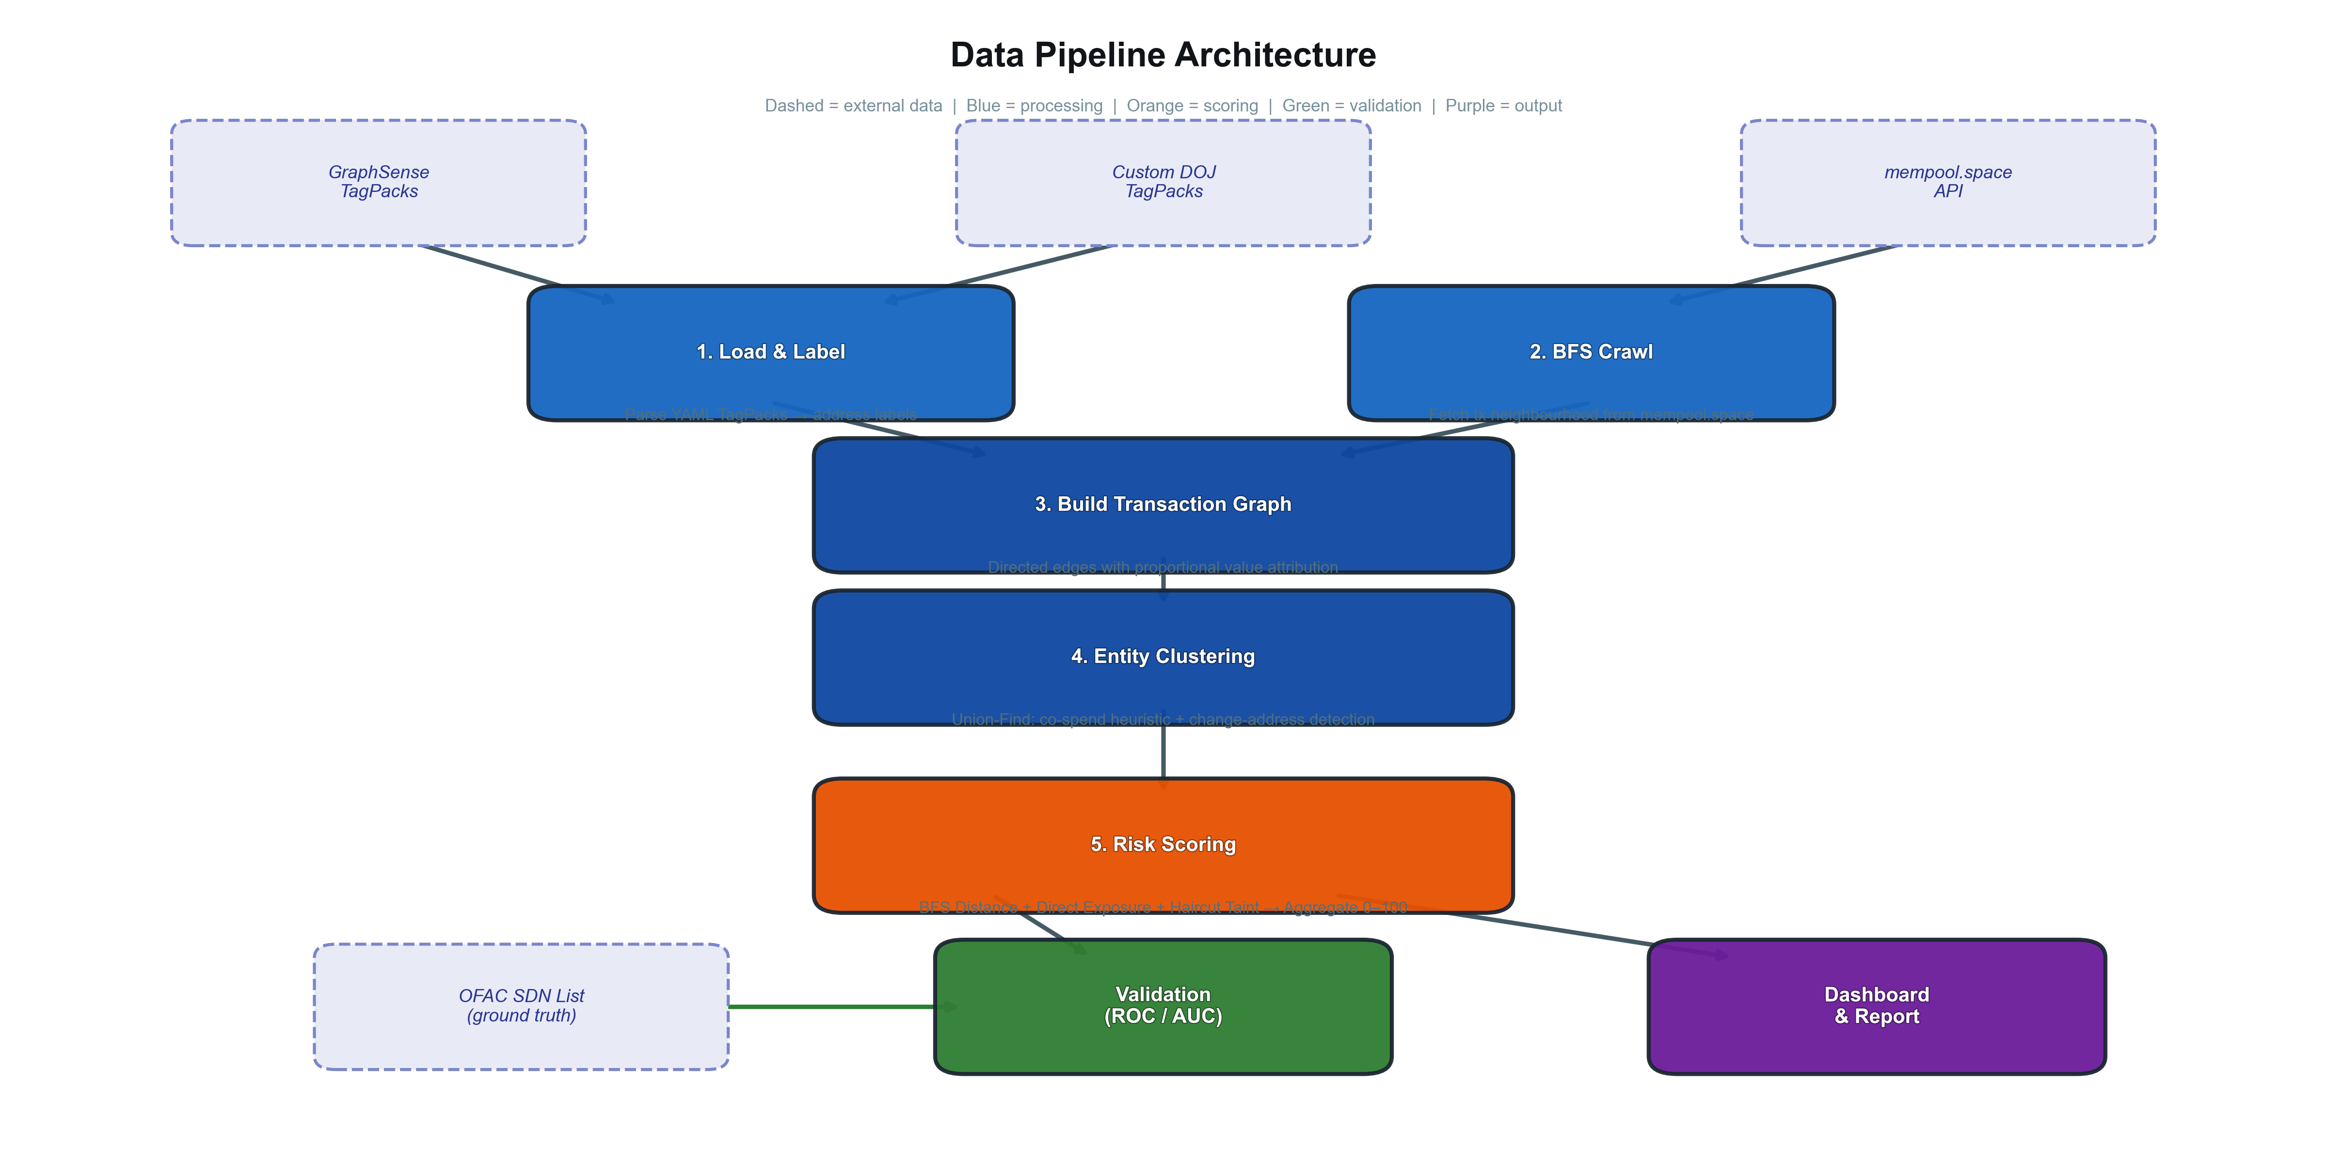
Pipeline Architecture
End-to-end: from raw labels to validated risk scores [Assignment Q3]
Crypto Asset Analytics · TU Wien Informatics · 2026S | 5/11
Proof of Funds — Bitcoin KYT/AML
Notes:
Walk the pipeline left to right, one sentence per stage. This slide has the architecture figure from the report. ~75 seconds.

Slide 6
Risk Metrics
Four complementary signals combined into one explainable score [Assignment Q3 detail]
BFS Distance
Direct Exposure
Shortest-path hops to nearest tainted predecessor (multi-source BFS).
Fraction of 1-hop incoming value from tainted predecessors.
↳ Proximity — fewer hops = higher risk.
↳ How much money comes directly from bad actors.
Haircut Taint
Aggregate Score
Multi-hop proportional taint via sparse-matrix Jacobi fixed-point iteration.
Weighted blend: 0.3 × Distance + 0.3 × Exposure + 0.4 × Haircut, rescaled 0–100.
↳ How taint dilutes as it flows through the graph.
↳ Single actionable score for compliance screening and prioritised review.
Crypto Asset Analytics · TU Wien Informatics · 2026S | 6/11
Proof of Funds — Bitcoin KYT/AML
Notes:
Four metrics. Key message: the aggregate formula is public and decomposable — each component has a clear meaning. ~60 seconds.

Slide 7
Entity Clustering
Grouping addresses into real-world actors [Assignment Q3 detail]
Two Standard Bitcoin Forensics Heuristics
Observed Node Reduction (4 case studies)
H1 — Common-Input-Ownership
Case | Addresses | Entities | Reduction
WannaCry | 426,535 | 336,715 | 21 %
Twitter Hack | 7,941 | 2,311 | 71 %
Colonial Pipeline | 6,585 | 4,229 | 36 %
Bitfinex | 607 | 539 | 11 %
All input addresses in the same Bitcoin transaction belong to the same wallet. Spending from multiple UTXOs requires holding all private keys.
H2 — Change-Address Detection
A single-use output appearing for the first time is likely the change address returned to the sender. We group it with the spending input cluster.
Implementation: Union-Find (disjoint-set) data structure — O(n·α(n)) amortised; scales to 400 000+ addresses.
Crypto Asset Analytics · TU Wien Informatics · 2026S | 7/11
Proof of Funds — Bitcoin KYT/AML
Notes:
Twitter Hack shows 71 % reduction — scammer consolidated aggressively. Bitfinex only 11 % — peel-chain laundering avoids co-spending. ~45 seconds.

Slide 8
Implementation Plan
Architecture, stack, and deliverables [Assignment Q4]
pof/ Python package
Tech Stack
tagpacks.py
— load & validate YAML TagPacks
• Python 3.10+
explorer.py
— mempool.space REST client (cached)
• NumPy / SciPy (sparse matrices for Jacobi iteration)
graph.py
— build weighted directed tx graph
• NetworkX (graph construction & BFS)
clustering.py
— Union-Find entity grouping
• Streamlit (interactive investigation dashboard)
metrics/distance.py
— multi-source BFS
• pytest (41 unit tests on hand-built fixtures)
metrics/direct_exposure.py
— 1-hop taint fraction
Deliverables
metrics/haircut.py
— sparse Jacobi propagation
✓ 3 Jupyter notebooks: methodology, case studies, validation
metrics/aggregate.py
— 0-100 weighted blend
✓ Interactive Streamlit dashboard (4 tabs)
validation.py
— ROC/AUC vs OFAC ground truth
✓ Per-address risk score table (Parquet)
dashboard.py
— Streamlit investigation UI
✓ LaTeX report with 7 publication-quality figures
precompute.py
— CLI: load → crawl → cluster → score
✓ CLI: python -m pof.precompute --seeds seeds.txt --hops 2
Crypto Asset Analytics · TU Wien Informatics · 2026S | 8/11
Proof of Funds — Bitcoin KYT/AML
Notes:
Walk through package layout and stack. Mention 41 unit tests. ~60 seconds.

Slide 9
Forensic Case Studies
Four real criminal cases — validated against DOJ filings [Assignment Q4 detail]
Case | Year | Event | BTC Involved | Why we chose it
WannaCry | 2017 | Global ransomware — 200 000+ victims in 150 countries, ~$140 K collected | 3 hardcoded addresses | Isolated wallets — perfect baseline for scoring
Twitter Hack | 2020 | 130 VIP accounts hijacked; BTC doubling scam — ~$117 K | 3 scam wallets | Aggressive consolidation — stresses entity clustering
Colonial Pipeline | 2021 | DarkSide ransomware shut US fuel pipeline for 6 days | 75 BTC (~$4.4 M) | Affiliate model — tests label coverage limits
Bitfinex Hack | 2016 | 119 756 BTC stolen; largest DOJ crypto seizure ($3.6 B in 2022) | 119 756 BTC | Peel-chain laundering — stresses haircut propagation
Validation approach
▸ ROC / AUC — treat aggregate score as binary classifier; positives = OFAC-listed or TagPack-labelled addresses
▸ Precision / Recall @ threshold 50 — operational metric for compliance analyst triage workflow
▸ Address-level vs. entity-level comparison — quantify how clustering shifts the risk distribution
Crypto Asset Analytics · TU Wien Informatics · 2026S | 9/11
Proof of Funds — Bitcoin KYT/AML
Notes:
One sentence per case — why it stresses a different part of the pipeline. Validation plan: ROC/AUC + precision-recall. ~75 seconds.

Slide 10
Expected Outcome
What will the project produce? [Assignment Q5]
Reproducible Risk Pipeline
Target metrics
A Python package that takes any Bitcoin address, crawls its transaction neighbourhood, clusters entities, and outputs a per-address / per-entity risk score table — fully reproducible from raw YAML, no paid services.
400 000+
Addresses scored
across 4 case studies
11–71 %
Node reduction
via entity clustering
Explainable Risk Scores
Every score decomposes into distance, direct exposure, and haircut taint. A compliance analyst can audit exactly why an address received its score and which component drives the risk.
>= 0.90
Validation AUC
against OFAC / TagPack labels
41 tests
Unit test coverage
hand-built fixtures
Real-World Validation
7 plots
Report figures
Scores are evaluated via ROC/AUC against OFAC sanctions and four DOJ-documented criminal case addresses — actual law-enforcement outcomes, not synthetic or simulated data.
pipeline, ROC, taint decay…
Crypto Asset Analytics · TU Wien Informatics · 2026S | 10/11
Proof of Funds — Bitcoin KYT/AML
Notes:
Summarise deliverables and target metrics. Emphasise validation is against real law-enforcement ground truth. ~60 seconds.

Slide 11
Timeline, Team & Thank You
Wk 1–2 — Data & Crawler
Wk 3–4 — Metrics & Cluster
Wk 5–6 — Case Studies
Wk 7–8 — Dashboard & Report
Load TagPacks BFS crawl + SQLite cache
4 risk metrics Union-Find clustering
4 DOJ cases Validation vs. OFAC
Streamlit UI Notebooks + LaTeX
Team
Ottitsch Franz Stefan Jakob
Arora Aaradhaya
Slutu Serhii
12024717 · Crawler / Graph
12534787 · Metrics / Validation
12537831 · Clustering / Dashboard
Thank you for your attention!
Repo & Notebooks
crypto-demo / pof/
Questions?
python -m pof.precompute --seeds data/seeds.txt --hops 2
Crypto Asset Analytics · TU Wien Informatics · 2026S | 11/11
Proof of Funds — Bitcoin KYT/AML
Notes:
Wrap up. Mention pipeline is already functional with preliminary results. Thank audience, invite questions. ~25 seconds.

