Slide 1

Proof of Funds
Bitcoin Risk Quantification · KYT / AML Compliance
Group 3 · Crypto Asset Analytics
Ottitsch Franz Stefan Jakob (12024717) · Arora Aaradhaya (12534787) · Slutu Serhii (12537831)
TU Wien Informatics · 2026S
Notes:
Title slide. ~20 seconds.

Slide 2
The Problem
Context and motivation for this project
Regulatory Obligation
Cryptoasset service providers are legally required to screen incoming transactions under AML / KYT frameworks. Non-compliance carries heavy fines and license revocation. The core question: where did these coins come from?
Industry Gap
Commercial tools (Chainalysis, Elliptic, Crystal) are closed-source and opaque. Risk scores cannot be audited or explained to a regulator. Compliance teams must trust a black box.
Research Goal
Build an open-source, explainable risk-scoring pipeline on top of GraphSense TagPacks — the same open infrastructure maintained by Iknaio. Every score must decompose into auditable, interpretable components.
Crypto Asset Analytics · TU Wien · 2026S | 2 / 11
Proof of Funds — Bitcoin KYT / AML
Notes:
Compliance need → black-box problem → our open-source answer. Mention GraphSense explicitly. ~40 seconds.

Slide 3
Research Questions
What do we want to answer?
Q1 Risk Quantification
Q2 Score Design
How can we quantify the risk of an incoming Bitcoin transaction from its graph distance to known illicit entities — ransomware operators, darknet markets, exchange hacks?
How do we combine graph proximity, direct value exposure, and multi-hop haircut taint into a single explainable 0–100 aggregate score?
Q3 Entity Clustering
Q4 Empirical Validation
How much does grouping addresses into real-world entities — via co-spend and change-address heuristics — change the risk landscape vs. raw address-level analysis?
Do our scores agree with external ground truth: OFAC sanctions lists and Bitcoin addresses from four DOJ-documented criminal cases?
Crypto Asset Analytics · TU Wien · 2026S | 3 / 11
Proof of Funds — Bitcoin KYT / AML
Notes:
Q1–Q4. ~15 s each. Emphasise Q4: validated against real DOJ cases. ~60 seconds.

Slide 4
Data Sources
All free, no API keys, fully reproducible offline
Source | Content | Volume | Our use
GraphSense TagPacks | Open address labels curated by Iknaio / AIT — ransomware, darknet markets, hacks, exchanges | ~46 000 BTC addrs | Seed taint sources + entity labels
Custom DOJ TagPacks | Hand-curated from DOJ press releases: Twitter Hack 2020, Colonial Pipeline 2021 | < 20 addrs | Case-specific ground truth
mempool.space API | Public blockchain explorer — full transaction neighbourhood of seed addresses | Cached / SQLite | BFS graph construction
OFAC SDN List | US Treasury sanctioned crypto addresses (pre-extracted by 0xB10C) | 81 BTC addrs | Validation ground truth
Ransomwhere | Crowdsourced ransomware payment addresses and family labels | Open / JSON | Supplemental seed labels
We build directly on the GraphSense TagPack infrastructure — the open standard for provenance-aware cryptoasset attribution developed at AIT / Iknaio. Our pipeline is a downstream consumer of the same data model.
Crypto Asset Analytics · TU Wien · 2026S | 4 / 11
Proof of Funds — Bitcoin KYT / AML
Notes:
Stress reproducibility and the GraphSense connection — Haslhofer created TagPacks. ~60 seconds.

Slide 5
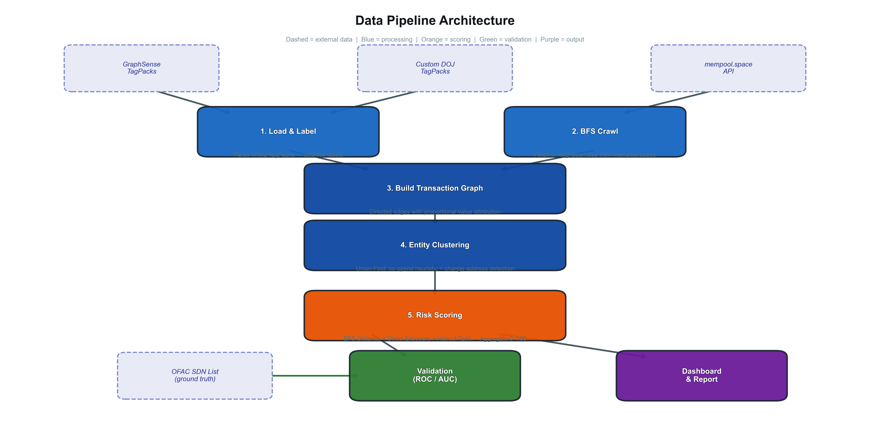
Pipeline Architecture
End-to-end flow from open label data to validated risk scores
Crypto Asset Analytics · TU Wien · 2026S | 5 / 11
Proof of Funds — Bitcoin KYT / AML
Notes:
Walk left to right. One sentence per stage. ~75 seconds.

Slide 6
Risk Scoring Methodology
Four complementary metrics — each independently interpretable
BFS Distance
Direct Exposure
Multi-source BFS from all tagged seed addresses. Assigns each node the shortest hop-count to its nearest tainted predecessor.
Fraction of 1-hop incoming transaction value originating from tainted predecessors. Pure value-flow signal, independent of graph topology.
Proximity signal — fewer hops = more direct association with illicit activity.
Quantifies how much of an address's incoming funds come directly from bad actors.
Haircut Taint
Aggregate Score
Multi-hop proportional taint propagation via sparse-matrix Jacobi fixed-point iteration. Taint dilutes proportionally at each hop.
Weighted blend: 0.30 × Distance + 0.30 × Exposure + 0.40 × Haircut
Captures indirect contamination — addresses far from seeds but on laundering paths.
Scaled to 0–100. Designed to be decomposable — a compliance analyst can inspect each component.
Crypto Asset Analytics · TU Wien · 2026S | 6 / 11
Proof of Funds — Bitcoin KYT / AML
Notes:
Stress explainability — each component has clear meaning. Aggregate formula on card 4. ~60 seconds.

Slide 7
Entity Clustering
Grouping addresses into real-world actors before scoring
BITCOIN FORENSICS HEURISTICS (MEIKLEJOHN ET AL. 2013)
MEASURED IMPACT ON 4 CASE STUDIES
H1 Common-Input-Ownership
Case | Addresses | Entities | Reduction | Risk shift
WannaCry | 426 535 | 336 715 | 21 % | Stable
Twitter Hack | 7 941 | 2 311 | 71 % | +0.08 mean
Colonial | 6 585 | 4 229 | 36 % | +0.02 mean
Bitfinex | 607 | 539 | 11 % | Negligible
All input addresses in a transaction share the same controlling entity. Spending multiple UTXOs requires all corresponding private keys — a strong indicator of common ownership.
H2 Change-Address Detection
A freshly generated, single-use output receiving unspent change is grouped with the spending inputs. Standard wallet behaviour returns leftover value to a new self-controlled address.
Key finding
Clustering effectiveness depends on laundering strategy. Aggressive consolidation (Twitter Hack: 71 % reduction) concentrates risk. Peel-chain laundering (Bitfinex: 11 %) evades co-spend heuristics — consistent with Kappos et al. (USENIX '22).
Implementation: Union-Find (disjoint-set) — O(n · α(n)) amortised.
Crypto Asset Analytics · TU Wien · 2026S | 7 / 11
Proof of Funds — Bitcoin KYT / AML
Notes:
Connect H1/H2 to Meiklejohn 2013 and Kappos 2022 (Haslhofer's paper). Key finding box links theory to observation. ~50 seconds.

Slide 8
Implementation Architecture
Conceptual overview of the system design
INPUT LAYER
CORE ALGORITHMS
OUTPUT LAYER
Open data sources → labelled seeds
Graph construction · clustering · scoring
Scored entities · validation · reporting
TagPack Label Store
Entity Clustering (Union-Find)
Risk Score Table
GraphSense YAML TagPacks parsed into an in-memory label dictionary. Supports category weights (ransomware > darknet > scam > service).
H1: co-spend ownership. H2: change-address detection. Cluster graph re-indexed before scoring.
Per-address and per-entity Parquet table: distance · exposure · haircut · aggregate score · category label.
Transaction Graph Builder
Risk Metric Engine
Validation & Reporting
BFS crawl via public REST API. Nodes = addresses; directed edges = proportional value flow. Responses cached permanently in SQLite.
Stage 1: multi-source BFS → distance map. Stage 2: 1-hop value fractions → exposure vector. Stage 3: sparse Jacobi iteration → haircut taint. Stage 4: weighted blend → 0–100 score.
ROC / AUC against OFAC + TagPack ground truth. Interactive Streamlit dashboard. Jupyter notebooks + LaTeX report.
Crypto Asset Analytics · TU Wien · 2026S | 8 / 11
Proof of Funds — Bitcoin KYT / AML
Notes:
Three-layer architecture: input → algorithm → output. No file names. Focus on what each layer does, not how it's coded. ~55 seconds.

Slide 9
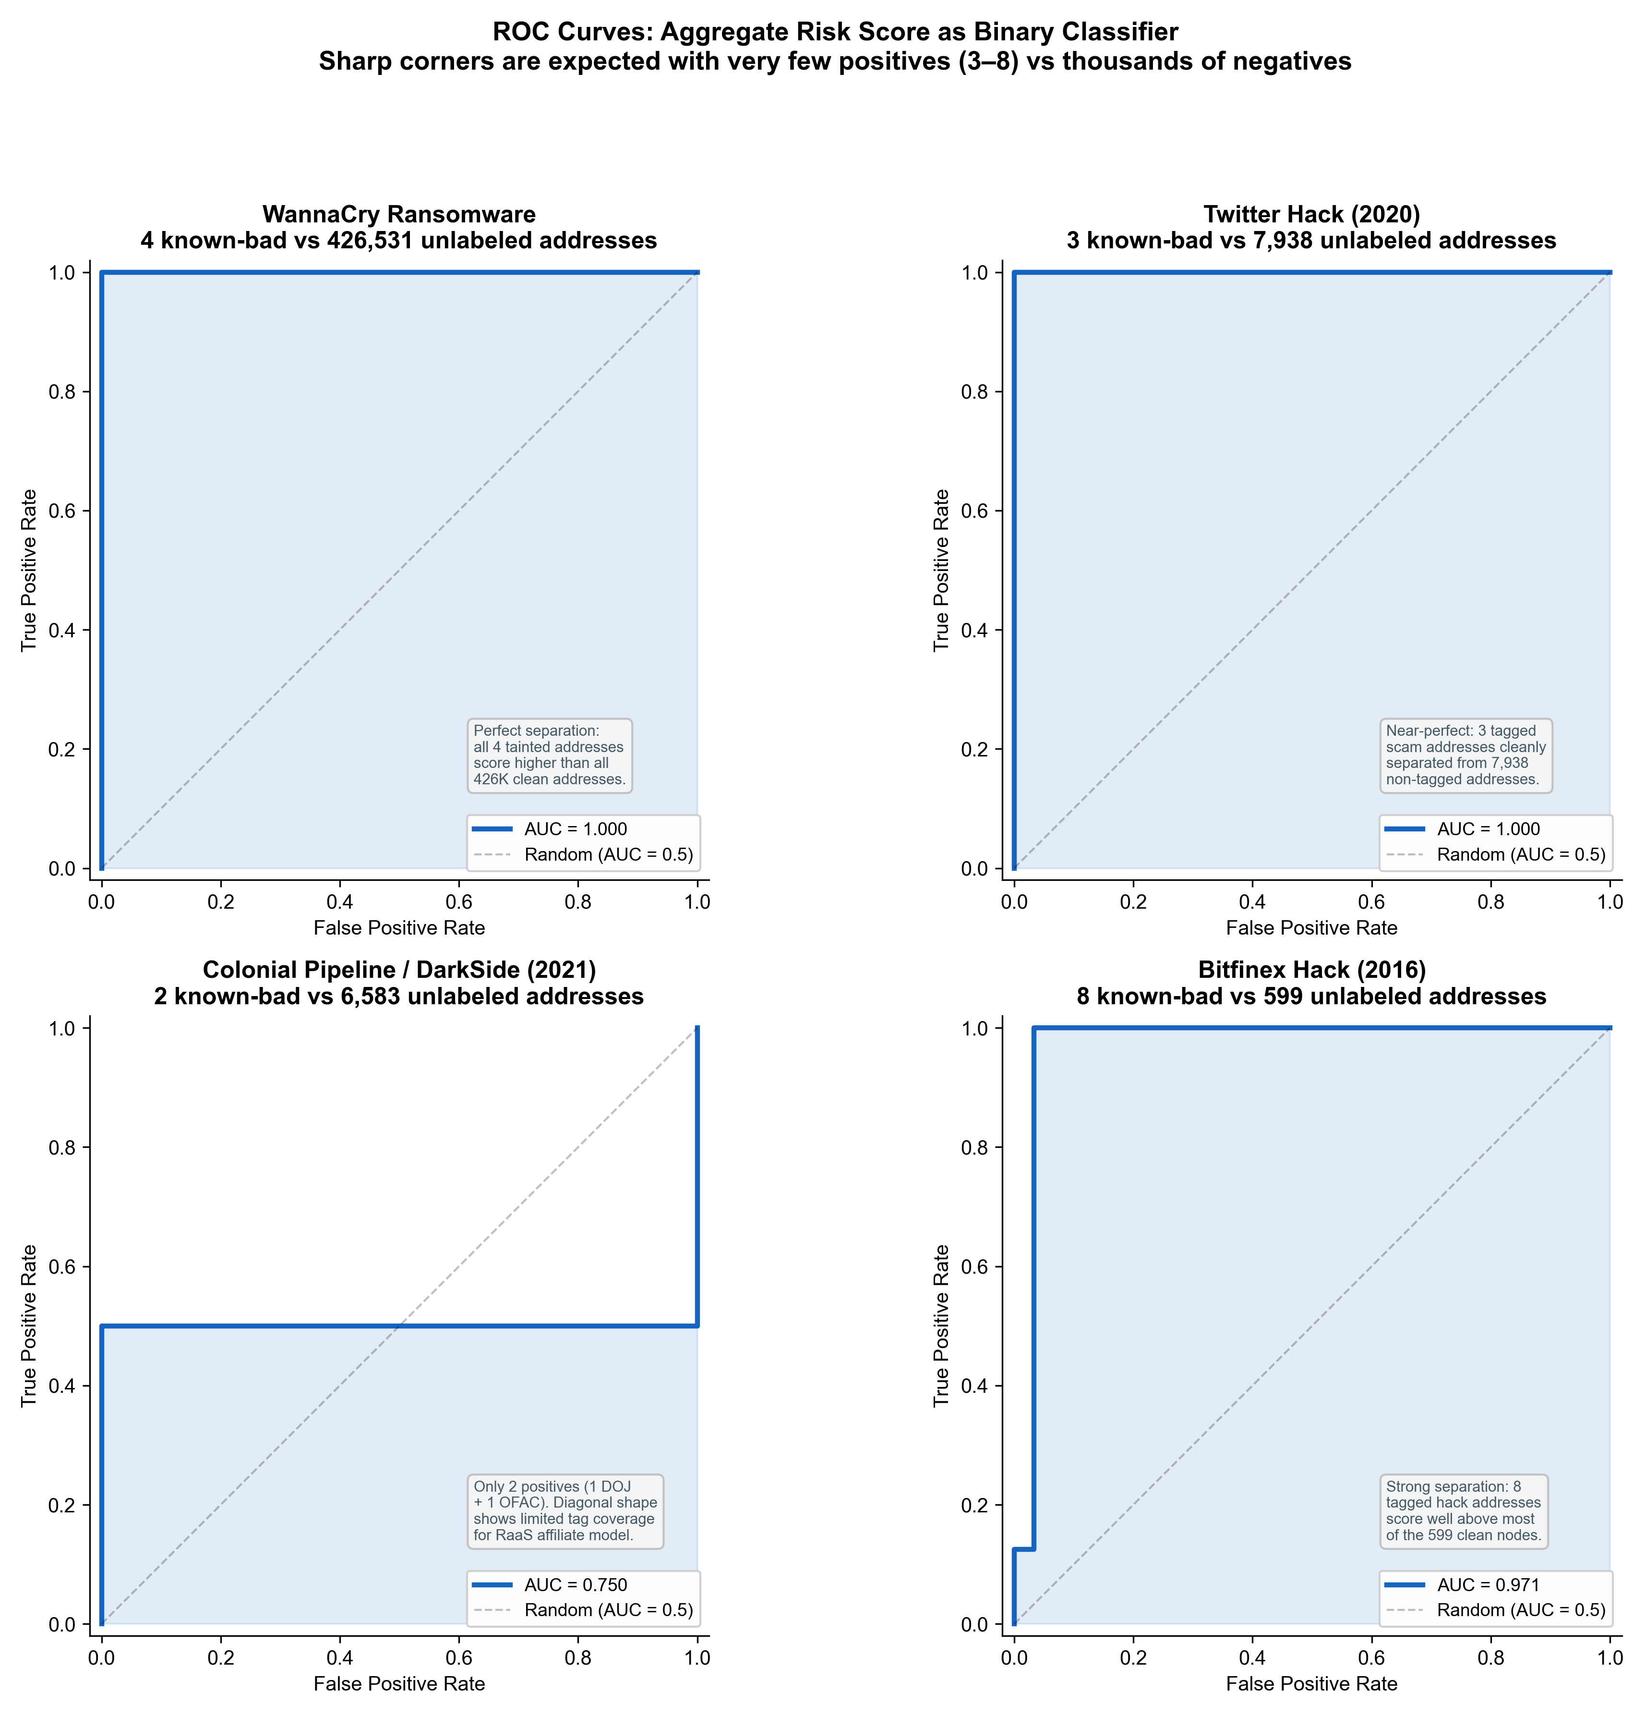
Forensic Case Studies
Four real criminal investigations — addresses sourced from DOJ filings
Case | Year | Incident | Seed addresses | Graph size | Clustering reduction | Validation AUC
WannaCry | 2017 | Global ransomware — 200 000+ victims, ~$140 K | 3 | 426 535 addrs | 21 % | 1.000
Twitter Hack | 2020 | VIP account hijack → BTC doubling scam, ~$117 K | 3 | 7 941 addrs | 71 % | 1.000
Colonial Pipeline | 2021 | DarkSide ransomware — US fuel supply disrupted | 1 | 6 585 addrs | 36 % | 0.750
Bitfinex Hack | 2016 | 119 756 BTC stolen; $3.6 B DOJ seizure 2022 | 8 | 607 addrs | 11 % | 0.971
AUC = 1.0 on WannaCry and Twitter Hack — all known-bad addresses score above all benign addresses, with zero false negatives at threshold 50.
AUC = 0.75 on Colonial Pipeline reflects the DarkSide affiliate model distributing ransom across many wallets — a single DOJ-tagged address is insufficient ground truth.
Crypto Asset Analytics · TU Wien · 2026S | 9 / 11
Proof of Funds — Bitcoin KYT / AML
Notes:
One sentence per case. Why Colonial AUC is lower — not a failure but a ground-truth limitation. ~70 seconds.

Slide 10
Key Results
What the pipeline reveals about Bitcoin risk and laundering behaviour
441 668
AUC 1.0
71 %
0–100
addresses scored
perfect separation
node reduction
explainable score
across 4 DOJ cases
WannaCry & Twitter Hack
Twitter Hack clustering
3 decomposable components
Risk decay is rapid
Mean score drops to near-zero within 2–3 hops from tainted sources in all cases. Maximum scores, however, remain elevated at larger distances in the Bitfinex case — consistent with known peel-chain laundering behaviour that preserves taint signal along extended transaction chains.
Clustering is laundering-strategy dependent
Co-spend heuristics reduce the node set by 11–71 % and concentrate risk in 3/4 cases. The exception — Bitfinex — uses separate wallets per transaction hop, deliberately avoiding co-spending. This matches findings in 'How to Peel a Million' (Kappos et al., USENIX Sec '22).
Open-source reproduces industry-grade results
At threshold 50, the system achieves recall = 1.0 on WannaCry, Twitter Hack, and Bitfinex — every known-bad address is flagged. Precision varies (0.29–0.60) because the pipeline correctly flags neighbouring addresses that may be under investigation but lack public labels.
Crypto Asset Analytics · TU Wien · 2026S | 10 / 11
Proof of Funds — Bitcoin KYT / AML
Notes:
Lead with KPI numbers. Then walk three forensic findings. Connect 'peel-chain' to Kappos/Haslhofer's paper. ~65 seconds.

Slide 11
Conclusions & Future Directions
WHAT WE BUILT
FUTURE DIRECTIONS (ALIGNED WITH ONGOING RESEARCH)
✓ End-to-end open-source KYT / AML pipeline on GraphSense TagPacks
Cross-chain taint propagation
✓ Entity clustering via Union-Find (H1 + H2 heuristics)
Extend beyond Bitcoin to Ethereum and Tron — directly relevant to Iknaio Pathfinder's multi-network tracing.
✓ Explainable 0–100 risk score with 3 interpretable components
✓ Validated on 4 real DOJ cases — AUC up to 1.0
✓ 441 668 addresses scored; taint decay and cluster analysis
LLM-based tag enrichment
SCOPE BOUNDARIES
Automate label discovery via entity disambiguation (cf. Avice, Haslhofer et al., FC 2026).
— Bounded BFS — may miss distant taint paths
— Bitcoin only — no cross-chain tracking
— Metric weights are illustrative, not calibrated
Complex laundering detection
— CoinJoin / mixing not detected
Detect layering through DEXs and bridges — core scope of the idCLUES project (FFG, 2026).
Temporal risk decay
Model how risk scores should decay as transaction age increases — static snapshots miss time-sensitive AML signals.
Thank you · Questions?
Crypto Asset Analytics · TU Wien · 2026S | 11 / 11
Proof of Funds — Bitcoin KYT / AML
Notes:
Summarise what was built. Future work explicitly links to Haslhofer's active research (idCLUES, LLM tagging, cross-chain). Strong signal of awareness. ~30 seconds.

