Slide 1

TriXX Lightweight tool for change data capture in relational databases
Peter Ramm, OSP Dresden
June 2021
Notes:
Abstract:
TriXX fängt Data Change Events (Insert/Update/Delete) in relationalen Datenbanken und transferiert diese zeitnah an einen Kafka Event Hub.
Für das Fangen der Change Events werden Datenbank-Trigger genutzt.
Über ein HTML-GUI werden die zu observierenden Tabellen und Spalten definiert sowie die Generierung der DB-Trigger ausgelöst.
Die Funktionen von TriXX sind alternativ zum GUI auch über API ansprechbar.
Die synchrone Erfassung und Speicherung der Change Events erfolgt initial lokal in der DB ohne weitere externe Abhängigkeiten.
Die Übertragung der Events an Kafka erfolgt dann asynchron (isoliert von der Trigger-Verarbeitung).
TriXX erlaubt ein systemweit identisches und redundanzfreies Verarbeiten der Change-Events von Datenbank-Tabellen.
Ein per TriXX versorgter Kafka-Cluster ist dann verantwortlich für Speicherung und Zustellung der Events an beliebige Konsumenten (Publish & Subscribe).
Der Fokus von TriXX liegt auf ressourcenschonender und dabei trotzdem stabiler und performanter Verarbeitung bei niedriger Komplexität im Betrieb und minimalem Operation-Aufwand.
Insbesondere ist Vergleich zu etablierten Produkten für Change Data Capture wie Oracle Golden Gate, Quest Shareplex or Red Hat Debezium nicht notwendig die Vorhaltedauer der Online-Transaktionslogs der DB drastisch zu vergrößern.

Slide 2

Otto Group Solution Provider (OSP) GmbH
www.osp.de
Founded: March 1991
Parent company: OTTO Group
Locations: Dresden, Hamburg, Burgkunstadt, Bangkok, Taipeh, Madrid
Number of employees : Ca. 300
Managing directors: Dr. Stefan Borsutzky, Norbert Gödicke, Jens Gruhl

Slide 3
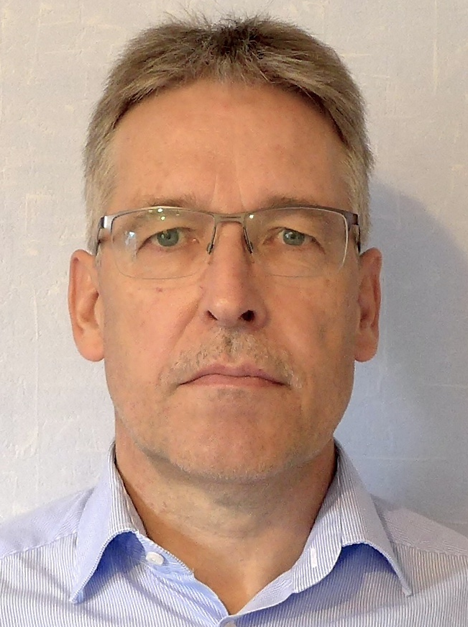
zur Person
Peter Ramm
Team leader strategic-technical consulting at OSP Dresden
> 30 years of history in IT projects
Main focus:
Development of OLTP systems based on Oracle databases
Architecture consulting to trouble shooting
Performance optimization of existing systems

Slide 4
Setting of tasks
Capture data change events (insert/update/delete) in relational databases and transfer these events in a timely manner in JSON format to a Kafka Event Hub.
Provision of a web UI for configuration of the tables to be monitored
Granular definition per table, which columns for which event type (insert/update/delete) should be monitored for changes
Definition of optional filter conditions as SQL expression
Definition of Kafka topics per table as target
Authorization concept with named users and rights assignment on schema level
Tracking of configuration changes (history)
Generation of triggers based on configuration data
Initial transfer of existing data when starting up the CDC tracking of a table

Slide 5
Motivation from first use case EKR
Starting situation
Each customer redundantly establishes its own trigger on tables of interest (up to > 100 triggers per table)
Different content and quality solutions for further processing of the events
Target scenario with TriXX
Exactly one trigger per table and event type
One hardened function for catching events in source DB and transfer to Kafka
Use publish/subscribe etc. in Kafka
Source table
Source table
Trigger 1
Process 1
Target 1
Trigger
Stage
TriXX
Kafka-Topic
Trigger 2
Stage 2
Process 2
Target2
Filter/KSQL
Consumer
Trigger n
Stage n
Process n
Kafka-
Topic
Consumer
Kafka-
Topic

Slide 6
Solution approach
Use of DB triggers to initially capture the change events that take place
Own schema for TriXX in source DB, no objects or operations outside this schema, => thus no structure impact on the application to be 'skimmed'.
Buffering of the change events to be transmitted by triggers in local table of the DB in the TriXX schema => thus no dependency of the event-triggering transactions on external resources like TriXX application or Kafka
Asynchronous transfer of events from Kafka buffer table to triggering transaction
Scalable number of parallel threads to ensure timely transmission
Generation of triggers based on the configuration entered via GUI in the TriXX-Schema
Provision of relevant functions as a Rest-API for automating processes

Slide 7
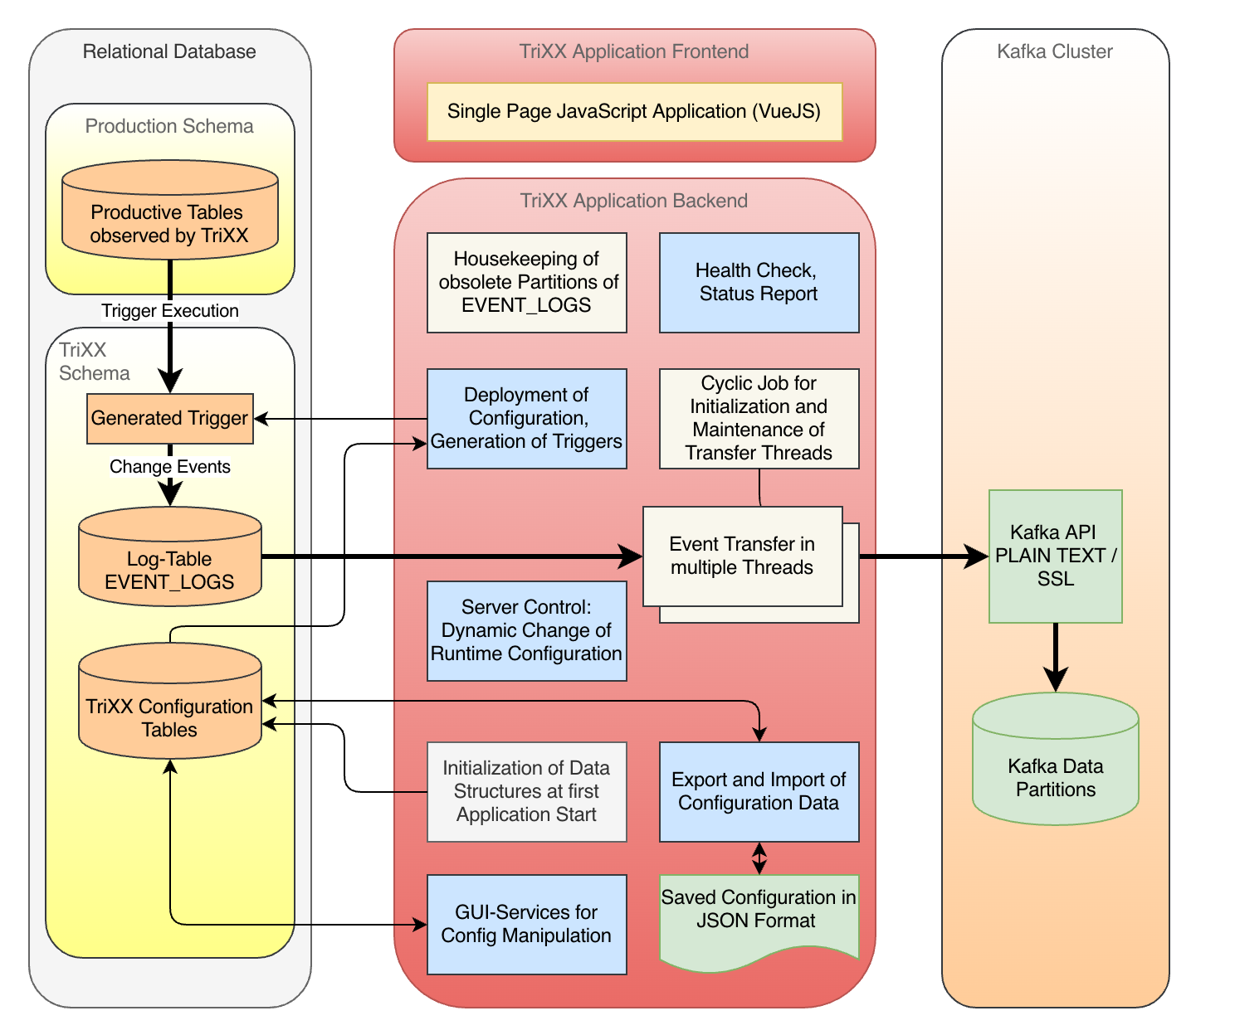
TriXX Module- Structure

Slide 8
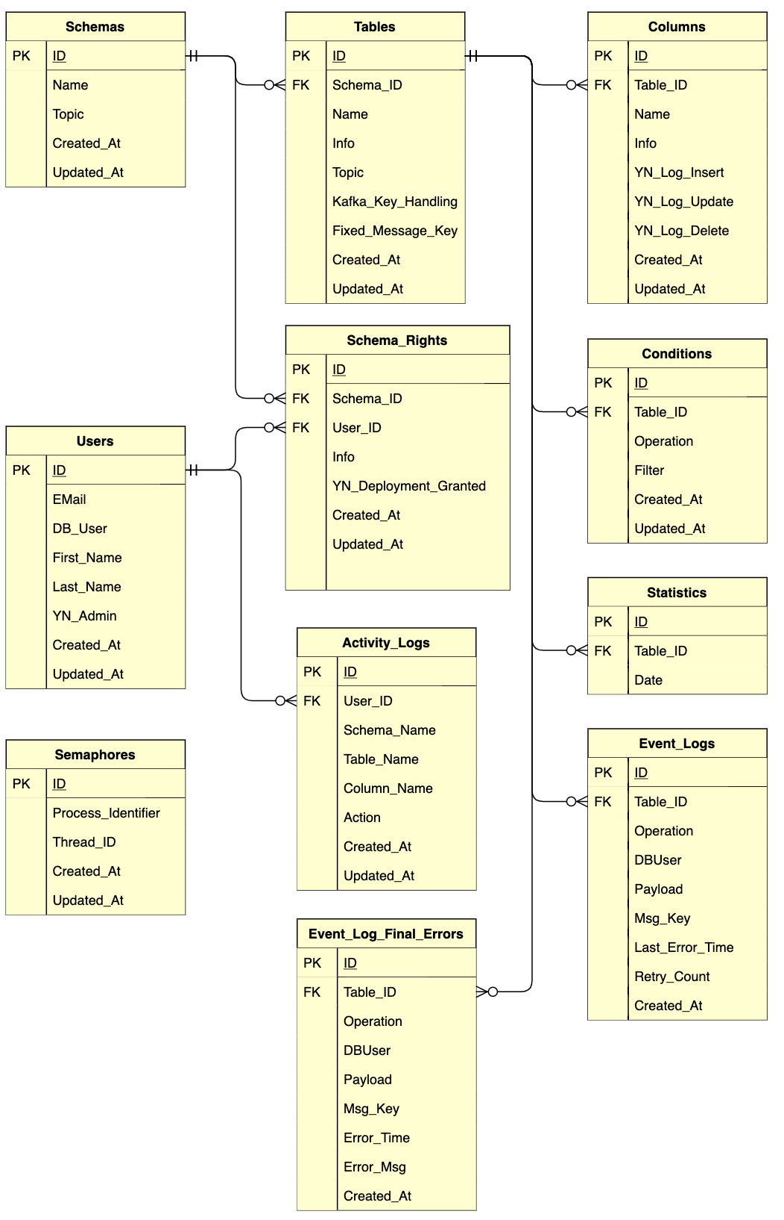
ER-Model
Own schema encapsulates all TriXX-relevant objects in DB
Export of configuration data to JSON file allows backup outside DB
Import of configuration data via JSON file e.g. for setup test systems
Via JSON import generation of TriXX configuration from external sources possible
Separate export/import per DB target schema possible

Slide 9
Supported database systems
TriXX was developed modular and DB-independent based on Ruby on Rails.
Runtime environment is a Java VM with jRuby, encapsulated in Docker containers.
Adaptations are thus in principle imaginable for all relational DB systems with trigger function for which JDBC drivers exist.
Currently supported databases :
Oracle: all editions with optimization for EE/partitioning
SQLite: Ensure DB independence in development
Further supported databases planned in the medium term:
PostgreSQL: Favorite free alternative to Oracle dependency
MS SQL-Server: For announced use in BI environment
MySQL / Maria-DB: Possibly if requirements exist

Slide 10
Goals / implementation challenges
Minimal impact on source system and original data changing transactions:
Earliest possible reduction of data to events of interest at the time they occur
Persistence of change events via trigger in table without indexes
Use of interval partitioning for calculable I/O effort (Oracle)
Robust operation without manual operating requirement :
Complete self-initialization of the system in DB schema at the start of the container.
Automatic restart after temporary failure of external dependencies (DB, Kafka)
Integrated housekeeping of all resulting artifacts in DB and file system
Integrated functions for health check and monitoring
Connection to external monitoring systems via log output of the Docker container

Slide 11
Implementation: Bulk operations
The process chain works consistently with bulk operations:
Trigger implemented as compound trigger with
Limitation to max. 1000 JSON records buffered in PL/SQL session memory
Bulk operation for insert in stage table EVENT_LOGS
Read records from EVENT_LOGS with SELECT FOR UPDATE SKIP LOCKED
No indexes for EVENT_LOGS means: Full Table Scan for each access to this table
Calculable load through interval partitioning with housekeeping of empty legacy partitions
Max. size of DB transaction towards Kafka is configurable (default: 10.000)
Transfer of events to Kafka (Produce) with transaction in Kafka cluster
Size of the transaction corresponds to DB transaction
Bulk size when transferring to Kafka is limited by Kafka (default 1000, configurable)

Slide 12
Implementation: Trigger example
CREATE OR REPLACE TRIGGER T1 FOR INSERT ON SCHEMA.TABLE COMPOUND TRIGGER
… /* Deklariere Memory-Collection payload_tab */ PROCEDURE Flush IS BEGIN … /* Schreibe Memory-Collection payload_tab in Event_Log-table */ END Flush; BEFORE STATEMENT IS BEGIN payload_tab.DELETE; /* remove possible fragments of previous transactions */ END BEFORE STATEMENT; AFTER EACH ROW IS BEGIN … /* Schreibe JSON-Record in Memory-Collection, Flush wenn > 1000 Records */ END AFTER EACH ROW; AFTER STATEMENT IS BEGIN Flush; /* Flush Collection in Table */ END AFTER STATEMENT; END T1;

Slide 13
Implementation: Uniqueness
Uniqueness at the target Kafka:
Each change event recorded in DB is transferred to Kafka and committed exactly once
A non commited transmission to Kafka can occur several times in case of error repetition
Kafka distinguishes between read_uncommited and read_commited when consuming
Due to implementation of nested transactions with two resources (DB, Kafka) without 2-phase commit, there is at least hypothetically a residual risk of double transfers

Slide 14
Implementation: Guaranteed sequences
Kafka guarantees the consumption of events in the order of their creation only within a partition
Events with the same key value always end up in the same partition in Kafka
TriXX supports optional keys: no key, primary key of the source table, fixed value or transaction ID
TriXX only transmits events with the same key value in an ordered sequence, all others in a timely manner but without guarantee of the sequence (conflict of objectives with parallel processing)
Kafka-Cluster
Cluster-Node 1
Cluster-Node 2
Cluster-Node 3
Topic 1
Partition
Partition
Partition
Topic 2
Partition
Partition
Partition

Slide 15
Implementation: Horizontal scalability
Bottleneck in the transfer between trigger event and Kafka is the transfer of events from the staging table EVENT_LOGS to Kafka
Scalability is given by configurable number of worker threads in the TriXX application, each working isolated with own DB and Kafka session
Depending on the capacity of the runtime env. (CPU, network) several 100 threads are possible
The allocation / synchronization of the events from EVENT_LOG to the worker threads is controlled by DB-Locks (SELECT ... FOR UPDATE SKIP LOCKED)
The guarantee of the order for events with key is ensured by processing events with the same key only by exactly one worker thread in the order of their occurrence
Distribution of keys to threads per modulo on a hash value of the key
Sequence violation can occur if DB transaction is committed only after successors with the same key from other DB transactions have already been transferred to Kafka.

Slide 16
Implementation: Fail-safe / Redundancy
Synchronization via DB locks using SELECT ... FOR UPDATE SKIP LOCKED would in principle also allow several TriXX instances to be actively operated in parallel.
However, in this mode of operation the sequence of events can no longer be guaranteed with key
Hot redundancy with multiple active TriXX instances should normally not be necessary, because:
An instance has enough potential for throughput optimization by thread scaling
A gapless operation of the TriXX application is not mandatory :
For catching the events via DB trigger no running TriXX instance is necessary
Suspension of TriXX execution does not lead to data loss, but only to delay of transmission to Kafka
This should allow scenarios such as version updates, changes to the runtime environment, etc. to be carried out with short downtimes during ongoing production operation

Slide 17
Implementation: Fault tolerance
In case of transmission errors / rejection of events by Kafka a Divide&Conquer procedure takes effect
The number of events transmitted by bulk operation is reduced until only a single event is processed. Among other things, this ensures immediate retry several times.
If an isolated event still remains erroneous, it is marked and retried with a time delay. After x unsuccessful attempts, this event will be sorted out in the error table.
From error table, events can be manually activated for post-processing, otherwise they will be permanently deleted after a holding period
Reasons for not broadcasting events can be e.g. :
Non-existent Kafka topic
Exceeding the permissible event size
Configuration without key although log compaction was configured on Kafka side

Slide 18
Implementation: Performance of DB actions
The target table of the events in the generated triggers is an interval-partitioned table without any index. This ensures minimal overhead and maximum availability when inserting the event data in the productive transactions.
The partitioning interval as well as the maximum number of simultaneous transactions (INI_TRANS) are controllable via the configuration of TriXX.
Fully processed partitions are promptly dropped by a housekeeping process.
Since the events are stored in a table without indexes, this means that reading the events for transmission to Kafka can only be done via Full Table Scan.
Interval partitioning ensures a limit to the amount of data to be read via full table scan
Even with temporarily massive data traffic, the reading effort due to Full Table Scan is reduced again with the next partition change (no problem with non-reducible high water mark).

Slide 19
Performance parameters / limitations
The achievable throughputs depend in reality strongly on:
Database performance
Performance of the Kafka cluster
Network latency and throughput / distance between DB, TriXX instance and Kafka cluster
Number of worker threads
Size of the JSON structure of the events, from 4 KB on, Oracle stores in significantly slower CLOB structures instead of heap tables.
Throughput for small distance between DB, TriXX and Kafka with 3 worker threads and JSON < 4K
820,000 events per minute 1.18 billion events per day

Slide 20
Application operation
Delivery artifact of TriXX is exactly a consistent Docker image
Configuration is done via a file or environment variables
Logging is done via console output of the Docker container, logging level can be changed dynamically via GUI or API
Operating status can be queried via HealthCheck API / monitored externally
Operating statistics (throughputs, error rates, etc.) are collected in table "Statstistics" every minute, condensed after some time
Temporary downtime or inaccessibility of DB or Kafka will be tolerated by TriXX. After resources are available again, operation will be resumed without further external activity.
Some configuration parameters can be adjusted at runtime, e.g. number of worker threads

Slide 21
Current developments / open points
As further steps in the project are planned:
Adaptation for other DB systems (PostgreSQL, MS SQL Server)
API interfaces for monitoring systems e.g. Prometheus
Establish as a product also available outside the Otto cosmos
Securing long-term financing of project expenses (maintenance/support contracts, licenses)
Establishing a fair pricing model vs. making it open source?

Slide 22
Differentiation from established CDC solutions
A diverse number of solutions for change data capture exist, both commercial and open source (Oracle Golden Gate, Quest SharePlex, Red Hat Debezium, etc.).
Most are based on scanning the transaction logs of a DB (late filtering for relevant events)
Thus no impact at runtime of the original transactions, however:
To compensate the potential unavailability of the target (Kafka) in an automated way requires to keep the transaction logs in DB for the maximum assumed downtime of the target
Taking into account response time, weekends, etc., this usually means at least 3 days.
For small proportion of change events in a large transaction processing system, there would be a disproportionate effort and complexity in dealing with transaction logs
Other pull alternatives like Kafka-Connect on JDBC level need individual structural adjustments in the application to work sufficiently performant.

Slide 23
Pros and cons of the solution approach
Pro:
Saving resources by filtering for relevant events at the time they occur
No dependencies or complexities for technical DB operation
No adaptations of existing applications necessary
Convenient configuration via GUI, but can also be automated via API
Contra:
Load on original transactions by trigger (double write)
At least theoretical coupling of operational risks for all participants
Tablespace full for table EVENT_LOGS otherwise affects possibly independent processes the same way

Slide 24
Demo
Roadmap with individual steps of the demo : https://bit.ly/3isjpJO

Slide 25
Thank you for your interest TriXX-Documentation: https://bit.ly/3jF1XPD
Otto Group Solution Provider (OSP) Dresden GmbH
Freiberger Str. 35 | 01067 Dresden
T +49 (0)351 49723 0 | F +49 (0)351 49723 119
osp.de

