Slide 1

The Quantum Resistant Ledger
Visionary Blockchain and Digital Asset Security

Slide 2
The Quantum Resistant Ledger
What is the QRL?
Visionary blockchain and digital asset security
A purpose built, industrial-grade, provably secure quantum computer resistant cryptocurrency running since 2018.

Slide 3
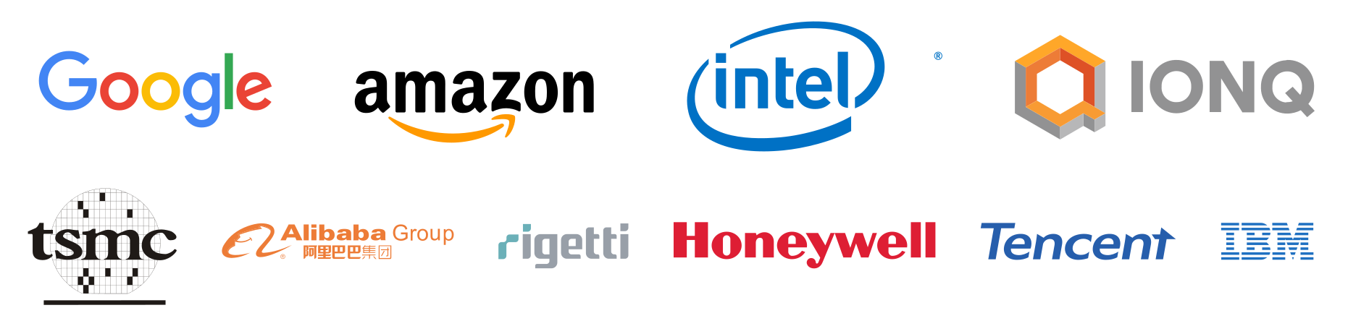
THE QUANTUM THREAT
Seven out of the top ten tech giants are either publicly competing for market dominance or involved in some capacity.
This amount of active funding by corporate and governmental entities indicate that quantum computing is rapidly moving out of the lab and into the competitive sectors.
The Quantum Threat (Y2Q) is recognised by industry leaders like IBM, Google, Microsoft, Intel, and others.
For existing blockchains, this will not be a simple drop-in replacement or fork because the underlying addressing scheme is vulnerable.
NIST has initiated a process to solicit, evaluate, and standardize quantum safe cryptography.
NSA is identifying areas that aren’t post-quantum secure.
Google is currently testing quantum cryptography that you can enable in your browser.
The brightest minds in the world are working on solutions to the Quantum Threat problem.
Many companies are already offering QaaS (Quantum as a Service) which allows anyone to rent quantum computer access in the cloud.

Slide 4
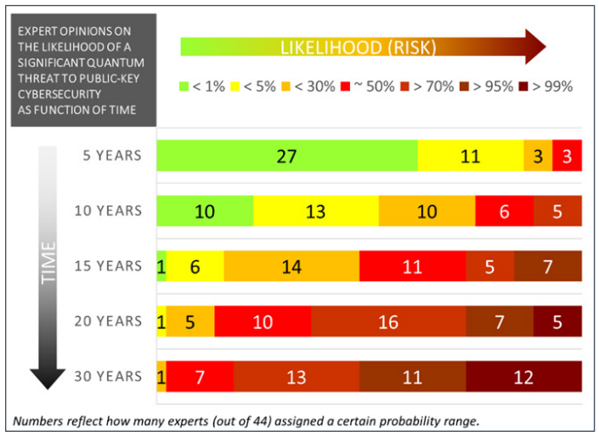
THE IMPACT ON BLOCKCHAIN
This threat impacts Bitcoin, Ethereum, Dogecoin, and 99%+ of other Cryptocurrencies.
With and industry of trillions on the line, if there is even a 1% chance of quantum technology disrupting cryptography and blockchain, the risk is too high. This is a problem, considering expert opinions see a 30% chance of cryptographic disruption in the next five years.
Why won't a fork or a software upgrade fix existing blockchains?
Blockchains are immutable, meaning that in many cases, vulnerable public addresses are written to the ledger for all to view. The reason for this is so that each node can verify the validity of each transaction. Past updates which are far simpler in nature have easily taken close to 5 years to update. An address migration will be necessary, which can take several more years, may not be possible in all cases, and may not work for all users.
The time to update & migrate might already be too late for many blockchains.

Slide 5
ROADMAP
2016
First quantum safe code released.
2017
Whitepaper with a working testnet.
2018
After two years of testing and multiple external audits, a full featured mainnet was released.
2019-future
With experience of building a pioneering blockchain, several protocol improvements and research to build out next generation Proof-of-Stake and smart contracts is underway.
Current Features
Comes with everything you’d expect from a layer-1 blockchain.
Wide platform coverage for wallets including browser, desktop, mobile, and hardware wallets (ledger).
Developers are treated to a great ecosystem of example code, documentation, and rich APIs.
Always prepared for the future with crypto-agility, allowing for seamless upgrades to systems underlying wallet transactions.
And done so in a way that other blockchains struggle to do.

Slide 6
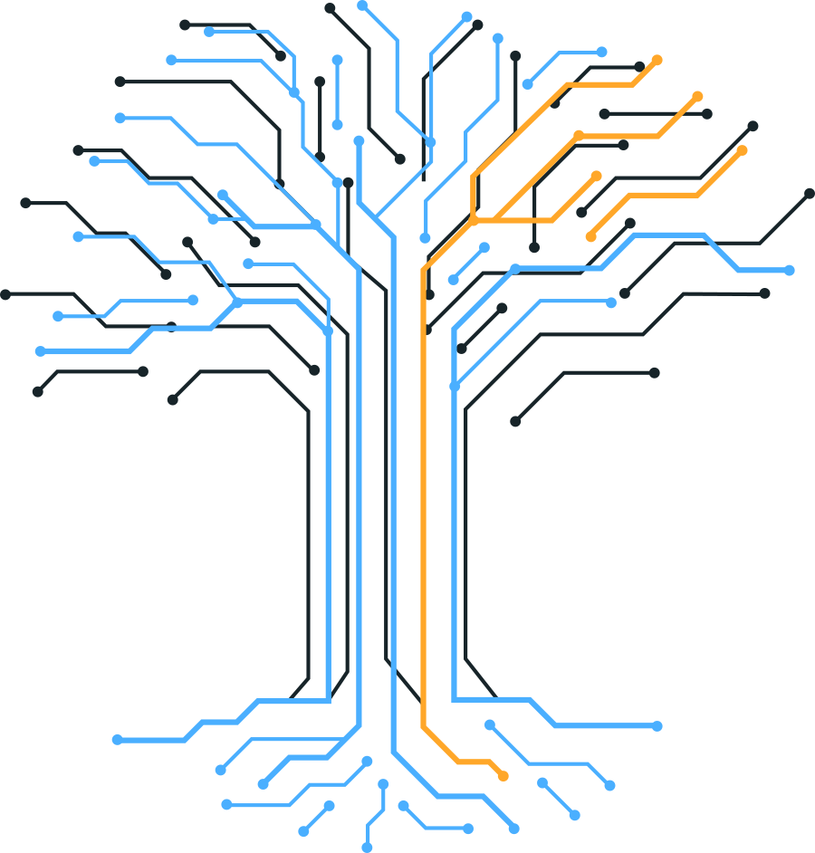
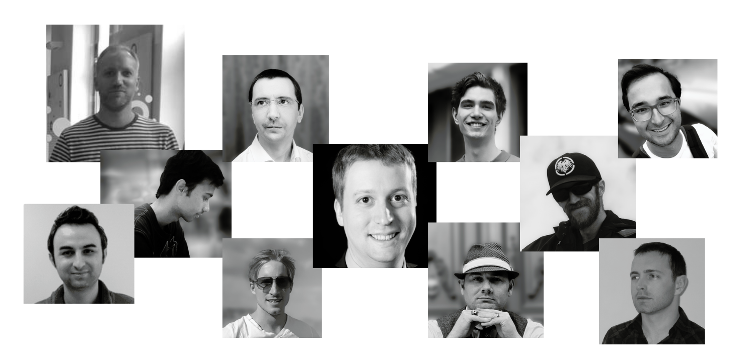
THE QRL CONTRIBUTORS
We are a dedicated team of code developers, PhD post-quantum cryptographers, and engineering professionals who created the first industrial-grade, provably quantum-secure cryptocurrency using an NIST-recommended addressing scheme.
Together, along with support of many key contributors, a total of 12,339 contributions between 57 contributors over 85 repositories have been made, with more being made each day.

Slide 7




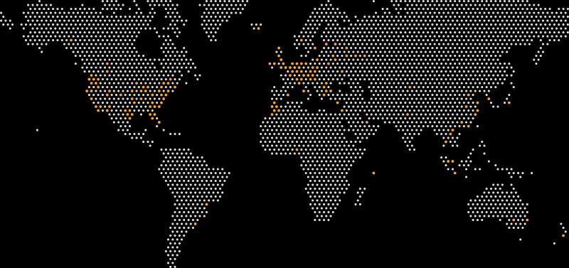


COMMUNITY
1.8k
3.3k
16.3k
800
800
57
The QRL community and contributors are comprised of compassionate quantum optimistic, forwarding-thinking professionals of various backgrounds from around the globe.

Slide 8
QUESTIONS?
Have any questions or would like to learn more? We would love to hear from you.
Let's talk!
Press inquiries
press@theqrl.org
Support requests
support@theqrl.org
General inquiries
info@theqrl.org
Social
Discord: https://www.discord.gg/qrl
Reddit: https://www.reddit.com/r/qrl
Twitter: https://twitter.com/QRLedger
YouTube: https://youtube.com/c/QRLedger
Website
https://www.theqrl.org/
Markets
https://www.theqrl.org/markets/

Slide 9
REFERENCES AND LINKS
COMMERCIAL ENTITIES:
IBM https://www.ibm.com/quantum-computing/
Google https://quantumai.google/
Microsoft https://www.microsoft.com/en-us/research/research-area/quantum-computing
GOVERNMENT ENTITIES:
Intel https://www.intel.com/content/www/us/en/research/quantum-computing.html
NIST https://csrc.nist.gov/news/2016/public-key-post-quantum-cryptographic-algorithms
MEDIA:
“No! You can't just Quantum Soft fork Bitcoin! Or can you ???” https://www.youtube.com/watch?v=cbP2ejgSxcA

