Slide 1

The Quantum Resistant Ledger
Visionary blockchain and digital asset security

Slide 2
The Quantum Resistant Ledger
Visionary blockchain and digital asset security
A purpose built, industrial-grade, provably secure quantum computer resistant cryptocurrency.

Slide 3
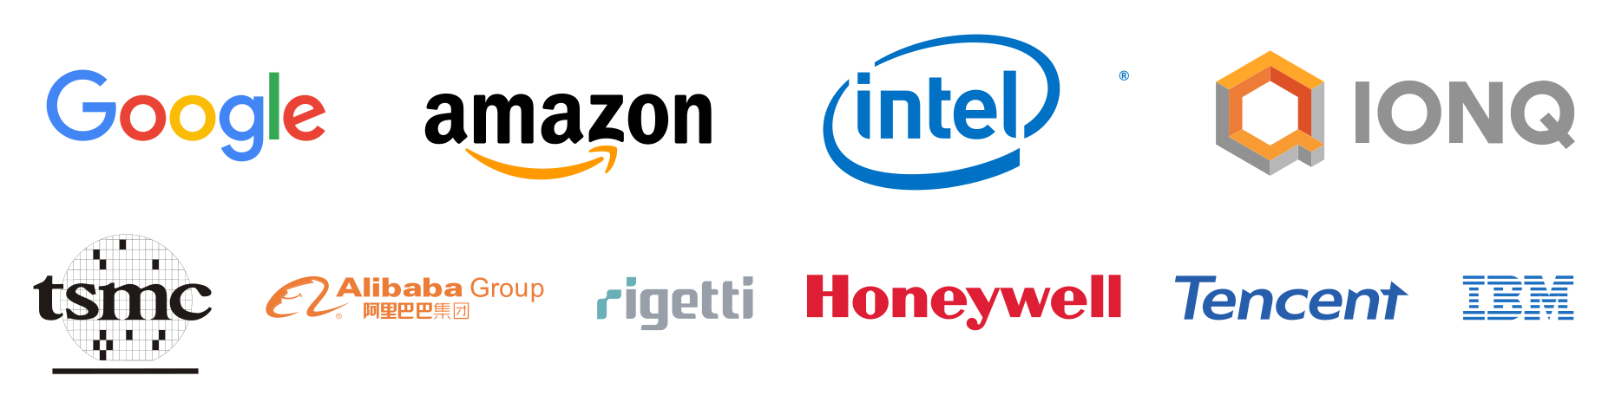
THE QUANTUM THREAT
Seven out of the top ten tech giants are either publicly competing for market dominance or involved in some capacity.
This amount of active funding and by industry indicates that it’s rapidly moving out of the lab and into the competitive commercial sector.
This threat is well recognised by industry leaders like Cloudflare, Google, and others.
With the understanding this won’t be a drop-in replacement and require and time to implement and migrate, preparations are being made.
NIST has initiated a process to solicit, evaluate, and standardize quantum safe cryptographic algorithms.
NSA is identifying areas that aren’t post-quantum secure.
GOOGLE is currently testing quantum cryptography that you can enable in your browser.
Fatally, this impacts Bitcoin, Ethereum, Dogecoin, and 99%+ of other cryptocurrencies.
Notably, a powerful enough quantum computer can break current public key cryptography used for the Internet, Banks, Blockchain, and many other systems.

Slide 4
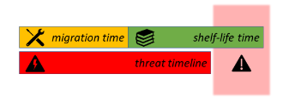
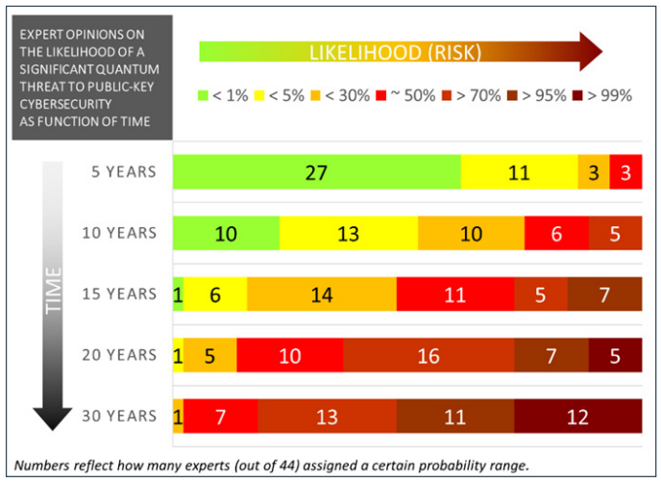
THE IMPACT ON BLOCKCHAIN
Bitcoin, Ethereum, Dogecoin, and 99%+ of other cryptocurrencies aren’t post-quantum secure.
With trillions on the line, even a 1% chance of a technology undoing everything would be too much. This is a problem, considering, expert opinions see a 30% chance of that happening in the next five years.
There’s no drop-in replacement. Making something post-quantum secure takes considerable time and effort, often requiring significant changes to the underlying network and code due signature size considerations. Past updates which are far simpler in nature have easily taken close to 5 years to update. A migration will be necessary, which can take several more years, and may not be possible in all cases.
The time to update & migrate might already be too late for many blockchains.

Slide 5
ROADMAP
2016
First quantum safe code released.
2017
Whitepaper with a working testnet.
2018
After two years of testing and multiple external audits, a full featured mainnet was released.
2019-future
With experience of building a pioneering blockchain, several protocol improvements and research to build out next generation Proof-of-Stake and smart contracts is underway.
Current Features
Comes with everything you’d expect from a layer-1 blockchain.
Wide platform coverage for wallets including browser, desktop, mobile, and hardware wallets (ledger).
Developers are treated to a great ecosystem of example code, documentation, and rich APIs.
Always prepared for the future with crypto-agility, allowing for seamless upgrades to systems underlying wallet transactions.
And done so in a way that other blockchains struggle to do.

Slide 6
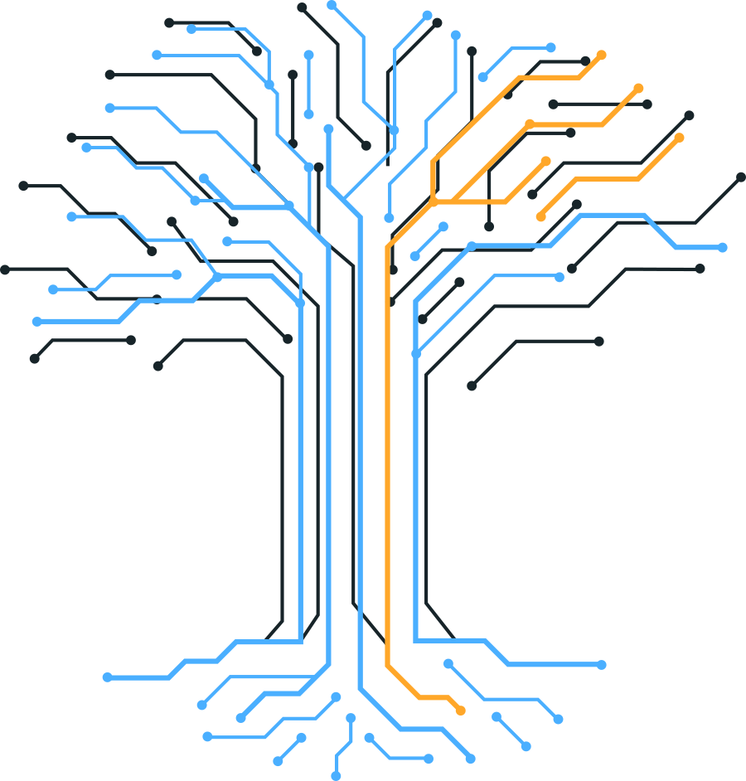
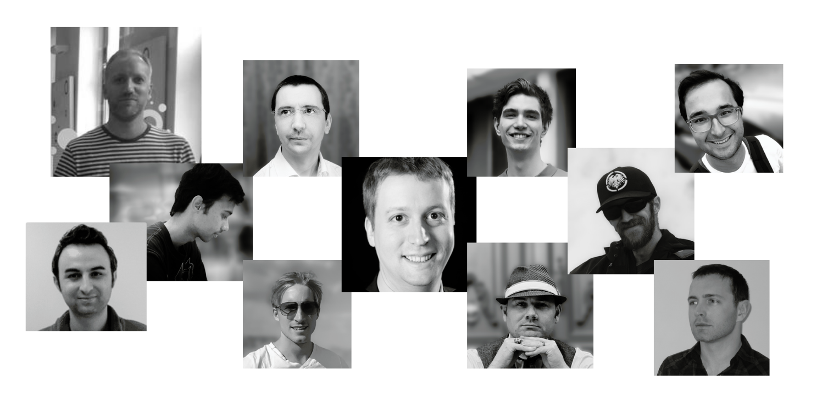
THE QRL CONTRIBUTORS
We are a dedicated team of code developers, PhD post-quantum cryptographers, and engineering professionals who created the first industrial-grade, provably quantum-secure cryptocurrency.
Together, along with support of many key contributors, a total of 12,339 contributions between 57 contributors over 85 repositories have been made, with more being made each day.

Slide 7




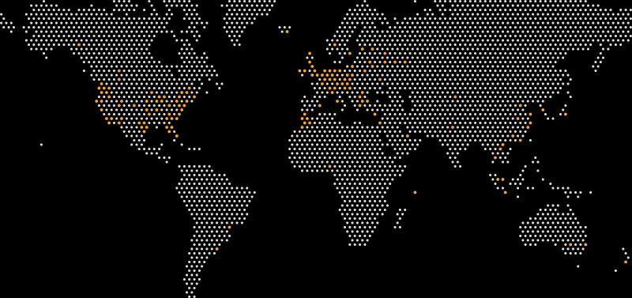


COMMUNITY
1.8k
3.3k
16.3k
800
800
57
The QRL community and contributors are comprised of compassionate quantum optimistic, forwarding-thinking professionals of various backgrounds from around the globe.

Slide 8
QUESTIONS?
Have any questions or would like to learn more? We would love to hear from you.
Let's talk!
Press enquiries
press@theqrl.org
Support requests
support@theqrl.org
General enquiries
info@theqrl.org
Social
Blog: https://www.theqrl.org/blog/
Discord: https://www.discord.gg/qrl
Reddit: https://www.reddit.com/r/qrl
Twitter: https://twitter.com/QRLedger
Youtube: https://youtube.com/c/QRLedger

