Slide 1
Name: Maryam Otunara Shefiu
School: School of Science and Technology
Department: Computer Science
Level: 100 level
Course: Introduction to Problem Solving
Lecturer: Dr. Desmond Moru
Topic: Algorithms (flowcharts and pseudocodes)

Slide 2
Pseudocode for store checkout after purchase

Slide 3
BEGIN
INPUT names of goods bought by the consumer
PRINT corresponding prices of the goods bought
INPUT which method of payment do you want to use?
IF INPUT = Cash
PRINT Here are your purchases.
IF INPUT = Card
COMPUTE processing payment via POS
IF COMPUTE = successful
PRINT Here are your purchases
ELSEIF COMPUTE =unsuccessful
INPUT Do you want to use any other method of payment?
IF INPUT = No
PRINT Goodbye
ELSEIF INPUT = Yes
GO BACK TO SECOND INPUT
IF OVERALL TRANSACTION = successful
PRINT Here are your puchases
END

Slide 4
Flowchart for store checkout after purchase

Slide 5
Was the transaction successful or unsuccessful?
Start
SUCCESSFUL
UNSUCCESSFUL
Do you want to use cash?
Input names of goods bought by consumer
Card
NO
YES
Method of payment
Input corresponding prices of the goods bought
Cash
Stop

Slide 6
Flowchart for my typical morning routine

Slide 7
Beginning of my morning routine
Wake up
Pray
Brush my teeth & have my bath
End of my morning routine
Go to school
Eat breakfast
Dress for school

Slide 8
Algorithm for swapping ages for two corresponding names (Pseudocode)

Slide 9
BEGIN
INPUT name1
INPUT age1
INPUT name2
INPUT age2
IF INPUT = name1
PRINT age2
ELSEIF INPUT = name2
PRINT age1
END

Slide 10
Algorithm for swapping ages for two corresponding names (Flowchart)

Slide 11
Start
Input name1
Input age1
If input is name1
YES
Input age2
Input name2
Print age2
NO
If input is name2
Stop
Print age1

Slide 12
Algorithm to find the root of a cubic equation (Pseudocode)

Slide 13
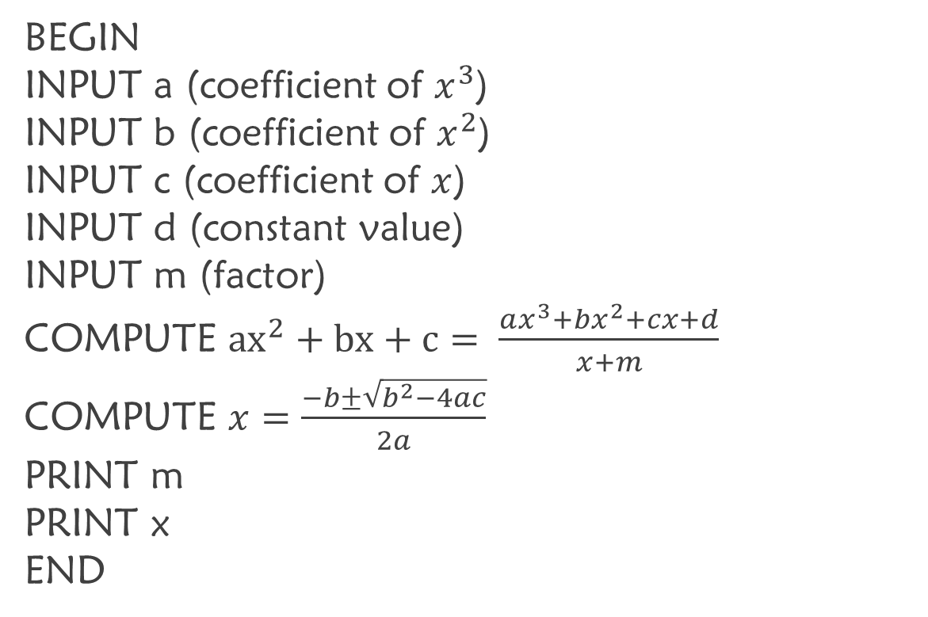
BEGIN
INPUT a (coefficient of $x^{3}$)
INPUT b (coefficient of $x^{2}$)
INPUT c (coefficient of $x$)
INPUT d (constant value)
INPUT m (factor)
COMPUTE ${ax}^{2}+bx+c= \frac{ax^{3}+bx^{2}+cx+d}{x+m}$
COMPUTE $x=\frac{−b±\sqrt{b^{2}−4ac}}{2a}$
PRINT m
PRINT x
END

Slide 14
Algorithm to find the roots of a cubic equation (Flowchart)

Slide 15
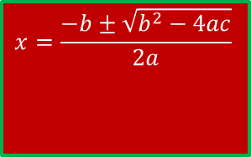
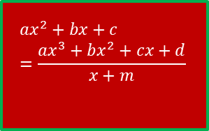
Input a
Input b
Input c
Start
Print m
$$x=\frac{−b±\sqrt{b^{2}−4ac}}{2a}$$
Input d
Print x
$$ax^{2}+bx+c=\frac{ax^{3}+bx^{2}+cx+d}{x+m}$$
Input m
Stop

Slide 16
Algorithm to find the roots of a quartic equation (Pseudocode)

Slide 17
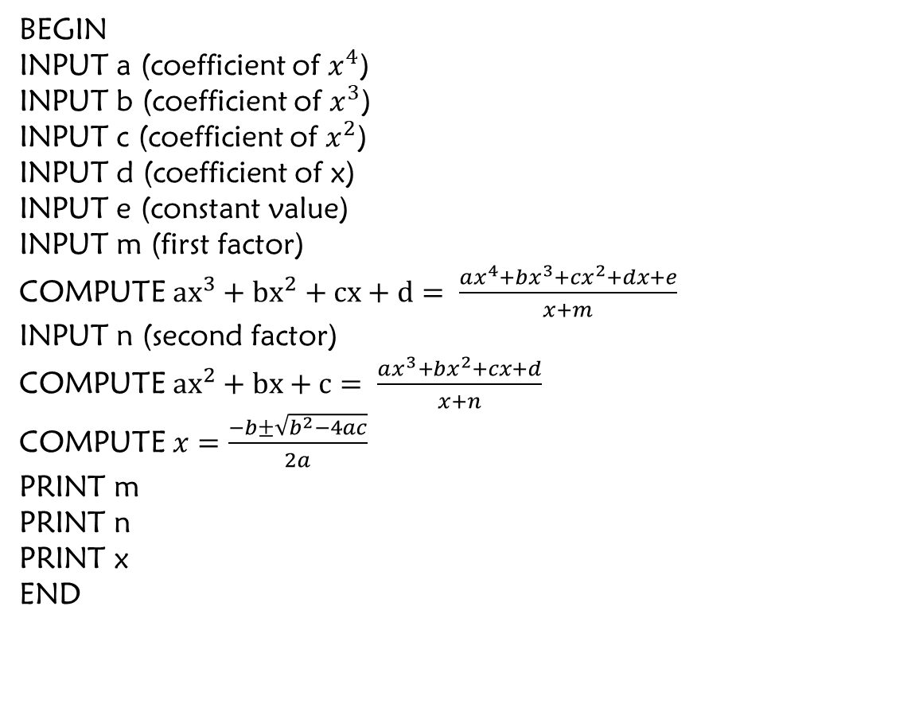
BEGIN
INPUT a (coefficient of $x^{4}$)
INPUT b (coefficient of $x^{3}$)
INPUT c (coefficient of $x^{2}$)
INPUT d (coefficient of x)
INPUT e (constant value)
INPUT m (first factor)
COMPUTE ${ax}^{3}+{bx}^{2}+cx+d= \frac{ax^{4}+bx^{3}+cx^{2}+dx+e}{x+m}$
INPUT n (second factor)
COMPUTE ${ax}^{2}+bx+c= \frac{ax^{3}+bx^{2}+cx+d}{x+n}$
COMPUTE $x=\frac{−b±\sqrt{b^{2}−4ac}}{2a}$
PRINT m
PRINT n
PRINT x
END

Slide 18
Algorithm to find the roots a quartic equation (Flowchart)

Slide 19
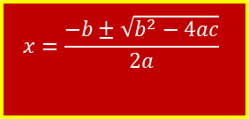
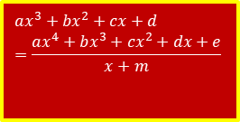
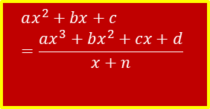
$$ax^{3}+bx^{2}+cx+d=\frac{ax^{4}+bx^{3}+cx^{2}+dx+e}{x+m}$$
Input n
Start
Input a
Input m
$$ax^{2}+bx+c=\frac{ax^{3}+bx^{2}+cx+d}{x+n}$$
Stop
Input b
Input e
$$x=\frac{−b±\sqrt{b^{2}−4ac}}{2a}$$
Print x
Print m
Print n
Input c
Input d

