Slide 1
Homework Assignment #2
J. H. Wang
Apr. 11, 2024

Slide 2
Homework #2
Chap.4: 4.8, 4.10, 4.16
Chap.5: 5.14, 5.18, 5.22, 5.25
Chap.6: 6.7, 6.15, 6.18
Programming exercises:
    Programming problems: 4.27*, (4.24**, ) 6.33*
      Note: Each student must complete all programming problems on your own
    Programming projects for Chap. 4* (*2) & Chap. 5*
      Team-based: select at least one programming project from each chapter
Due: two weeks (Apr. 25, 2024)

Slide 3
Chap. 4
  4.8: Provide two programming examples in which multithreading does not provide better performance than a single-threaded solution.
  4.10: Which of the following components of program state are shared across threads in a multithreaded process?
    (a) Register values
    (b) Heap memory
    (c) Global variables
    (d) Stack memory

Slide 4
  4.16: A system with two dual-core processors has four processors available for scheduling
    A CPU-intensive application is running on this system
    All input is performed at program start-up, when a single file must be opened
    Similarly, all output is performed just before the program terminates, when the program results must be written to a single file
    Between start-up and termination, the program is entirely CPU-bound
    Your task is to improve the performance of this application by multithreading it
    The application runs on a system that uses the one-to-one threading model (each user thread maps to a kernel thread)
    (…to be continued)

Slide 5
(… continued from the previous slide)
How many threads will you create to perform the input and output? Explain.
How many threads will you create for the CPU-intensive portion of the application? Explain.

Slide 6
Chap. 5:
  5.14: Most scheduling algorithms maintain a run queue, which lists processes eligible to run on a processor. On multicore systems, there are two general options:
    (1) each processing core has its own run queue, or
    (2) a single run queue is shared by all processing cores.
  What are the advantages and disadvantages of each of these approaches?

Slide 7
  5.18: The following processes are being scheduled using a preemptive, priority-based, round-robin scheduling algorithm.
  Each process is assigned a numerical priority, with a higher number indicating a higher relative priority.
  For processes with the same priority, a round-robin scheduler will be used with a time quantum of 10 units.
  If a process is preempted by a higher-priority process, the preempted process is placed at the end of the queue.
  (… to be continued)

Slide 8
    (… to be continued)
Thread | Priority | Burst | Arrival
P₁ | 8 | 15 | 0
P₂ | 3 | 20 | 0
P₃ | 4 | 20 | 20
P₄ | 4 | 20 | 25
P₅ | 5 | 5 | 45
P₆ | 5 | 15 | 55

Slide 9
  (a) Show the scheduling order of the processes using a Gantt chart.
  (b) What is the turnaround time for each process?
  (c) What is the waiting time for each process?

Slide 10
  5.22: Consider a system running ten I/O-bound tasks and one CPU-bound task.
  Assume that the I/O-bound tasks issue an I/O operation once for every millisecond of CPU computing and that each I/O operation takes 10 milliseconds to complete.
  Also assume that the context-switching overhead is 0.1 millisecond and that all processes are long-running tasks.
  Describe the CPU utilization for a round-robin scheduler when:
  (a) The time quantum is 1 millisecond
  (b) The time quantum is 10 millisecond

Slide 11
  5.25: Explain the differences in how much the following scheduling algorithms discriminate in favor of short processes:
  (a) FCFS
  (b) RR
  (c) Multilevel feedback queues

Slide 12
Chap.6:
  6.7: The pseudocode of Figure 6.15 illustrates the basic push() and pop() operations of an array-based stack. Assuming that this algorithm could be used in a concurrent environment, answer the following questions:
    (a) What data have a race condition?
    (b) How could the race condition be fixed?

Slide 13
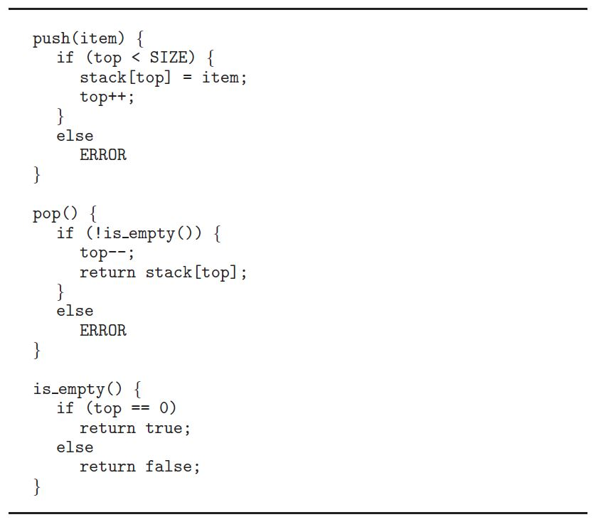
Fig. 6.15:

Slide 14
  6.15: Explain why implementing synchronization primitives by disabling interrupts is not appropriate in a single-processor system if the synchronization primitives are to be used in user-level programs.

Slide 15
  6.18: The implementation of mutex locks provided in Section 6.5 suffers from busy waiting.
  Describe what changes would be necessary so that a process waiting to acquire a mutex lock would be blocked and placed into a waiting queue until the lock became available.

Slide 16
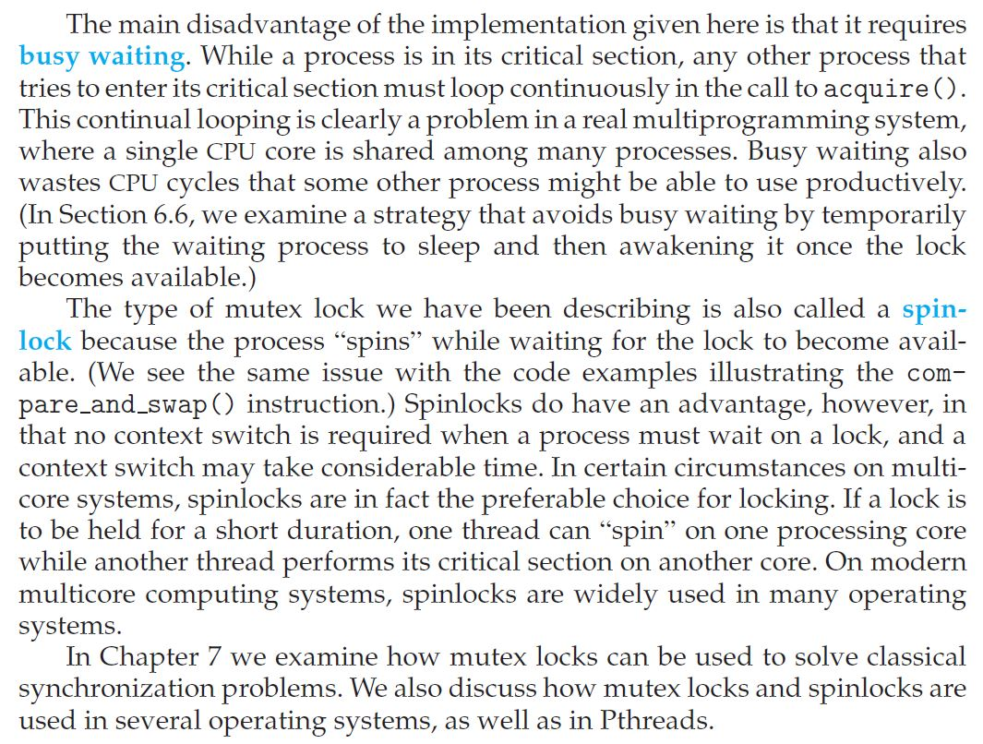

Slide 17
Programming Problems
  4.27*: The Fibonacci sequence is the series of numbers 0, 1, 1, 2, 3, 5, 8, … . Formally, it can be expressed as:
  fib₀=0
  fib₁=1
  fib_{n}=fib_{n-1}+fib_{n-2}
  Write a multithreaded program that generates the Fibonacci sequence using either the Java, Pthread, or Win32 thread library.
  (… to be continued)

Slide 18
This program should work as follows:
  On the command line, the user will enter the number of Fibonacci numbers that the program is to generate
  The program will then create a separate thread that will generate the Fibonacci numbers, placing the sequence in data that can be shared by the threads (an array is probably the most convenient data structure)
  When the thread finishes execution, the parent thread will output the sequence generated by the child thread
  Because the parent thread cannot begin outputting until the child finishes, the parent will have to wait for the child thread to finish

Slide 19
  [optional] (4.24**): An interesting way of calculating pi is to use a technique known as Monte Carlo, which involves randomization. This technique works as follows:
    Suppose you have a circle inscribed within a square, (Assume that the radius of this circle is 1.)
    First, generate a series of random points as simple (x,y) coordinates
    These points must fall within the Cartesian coordinates that bound the square
    Of the total number of random points that are generated, some will occur within the circle
    (… to be continued)

Slide 20
    Next, estimate pi by performing the following calculation:
      Pi=4*(number of points in circle) / (total number of points)
  Write a multithreaded version of this algorithm that creates a separate thread to generate a number of random points.
    The thread will count the number of points that occur within the circle and store that result in a global variable.
    When this thread has exited, the parent thread will calculate and output the estimated value of pi.

Slide 21
6.33*: Assume that a finite number of resources of a single resource type must be managed.
  Processes may ask for a number of these resources and will return them once finished.
  As an example, many commercial software packages provide a given number of licenses, indicating the number of applications that may run concurrently.
  When the application is started, the license count is decremented.
  When the application is terminated, the license count is incremented.
  If all licenses are in use, requests to start the application are denied.
  Such a request will be granted only when an existing license holder terminates the application and a license is returned.

Slide 22
  #define MAX_RESOUCRES 5
  int available_resources = MAX_RESOURCES;
  int decrease count(int count) {
  if (available resources < count)
  return -1;
  else {
  available resources -= count;
  return 0;
  }
  }
  int increase count(int count) {
  available resources += count;
  return 0;
  }

Slide 23
  The preceding program segment produces a race condition. Do the following:
    (a) Identify the data involved in the race condition.
    (b) Identify the location (or locations) in the code where the race condition occurs.
    (c) Using a semaphore or mutex lock, fix the race condition. It is permissible to modify the decrease_count() function so that the calling process is blocked until sufficient resources are available.
    https://medium.com/%E7%A8%8B%E5%BC%8F%E4%BA%BA%E6%9C%88%E5%88%8A/%E7%AB%B6%E7%88%AD%E6%83%85%E6%B3%81%E7%9A%84c%E8%AA%9E%E8%A8%80%E7%AF%84%E4%BE%8B-1a88df31c20e
    https://github.com/andreiarnautu/Operating-Systems-Concepts-Practical-Exercises/blob/master/6.33/main.c

Slide 24
End-of-Chapter Programming Projects
Programming Projects for Chap. 4: (Choose one)
  Project 1. Sudoku solution validator
    To design a multithreaded application that determines whether the solution to a Sudoku puzzle is valid.
    Passing parameters to each thread
    Returning results to the parent thread
  Project 2. Multithreaded sorting application
    Write a multithreaded sorting program that works as follows: A list of integers is divided into two smaller lists of equal size. Two separate threads sort each sublist using a sorting algorithm of your choice. The two sublists are then merged by a third thread.

Slide 25
End-of-Chapter Programming Projects
Programming Projects for Chap. 5:
  Project. Scheduling Algorithms
    This project involves implementing several process scheduling algorithms
      FCFS
      SJF
      Priority-based
      Round-Robin
      Priority with round-robin
    The implementation of this project may be completed in either C or Java

Slide 26
Homework Submission
For hand-written exercises, please hand in your homework on paper in class
For programming exercises, please upload your program to the iSchool+ as follows:
  Program uploading: a compressed file (in .zip format) including source codes, execution snapshot, and documentation
  Documentation: containing -
    Team members and responsibility
    Compilation or configuration instructions if it needs special environment to compile or run
  Please contact with the TA if you are unable to upload your homework

Slide 27
Any Question or Comments?

