Slide 1
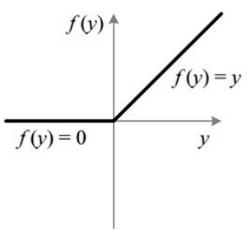
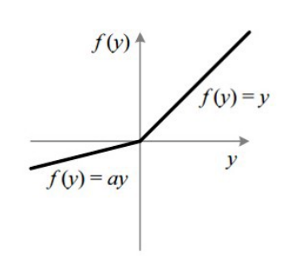
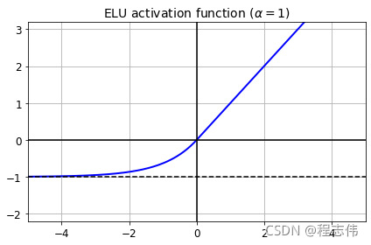
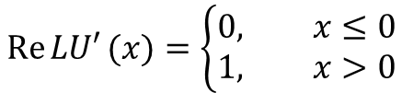
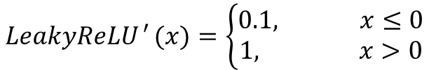
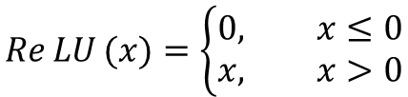
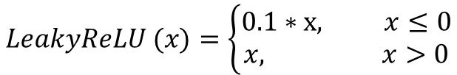
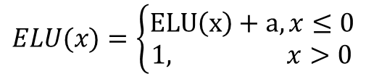
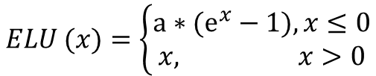
$$\operatorname{Re}{LU}(x)=\left\{\begin{matrix}0, x≤0 \\ x, x>0\end{matrix}\right.$$
$$\operatorname{Re}{LU′}(x)=\left\{\begin{matrix}0, x≤0 \\ 1, x>0\end{matrix}\right.$$
$$LeakyReLU (x)=\left\{\begin{matrix}0.1∗x, x≤0 \\ x, x>0\end{matrix}\right.$$
$$\operatorname{LeakyReLU}{′}(x)=\left\{\begin{matrix}0.1, x≤0 \\ 1, x>0\end{matrix}\right.$$
$$ELU (x)=\left\{\begin{matrix}a∗(ⅇ^{x}−1), x≤0 \\ x, x>0\end{matrix}\right.$$
$$ELU(x)=\left\{\begin{matrix}ELU\left(x\right)+a, x≤0 \\ 1, x>0\end{matrix}\right.$$

Slide 2
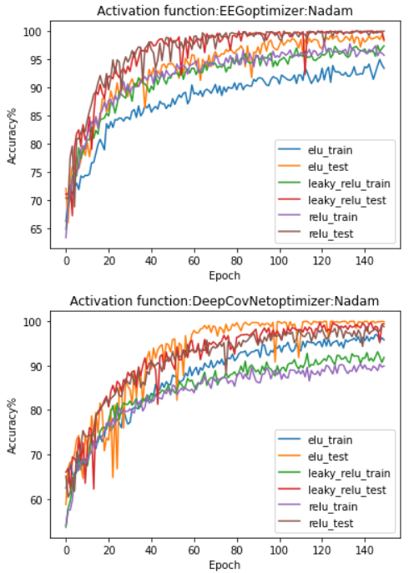
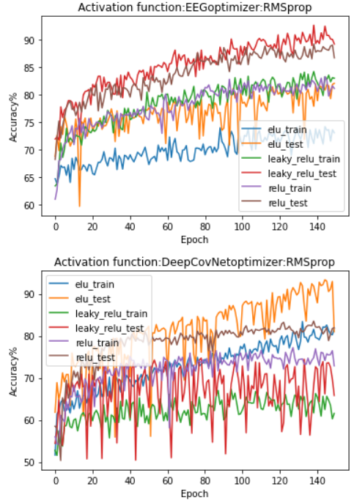
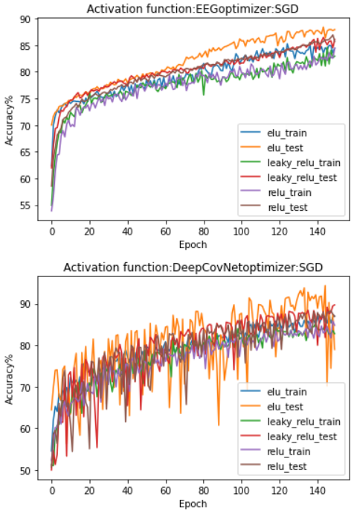

Slide 3
elu_train
elu_test
leaky_relu_train
leaky_relu_test
relu_train
relu_test

