Slide 1
NYCU 2022 Summer DLP Lab5 – Let’s Play GANs
TA 高嘉豪
chiahaok.cs10@nycu.edu.tw
August 2, 2022
Notes:
1

Slide 2
Outline
Lab Objective
Important Date
Lab Description
Scoring Criteria
Notes:
2

Slide 3
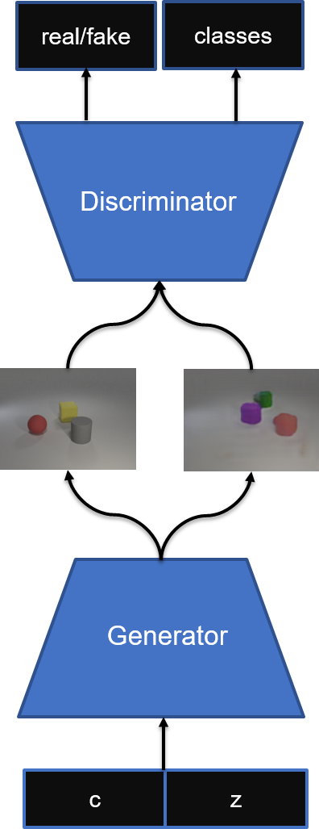
Lab Objective
In this lab, you need to implement a conditional GAN and generate synthetic images based on multi-labels conditions
Example of labels:
[“cyan cylinder”, “red cube”], [“green sphere”], …

Slide 4
Important Date
No DEMO
Experiment Report Submission Deadline: 8/23 (Tue.) 11:59 p.m.
Zip all files in one file
Report (.pdf)
Source code
Name it like ”DLP_LAB5_yourstudentID_name.zip”
Example: “DLP_LAB5_310111111_王小明.zip”
-5% to your score if you do not follow the format

Slide 5
Lab Description
Implementation details
Choose your conditional GAN architecture
Design your generator and discriminator
Choose your loss function

Slide 6
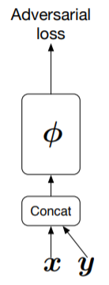
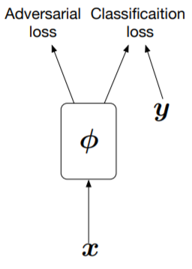
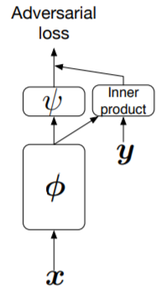
Lab Description – Choice of cGAN
Generator
Concatenation, multiplication, batch normalization, etc.
Discriminator
Conditional GAN
InfoGAN
Auxiliary GAN
Projection discriminator
…
Hybrid version

Slide 7
Lab Description – Design of GAN
De-convolution layers
Basic block
Bottleneck block
Residual
Self-attention
Again, hybrid version
E.g.
DCGAN
SA-GAN
Progressive GAN
…

Slide 8

Lab Description – Choice of loss functions
GAN loss function
LSGAN
WGAN
WGAN-GP
Combine with your choice of cGAN

Slide 9
Lab Description – Other details
You can use any GAN architecture your like
Use the function of a pretrained classifier, eval(images, labels), to compute accuracy of your synthetic images.
Labels should be one-hot vector. E.g. [[1,1,0,0,…],[0,1,0,0,…],…]
Images should be all generated images. E.g. (batch size, 3, 64, 64)
Use make_grid and save_image functions from torchvision.utils to save your image (8 images a row, 4 rows)
The resolution of input for pretrained classifier is 64x64. You can design your own output resolution for generator and resize it.
Some tips: https://github.com/soumith/ganhacks.

Slide 10
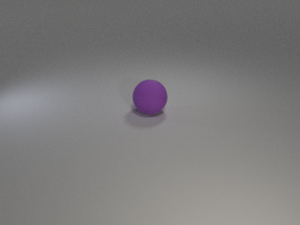
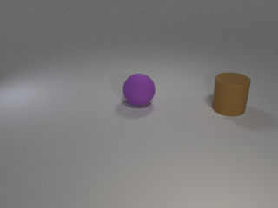
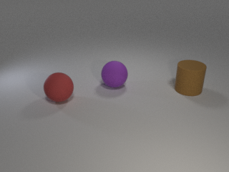
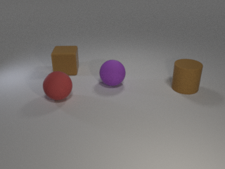
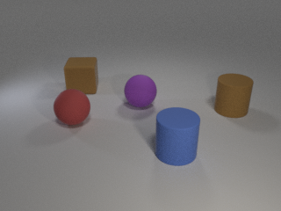
Lab Description - Dataset
Provided files
readme.txt, train.json, test.json, object.json, iclevr.zip, evaluator.py, checkpoint.pth
iclver.zip
Download from this google drive link (backup link)
object.json
Dictionary of objects
24 classes

Slide 11
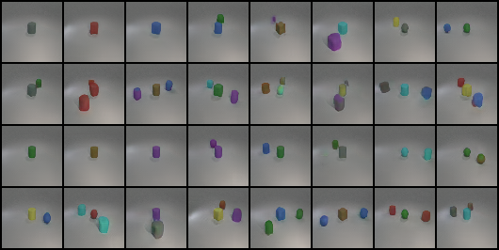
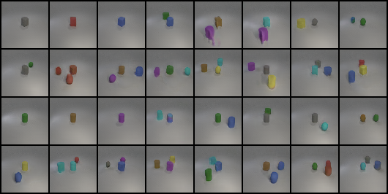
Lab Description – Output examples
Accuracy: 0.667
Accuracy:0.847

Slide 12
Lab Description – Requirements
Implement training, testing functions, and dataloader
Choose your cGAN architecture
Design your generator and discriminator
Choose your loss functions
Output the results based on test.json and new_test.json (will be released later)

Slide 13
Scoring Criteria
Report (50%)
Introduction (5%)
Implementation details (20%)
Describe how you implement your model, including your choice of cGAN, model architectures, and loss functions. (15%)
Specify the hyperparameters (learning rate, epochs, etc.) (5%)
Results and discussion (25%)
Show your results based on the testing data. (5%)
Discuss the results of different models architectures. (20%) For example, what is the effect with or without some specific loss terms, or what kinds of condition design is more effective to help cGAN

Slide 14
Scoring Criteria
Result (50%)
Classification accuracy on test.json and new_test.json. (25% + 25%)
Score >= 0.8 ---- 100%
0.8 > score >= 0.7 ---- 90%
0.7 > score >= 0.6 ---- 80%
0.6 > score >= 0.5 ---- 70 %
0.5 > score >= 0.4 ---- 60 %
score < 0.4 ---- 0%

Slide 15
conds
Generator
conds
Discriminator
score
Fake img
Z

