Slide 1
計算物理
誤差問題

Slide 2
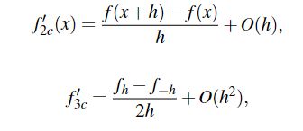
Problem
Using different integrate formula and different data type and compare the difference.

Slide 3
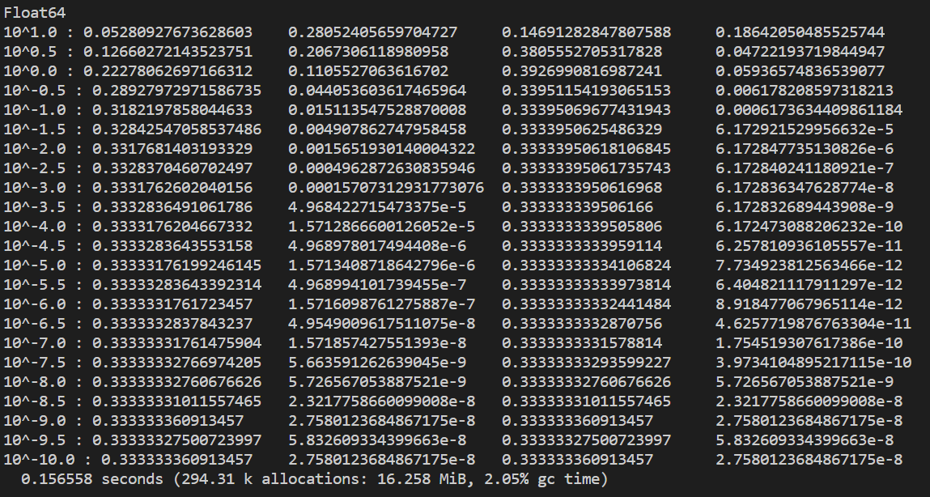
Float64
N f2 error(%) f3 error(%)

Slide 4
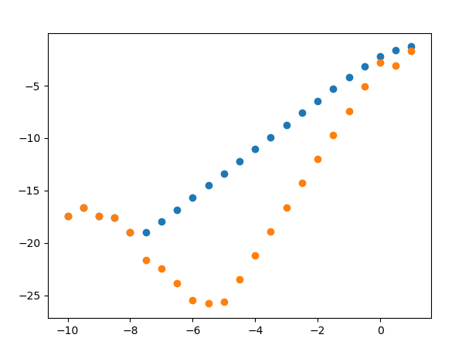
Log(error) : O(h)、O(h^2)

Slide 5
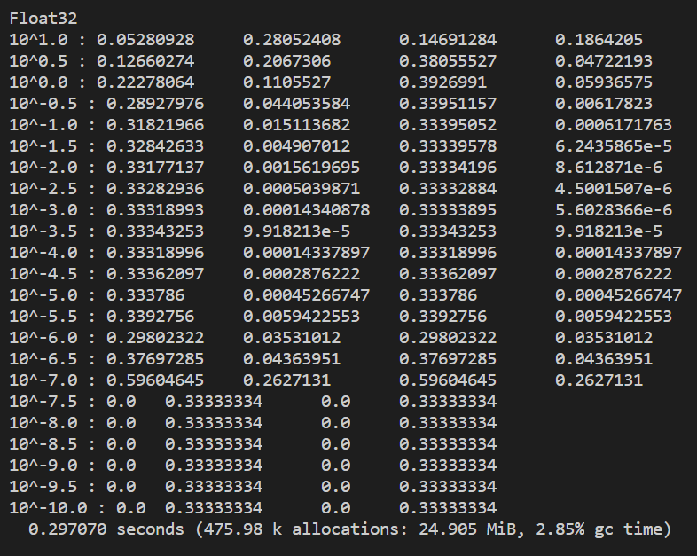
FLoat32
N f2 error(%) f3 error(%)

Slide 6
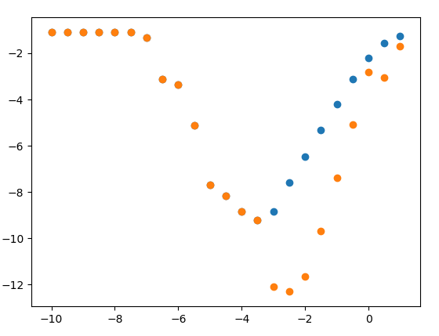
Log(error) : O(h)、O(h^2)

