Slide 1
計算物理
誤差問題

Slide 2
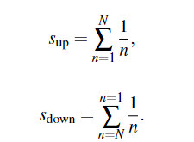
Problem
Using different data type to calculate the formula
And compare the difference

Slide 3
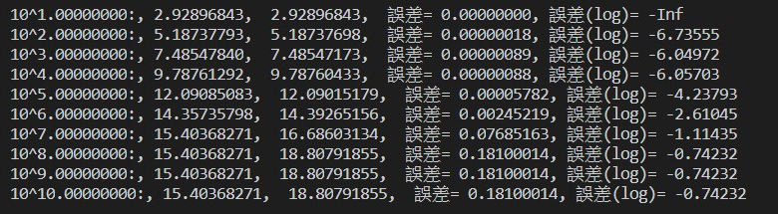
Float32
N sum_up sum_down error log10(error)

Slide 4
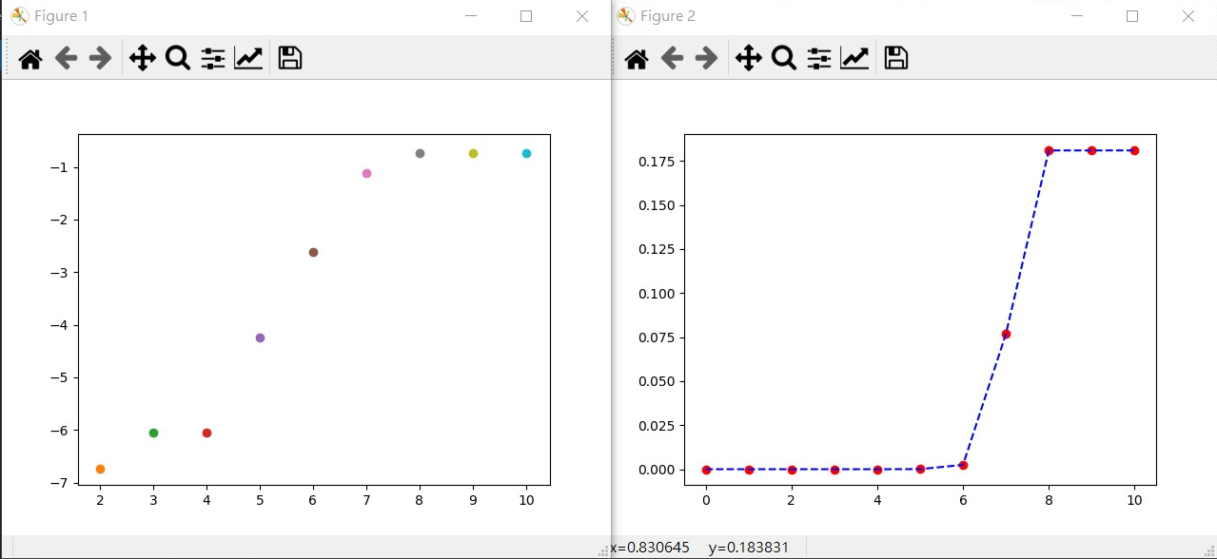
Float32 Plot (log10) (linear)

Slide 5
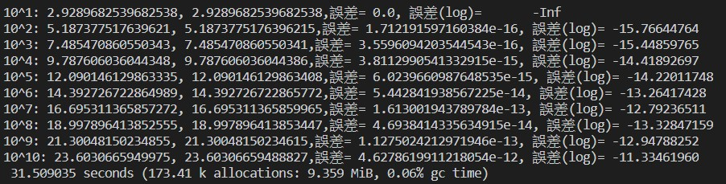
Floa64
N sum_up sum_down error log10(error)

Slide 6
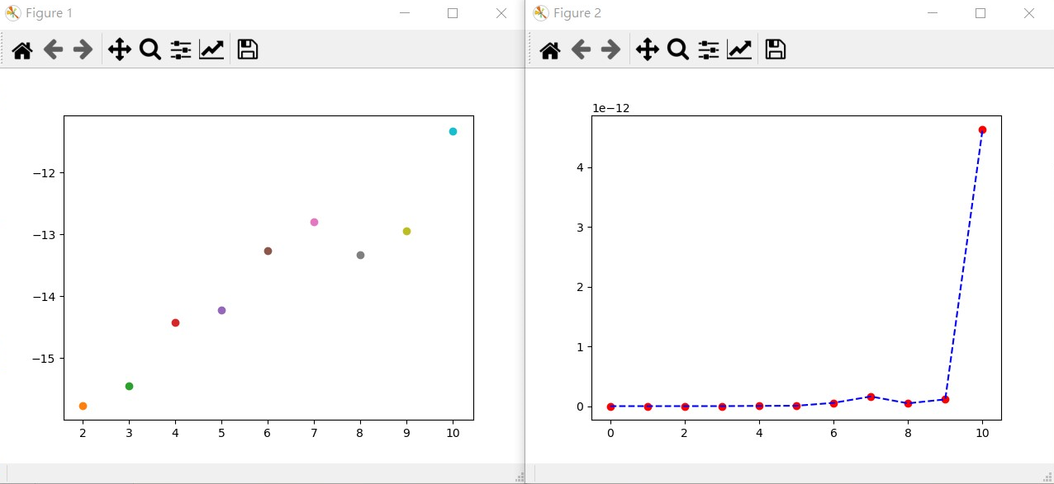
Float64 Plot (左log10) (右linear)

Slide 7

Conclusion
$s_{down}$is more accurate then the $s_{up}$
These are from truncation error.

