Slide 1
計算物理
誤差問題

Slide 2
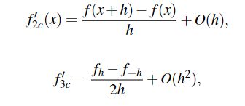
Problem
Using different integrate formula and different data type and compare the difference.

Slide 3
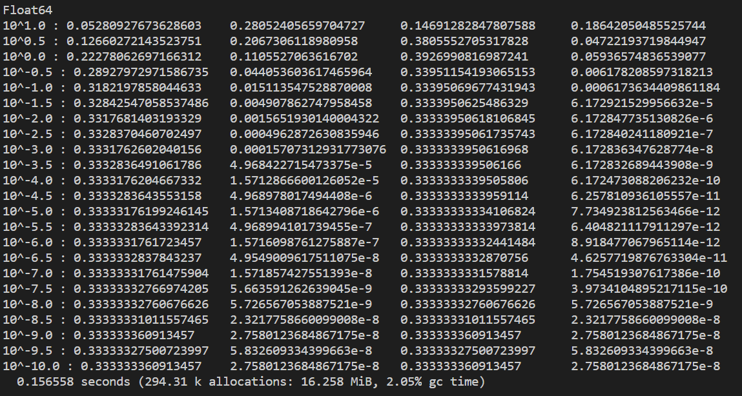
Float64
N f2 error(%) f3 error(%)

Slide 4
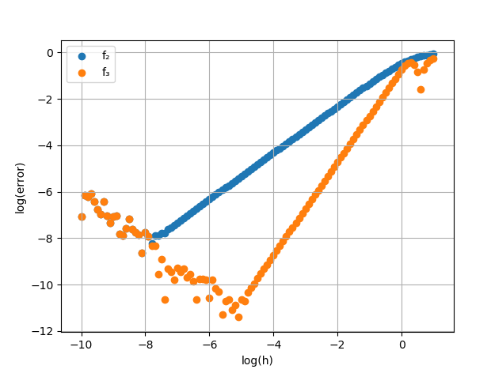

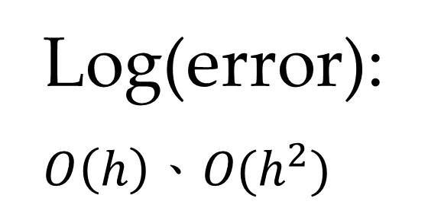
Log(error): $$O\left(h\right)、O(h^{2})$$
$f_{2}=\frac{8}{8}=1$
$f_{3}=\frac{12}{6}=2$

Slide 5
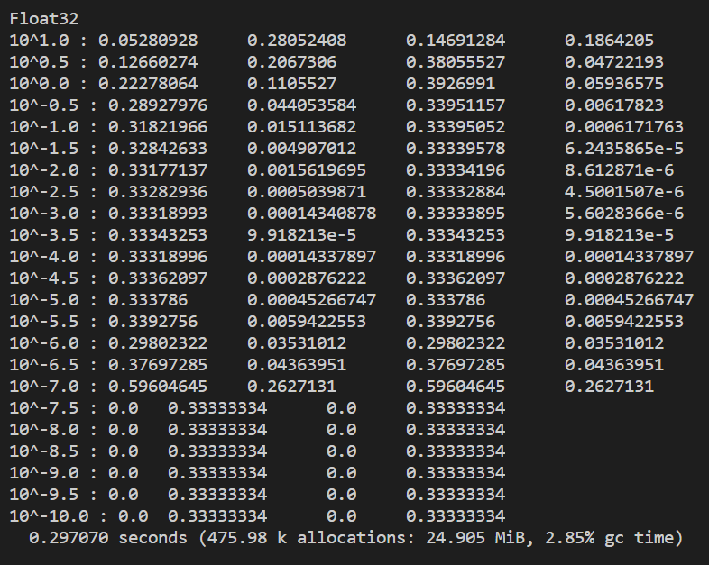
FLoat32
N f2 error(%) f3 error(%)

Slide 6
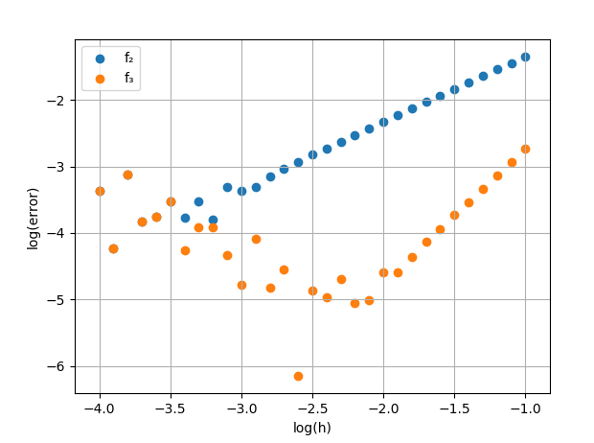
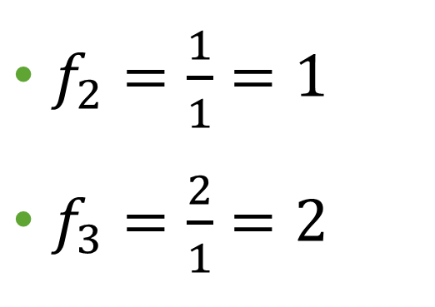
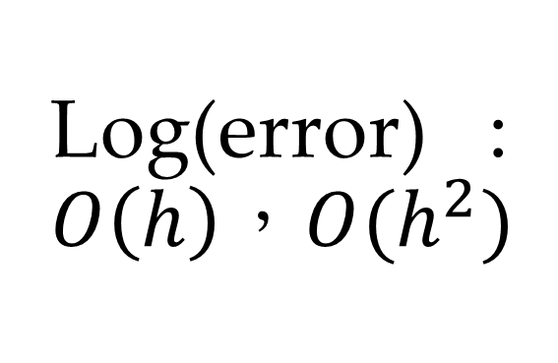
Log(error) : $$O\left(h\right)，O(h^{2})$$
$f_{2}=\frac{1}{1}=1$
$f_{3}=\frac{2}{1}=2$

Slide 7
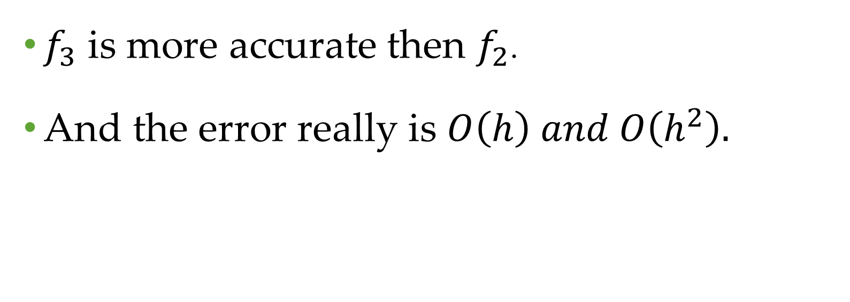
conclusions
$f_{3}$ is more accurate then $f_{2}$.
And the error really is $O\left(h\right) and O\left(h^{2}\right).$

